Slide 1
W
E
L
C
O
M
E
Mahia
Rahman
Assistant Teacher
English
Silam P.L High School
B.A Hons
M.A (English)

Slide 2
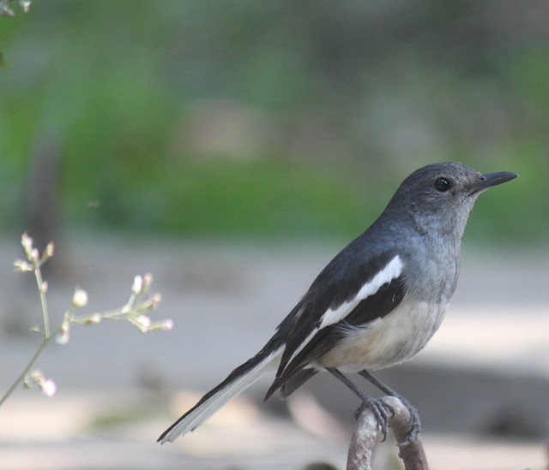
Look at the picture. Say name of birds.

Slide 3
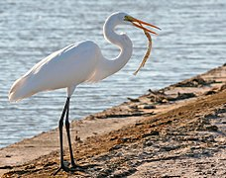

Slide 4
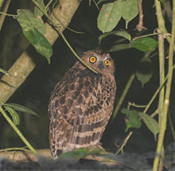

Slide 5
These picture is about birds of Bangladesh.
Birds of Bangladesh
Lesson-12

Slide 6
Talk about people ,places and familiar objects in short simple sentences.
After completing the lesson of students will be able to :
Write short paragraph

Slide 7
New-word
 Geographical –
 Fauna –
 Resources-
 Beak –
 Lay -

Slide 8
Look at the picture of the ‘Tia’(parakeet) below. And then write a paragraph on the bird using the clues given
Clues: found all over Bangladesh –about 42 cm-whole body green-strong,
Curved beak,bright red-eyes round and yellow-feet red-tall,silm tail-around its neck black and red coloured rings-eats grass ,nuts chilli,ripe banana and other fruits-live in flocks –build nests in tall shimul trees/in holes
Of empty buildings- lays four to six eggs.

Slide 9
Home-work
Home-work
Do you know the name of our national bird ? Can you describe it in simple words ?

