Slide 1
Welcome

Slide 2
IDENTITY
ABDUL AZIZ
B.A(HON’S), M.A (ENGLISH)
ASSISTANT TEACHER (ENGLISH)
MADHAIA BAZAR SADIM HIGH SCHOOL
E-MAIL: azizabidpur@gmail.com
Class –Six
English Second Paper
Tense

Slide 3
The letters are jumbled. Can you tell me the word.
SETNE
TENSE

Slide 4
So, Our today’s lesson is
Tense

Slide 5
After the end of the lesson, ss will be able to
Talk about tense.
Narrate Classification of tense
Describe Structure of tense

Slide 6
Tense
Definition : Tense is the action of time
There are three kinds of tense
Present Tense
Past Tense
3. Future Tense

Slide 7
Present Tense
Definition:Present Tense is the action of present time.
There are four kinds of present Tense
1. Present Indefinite : Subject + V₁ + Obj/Ext.
Example : She helps me.
2. Present Continuous : Sub + am/is/are +v₁ +ing + obj+ Ext.
Example : She is going there.

Slide 8
Present perfect tense : Sub +has/have +V₃+obj/Ext.
Example : She has done it.
Present perfect cont. Tense: Sub + have been / has been + v1 + ing + obj/Ext.
Example : He has been doing it for an hour.

Slide 10
Definition : Past tense is the action of past time. There are four kinds of past tense. 1. Past Indefinite : Sub+V₂+ Obj/Ext. Example : She did the job

Slide 11
Past Tense

Slide 12
Past Perfect Continuous Tense

Slide 13
Future perfect Tense : Sub + shall have /will have + V3 + object/Extension.
Example: She will have done it.
Future perfect continuous tense : Sub + shall have been/will have been+V1+ing +Obj/Ext.
Example : We shall have been studying for an hour

Slide 14
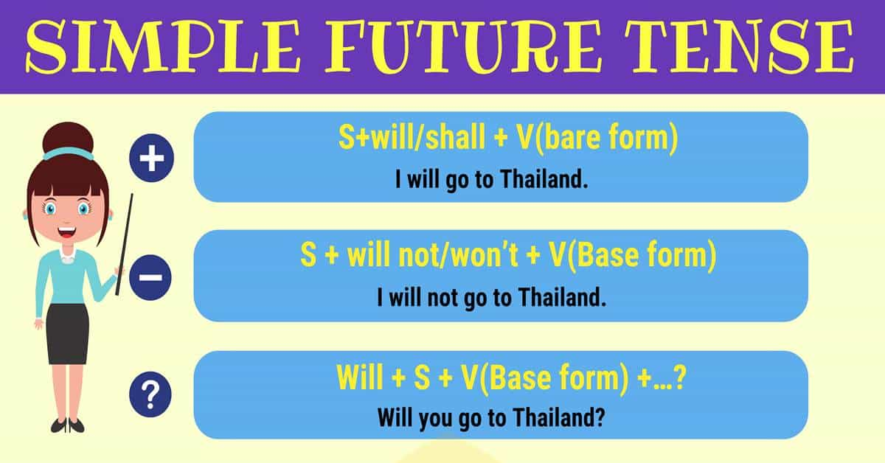
Definition : Future tense is the action of future time
There are four kinds of future tense.
Future Indefinite Tense : Sub +shall/will +V1 +O/E
Example : She will do it.
2. Future Continuous Tense : Sub+ shall be /will be + v1 + ing + object/Extension.
Example : She will be doing it.

Slide 15
Evaluation
Find out the name of the tense.
Mina has done the job.
Mr. Ahmed will go there.
Shafiq Ahmed was playing Tenis
It has been raining for an hour
They play cricket.
Present perfect tense
Future Indefinite tense
Past continuous tense
Present perfect cont. tense
Present indefinite tense

Slide 16
Home work
What is Tense? How many kinds of tense? Write the structure with example.

