Slide 1
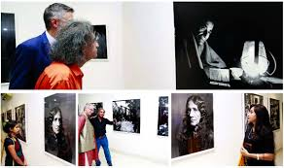
W
E
L
C
O
M
E

Slide 2
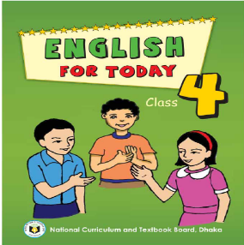
Presented by
Biplob kumar das
Assistant Teacher
Lutia GPS
Lohagara,Narail.
Class:Four
English For Today
Lesson unit: 34
Lesson:S M Sultan(part-2)
SM Sultan---------of Bangladesh.
Time:50 minutes

Slide 3
Learning outcomes
Students will be able to-
Listening 4:2:1Enjoy and understand simple stories.
Speaking 1.1.1 Repeat after the teacher and say words, phrases and sentences with proper sounds,stress and intonation.
Reading1.4.1 Read words,phrases and sentence in the text with proper pronunciation ,stress and intonation.

Slide 4
Good morning students.
How are you today?
Let’s sing the good morning song.

Slide 5
Sm sultan
Painter
Born in 1923
Loved to draw
In 1938 he went to kolkata
Stayed there 3 years
Travelled Asia & Europe
Painted farmers & fisherman
Born in narail
Review of Previous Lessons

Slide 6
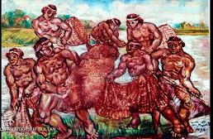
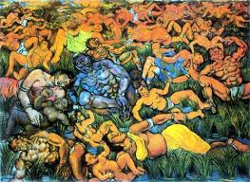
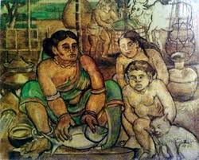
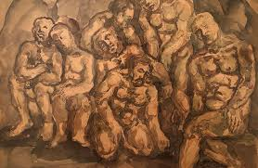
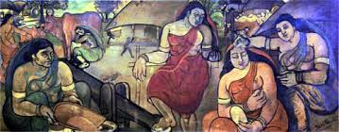
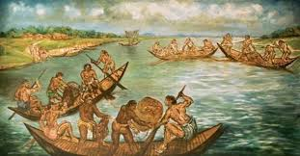
Lets see some picture..

Slide 7
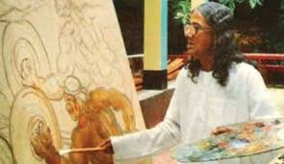
Title Declaration
SM Sultan

Slide 8
Teacher’s reading:

Slide 9
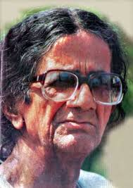
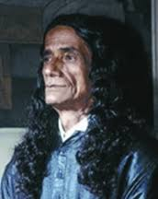
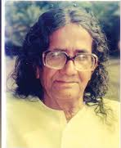
People around the world know about Sultan and his paintings .

Slide 10
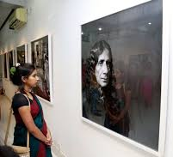
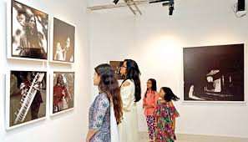
He exhibited his paintings along with the famous painters,Pablo Picasso and Salvador Dali.

Slide 11
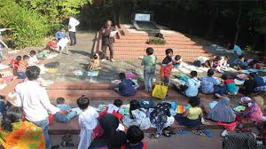
Sultan loved children.

Slide 12
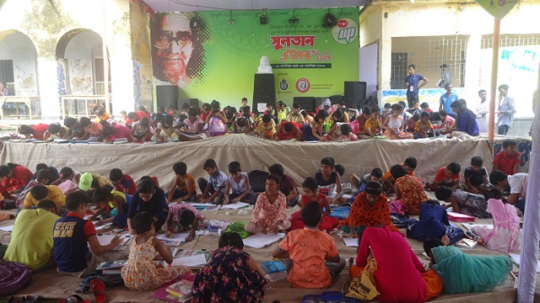
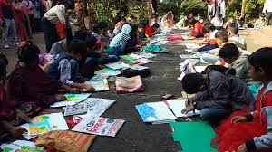
He established `Nandankanon’and `Shishuswargo’ for children.

Slide 13
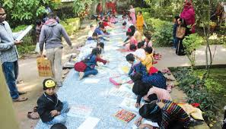
Here they could get some education and learn painting.

Slide 14
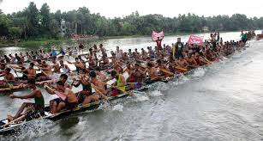
Every year, there is a Sultan Mela in Narail

Slide 15
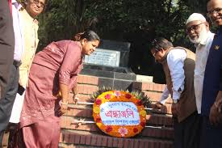
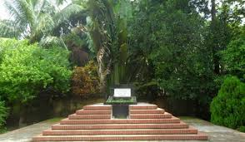
He died in 1994 at a hospital in Jashore.

Slide 16
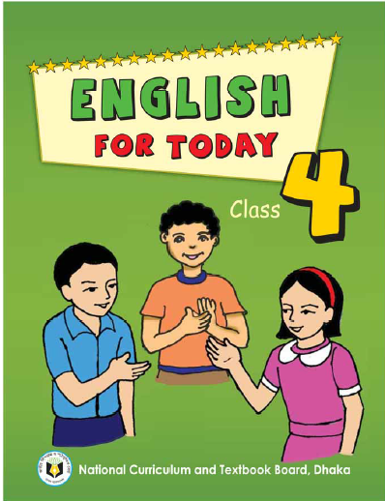
Open your book & go to page no.68

Slide 17
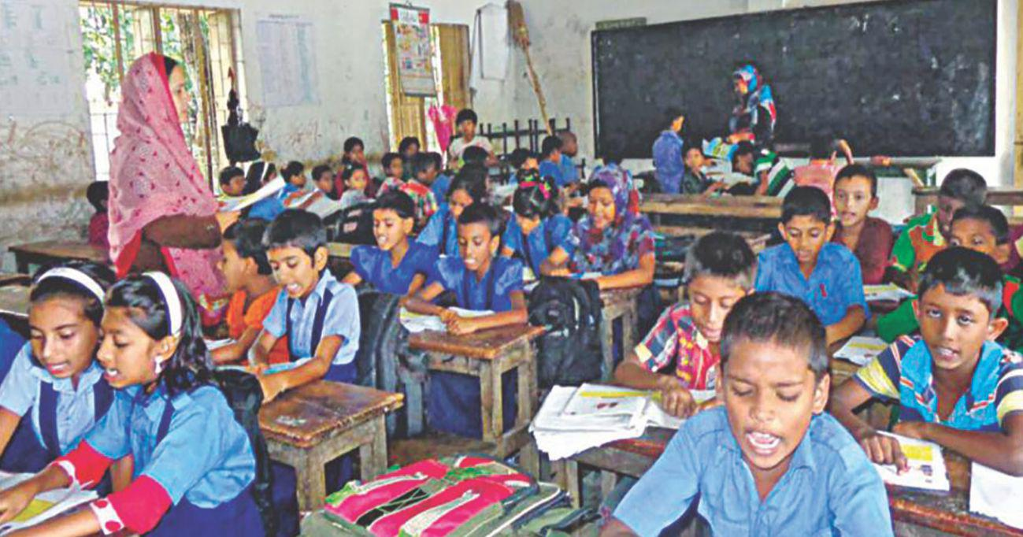
Student’s loud reading:

Slide 18
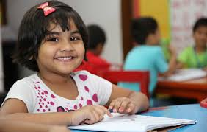
Student’s silent reading:

Slide 19
New words
famous
painter
draw
money
love
stay
travel

Slide 20
Match column A with column B
Column A | Column B
1.Famous | a)A person who draws picture.
2.Painter | b) Familiar or known.
3.Travel | c) Round a place or thing.
4.Around | d) Journey.
5.Comeback | e) return.

Slide 21
Fill in the blanks:
1.People around the world know about Sultan and his ------------ .
2.He exhibited his -----------------.
3.Sultan loved ---------------------.
4.He established --------------------- for children.
Every year, there is a----------------- in Narail

Slide 22
Write “True” or “False”
1.People around the world know about Sultan .
2.He exhibited his home work.
3.Sultan did not love children.
4.He established shishusargo for children.
Every year, there is an art mela in Narail

Slide 23
Ask and Answer these questions?
01. Who was SM Sultan?
02. Where did SM Sultan born?
03. When did SM Sultan born?
04. What did he like?

Slide 24
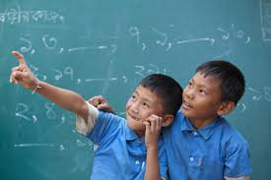
Pair Work
01. Where is in Sultan Mela every year?
02. What did SM Sultan establish for children?
03. What did SM Sultan love ?
04. What did he exhibite?
05.When did he die?

Slide 25
Group Work
GROUP –A:rearrange: swashurshigo
GROUP –B:rearrange: horejas
GROUP –C:rearrange: kanonnandan

Slide 26
Evaluation
Make Sentences with the given words.
famous
children
college
jashore
hospital
painting

Slide 28
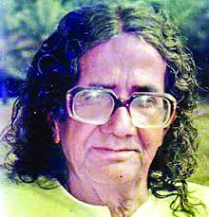
Home work
Write a short composition about S M Sultan.

Slide 29
