Slide 1
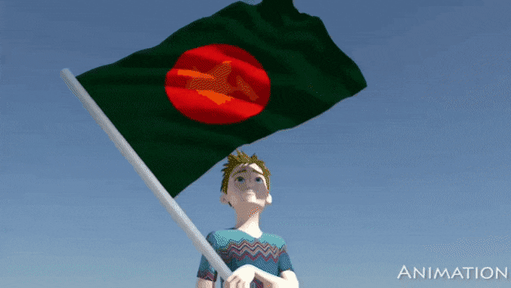
Welcome to All

Slide 2
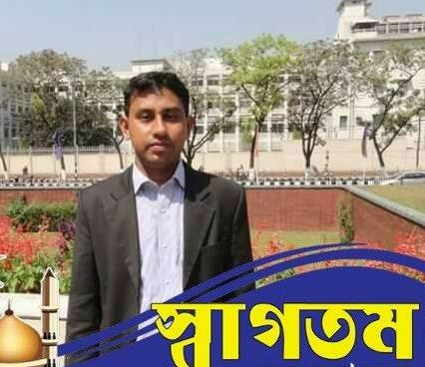
Presented By :
Md Tazul Islam
Assistant Teacher
Fokirnala Govt. Primary School
Manikchari, Khagrachari.
Cell# 01552703802

Slide 3
Introduction of lesson
Class- Five
Subject- English
Topic- Be healthy
Page No- 26
Time- 45 minutes
Date- 26.01.2020

Slide 4
Learning outcomes: Students will be able to-
Listening:
1.2.1 Recognize which syllable in a word is stressed.
1.3.1 Recognize which word in a sentence are stressed.
1.4.2 Recognize and use intonation patterns for greetings and statements.
3.1.1 Understand questions asked by the teacher about them.
3.2.1 Understand questions about family and friends or students.
3.4.1 Understand statements made by the teacher and student.
Speaking:
1.1.1 Say words, Phrases and sentences.
1.1.2 Say sentence with proper intonation.
8.1.1 Take part in conversations on appropriate topics.
Reading:
1.5.1 Read words, phrases and sentences in the text with proper
pronunciation, stress and intonation.
1.6.1 Recognize and read statement, commands, greeting, questions and answers.
5.1.3 Read silently with understanding dialogues.

Slide 5
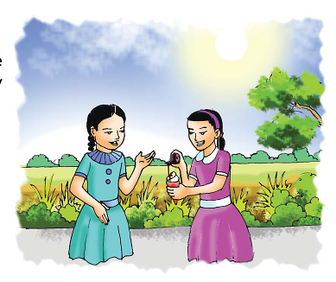
Look at the picture
Q- Who are they?
Q- What’s in Nazreen's hand?
What is she doing?

Slide 6
Let’s see a video
https://www.youtube.com/watch?v=utwgf_G91Eo

Slide 7
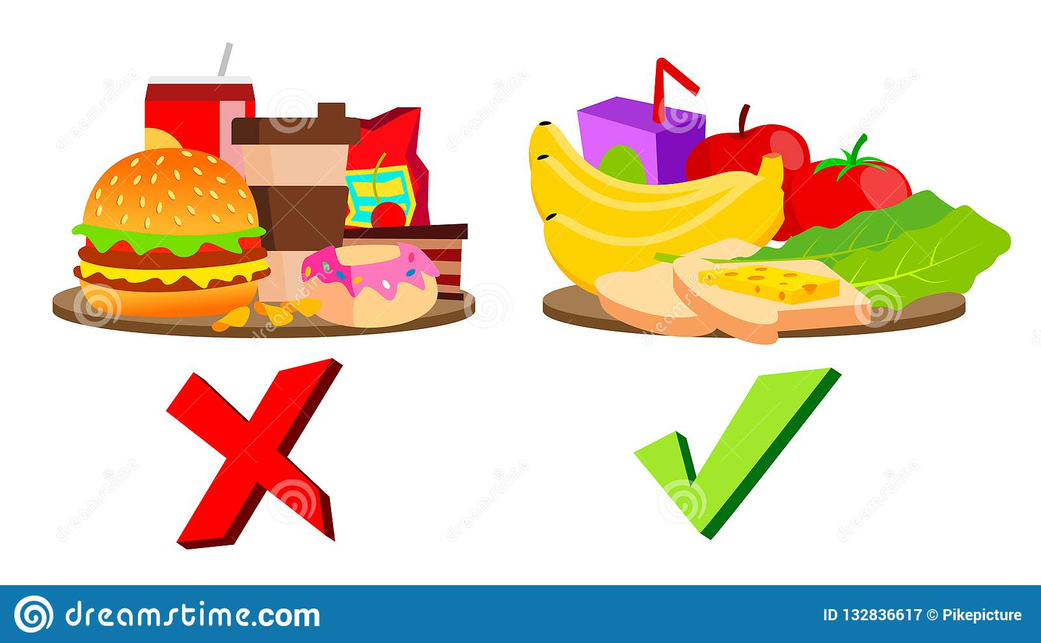
What foods are good for health?

Slide 8
Lesson Title:
Be healthy

Slide 9
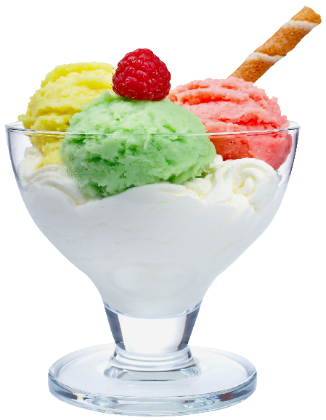
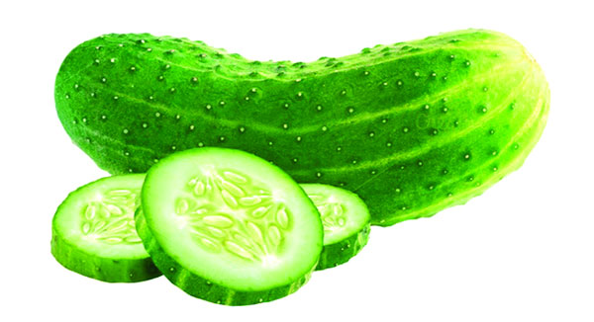
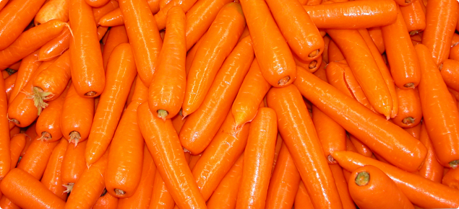
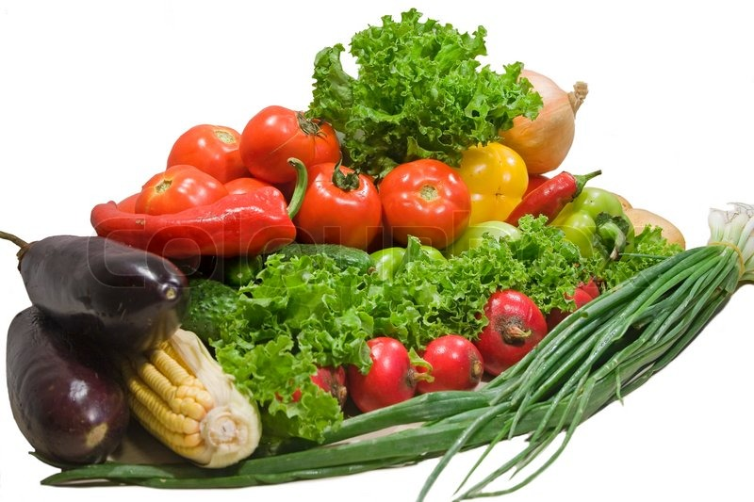
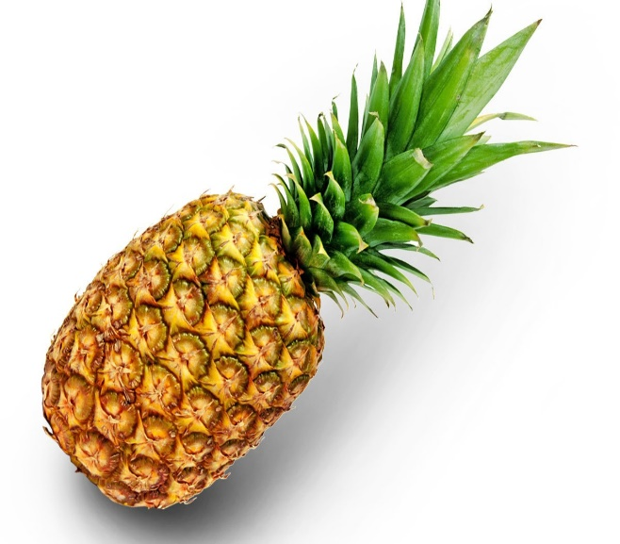
Ice-cream
Cucumber
Carrots
Vegetables
Pineapple

Slide 10
Vocabulary:
Delicious
Cumber
Lettuce
Strawberries
Pineapple
Favorite
Weather
Q- Do you have any unknown words?

Slide 11
Teachers reading in the classroom or audio play
Q- Which food does Nasreen eat regularly?
Ans: Fruits and vegetable.
Q- Which foods does Sima eat regularly?
Ans: Fruits and vegetable.
Q- Which food melts quickly is hot weather?
Ans: Ice-cream.

Slide 12
Students reading

Slide 13
Pair work:
Practice the dialogue with your partner.

Slide 14
Group work
Practice the dialogue in your group

Slide 15
Individual work
Try to answer to my questions:
Q- Which food gives us energy?
Q- Which food have vitamins?
Q- What are Nazreen's favourite food?
Q- What are Siam's favourite food?

Slide 16
Home work
Write five sentence about your family

Slide 17
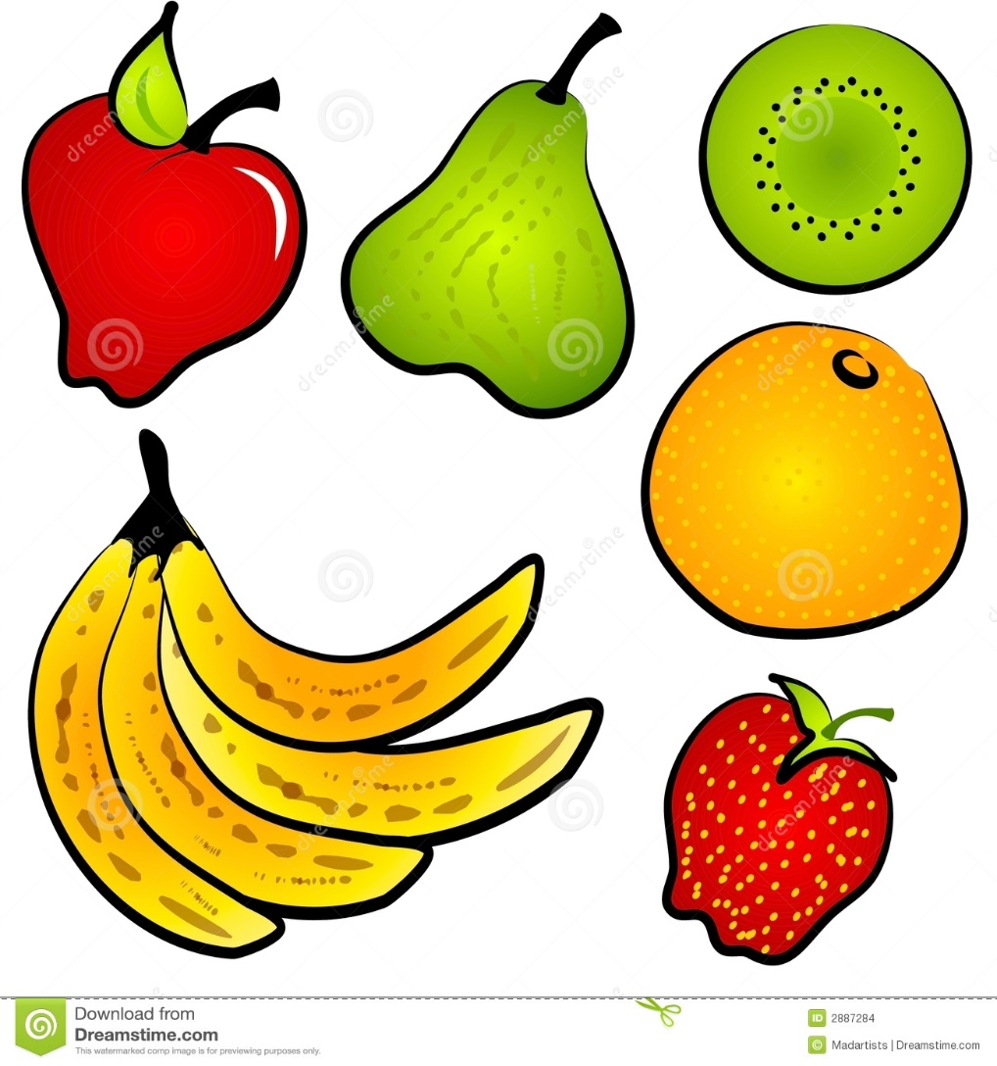
Thanks

