Slide 1
Welcome to everybody

Slide 2
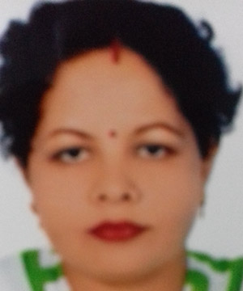
INTRODUCTION
SHILPI RANI BISWAS
Assistant Teacher
Mohendrapur secendary School
Mobile: 01722414935
E-mail: shilpib593@gmail.com
Lesson - 26
Page no- 78
Time- 50 minutes
Date- 12/07/2020

Slide 3
LEARNING OUTCOMES
After completing the lesson students will be able to
Ask and answer questions
Read and understand texts
Participate in short dialogues and conversations on familiar topics

Slide 4
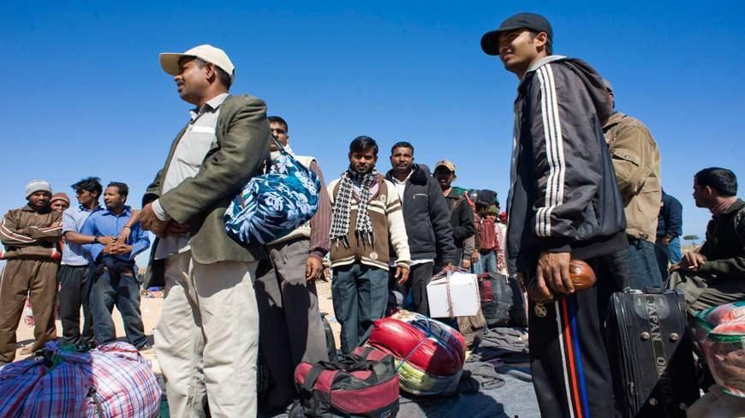
Bangladeshi workers

Slide 5
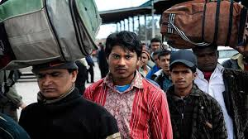
Bangladeshi workers

Slide 6
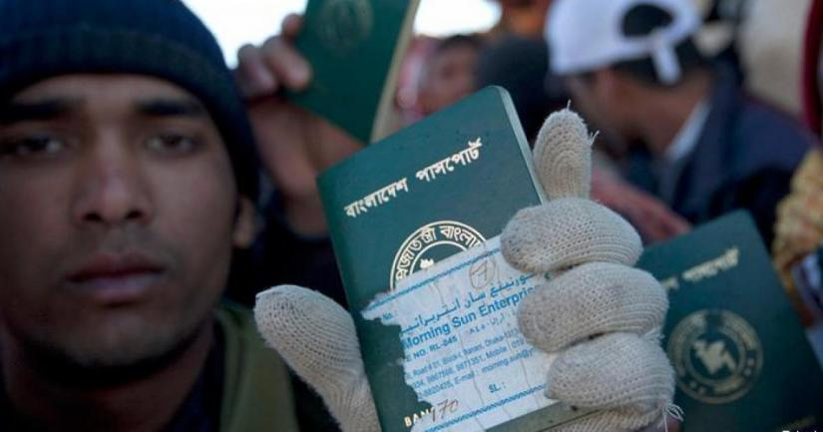
Bangladeshi workers

Slide 7
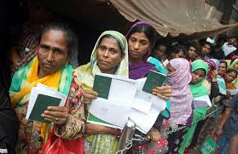
Bangladeshi women workers

Slide 8
TODAY’S LESSON
OUR WAGE EARNERS

Slide 9
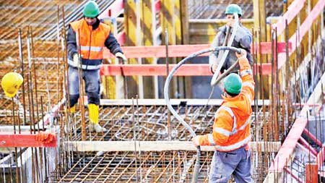
Working in Bangladeshi workers of UAE/ Saudia Or Middle East Country

Slide 10
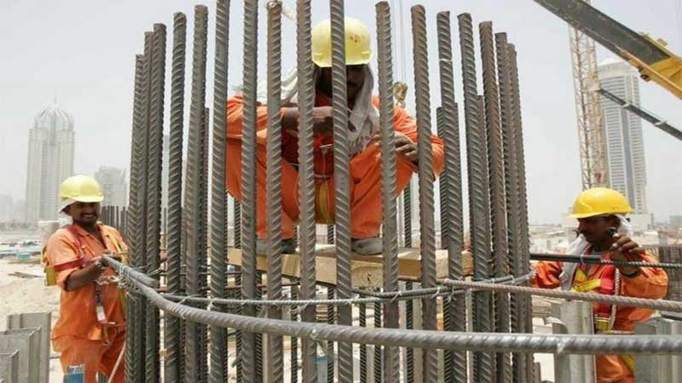
Working in Bangladeshi workers of UAE/ Saudia Or Middle East Country

Slide 11
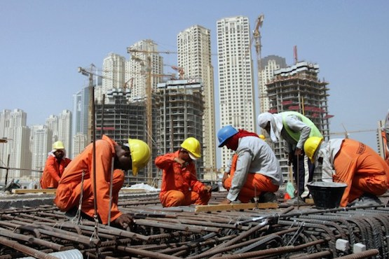
Working in Bangladeshi workers of UAE/ Saudia Or Middle East Country

Slide 12
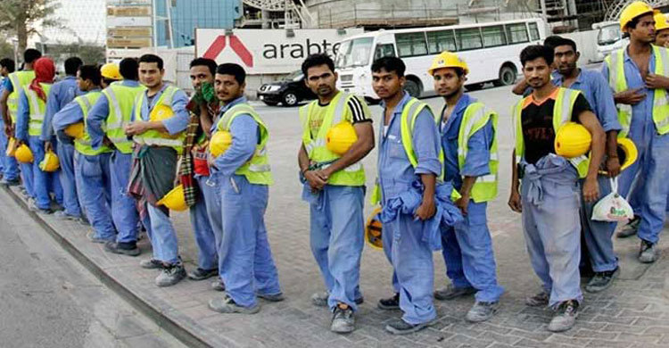
Working in Bangladeshi workers of UAE/ Saudia Or Middle East Country

Slide 13
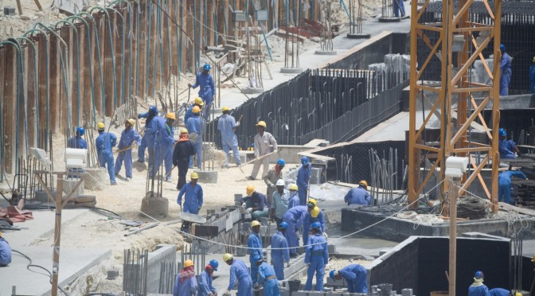
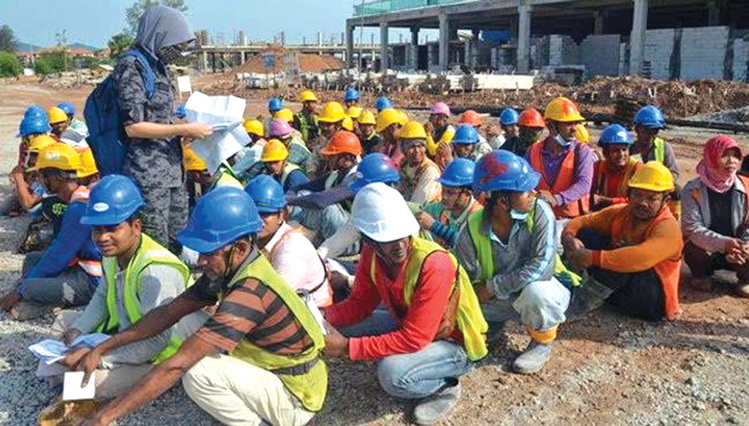
Bangladeshi worker

Slide 14
Reading texts: A huge number of Bangladeshies go abroad for jobs. There is always a high demand of workers in some foreign countries like UAE, Oman, Saudia Arabia, Quatar, Bharain, etc. They like Bangladeshi workers because they are hard working. But this is a matter of regret that our workers are doing odd jobs. As a result they are not paid much. This is because our workers are not good at English, Arabic, or other languages. So we should develop language skils of our workers for the countries they go for work. If they can develop their language skills, they can get good jobs and sendo more money to our country. Thus the wage earners of our country can help develop our economy.

Slide 15
WORD MEANING:
Wage earner- শ্রমিক
Huge- প্রচুর
Number-সংখ্যা
Abroad- বিদেশ
Demand- চাহিদা
Foreign- বিদেশ
Job- চাকুরি
Result- ফলাফল
Paid- প্রদান
Good at- দক্ষ
Language- ভাষা
Skill- দক্ষ
Workers- শ্রমিকেরা
Develop- উন্নয়ন
Send- পাঠানো
Money- অর্থ
Economy- অর্থনীতি
Help- সাহায্য

Slide 16
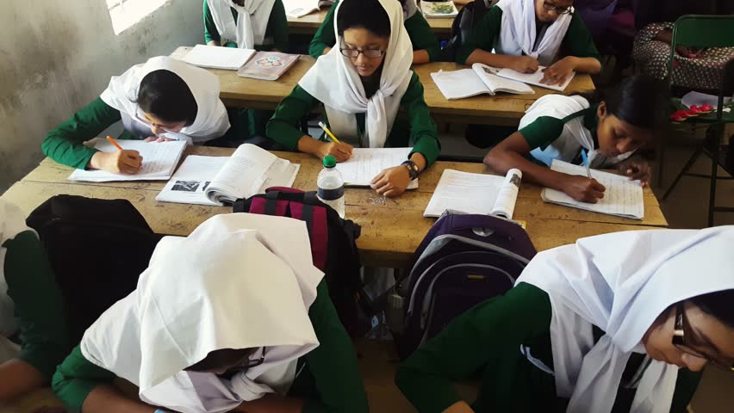
Time: 08 Minutes
PAIRS OF WORK:
Why is foreign countries demand for Bangladeshi workers?

Slide 17
Wage earners welfare board

Slide 18
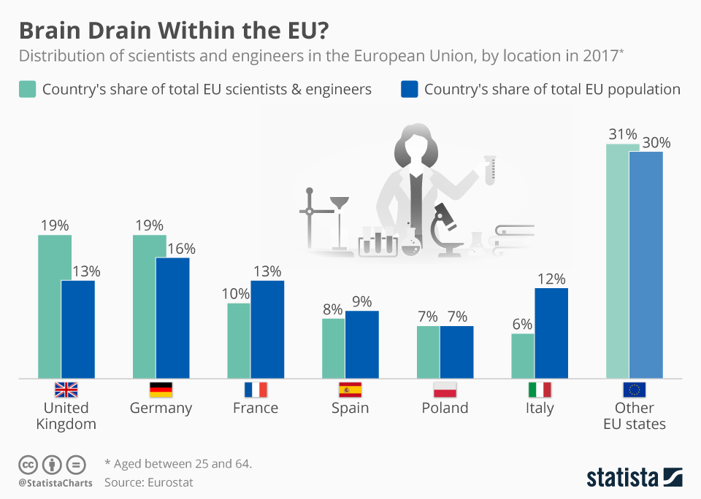
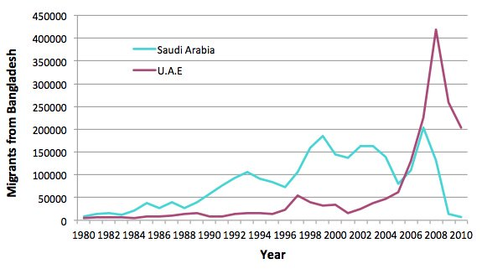
Statistics of Bangladeshi workers

Slide 19
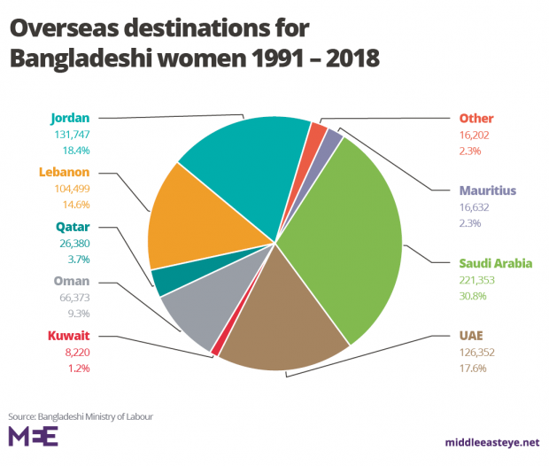
Statistics of Bangladeshi workers

Slide 20
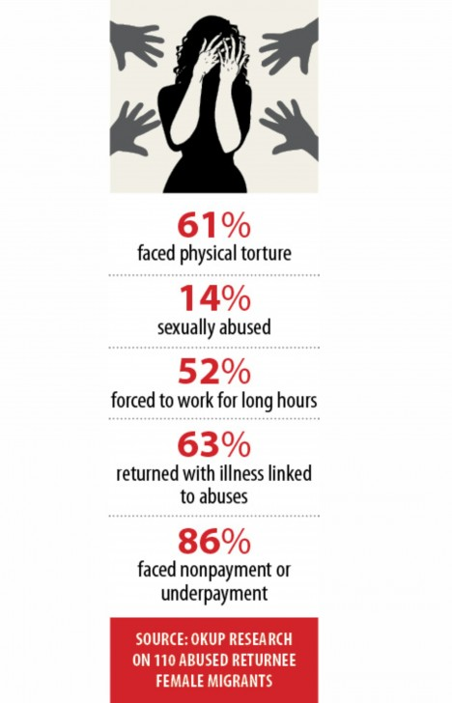
Condition of Bangladeshi women workers

Slide 21
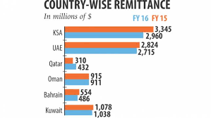
Country wise remittance

Slide 22
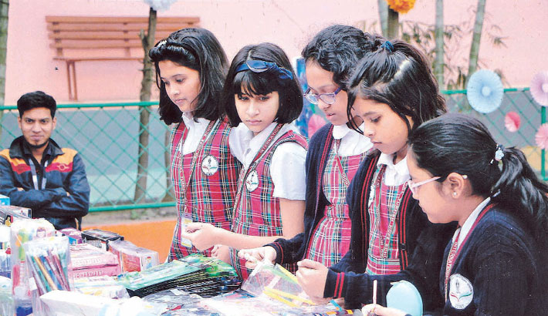
Group work
Time: 10 Minutes
What kind of jobs do the Bangladeshi workers do ?
What are odd jobs ?

Slide 23
Evalution
Time: 06 Minutes
What is the appropriate word in UAE ?
Which are the Bangladeshi Workers ?
How can our people get good job ?
Where is a high demand of Bangladeshi workers ?
What is language skills ?

Slide 24
Home Work
Srestho had a conversation with a Bangladeshi doctor, Mr Arnob who works in a hospital in Quatar. Now write a dialouge about their situation.

Slide 25
THANKS

