Slide 1
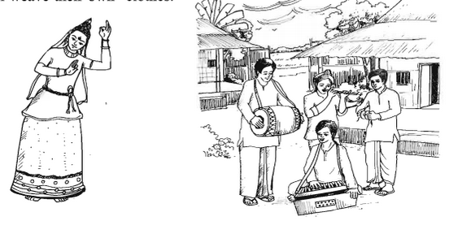
Welcome to the presentation

Slide 2
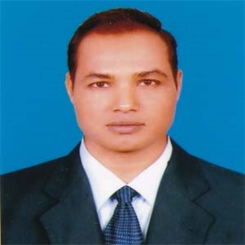
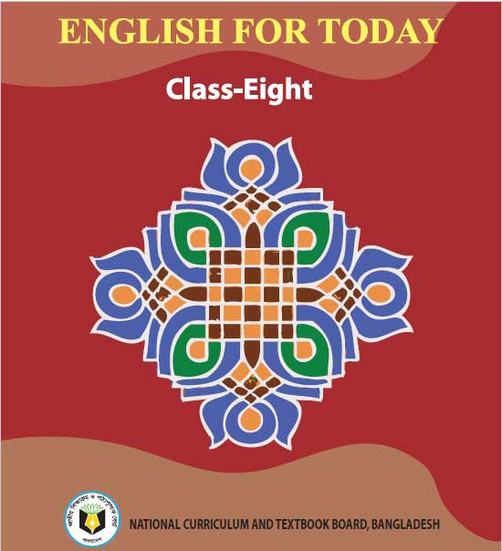
Introduction
Md. Mizanur Rahman
B.A.(Hons.), M.A. in English, B.Ed.
Assistant Teacher
Police Lines School and College, Pabna.
E-mail: mizanplsc@gmail.com
Cell Phone :01737979719
Class: VIII
Subject: English 1st Paper
Unit: One (A glimpse of our culture)
Lesson: Four
Lesson Title: Our ethnic friends-2 Class Duration: 40 minutes
Date: 14/07/2020

Slide 3
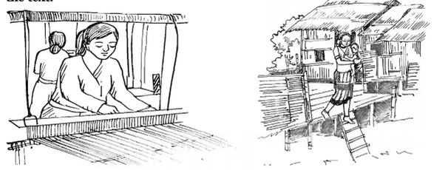
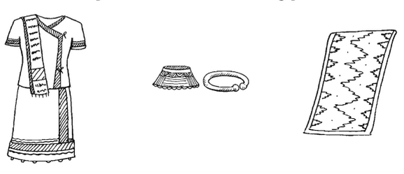
Look at the picture
Picture-1
Picture-2
Picture-3
What do you see in the pictures?

Slide 4
Today’s Lesson
Our ethnic friends

Slide 5
Learning Outcomes
At the end of the lesson, the students will be able to:
describe about ethnic people in Bangladesh.
infer meaning from the text.
Read and understand text.
Choose the best answer and fill in the gaps.

Slide 6
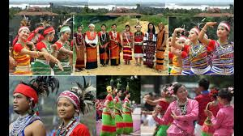
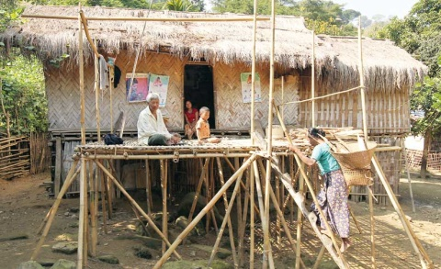
Key words prostration
Word - Ethnic
Meaning: Relating to a particular race of people.
(Adjective)
Syn. Racial, tribal
There are different groups of ethnic people in Bangladesh.
Word :Machang
Meaning: Bamboo or wooden platforms
Noun
Example: They build their houses on machang.

Slide 7
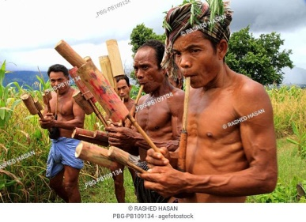
Meaning: A brass musical instrument
Word: Bugle
Noun
Example: Bugle is an one kind of flute
Word: Shifting
Meaning: Always changing and moving.
adjective
Syn. movable
Example: Now a days, they are shifting their occupations.

Slide 8
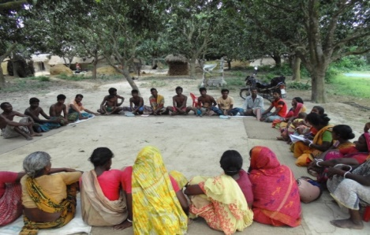
Noun
Meaning
Some features or qualities belonging typically to a person or a group of persons.
Characteristics
Syn. features.
Example: The ethnic people have some common characteristics.
Word: Communities
Meaning
A body of people living in the same place under the same law.
Noun
Syn. societies
Example: They are the member of same community.

Slide 9
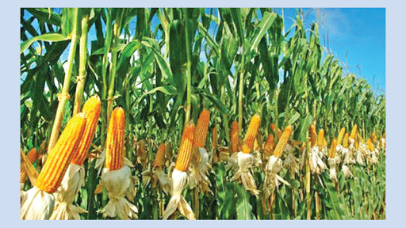
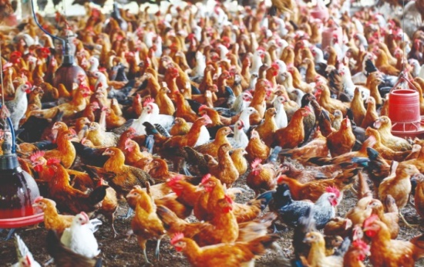
Word: Maize
Meaning:
Corn, a kind of crop
Noun
Example: They like to eat maize.
Word: Poultry
Meaning: Domestic birds kept for eggs and meat.
Noun
Example: Poultry is their one of the most favourite foods.

Slide 10
Read the text silently.
Most of these ethnic people living in Bangladesh have some common characteristics. They have their own lifestyles.
They build their houses on bamboo or wooden platforms called ‘machang’. Rich is their staple food. They eat vegetables, maize and fish, poultry and meat. Their kitchen utensils are bamboo, wooden and earthen pots which they make themselves. Men wear lungis and women wear thamis or sarongs and angis. Women weave their own clothes.
Hunting and fishing are their favourite pastimes .They are fond of songs, music, dances, theatre and fairs. Traditional musical instruments used are bugles made from buffalo horns, drums and bamboo flutes. Wrestling is a popular sport for them.

Slide 11
Find the answers from column B to the questions in column A and write them in complete sentences.
A | B
1. Where do the ethnic people build their houses? | a. a traditional musical instrument made from a buffalo horn
2. What are their favourite pastimes? | b. clay, bamboo and wood
3. What is a bugle? | c. rice
4. What do the women wear? | d. on the wooden or bamboo platforms
5. What are their kitchen utensils made of? | e. finishing and hunting
6. What is their staple food? | f. thamis or sarongs and angis

Slide 12
C. Complete the paragraph. Use the words below to fill in the gaps. There are more words than necessary.
Lungi, sport, earthen, machang, weave, wrestling, song, rice, fishing, lifestyles, wooden, bugle
The tribal people follow their . The platform they build their houses on is called . Men wear . Women their own clothes. Their staple food is . They are fond of songs, dance, music, and . is their favourite sport.
lifestyles
machang
Lungi
weave
rice
fishing
wrestling

Slide 13
F. Choose the best answer to each question from the alternatives given and write the corresponding number of the answers in your answer script.
The ethnic people in Bangladesh play a significant role in the culture of the country. Here the word ‘ethnic’ means ----------
Urban ii. Rural iii. Aboriginal iv. original
b. The ethnic people live in --------------.
Rural area ii. Urban area
iii. Some particular regions of Bangladesh iv. Hilly area
c. They do Jhum cultivation----------------.
In the plain land ii. In the forest
iii. Beside a river iv. In the hill

Slide 14
d. Most of them do the job of ------------------------.
Cleaning an clearing forest
ii. Maintaining forest area
iii. Growing and collecting crops
iv. Fishing in the river
e. They use---------- language.
Foreign ii. Global
iii. Native iv. International
f. The word ‘weave’ refers to ----------------.
Knit iii. create iii. Invent iv. Paint
g. ‘Bugle’ is a ---------------
Kitchen ii. Sport item
iii. Farming tool iv. Musical instrument

Slide 15
Read the following text and fill in the gaps with appropriate words to make it a meaningful one.
Most of the ethnic people (a) in rural Bangladesh. They have their (b) lifestyles. They (c) their houses on bamboo or wooden platforms called ‘machang’. Rice is their (d) food. Hunting and fishing are their favourite (e)
live
own
build
staple
pastimes.

Slide 16
Thanks to all.

