Slide 1
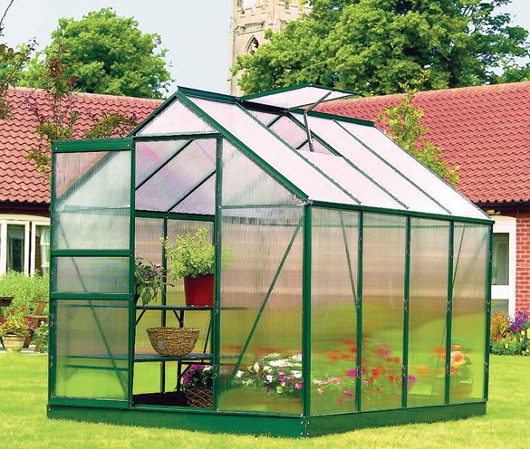
My dear students
Welcome to my class

Slide 2
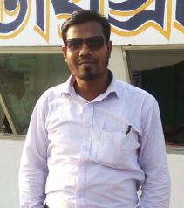
Md Hasan ali
Assistant Teacher
Borotila Abdul jobbar Govt Primary School.
Manikchari, khagrachari.

Slide 3
Introducing lessons
Subject: English For Today
Class: Four
Unit: 17 ( In the park-use of tense )
Lessons: 1-2
Part of the lessons: Mita----stand.
Time: 50 minutes
Date:

Slide 4
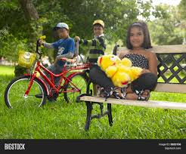
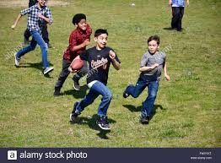

Slide 5
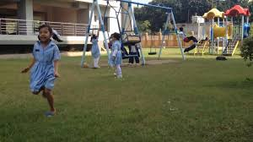
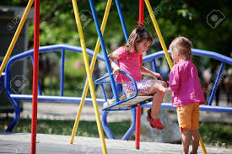

Slide 6
Today’s topic
In the park
( Use of present continuous tense.)

Slide 7
Learning outcomes
By end of the lessons the students will be able to------
Use present continuous tense.

Slide 8
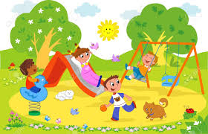
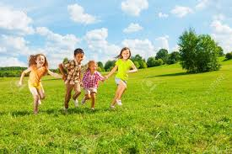

Slide 9
Present continuous tense.
We use the present continuous to talk about things happening now.

Slide 10
I am doing something.
After ‘I’ we use ‘am’.

Slide 11
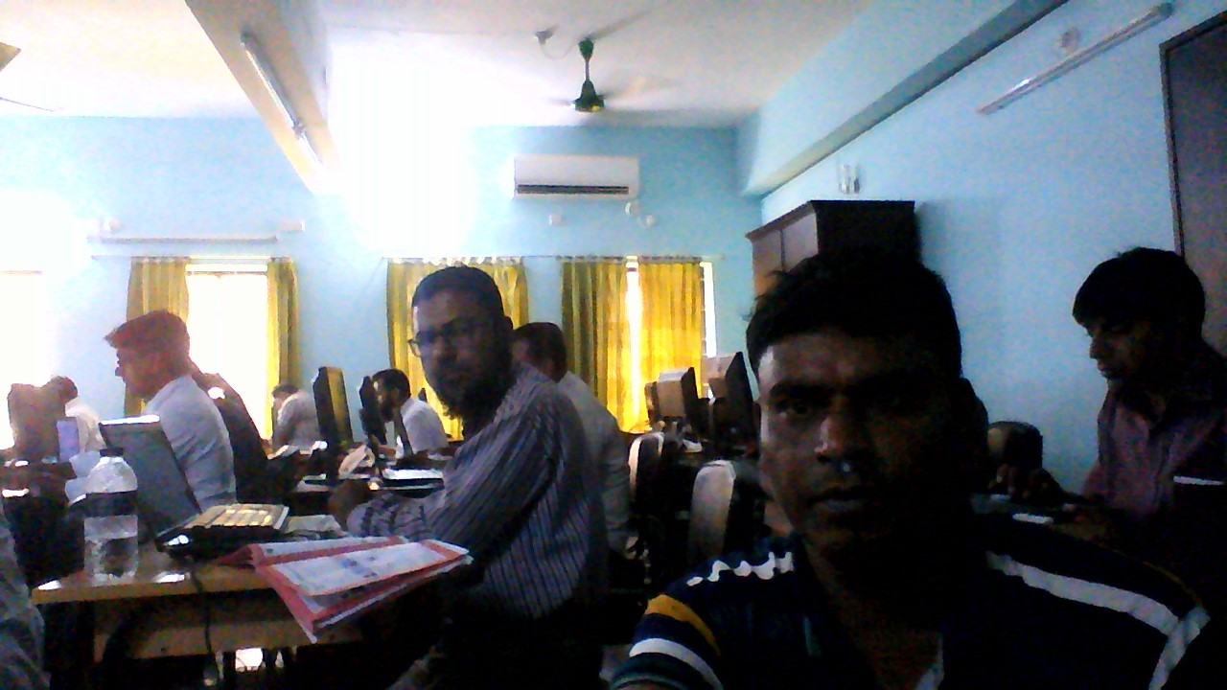
We are doing something.
We use ‘are’ after ‘we’.

Slide 12
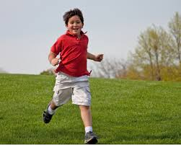
The boy is running in very fast.
We use ‘is’ after one boy or he.

Slide 13
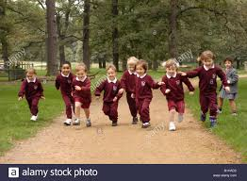
The boys are running very fast.
We use ‘are’ after many boys or they.

Slide 14
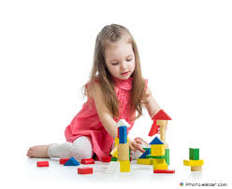
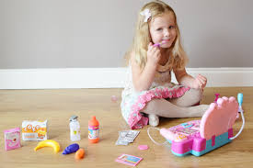
The girl is plating.
We use ‘is’ after a single girl or she.

Slide 15
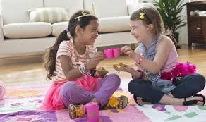
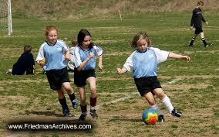
The girls are playing.
We use ‘are’ after many girls 0r they.

Slide 16
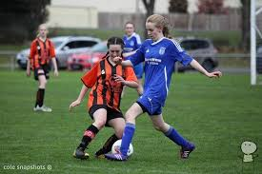
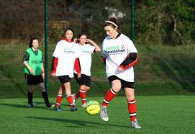
They are playing football.
We use ‘are’ after they.

Slide 17
Note
Always remember that------
‘am’ is used after ‘I’.
‘is’ is used after ‘ any name , he , she, boy, girl’ that means singular number.
‘are’ is used after ‘we, you, they, boys, girls’ that means plural number.

Slide 18
Individual work
Make five sentences from the following table.
I You He/She/It We They | Am Is are | playing | With Mehnaz.

Slide 19
Group work
Group-A
Make any five sentences using ‘are’.
Group-B
Make any five sentences using ‘is’.
Group-C
Make any five sentences using ‘am’.

Slide 20
Evaluation
Fill in the gaps by using ‘am, is, are’-------
The boy ------ eating rice.
They ------ playing cricket.
We ------ swimming in the pond.
You ------ cooking rice.
Father ----- working in the field.

Slide 21
Home work
Everybody will write ten sentences by using ‘am, is , are’ from home.

Slide 22
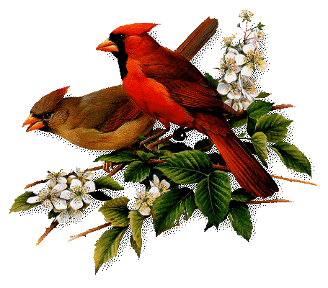
Good bye
Good bye

