Slide 1
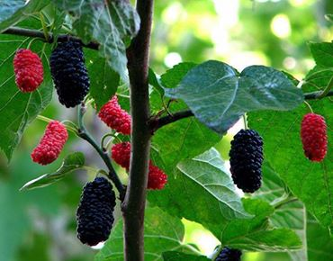

Slide 2
Kaligonj Karim Uddin Public Pailot High School
Welcome Students
Notes:
Welcome slide

Slide 3
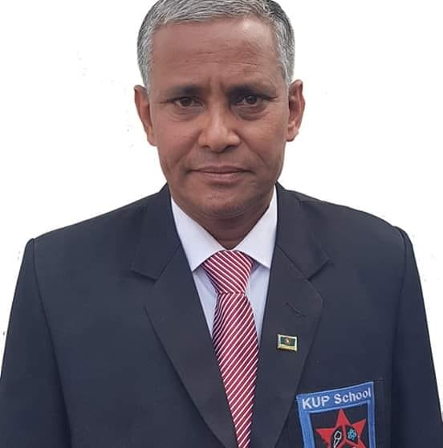
Introduction
Lakshmi kanto barma
Department (English)
kup high school
kaligonj,lalmonirhat
ENGLISH 2ND PAPER
CLASS-NINE (A)
4TH PERIOD, 50 MIN
DATE:14/07/2020
Notes:
Introduction of teacher & class.

Slide 5
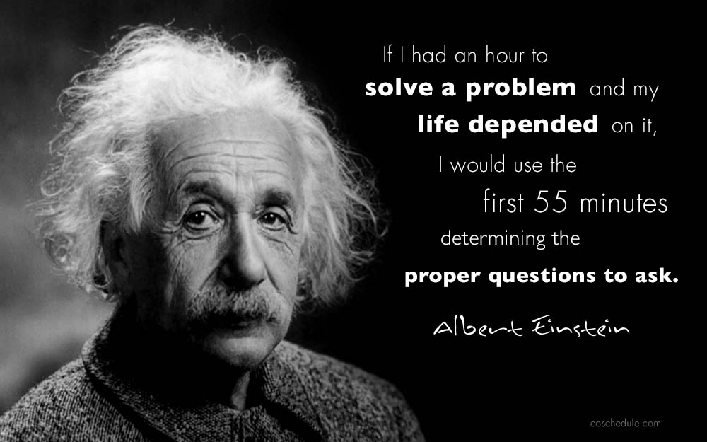

Slide 6
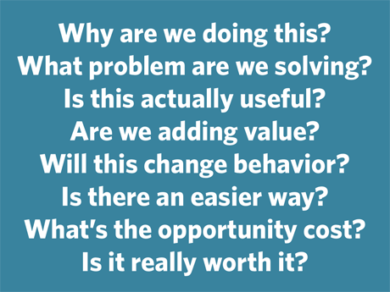
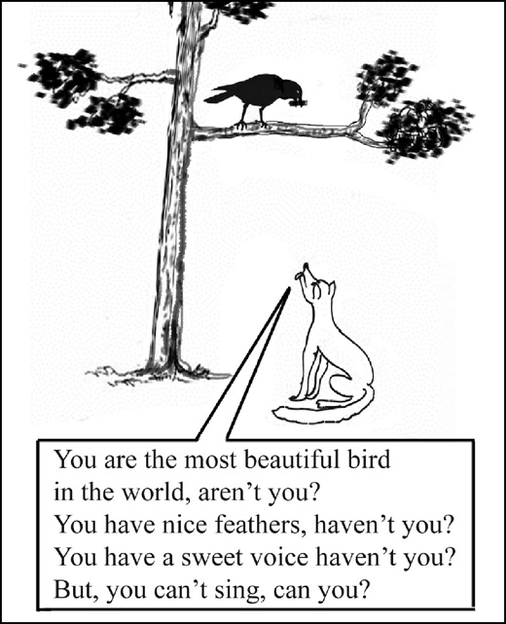
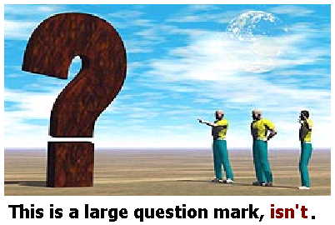

Slide 8
After finishing the topic the students will able to-
make new sentences of tag question.

Slide 9
P
R
E
S
E
N
T
A
T
I
O
N
Question tags are short questions at the end of statements.
They are mainly used in speech when we want to:
confirm that something is true or not, or to encourage a reply from the person we are speaking to.

Slide 10
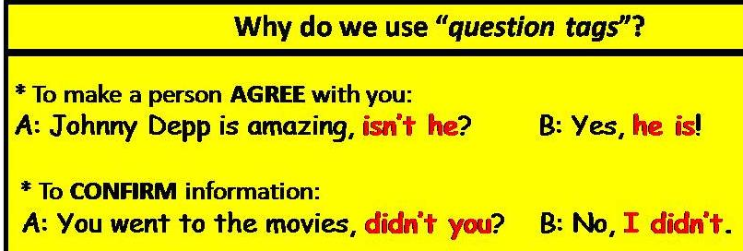

Slide 15
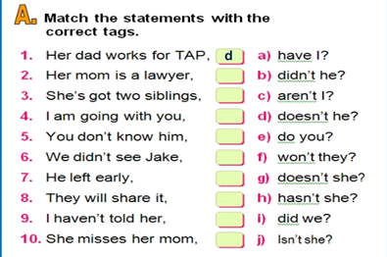
05Min

Slide 16
10 min

Slide 18
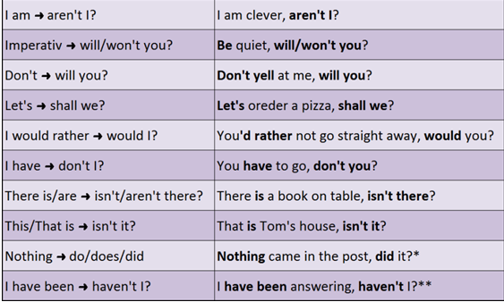

Slide 19
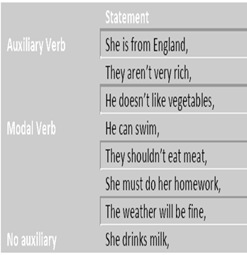
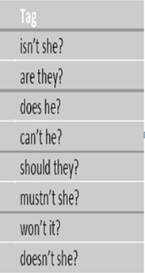

Slide 20
Write ten +ve and – ve statement with their tag.

Slide 21
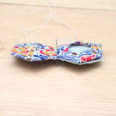
THANKS

