Slide 1
Welcome to my Online class

Slide 2
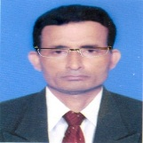
Identity
Manik Chandra Majumder
Senior Teacher (English)
Gazirhat High School
Senbag, Noakhali.
Mobile No: 01717155169
Email: manikmajumder01@gmail.com
Class : Nine-Ten
Subject : English 1st paper
Time : 50 Minutes
Date : 00/00/2018

Slide 3
What did we talk about in the previous class?
What are the sources of energy?

Slide 5
Energy sources
Bio-mass
Solar Energy
Flow of water
Wind mill
Coal burning

Slide 6
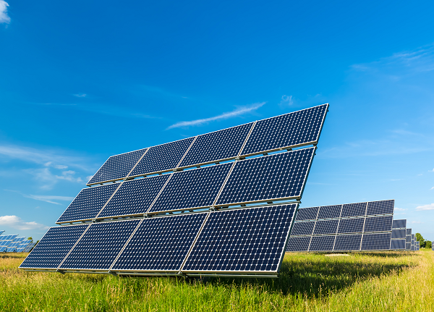
Our today’s topic is …….
Renewable energy sources
Unit : 11
Lesson : 2

Slide 7
Learning outcomes
After we’ve studied the lesson, we will be able to --------
a) talk about familiar objects,
b) participate in conversation,
c) read intensively and extensively,
d) Write paragraph.

Slide 8
Pairwork
Read the words in the box. Which words are related to energy?
1.fuel | 2. desert | 3.fossil | 4.sun
oil | forest | relic | wind
gas | valley | remnant | water
soil | waterfall | sign | coal

Slide 9
A dialogue between myself and my partner.
Have you seen most of the words in the box somehow relates to energy?
Myself
Partner
Yes, it’s interesting. But would you tell me which words are related to energy.

Slide 10
Thanks, You see the words fuel, oil, gas, waterfall, fossil, sun wind, water and coal provide us energy. So these words are related to energy.
Myself
Partner
Now underline the odd words in each column that doesn’t belong to the group.

Slide 11
Thanks, I think soil, desert, forest, valley
Relic, remnant and sign are irrelevant words. These words are not related to energy.
Myself
Exactly, Thanks.
Partner

Slide 12
Observe the video.

Slide 13
Write the names of renewable energy sources.
How do renewable energy sources save earth?

Slide 14
Match your Answer
Renewable energy sources are Solar energy, Biomass, Windmill, Flow of water, Ocean current, Geothermal, These are replenishable and they will never run out. They are environment friendly. They do not emit harmful carbon dioxide and help to maintain ecological balance. Thus they save the earth.

Slide 15
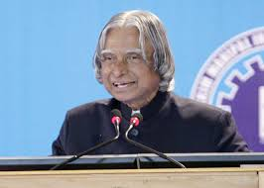
Read the text and answer the following questions. Sec-B
Former Indian president
Mr APJ Abdul Kalam
In a speech at the 90th Science Congress, internationally acknowledged scientist and former Indian president Mr APJ Abdul Kalam mentioned a very important aspect of mankind's future energy crisis.

Slide 16
He pointed out that the era of wood and bio-mass has almost come to an end. The ago of oil and natural gas would soon be over within the next few decades. Massive burning of world's coal reserves may lead to a worldwide ecological disaster because coal burning emits the highest amount of carbon in the atmosphere.

Slide 17
Ukraine's (former Soviet Union) Chernobyl disaster in 1986 has exposed that nuclear energy can be potentially dangerous too. So according to Kalam, the only solution that mankind can look to is the massive use of solar energy in future because it has some advantages over other forms of renewable energies. Now, why has Kalam put so much importance to the issue of energy? The energy sources have always been a major actor of change throughout history. The world's petroleum consumption has increased from 3 billion barrels in 1930 to annually 50 billion barrels today.

Slide 18
In the next quarter century, the world's population is expected to be about 8 billion which is 30 percent higher than today. Developing countries will grow their economies about two times faster than industrialised countries. Global economic growth is expected to continue at 3 percent per year. Consequently, the global demand for energy will grow at about 1.7 percent per year on an average. It indicates a 50-patent rise of energy consumption by 2030. If the world's daily petroleum consumption is 220 million barrels now, it will rise to 335 million barrels by that time.

Slide 19
The present reserve of hydro- carbon energy resources is limited and it will not be sufficient to meet the future energy challenges of the world. And hence, leading industrial countries have taken initiatives to tap alternative energy sources mainly known as green or renewable energy sources. The buttom line of kalam’s speech indicates that concern of mankind in the 21st century,

Slide 20
Vocabulary
a formal meeting or series of meetings for discussion about scientific affairs.
Science Congress
Acknowledged
Recognized, Approved,
Emit
Release, Discharge, Give out
Disaster
Calamity, Mishap, Catastrophe
Expose
Representation, Depiction

Slide 21
Find out the Answer of the following questions.
Q: 2. Why do you think the massive burning of coal may lead to an ecological disaster ?
Q : 4.What according to Mr. Kalam is the solution of
future energy crisis ?
Q:1.What is scientist Kalam concerned about?
Q: 3. What do you mean by the potential danger of nuclear energy?
Q: 6. Why does he put much importance on solar energy?
Q: 5. Why does Mr. Kalam put so much importance to the issue of energy?
Ans: 5, Mr. Kalam puts so much importance to the issue of energy because energy sources have become a major factor of change through out the world.
Ans: 6. Mr. Kalam puts so much importance on solar energy because it is infinite and naturally replenishable and will never run out. Above all, it is environment friendly.
Ans: 2. I think massive burning of coal may lead to ecological disaster because coal burning emits the hightest amount of carbon in the atmosphere.
Ans: 1. Scientist Kalam is concerned about the future
energy crisis.
Ans: 3. The potential danger of nuclear energy I mean global warming that will cause natural disasters around the world.
Ans: 4. According to Mr. Kalam the solution of
future energy crisis is the massive use of solar energy
instead of non renewable energy.

Slide 22
Make sentences using the substitution table.
1.Chernobyl disaster 2.The energy industries 3.The global petroleum- consumption 4. Major industrial- economies 5. Scientists | have has | taken been emphasized increased exposed | the use of renewable energy sources. the potential danger of nuclear energy. a major factor for change throughout history. to three billion barrels per year. initiatives to tap alternative energy sources.

Slide 23
Match your Answer.
1.Chernobyl disaster has exposed the potential danger of nuclear energy.
2.The energy industries have been a major factor for change through out the history.
3.The global petroleum consumption has increased to three billion barrel per year.
4. Major industrial economies have taken initiatives to tap
alternative energy sources.
5. Scientists have emphasized the use of renewable energy
sources.

Slide 24
Complete the following passage with words from the box. There are more words than necessary.
suggested
radiates
would
effective
conducted
either
energy
affected
crisis
tap
were

Slide 25
suggested
radiates
would
effective
conducted
either
energy
affected
crisis
tap
were
To answer the energy--------- in the world, scientist, professor, and former Indian president Mr APJ Abdul Kahan has --------- - that solar energy can be harnessed by establishing space stations in outer space in order to--------- solar power round the clock. Mr Kalam said that the sun--------- --about 10 trillion times the energy which humans consume across the world today. If we --------- able to extract even a small portion of this energy from the sun, it-------- -- be sufficient to secure the energy demands of our future. Pointing out that space based solar power plants do not get -------------by weather, the scientist said that thus it would be far more ------------ in efficiency and power generation than the surface based systems. Professor Kalam suggested that the energy should be transmitted from space back to earth ------------ through microwave or any other technology like laser. Careful research of the impact and safety concerns would have to be-------------- in this regard.

Slide 26
Evaluation
Choose the best answer from the alternatives:
a) The science congress is a/an------ -------organization.
i) ancient
Cor. Ans:
i) ancient
ii) primitive
iii) recent
iv) modern
Cor. Ans:
b) What was the world’s petroleum consumption in 1930?
ii) 3 million barrels
Cor. Ans:
i) 50 million barrels
ii) 3 million barrels
Cor. Ans:
iii) 30 million barrels
iv) 15 million barrels

Slide 27
c) What is the former Address of Ukraine?
Cor. Ans:
Cor. Ans:
ii) Soviet Union
i) United States
ii) Soviet Union
iii) United Kingdom
iv) Russia
d) When was Chernobyl disaster happened?
i) 1886
ii) 1976
Cor. Ans:
Cor. Ans:
iii) 1876
iv) 1986
iv) 1986
e) Which forms of energies are most advantageous ?
i) Solar energy
ii) Kerosine
i) Solar energy
Cor. Ans:
Cor. Ans:
iii) coal
iv) firewood

Slide 28
HOME WORK
Write a paragraph on load shedding expressing the sufferings of ordinary people caused by load-shedding.

Slide 29
Thank you all
Good bye

