Slide 1
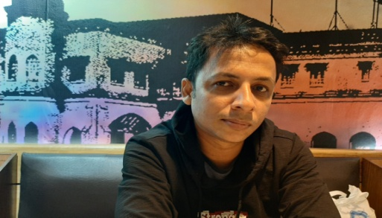
কোথায় ARTICLE বসবে না ‘ZERO’ ARTICLE এবং
Md. Sohrab Hossain
Teacher in English
Railway Public High School,
Chattogram
Class VI,VII,VIII,IX,X,XII
WELCOME
কোথায় ARTICLE ‘The’ বসবে

Slide 2
ভৌগলিক অঞ্চলের/দেশের নামের পূর্বে
Use zero article (-) with:
1)The names of most countries, cities and continents:
যেমন: Saudi Arabia, Bangladesh, Europe, Asia
2)Geographical areas in +adjective phrases:
যেমন: I live in (-) north-west Egypt, (-) eastern France
3)The names of single mountains and lakes(একক পর্বত/হ্রদ এর পূর্বে):
যেমন: Mount Kilimanjaro, Foy’s Lake
4)Exact days, months and times(নির্দিষ্ট দিন/মাস/সময়):
যেমন: on (-) Friday, in (-) March, at (-) 7 o’clock
5)Some prepositional phrases of place:
যেমন: at (-) home, at (-) work, in(-) bed, at (-) sea

Slide 3
Article ‘The’ এর ব্যবহার
1)Countries with plural names(দেশের নাম বহুবচন) or with Republic /Kingdom/Abbreviation(দেশের নামের সংক্ষিপ্ত রুপ হলে) in the name:
Example:
The United Arab Emirates, The Netherlands, The United Kingdom
2)Geographical areas(ভৌগলিক নাম) in noun phrases:
Example : I live in the north-west of Egypt, in the east
3)The names of rivers(নদী), seas(সাগর), oceans(মহাসাগর) and mountain ranges(পর্বতমালা):
Example: The Mississippi, The Black Sea, The Atlantic, The Urals
4)Parts of the day(দিনের অংশ): in the morning/the afternoon/ the evening
Most prepositional phrases of position and place: at the top, on the left, at the office/bank/cinema

Slide 4
বিশেষ নিয়ম:There is a special rule for these places: school, university, college, hospital, prison, church. Compare these examples:
The children go to school by bus. I go to the school to help twice a week.
He is studying math at university. He works in the canteen at the university.
She was in hospital for three weeks. Is there a shop in the hospital?
**If someone is at the place because they are a student / are sick / a prisoner, etc, we don't use the. (নিয়মিত যাতায়াত হয়,এমন ক্ষেত্রে ‘the’ হবে না)
Example: Romel goes to (x) school regularly.
**If they are there for another reason(ভিন্ন উদ্দেশ্যে গেলে ‘the’ হবে),
or
we are talking about the building, we use the.
Example: The officer goes to the school to audit.
Use of ‘The’

