Slide 1
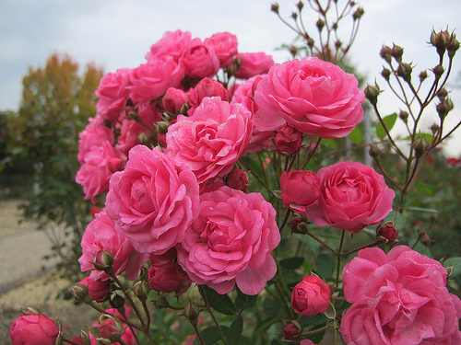
Good morning
Notes:
Greetings

Slide 2
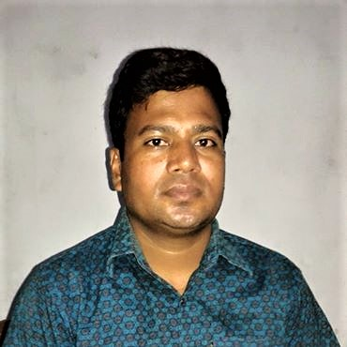
Introducing:
Md. Saiful Islam
Assistant teacher(English)
Bagbari Chowbaria High School
Tangail Sadar Tangail
Email: hridoy9555@gmail.com
Notes:
Teacher's identity

Slide 3
Lesson identity
Class: Eight
Sub: English for today
Unit: Two
Lesson: 01
Time: 50 Minutes
Date:22-07-2020
Notes:
Lesson identity

Slide 4
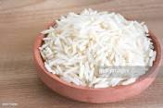
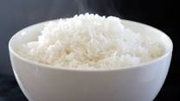
What are the pictures about?
Rice
Notes:
Rice

Slide 5
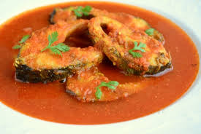
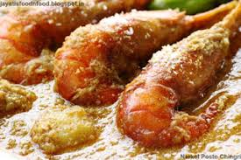
What are the pictures about?
Fish curry
Notes:
Fish curry

Slide 6
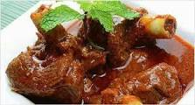
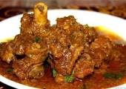
What are the pictures about?
Meat
Notes:
Meat

Slide 7
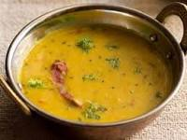
What are the pictures about?
Lentil soup
Notes:
Lentil soup

Slide 8
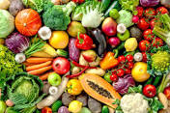
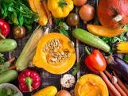
What are the pictures about?
Vegetables
Notes:
Vegetables

Slide 9
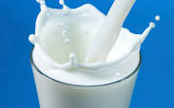
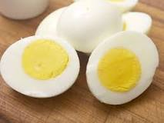
Lesson declaration:
Good food
Notes:
Lesson declaration

Slide 10
Learning out comes:
After finishing the chapter the SS will be able to —
Say what is good food
match the sentences
Say true or false
Fill in the gaps without clues
Make a dialogue about good food
6. Word meaning
Notes:
Learning outcomes

Slide 11
Loud or standard reading
Notes:
Standard reading

Slide 12
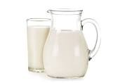
What are the pictures about?
Milk
Notes:
Milk

Slide 13
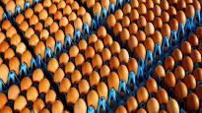
What are the pictures about?
Eggs
Notes:
Eggs

Slide 14
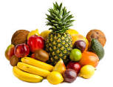
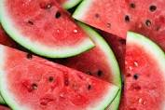
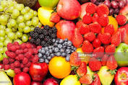
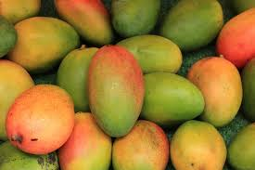
What are the pictures about?
Fruits
Notes:
Fruits

Slide 15
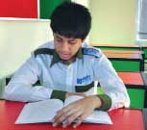
Individual work:
Why is food very important for us?
What do you mean by ‘nutritious food’?
How much food does a person need to eat a day?
Does everyone need the same amount of food? Why ?
Notes:
Individual work

Slide 16
Answers:
(1) Food is very important for us because we cannot live without it.
(2) Nutritious food means the right kind of food that our body need to grow properly and stay healthy.
(3) A person needs to eat a certain amount of food that his body needs.
(4) No, everyone does not need the same amount of food. Because it depends on his/ her growth and physical structure.

Slide 17
Group work
Write the meaning of the following words:
Certain, contain, nutritious, quantity, remember,
structure, substance, properly, depend, physical
Certain- নির্দিষ্ট Particular
Contain– ধারন করা Hold
Nutritious- পুষ্টিকর Nutritive
Quantity- পরিমাণ Amount
Remember- মনে করা Recollect
Physical- শারীরিক Bodily
Structure- গঠন Formation
Substance- পদার্থ Element
Properly-সঠিকভাবে Rightly
Depend- নির্ভর করা Rely
Notes:
Group work

Slide 18
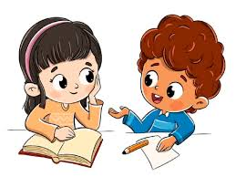
Pair work
Make five questions from the following table.
Why |  | Essential for our body?
What | do | Good for our skin?
What foods | are | We need to eat good food?
 | is | Vegetables contain?
 |  | Minerals do to us?
Notes:
Evaluation

Slide 19
Complete the sentences.
We should eat good food to ----------.
We should not eat more than-------.
Eating too much food is not --------.
Good food means ----------------------.
We cannot live without --------------.
Notes:
Evaluation

Slide 20
Evaluation
Choose the best answer from the alternatives:
Foods are divided into classes according to their -- (i) colours and tastes (ii) shapes and sizes (iii) substances they contain (iv) water they contain.
Potatoes contain a lot of (i) carbohydrate (ii) protein (iii) vitamins (iv) minerals.
Butter and ghee are a good source of --- .(i) protein (ii) fat (iii) vitamins (iv) carbohydrate.
Minerals are present in--- (i) nuts (ii) peas (iii) milk (iv) water
(e) Which food has the most carbohydrate? (i) sugar (ii) rice (iii) fruits (iv) vegetables.

Slide 21
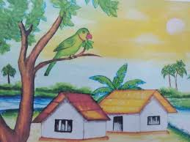
Home work
Write a paragraph about Good food
Notes:
Home work

Slide 22
Allah Hafez
Notes:
Ending

