Slide 1
Welcome to the class

Slide 2
Introduction
Md. Mizanur Rahman
B.A.(Hons.), M.A. in English, B.Ed.
Assistant Teacher
Police Lines School and College, Pabna.
E-mail: mizanplsc@gmail.com
Cell Phone :01737979719
Class: VIII
Subject: English 1st Paper
Unit: Six ( Going on a foreign trip)
Lesson: Seven
Lesson Title: Reaching Bangkok
Class Duration: 40 minutes
Date: 16/07/2020

Slide 3
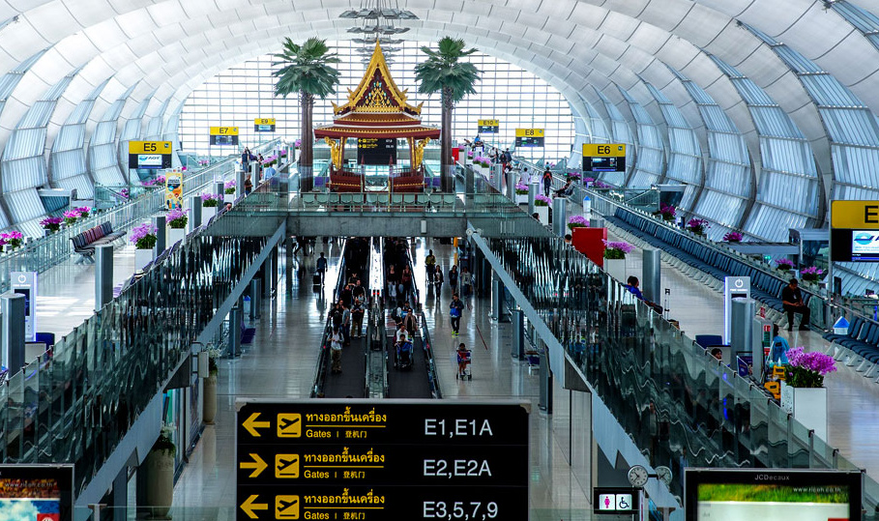
Look at the picture
What do you see ?
What could be this place?
How do you know?

Slide 4
Today’s Lesson
Reaching Bangkok

Slide 5
Learning Outcomes
At the end of the lesson, the students will be able to:
read and understand text .
complete the information.
fill in the gaps and choose the best answer .
write the answer of the questions

Slide 6
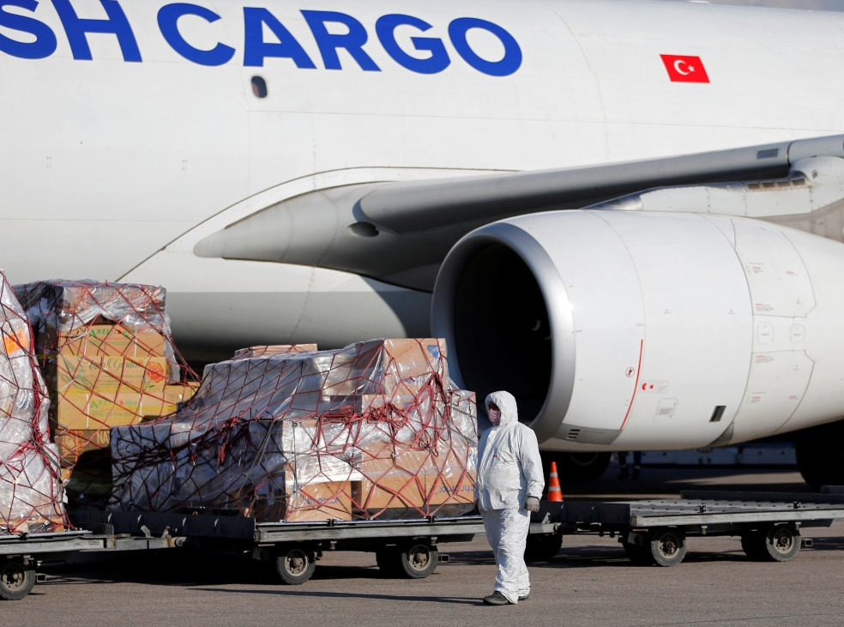
Key words presentation
Word: Cargo
Noun
Synonym : baggage
Meaning: the goods carried in ship or plane
Example: The airport can handle 3 million tonnes of cargo per year.

Slide 7
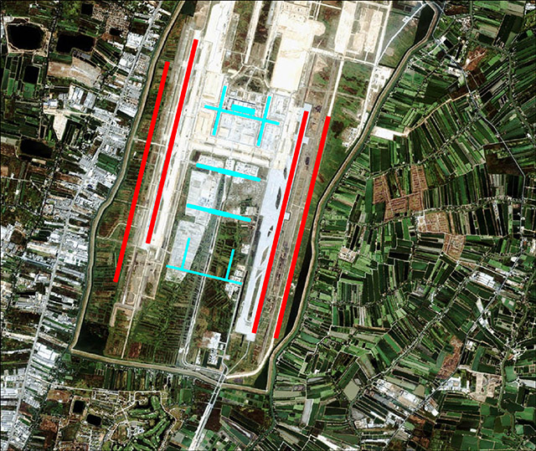
Word: Parallel
adjective
Synonym: collateral
Ant. unparallel
Meaning: having the same overall direction
Example: The airport has tow parallel runways.

Slide 8
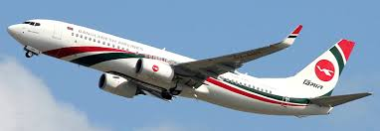
Word: Flight
Noun
Synonym: flying, soaring
Ant. standing
Meaning: A journey made by air, especially in a plane
Example: The airport can handle 76 flight operations per hour.

Slide 9
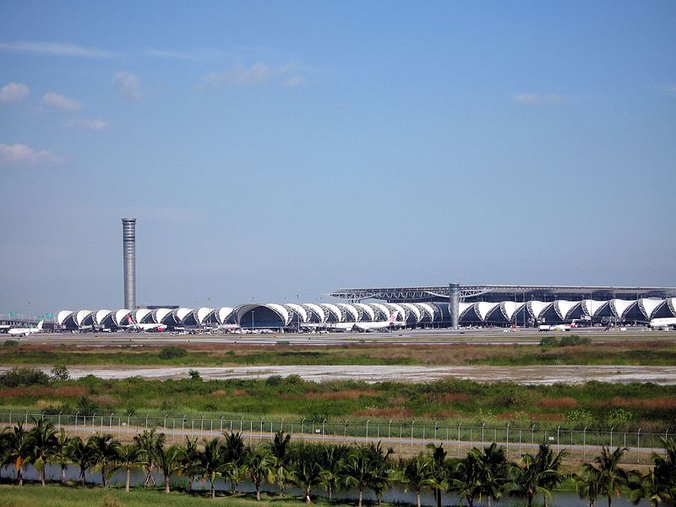
Read the text.
The plane landed at Suvarnabhumi Airport at 4: 55 p.m.
The name ‘Suvarnabhumi’ is pronounced as “su-wan-na-poom”. The name is derived from Sanskirt, which means golden land. The name was chosen by King Bhumibol Adulyadie.
Suvarnabhumi Airport
The airport is located in Racha Thewa in the Bang Phli district of Samut Prakan province, 30 kilometres east of Bangkok.

Slide 10
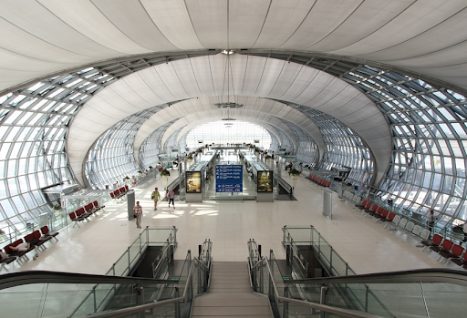
The airport has two parallel runways. Both of them are 60metes wide. One of the runways is 4000 metres long and the other is 3700 metres. It can handle 76 flight operations per hour.
It can handle 45 million passengers and 3 million tonnes of cargo per year.
The airport passenger terminal is 563000 square metres, that is 6060000 square feet.
Passenger Terminal

Slide 11
It is the fourth biggest passenger terminal building in the world. The airport is going through phase 2. It will raise its capacity to handle 65 million passengers per year. The airport has two 5 – storey car park buildings. The buildings can house 5000 cars.

Slide 12
Individual Work
Complete the Chart:
Bangkok Airport | Information
1. Name
2. Origin of the name
3. Chosen by
4. Meaning
5.Distance from Bangkok
6. Runway
7.Length of runways
8.Aircraft control per hour
9. Number of passengers
10. Number future passengers
Suvarnabhumi
From Sanskrit
King Bhumibol Adulyadie
Golden land
30 kilometers east of Bangkok
Two parallel both 60 meter wide
One is 4000 and other is3700 meters
76 flight operations per hour
45 million passengers
65 million passengers per year.

Slide 13
Pair Work
Read the following text and fill in the gaps with appropriate words to make a meaningful one.
Suvarnabhumi Airport is the (a) biggest passenger terminal building in the world. This (b) airport has two © runways, and they have the capacity to manage 45 million passengers (d) year. It is a complete airfield of (e) .
fourth
enormous
parallel
per/ a
Bangkok/ Thailand

Slide 14
Listen to the teacher and circle the correct information:
Group Work
Suvarnabhumi Airport has:
Checkpoints for arrival: 130/ 131 / 132
Checkpoints for departures : 70 / 71 / 72
Custom control checkpoints for arrivals: 25 / 26 /27
Custom control checkpoints for departures: 4 /6 / 8
Baggage conveyor belts: 20 / 22 / 24
Check in counters : 360 / 361 / 362
Moving walkways: 106 / 107 /108
Elevators: 102 / 103 /104
Escalators: 81/ 82 / 83

Slide 15
Evaluation
Give the answer of the following questions
Where did the plane land and when?
Where did the airport locate?
Write two sentences about the airport passenger terminal.

Slide 16
Home Work
Write a short paragraph on any International airport of Bangladesh.

Slide 17
Thanks to all
See you again in the next class.

