Slide 1
Welcome

Slide 2
Introduction
Khandoker Mufakkher Hossain
Assistant Teacher (ICT)
AftabUddin School and College
Bajitpur ,Kishoregonj , Dhaka
Presentation made for
Class IX-X
English 2nd paper
Grammar

Slide 3
We eat so that__________
we can live.
What are we going to discuss today?
Completing sentence

Slide 4
Learning outcomes
At the end of the lesson , we will be able to –
identify the definition of completing sentence
identify the method of completing sentence
complete incomplete sentences

Slide 5
What is a completing sentence?
When a part of a sentence is completed with a
clause or a phrase is called a completing sentence.

Slide 7
Completing item -1
Use of ‘too + adj/adv + to + verb + extension’.
The man is too___________.
old to walk
Complete the following sentences.
He is too dishonest to___________.
You are too short to_____________.
The girl was too silly ___________.
Note: Completed part must be underlined.

Slide 8
Completing item -2
Use of ‘too + adj/adv + for + personal object + to + verb + extension’.
to drink
The tea is too hot for me__________.

Slide 10
Complete the following sentences.
The book is too hard for me to_______.
The path is too long for him to_____________.
The load is too heavy for them to___________.

Slide 11
Completing item -3
Use of ‘so………… that’.
she could not study at all
She was so ill that_______________________.
Formation: Given clause with so.. that + relevant sentence.

Slide 12
Completing item -4
Use of ‘so/in order that’.
Formation: Given clause with so that/in order that + sub+
can/could/ may/might
+ verb +extension
Be prepared so that________________
He reads attentively so that________________________.
he can make a good result

Slide 13
Activities
The farmers sow good seeds so that ________________________________
He walked fast in order that_______________________________________
We eat vegetables so that__________________________________________
They play well in order that_______________________________________
He was so weak that______________________________________________

Slide 14
Completing item -5
Use of ‘provided/provided that/providing that
Normally present indefinite tense is used
after provided/provided that/providing that
The plane will take off in time provided
weather is good.
Formation:
Future indefinite tense + provided/provided
that/providing that + present indefinite tense

Slide 15
Activities
I will go to London provided that_______________________________________
They will play well provided that_______________________________________
I will take umbrella providing that______________________________________
He will wait for me provided___________________________________________
He will shine in life provided that______________________________________

Slide 16
Completing item -6
Use of ‘lest’.
He walks fast lest_________________________.
he should/might reach in time
Structure: Assertive sentence + lest + subject + should/might + V₁ + extension.
Complete the sentences
He ran away fast lest _________________________
Read diligently lest___________________________
The thief ran quickly lest_______________________
Go sharp lest________________________________
He came to the station quickly lest_______________

Slide 17
Completing item -7
Use of Unless
you will fail.
Unless you work hard, _____________
Complete the following sentences
Unless you read attentively,_________________
Unless you start at once,____________________
Come at 8 o’ clock unless___________________
He will not shine unless____________________
Unless you respect others,___________________

Slide 18
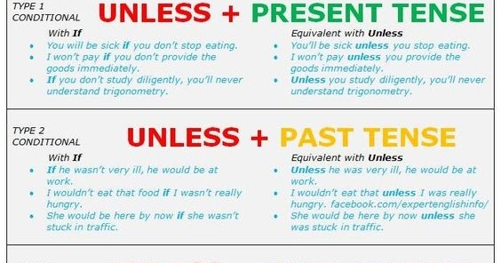

Slide 19
Completing item -8
Use of Till/ Until
Formation: Given clause with till/until +An
affirmative sentence in present indefinite form
Wait until_______________
the rain stops.
Complete the sentences
1.Wait for me until________________
2. I will teach him till______________
3. He will nurse me until ___________
4. I will help him till ______________
5. Until I come___________________

Slide 20
Completing item -9
Use of As long as
Formation: Given clause with as long as +An affirmative sentence
Wait here as long as____________
I come back.
Complete the sentences
1. Allah will be with us as long as_________
2. He worked as long as ______________
3. Read as long as ___________
4. Help him as long as______________
5. I gave him as long as ___________________

Slide 21
Completing item -10
Use of Though, although, since, as, because, if
Though he is poor,_____________
he is honest.
Since he is poor,_____________(complete the sentence)
He has to work hard because,_____________(Complete the sentence)
Formation : Given clause with though, although,
since, as, because, if + relevant sentence

Slide 22
Completing item -11
Use of In spite of/despite
he is honest.
In spite of his poverty,___________
Formation: In spite of /Despite + possessive +
noun + relevant opposite meaning sentence.
Despite his good qualifications__________________________ (Complete it)
_________________________despite his innocence (Complete it)
In spite of trying hard ________________________________(complete it)

Slide 23
Completing item -12
Use of In stead of/ In lieu of
In stead of history____________
he took logic.
in lieu of a pencil.
He bought a pen___ _____________
He ate fish __________________ (Complete it)

Slide 24
Continue to next content

