Slide 1
Welcome
1 M

Slide 2
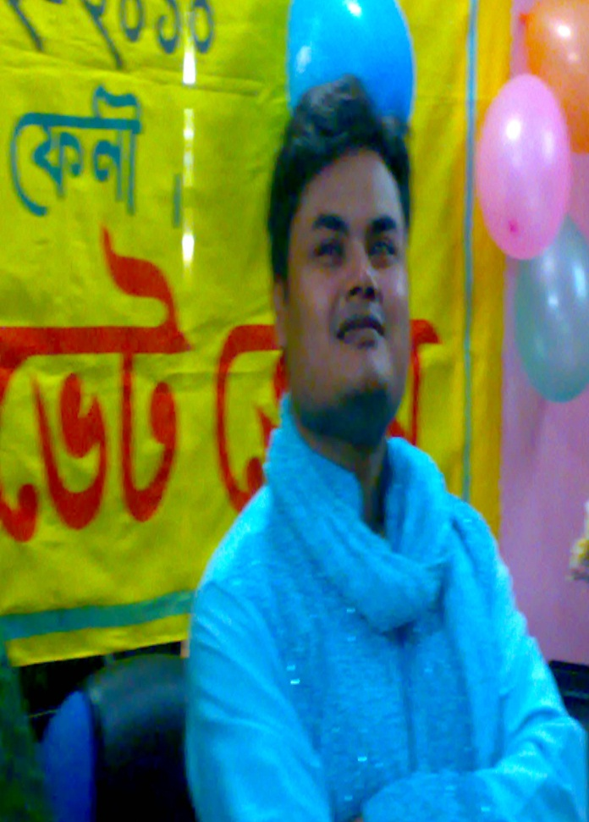
Introduction
MD.Nasir uddin (Bahar)
Assistant teacher (English)
Jamila khatun Chowdhury High School.
Mobile: 01817204698
E-mail:baharfeni100@yahoo.com
Class:Ten
Sub:English 1st paper

Slide 3
Match with their synonyms:
Despair | Result
Pebble | Look for
Search | Again and again
Effect | Stone
Over and over | Hopelessness

Slide 4
Enjoy the story!

Slide 5
Fill in the gaps:
It was ____ hot summer day.
A crow was very ____.
He _____ about here and there looking ___ water.
He saw a ____ with water.
He went ____ to the pot.

Slide 6
Fill in the gaps:
He looked _____.
He saw some _____.
He had an _____.
He picked up the pebbles one ____ one and dropped them ___ the pot.

Slide 7
Rearrange
As each pebble went down, the water in the jar rose up little by little.
It flew from one place to another in search of water and at last found a jar in a garden.
Then it decided to fly away in despair.
The crow tried to turn the jar over and over again but it had no effect.
Then it dropped the pebbles into the jar.

Slide 8
A crow was very thirsty and wanted to drink water.
There was some water in the jar but it was too low down and out of reach.
As it was leaving the jar, it noticed a heap of pebbles nearby.
He hit upon a plan then and took some pebbles.
When the water came to the mouth of the jar, the crow drank it.

Slide 9
A thirsty crow
1 | 2 | 3 | 4 | 5 | 6 | 7 | 8 | 9 | 10
f | b | g | d | c | h | i | c | a | j

Slide 10
Thank You

