Slide 1
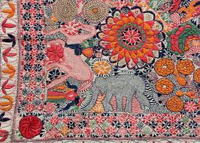
Welcome to My Multimedia Classroom

Slide 2

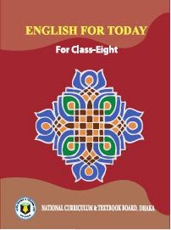
Identity
Md. Robiul Islam
Assistant Teacher English
Pioneer Girls’ High School, Khulna
Cell. 01914223493
Email. robittck@gmail.com
English For Today
Class- VIII
Unit – 1
Lesson-2

Slide 3
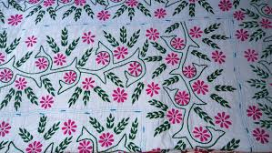
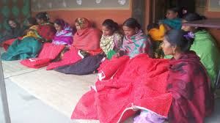
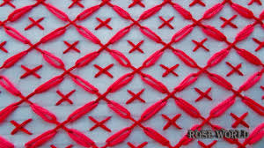
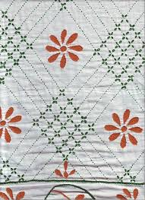

Slide 4
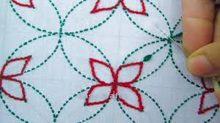
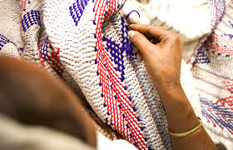
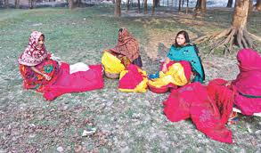
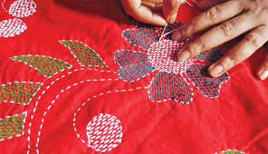

Slide 5
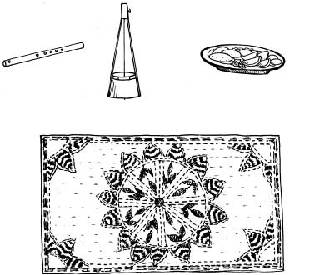
1. What is called it?
Nakshi Kantha

Slide 6
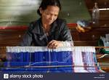
Today we are going to read about-
Nakshi Kantha

Slide 7
After we have studied this unit, we will be able to-
read and understand the text through silent reading.
Ask and answer questions.
write a paragraph.

Slide 8
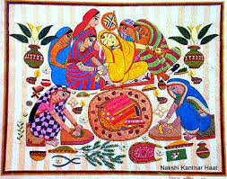
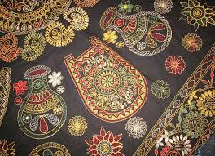
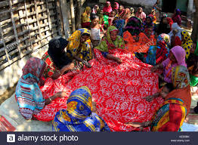
Look at the pictures and questions. Then ask and answer the questions with your partner.
1. What do you see in the picture?
2. What is called it?
3. Have you seen it before? Where?
4. What do we do with it?

Slide 9
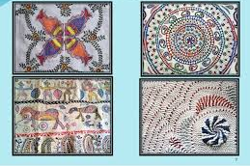
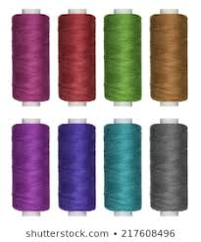
Embroidered
Decorate, Adorn
Verb
Nakshi Kantha is a kind of embroidered quilt.
Thread
Yarn, Twist
Noun
Old or new cloth and thread are used to make these quilt.

Slide 10
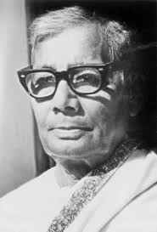
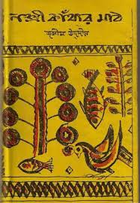
Information about Nakshi Kantha
Jasimuddin
Nakshi Kanthar Math
The name ‘Nakshi Kantha’ became popular after the poet Jasimuddin’s poem “ Nakshi Kanthar Math” was published in 1929.

Slide 11
Nakshi Kantha
Mymensingh
Jamalpur
Rajshahi
Faridpur
Bogura
Jashore
Famous district for Nakshi Kantha

Slide 12
B. Now read the text to know about nakshi kantha.
Nakshi Kantha is a kind of embroidered quilt. The name was taken from the Bengali word “ naksha” which means artistic pattern. It is a kind of traditional craft and is said to be indigenous to Bangladesh and West Bengal in India. The art has been practiced in rural Bengal for centuries. The name ‘Nakshi Kantha’ became popular after the poet Jasimuddin’s poem “Nakshi Kanthar Math” was published in 1929. Traditional Kanthas are made for family use. Old or New cloth and thread are used to make these quilts. Mymensingh, Jamalpur, Faridpur, Bogura, Rajshahi and Jashore are most famous for this craft. Now it is produced commercially . You can find them in many expensive handicraft shops in cities. The quilts are now in great demand because of the colourful patterns and designs embroidered on them.

Slide 13
C. Write a paragraph describing how the nakshi kantha is made. Start like this :
Old or new cloth and coloured thread are needed. First the cloth is folded, then ------------

Slide 14
D. Do you like a Nakshi Kantha or an ordinary kantha? Why?

Slide 15
E. Complete the sentences with clues given.
Bengali
patterns
embroidery
years
fashion
art
rural
design
quilt
naksha
Naksha means --------------------------.
The name was taken from a ------------------ word ----------------
The are has been practiced in --------------- Bengal for -------------
Nakshi Kanthas are now sold in --------------------- shops.
Nakshi Kanthas are in great demand because of their colourful -------- and ------------------.
Nakshi Kanthas are a kind of ----------------------.

Slide 16
F Write down five questions for the completed statements in E above.
One is done for you.
1. What does naksha mean?
Match your answer.
2. What word was taken as the name from?
3. Where has the art been practiced? How long?
4. Where are they sold now?
5. Why are Nakshi Kanthas in a great demand?
6. What are Nakshi Kanthas?
G Work in pairs. Ask and answer all the questions. Now write 3-4 more questions on the text given B above.

Slide 17
Write a paragraph about Traditional Kantha like Nakshi Kantha.
Home Work

Slide 18
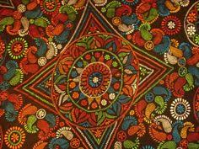
Thank You

