Slide 1
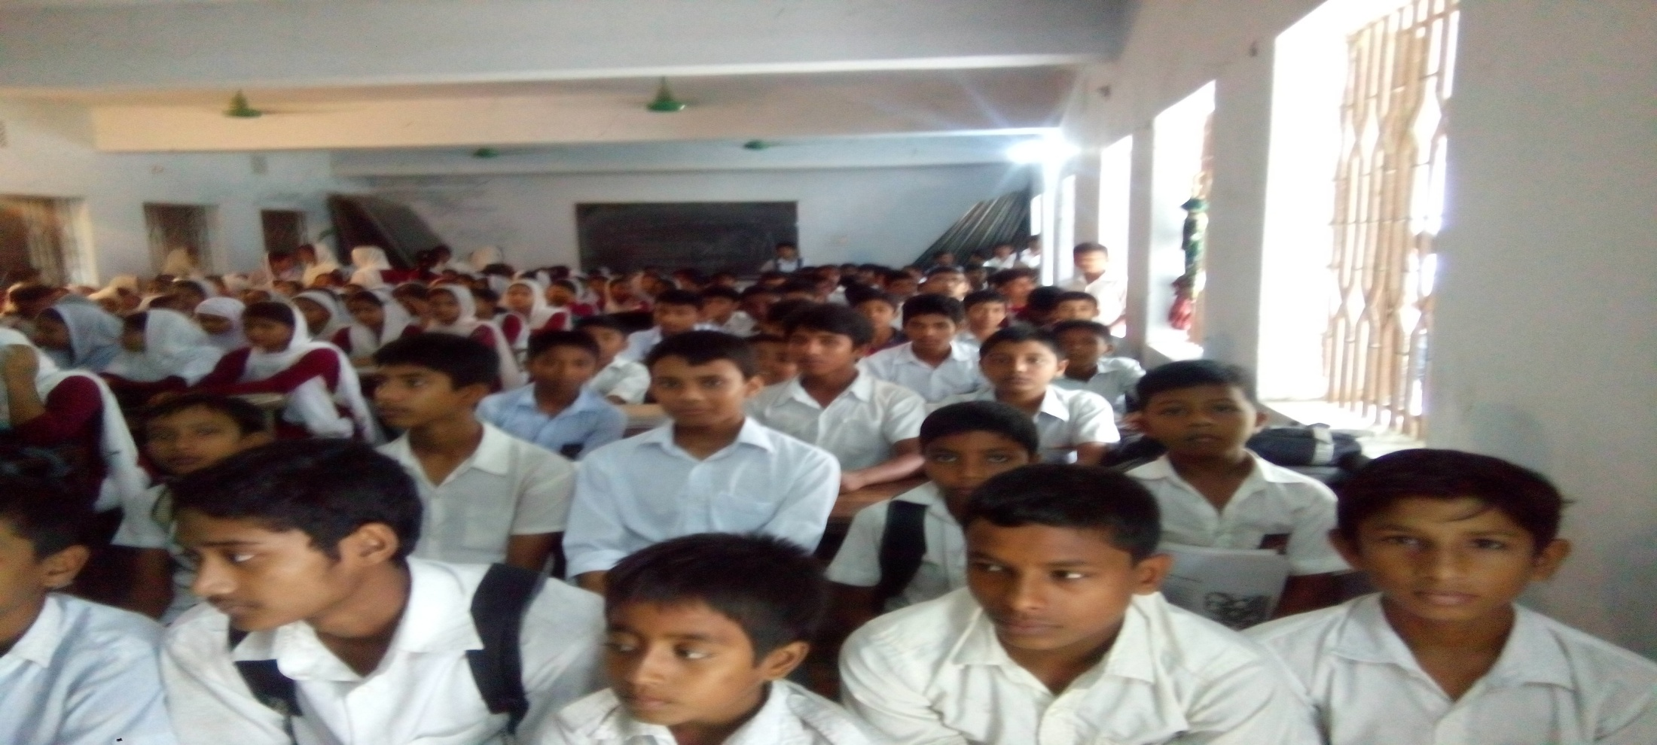
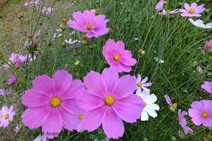
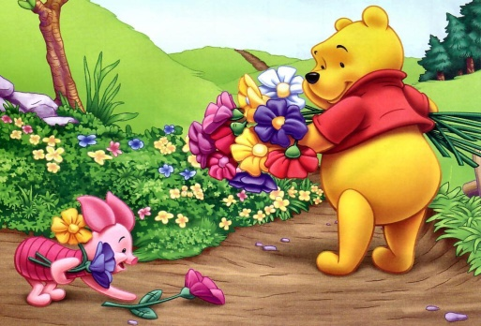
Good Morning Students

Slide 2
W
E
L
C
O
M
E
INTRODUCTION
CLASS: Vii
SUBJECT: Enlish 2nd paper.
TOPIC: RIGHT FORMS OF VERBS (SUBJECT VERB AGREEMENT)
Kallan Baran Sikder
Assistant Teacher ( HRT)
Panchagram High School.
Wazirpur, Barishal.

Slide 3
Can you match the subjects with the verbs?
A
B
I
are
He
am
They
is
reads
It

Slide 4
Today our topic is
Subject Verb Agreement
(Right form of verbs)

Slide 5
Learning Outcomes-
After the lesson the students will be able to –
Choose the correct answer with right form of the verbs.

Slide 6
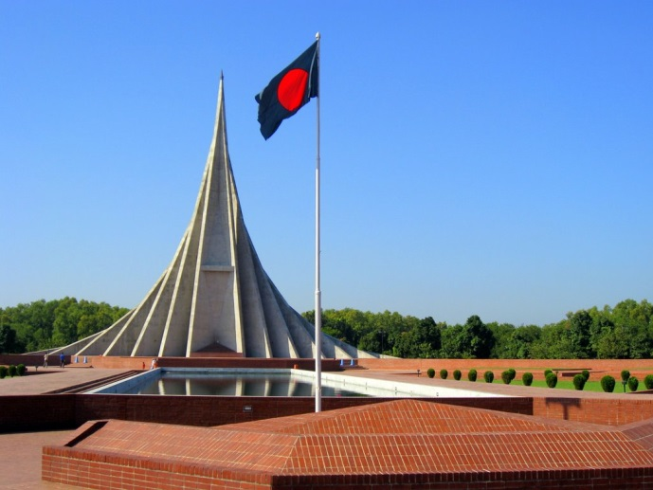
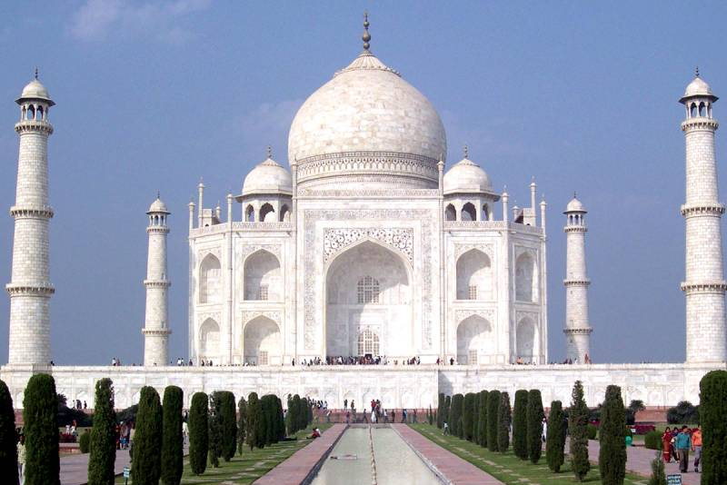
Can you choose the correct verb?
The National Memorial is/are one of the greatest monuments in the history of Bangladesh.
The Taj Mahal looks/look very beautiful.
Verb will be according to the number of the subject. If subject is singular, verb will be singular.

Slide 7
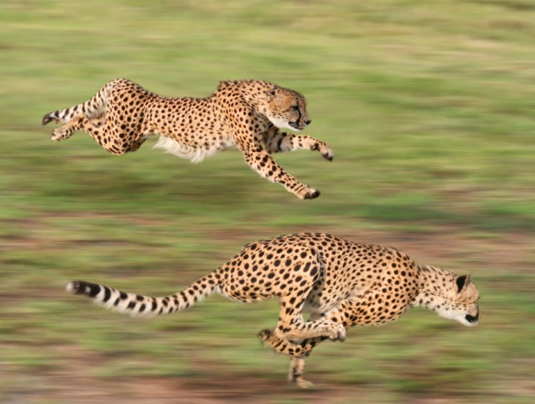
Choose the correct verbs.
The cheetahs is/are running.
The flower is/are blooming.
Verb will be according to the number of the subject. If subject is plural, verb will be plural.

Slide 8
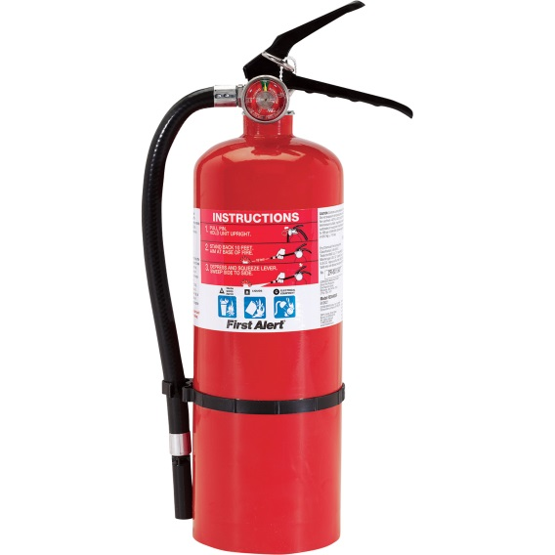
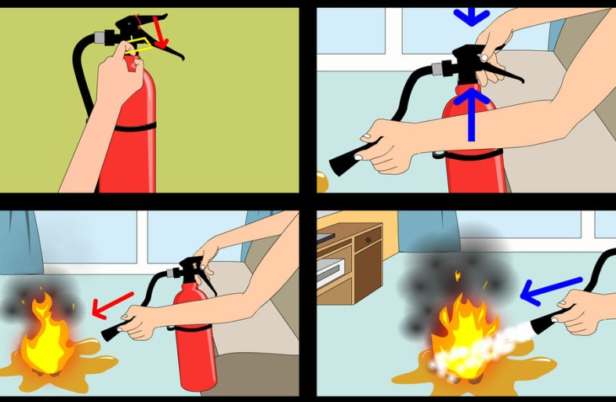
Choose the correct verbs.
1. Fire is/are the most common serious hazard that one face/faces.
2. Fire extinguishers is/are active fire protection devices used to extinguish or control small fires.
Notes:
This slide is the evaluation of the previous two rules of the subject-verb-agreement.

Slide 9
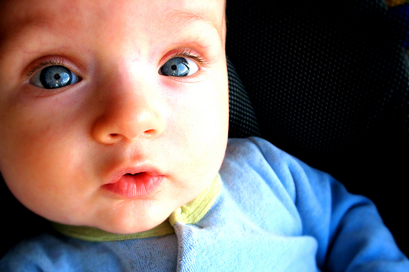
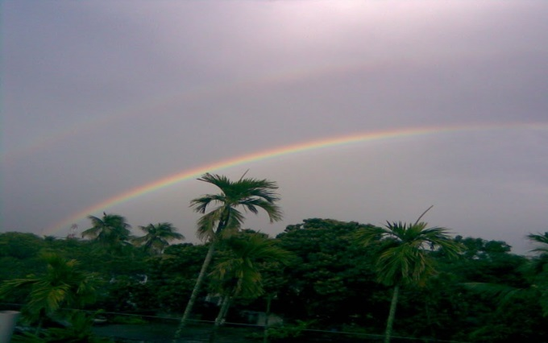
Can you choose the correct verb?
1. The colour of his eyes is/are blue.
2. The colours of rainbow attracts/attract us.
Sometimes subject becomes parted from verb by prepositional phrase. But the prepositional phrase does not have any effect on the subject. Verb will be according to the real subject.

Slide 10
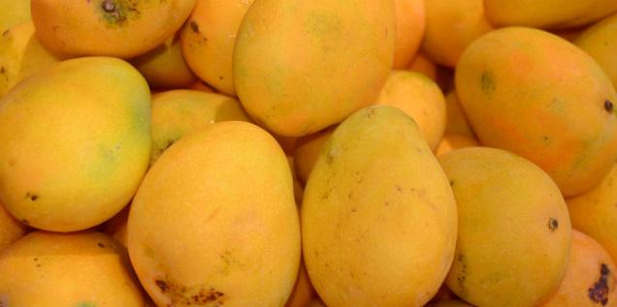
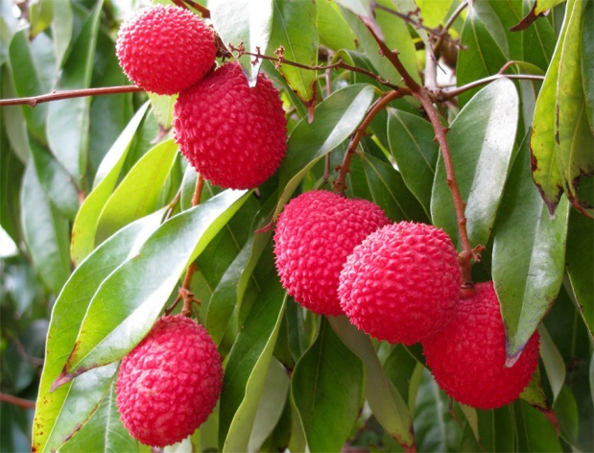
Give the answers using right forms of verbs.
1. The mangoes of Rajshahi ____ (be) famous.
are
2. The quality of the lychees ____ (be) good.
is
Notes:
This slide is the evaluation of the previous rule of the subject-verb-agreement in slide no. 9.

Slide 11
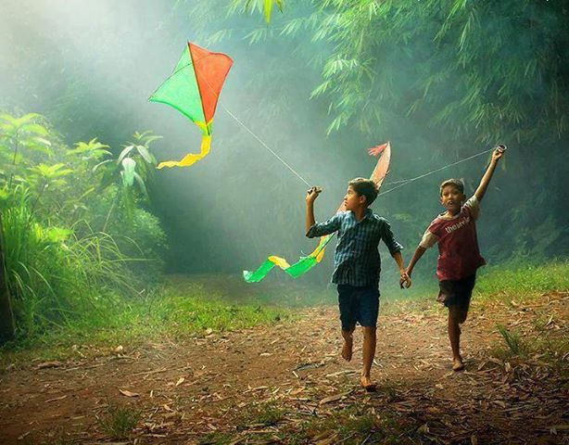
Can you choose the correct verb?
1. Ratan and Rabi likes/like to fly kite.
2. Bipasha and Natasha is/are two daughters of Abul Hayat.
If in the subject more than one nouns or pronouns are connected with and, and if they point out different persons or things, the verb will be plural.

Slide 12
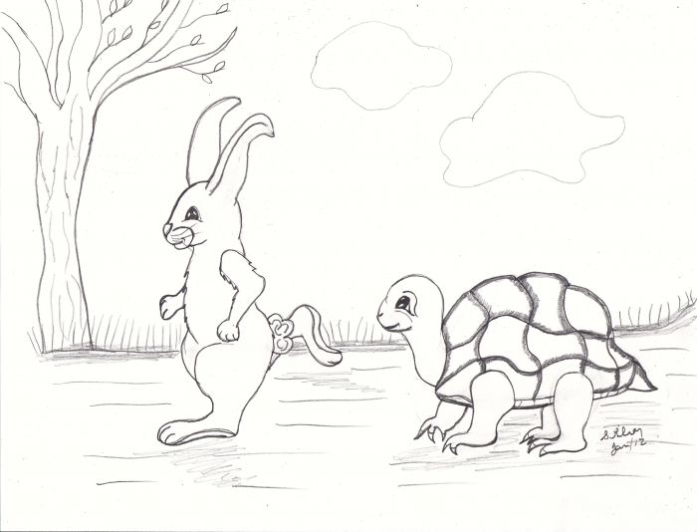
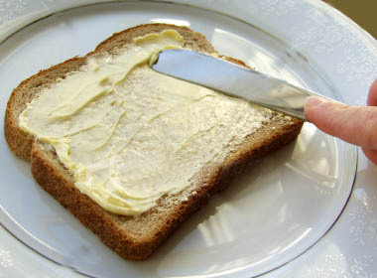
Can you choose the correct verb?
1. Slow and steady wins/win the race.
2. Bread and Butter is/are is my favourite food.
If in the subject more than one nouns are connected with and, and if they point out one person or one thing or one idea, the verb will be singular.

Slide 13
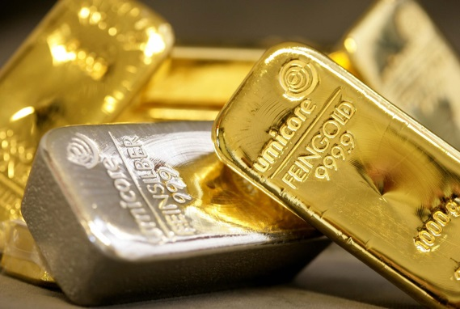
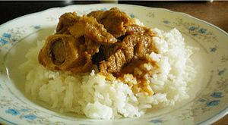
Give the answers using right forms of verbs.
1. Gold and silver ____ (be) precious metals.
are
2. Rice and curry ____ (be) my only food.
is
Notes:
This slide is the evaluation of the previous two rules of the subject-verb-agreement in slide no 11 and 12.

Slide 14
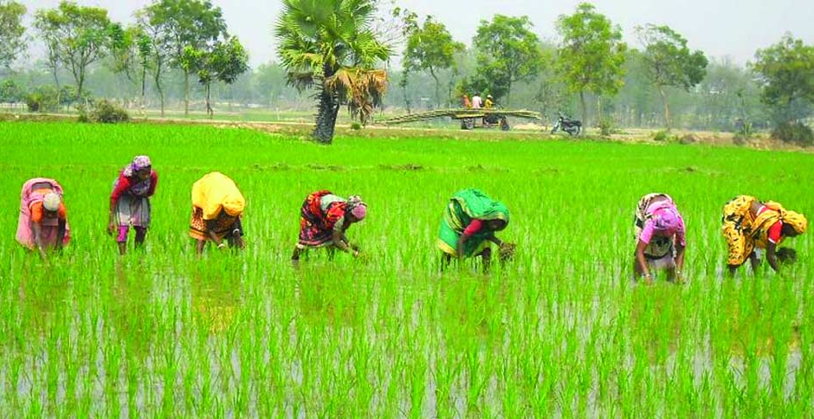
Choose the correct verbs and fill the gaps with right forms of verbs.(Pair/Group work)
be
go
work
is
1. The scenery _______ nice.
are
2. The plants ________ green.
work
3. The women in the field _______ hard everyday.
go
4. Banu and Ranu ______ to the field early in the morning.
Notes:
This slide is the evaluation of the previous all rules of the subject-verb-agreement in this lesson.

Slide 15
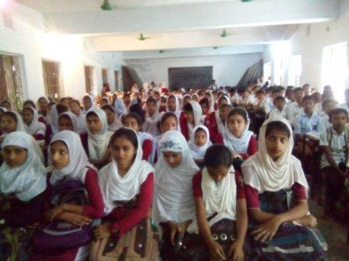
Thank You All

