Slide 1
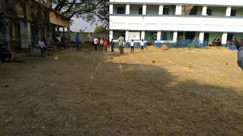
Welcome

Slide 2
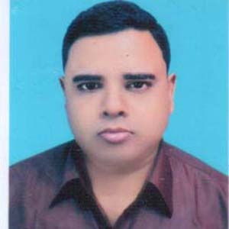
Introduction
Abdul Aziz
Assistant Teacher (English)
Madhaia Bazar Sadim High School
E-mail : azizabidpur@gmail.com
Class –Seven
English First Paper
Unit -08, Lesson -03
Paul visits to Sundarpur

Slide 3
In pairs, tell your partner the names of four things –one thing you like , one thing you dislike, one thing you love and one thing you hate.
Section -A
Pair Work

Slide 4
A : banana, tea, milk, carrot B : You like banana A : You’re right. B : You love carrot. A : That’s not right. I dislike it. B : Then you love milk. A : Yes. B : And you like tea. A : No, I hate it.
Suppose, you have made a pair A and B

Slide 5
Let’s watch a video
What did you see in the video?
A teacher is taking a class on democracy

Slide 6
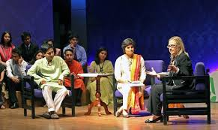
Look at the pictures
Hilary Clinton visits a school
and talks with the students.
Hilary Clinton visits Bangladesh and talks with the Bangladeshi students

Slide 7
So , Our today’s topic
Paul visits Sundarpur

Slide 8
Learning Outcomes
After the end of the lesson, students will be able to-
Talk about a visit
Infer vocabulary
Ask and Answer Questions.

Slide 9
Key words
A person who does something
Willingly and without being paid
Volunteer
স্বেচ্ছাসেবক
Arsenic poisoning
আর্সেনিক বিষক্রিয়া
Contaminated by arsenic
To make something clear or understandable
Explain
ব্যাখ্যা করা
Phtotography
The art or process of taking photo
আলোকচিত্রবিদ্যা
Hire
To pay to use something for a short period
ভাড়া করা

Slide 10
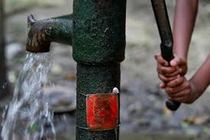
Read the text.
Paul went to Sundarpur High School to meet the teachers and students there. He was warmly greeted by all. He quite enjoyed the green coconut drink that was served on his arrival. He gave a short lecture to the students and explained how they would fight against arsenic poisoning. Paul also answered the questions asked by some students.

Slide 11
He liked most of the questions. He also took some pictures with the
students. He always takes his camera with him. He loves photography.
As he was taking leave, all the students followed him up to the school
Gate. The teachers wanted to hire a rickshaw for him. He does not like
Riding rickshaws. In fact, he hates the idea of sitting while another
personIs pulling the rickshaw. So, he did not mind walking towards the
local Union Council Office.

Slide 12
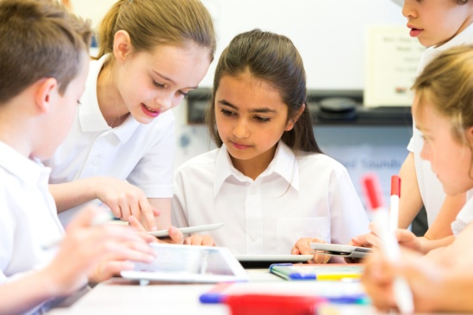
Group Work
Why did Paul go to Sundarpur High School?
A : I think, Paul went to Sundarpur High School to meet the teachers and students of the school.
B : Is there any other reason behind his visit?
A : Yes. He wanted to make the students aware of arsenic poisoning. He gave a short lecture on arsenic poisoning.
B : That’s great!

Slide 13
Individual Work
Write your likes and dislikes in the grid below
Things I really like
…………………………
………………………….
…………………………..
Things I like
…………………………
………………………….
…………………………..
Things I dislike
…………………………
………………………….
…………………………..
Things I really dislike
…………………………
………………………….
…………………………..

Slide 14
Things I really like :
I really like to read novels
I really like to play crickets
I really like to travel
Things I like :
I like to read poems
I like to walk in the morning
I like to play chess

Slide 15
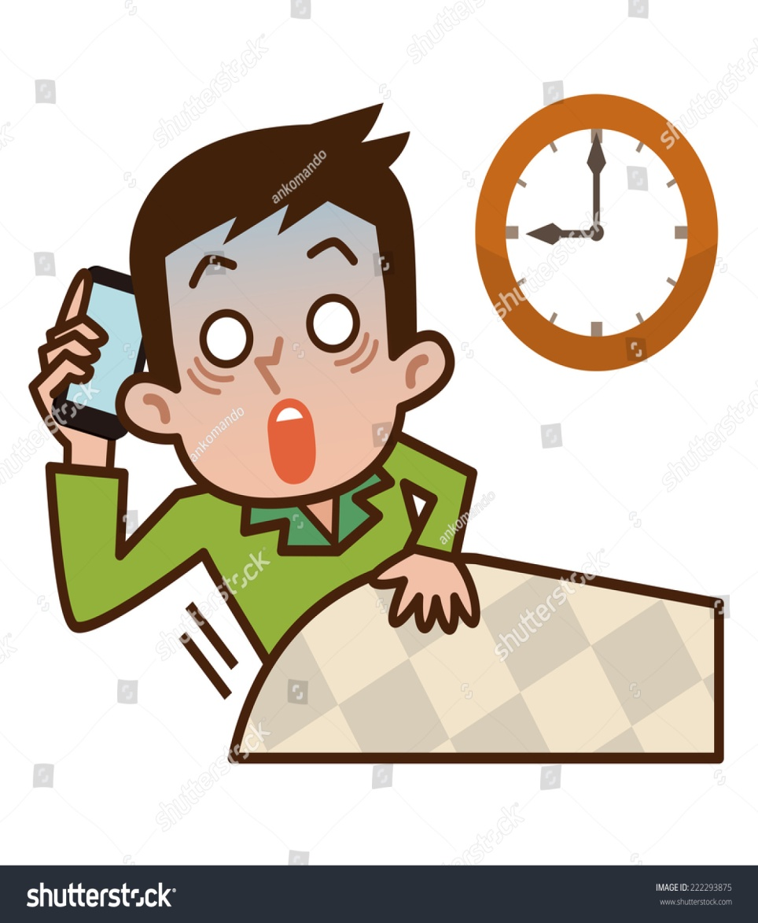
Things I dislike :
I dislike wasting time.
I dislike sound pollution
I dislike classical music
Things I really dislike :
I really dislike bad people
I really dislike lies
I really dislike waking up late.

Slide 16
Individual Work
tell
mind
young
visited
fight
Paul is a _____ volunteer. He ______ the school in order to _______ the students how to _______ against arsenic. He did not ________ walking towards the local Union office

Slide 17
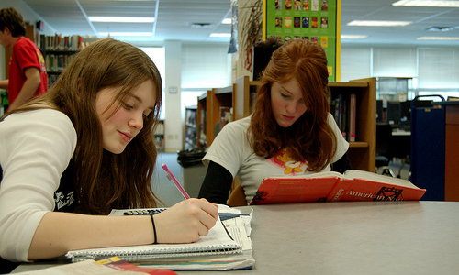
Evaluation
How was Paul entertained at the school?
What did Paul talk about?
Why doesn’t Paul like riding rickshaw?

Slide 18
How was Paul entertained at the school?
What did Paul talk about?
Why doesn’t Paul like riding rickshaw?
Paul was entertained with a green coconut.
Paul talked about arsenic poisoning.
He dislikes the idea of sitting idle while another person is pulling the rickshaw.

Slide 19
Write a short paragraph on
“Paul visits to Sundarpur High School”

