Slide 2
Presented by
Mira Rokeya Khatun
(Assistant teacher)
Rarishal govt.primary school.
Lakhai, Habigonj.
Class:Five
Unit:14
The hare and the tortoise
Time: 45 minutes

Slide 3
Learning outcomes
By end of the lesson students will be able---
1
To read the text with proper pronunciation.
2
To make sentences using words.
3
To write a short simple composition.

Slide 4
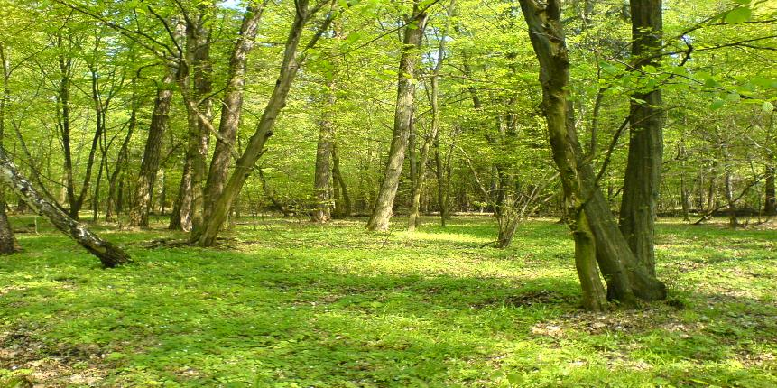
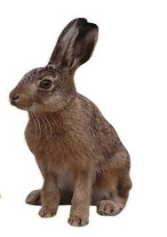
Look at the picture
What can you see in the picture?
The Hare and the tortoise.

Slide 5
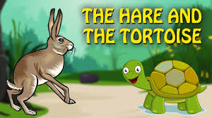
Today’s lesson

Slide 6
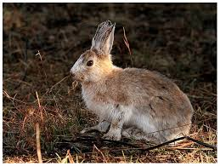
Look at the picture.
One day, a hare was walking in the forest when he saw a tortoise. The hare was the fastest animal in the forest.

Slide 7
The tortoise was the slowest animal in the forest. The hare called out to the tortoise, Hurry up! You are so slow.

Slide 8
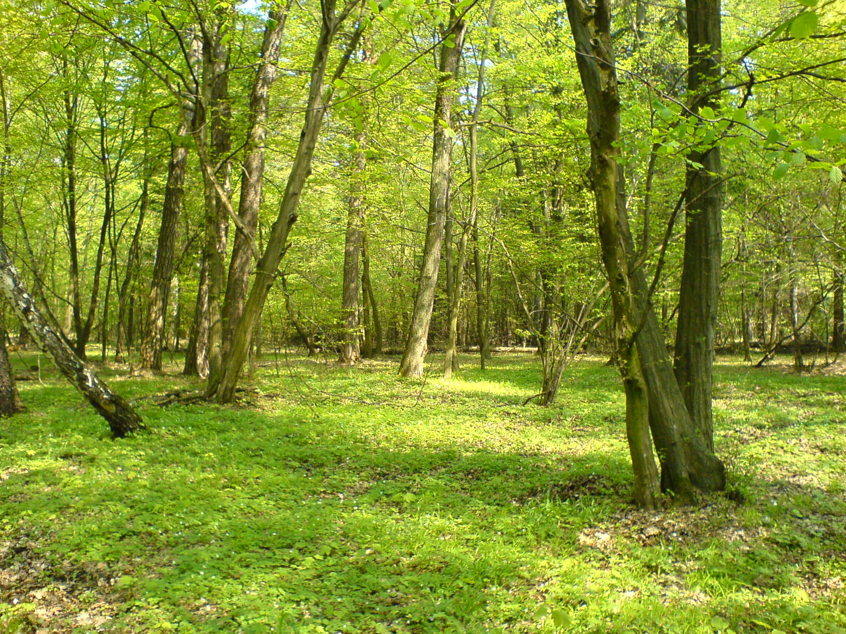
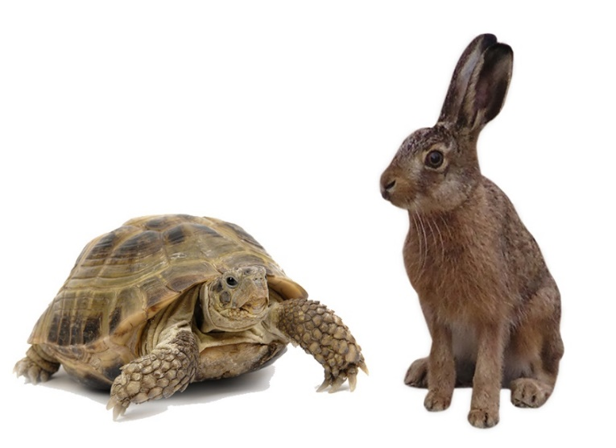
The tortoise felt angry and said to the hare, Why don’t we have a race? May be I can win!” The hare laughed and laughed. They agreed.

Slide 9
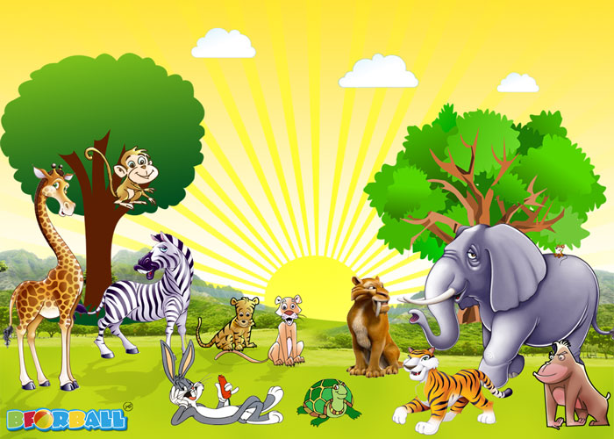
Then they called there friends to watch race.

Slide 10
Let’s watch a video.
To watch video click here.

Slide 11
Individual work
Match the answer
Write only the answer on the answer paper
1.Where was the hare walking ?
✓
(a) Beside a forest
(b) In the forest
(c) Beside a river
(d) Beside a tank
2. What did the hare see ?
✓
(a) A snake.
(b) A frog
(c) A tortoise
(d) A cat
3. How was the tortoise moving ?
✓
(a) Slowly
(b) Quickly
(c) Lazily
(d) Very fast
4. Who is proud of speed?
✓
(a) The tortoise
(b) The hare
(c) The fox
(d) The deer

Slide 12
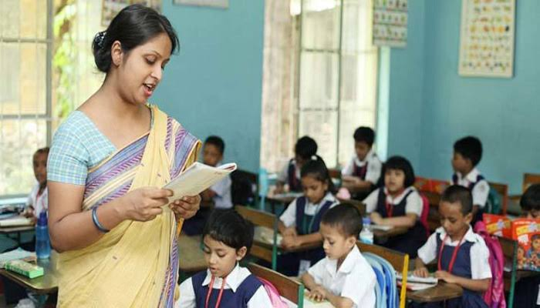
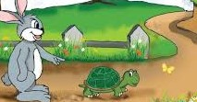
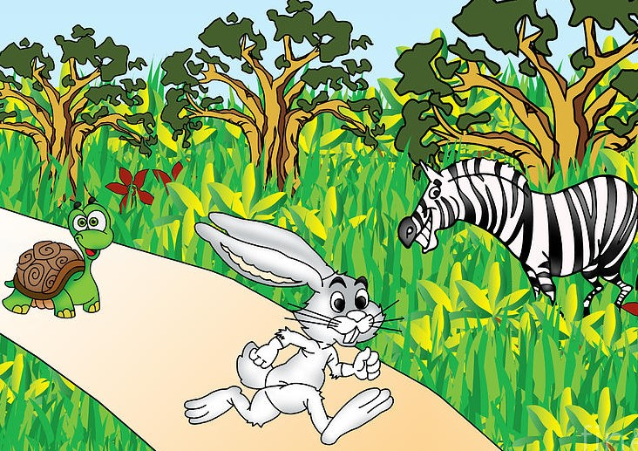
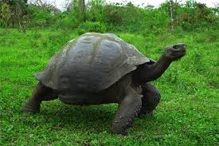
Teacher’s loud reading and discuss the lesson.
One day, a hare was walking in the forest when he saw a tortoise.The hare was the fastest animal in the forest . The tortoise was the slowest animal in the forest.The hare called out, “Hurry up ! You are so slow ! Can’t you walk faster ? Can’t you run?”
The tortoise felt angry and said to the hare , “Why don’t we have a race?May be I can win!”
The hare laughed and laughed .“Sure! I will win ” the hare said. They agreed to start next to a big tree and finish at the river.
Then they called their friends to watch . The hare stood beside the tortoise and the race began.

Slide 13
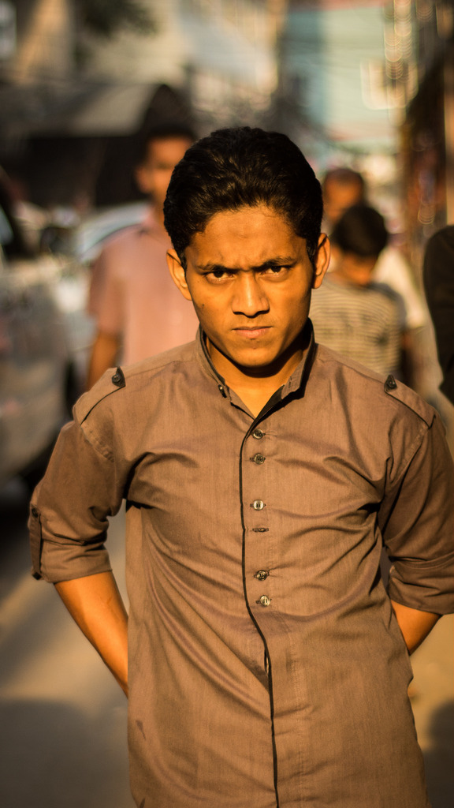
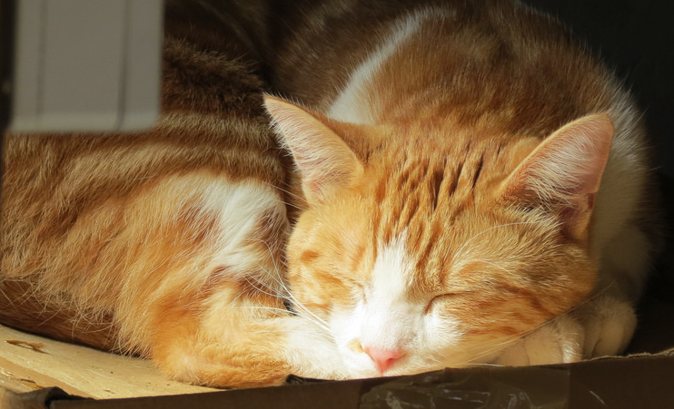
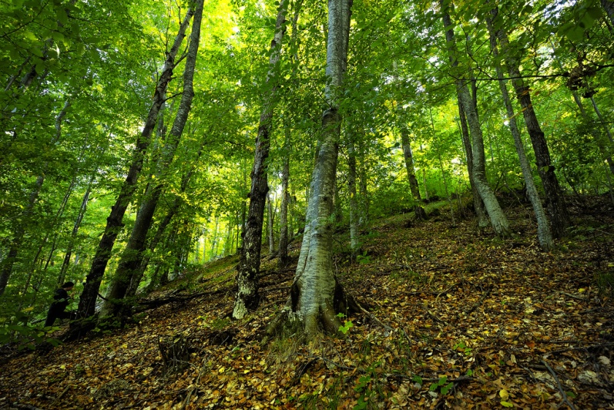
New words with sentences by using picture
A large uncultivated tract of land full of trees and under wood.
Hot tempered
In a sleeping state
Forest
Angry
asleep
The cat was asleep on the floor.
The man felt angry.
Animals live in forest.

Slide 14
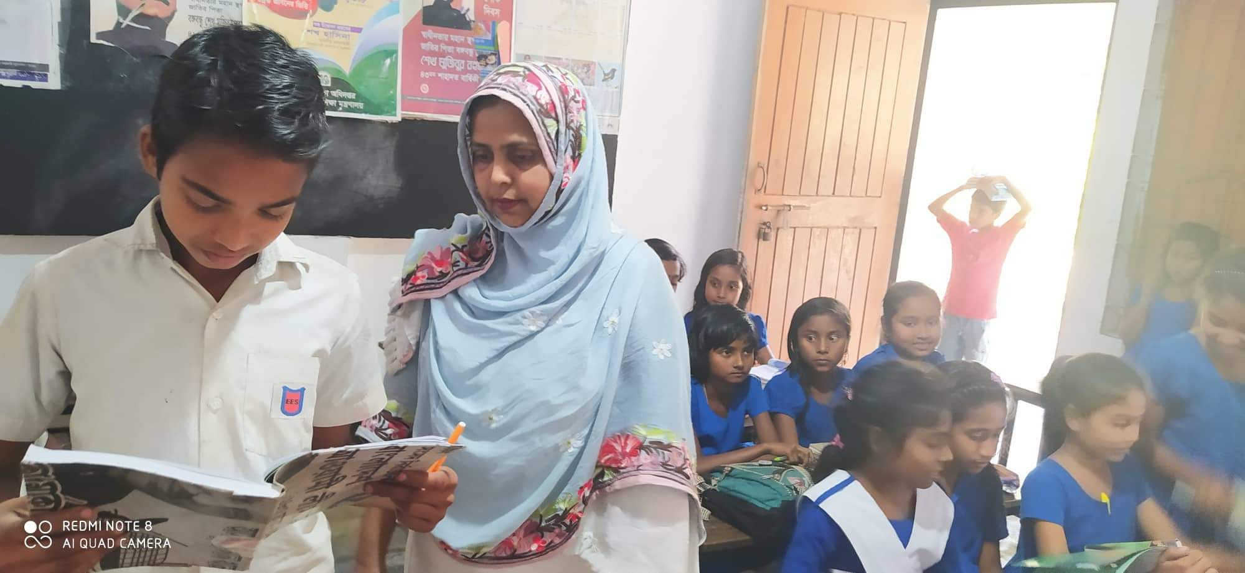
Student’s loud reading help by teacher.

Slide 15
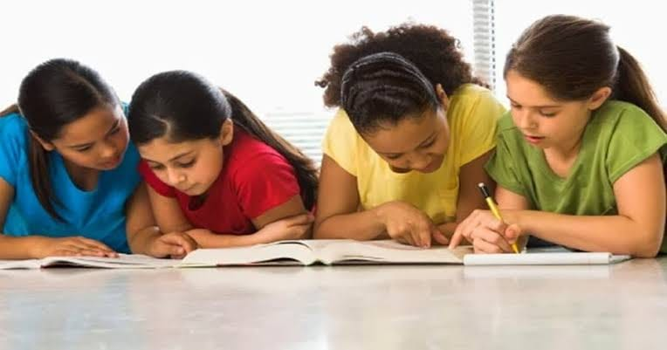
Pair work
Write a short composition on “ The Hare and Tortoise” at least five sentences.

Slide 16
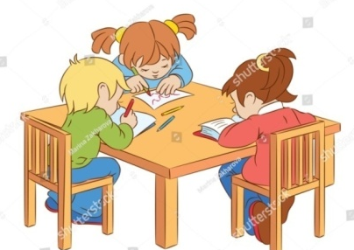
Group work
G -1. Who felt angry? and why
G- 2.what is the moral of the passage?
G – 3.who won the race? and why?

Slide 17
Evaluation
Match the answer
Fill in the blanks with the correct word from the box.
fastest passed raced slowest steadily took won
fastest
passed
raced
slowest
steadily
took
won
The hare was the ------------------ animal, but the tortoise was the -------------. One day, the tortoise and the hare ----------------------. The hare ran very quickly, but then he ------------- nap. The tortoise walked on -------------- while the hare was sleeping, the tortoise ------------- him. The tortoise crossed the finish line and ----------- the race.

Slide 18
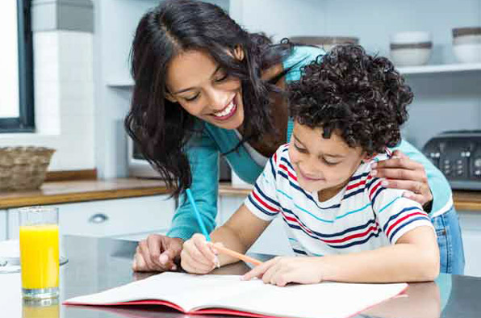
Home
work
You will write a short composition about “a sports day” in five sentences.

