Slide 1
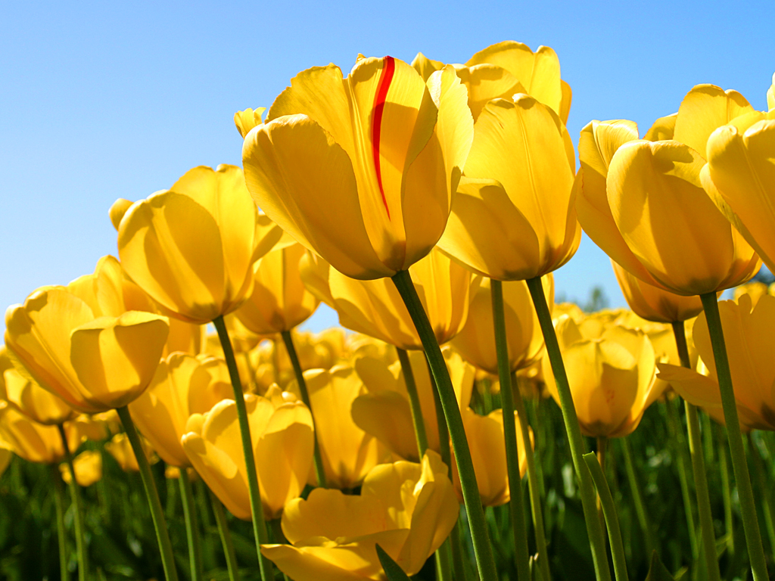
WELCOME

Slide 2
Introduction
Nasir sir
MD.Nasir uddin (Bahar)
Assistant teacher (English)
Jamila Khatun Chowdhury High School
Monurhat,Chagolnaia,Feni
Mobile:01817204698
E-mail:baharfeni100@yahoo.com

Slide 3
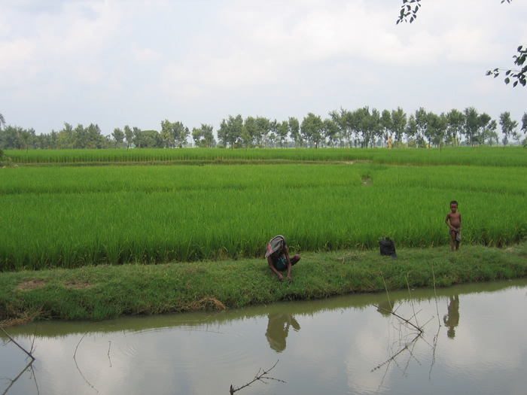
Natural scenery of Bangladesh

Slide 4
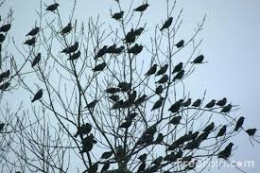
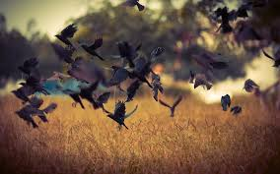
Flocks of bird

Slide 5
BIRDS OF BANGLADESH

Slide 6
Learning Outcomes:
Ss will be learn words meaning.
Ss will be able to identify Benebua bird .
Ss will be write paragraph about Tia .
Ss will be able to answer the question .

Slide 7
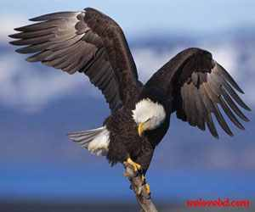
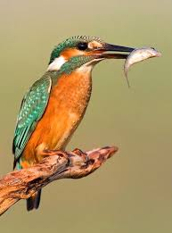
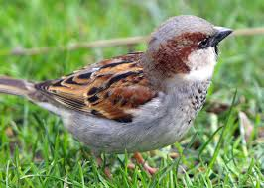
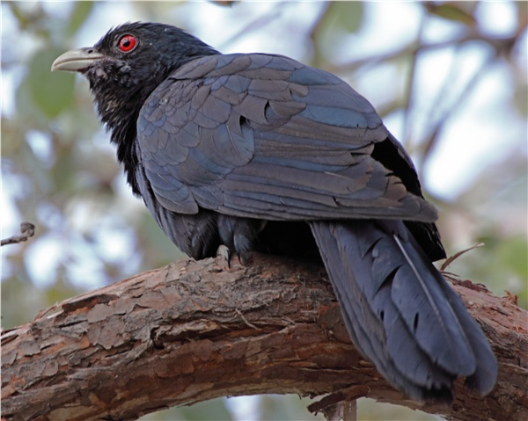
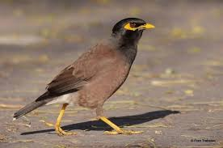
sparrow
kingfisher
shalik
cuckoo

Slide 8
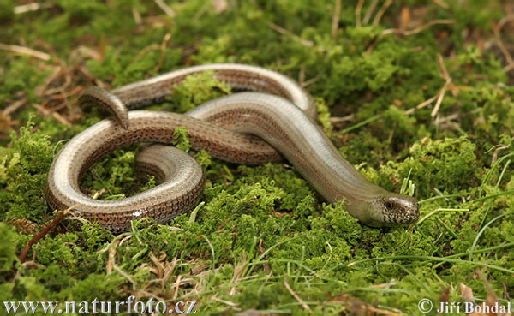
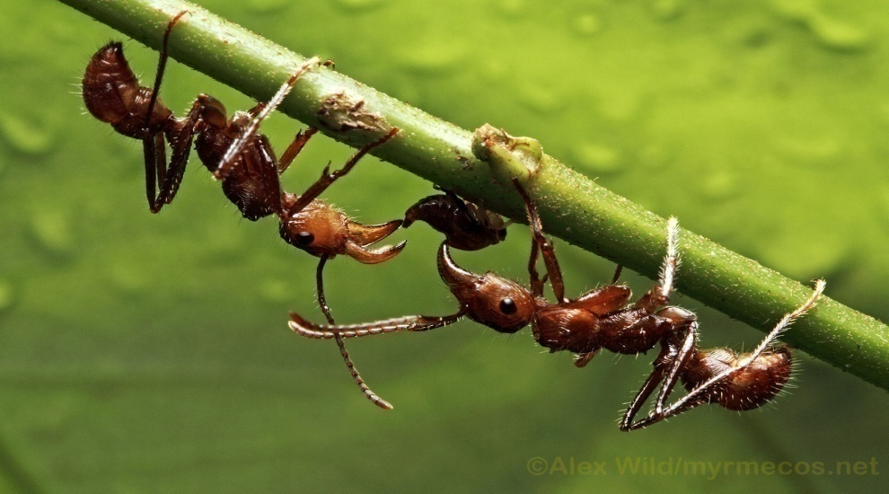
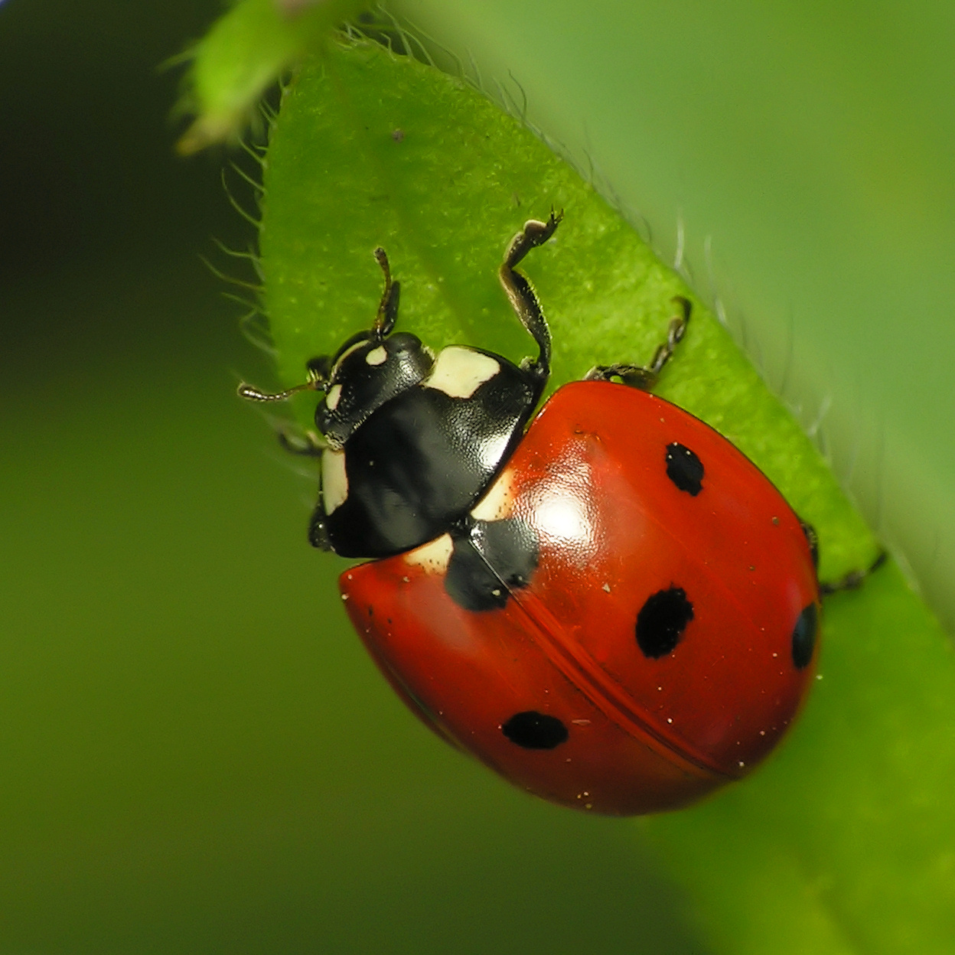
Words meaning
worm
insect

Slide 9
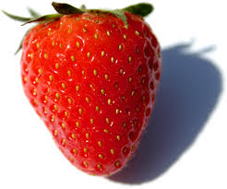
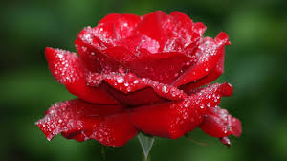
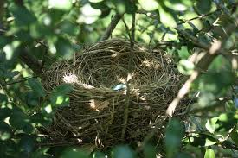
Fruit
flower
nest

Slide 10
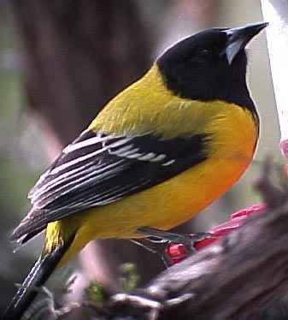
Read the passage
Bangladesh is a country full of natural resources. We are proud of flowers ,fruits and bird.
Today we will read about a bird known as ‘’ Benebau ‘’ in Bangla and Blackheaded Oriole
In English .
beak
wing
throat
tail
Yellow colour

Slide 11
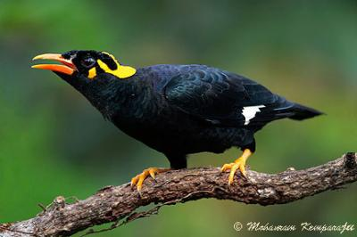
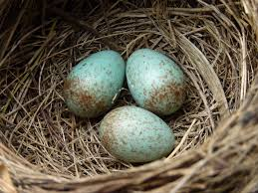
PAIR WORK
Ans .
Questions
1. How does it look like ?
2 .How many eggs does it lay ?

Slide 12
Evaluation
True or False .If false ,give the correct answer.
a)Bangladesh is a full of natural assets .
b) It has only flower .
c)Benebau looks like Mayna .
d)It lays 3eggs at a time .

Slide 13
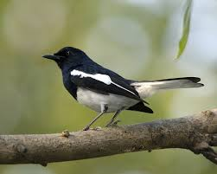
HOME WORK
Write some dissimilarity between DOEL and TIA .

Slide 14
Thank you
Bless to you all.

