Slide 1
Welcome

Slide 2
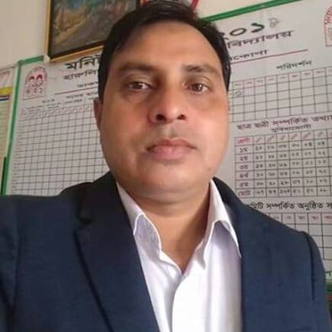
Teacher introduce:-
Md.Kamruzzaman
Assistant Teacher
Harulia govt. primary school.
Kendua,netrakona.

Slide 3
Lesson introduce:
Class:-Five
Subject:-English.
Unite:-15
Chapter:-Happy Birthday.

Slide 4
Learning outcome
Listening : 3.4.1- understand statements made by the teacher and statement.
Speaking : 6.2.1- talk about people, objects, events etc.
Reading : 1.7.1- read paragraphs, dialogue stories, letters and other texts.

Slide 5
Let’s Watch a video
What have you seen in the video?
Yes, you ca n guess. It’s a Birthday video.

Slide 6
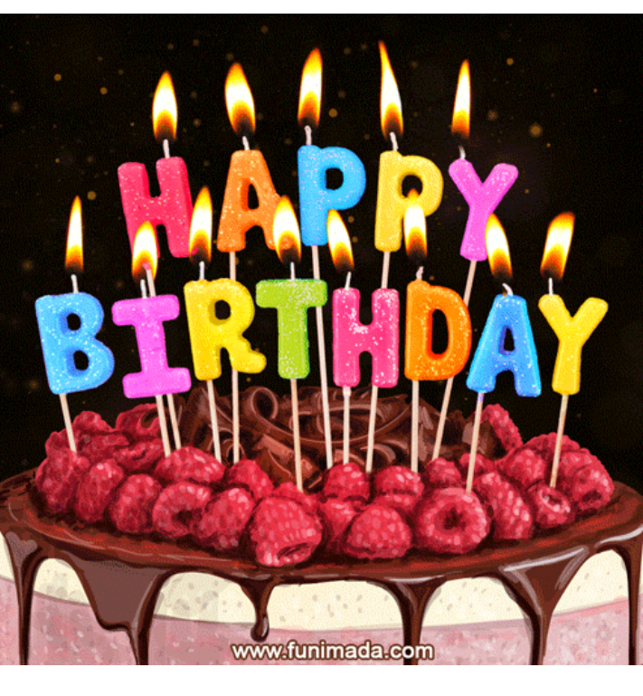
Today our lesson is..
Happy Birthday

Slide 7
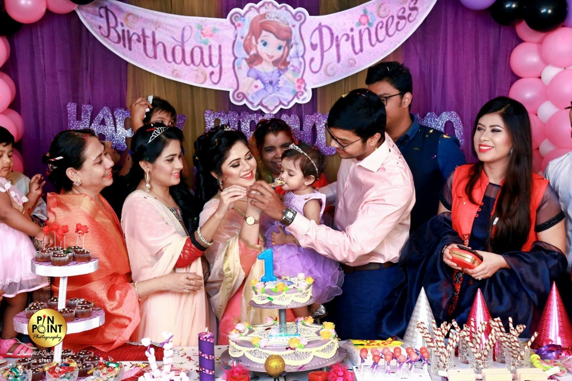
Look at the Picture.

Slide 8
What can you see in the picture ?
What is the happening in the picture ?
Who are there in the picture?

Slide 9
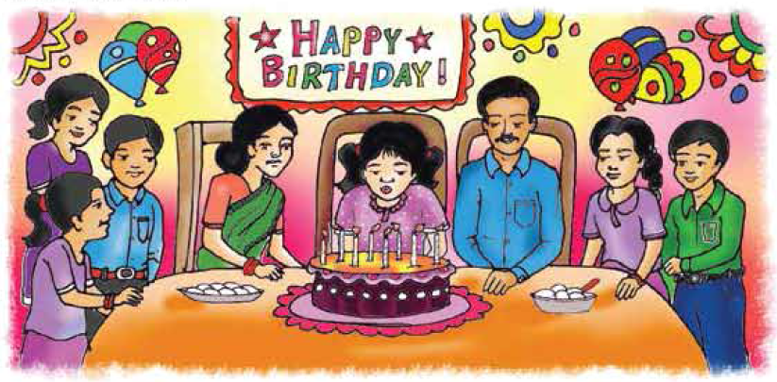
Look at the Picture.
What are they doing ?
What is written on the top of the picture?

Slide 10
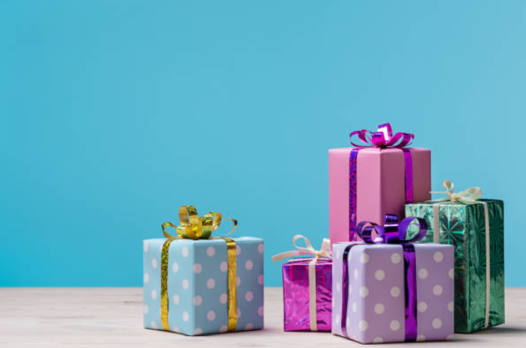
1. What do these packets look like ?
2. What do we do with these packets?
3. When do we present these to others?

Slide 11
New word meaning
Birthday
the anniversary of the day on which a person was born.
জন্ম দিন।
Special
extraordinary
extraordinary.
বিশেষ।
world
universe
পৃথিবী।
Celebrate
observe/ share any occasion
উদযাপন করা।

Slide 12
Cake
Sweet food made from a mixture of flour .
পিঠা।
Candle
illumination.
মোমবাতি।
Gift
present.
উপহার।
Wrap
typically as a covering.
মোড়ানো।
Enjoy
pleasure.
আনন্দ করা।

Slide 13
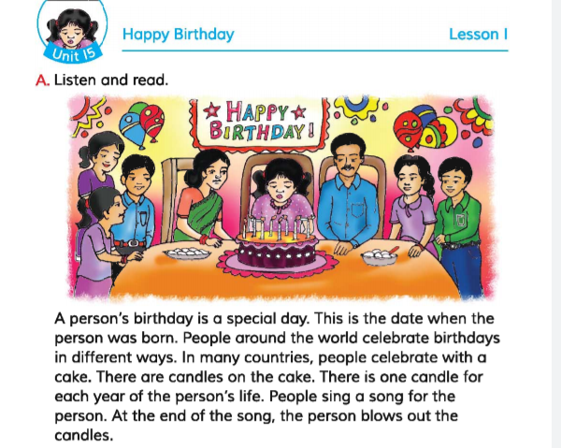
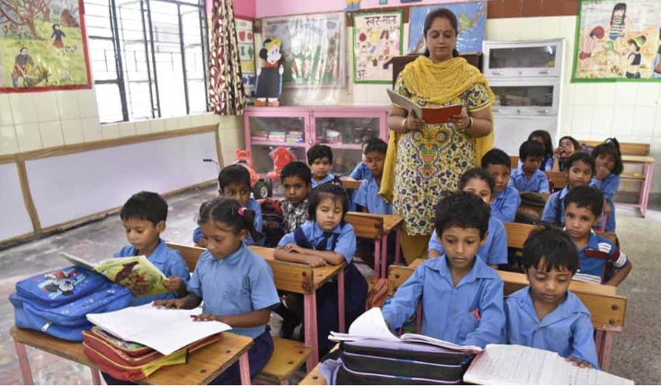
Teacher loud reading
Open your book at page 58.

Slide 15
Ask and answer the question.
What is birthday?
✓ Birthday is the date when a person was born.
b) Why birthday is special?
✓ Birthday is a special day because this day it is a begining point earthly life of a person.
c) What do the do on birthday ?
✓ Children wear new cloth, sing-songs, play games and enjoy the birth day in different ways.

Slide 16
Evaluation
Answer the following questions.
Which is a special day in one’s life?
Who have fun on the day?
c) When the person blow out the candle?
d) What did the children do the birthday party?
What is the most important thing in a birthday party?

Slide 17
Fill in the blank with appropriate word.
having, cake, different, home, special
Children enjoy the day in……… Ways.
b) Candles are ………… on the cake.
c) A birthday party needs birthday ……..
d) A birthday is a…………… day.
e) The child’s friend come to …………

Slide 18
Now check your questions answer.
having, cake, different, home, special
Children enjoy the day in……… Ways.
Ans: Children enjoy the day in different Ways.
b) Candles are ………… on the cake.
Ans : Candles are having on the cake.
c) A birthday party needs birthday……….
Ans: A birthday party needs birthday cake.
d) A birthday is a…………… day.
Ans: A birthday is a special day
e) The child’s friend come to …………
Ans : The child’s friend come to home

Slide 19
One day one word
Celebrate=উদযাপন করা।
Making sentence.
celebrate- We will celebrate our Eid festive soon.

Slide 20
Home work:-
Suppose you are sumon or Tania.you are living at court Road,kendua,netrakona. your friend name is kalam or Tania who lives in tonghi,Dhaka.Now write a letter to your friend describing a birthday party.

Slide 21
Home work
Write a short paragraph about ``Your birthday’’ with five sentence.

Slide 22
Thank you.

