Slide 1
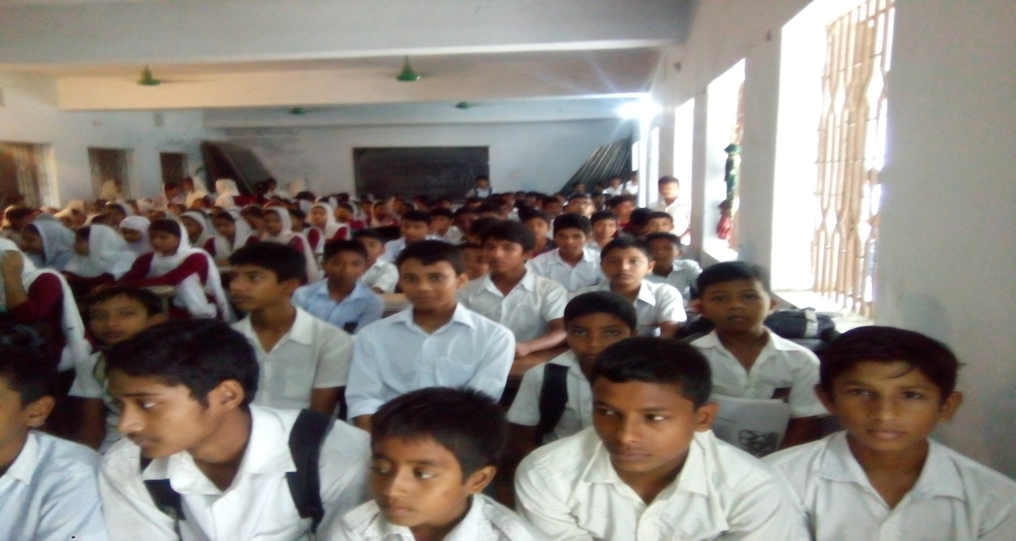
Welcome dear students
Notes:
Welcome slide

Slide 2
Introduction
Kallan Baran Sikder.
Assistant Teacher.
Panchagram High School.
Wazirpur,Barishal.
Class-IX-X
English 2nd Paper
Grammar
Notes:
Introduction of teacher & class.

Slide 3
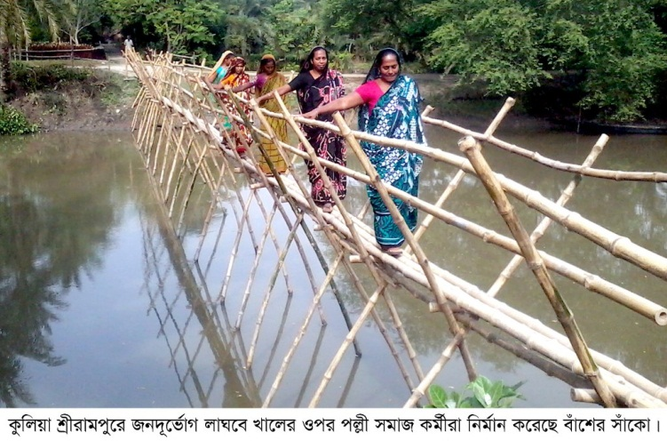
If there is a bridge on the canal, people can
easily connect with the people of other side.
Notes:
Suspension.

Slide 4
Connectors/Linkers
That means sentence connectors.
Unit-9
Lesson-1
What is our today’s lesson?
Notes:
Lesson declaration.

Slide 5
Learning outcomes
After completing this lesson, we will be able to –
define connectors
identify connectors
use connectors to connect sentences
Notes:
Aim of this lesson.

Slide 6
What is connector/linker?
A connector/linker is a word that works as a conjunction to join two or more words, phrases and clauses together.
Notes:
Definition of connectors.

Slide 7
We need them because…
Why do we need them?
They join ideas and show how those ideas are related to one another.
They help us organize our ideas.
It’s easier for the reader to follow.
Notes:
Function of connectors.

Slide 8
Connectors of addition
Additionally -অতিরিক্তভাবে
Furthermore -অধিকন্তু
In addition -অতিরিক্ত
Moreover -অধিকন্তু
Similarly -একইভাবে
Likewise -অনুরূপভাবে
In the same way -একইভাবে
Besides -তাছাড়া
Not only … but also-শুধু তাই নয় বরং
Notes:
Bengali meaning added to make the meaning of the connectors clear.

Slide 9
Connectors of contrast (To mean different)
However -যাইহোক
Nevertheless -তবুও/তথাপিও
Although / though / even though-যদিও
In spite of / despite -সত্ত্বেও
In contrast to -অন্যদিকে
On the other hand -অন্যদিকে
Whereas / while -যেখানে
On the contrary -পক্ষান্তরে
Notes:
Bengali meaning added to make the meaning of the connectors clear.

Slide 10
Connectors of cause and effect
Therefore - অতএব
Consequently -ফলস্বরূপ/পরিনামে
As a result -ফলে
Thus -এভাবে
For this reason -এ কারনে
Because -কারণ
Because of -কারনে/জন্যে
In order to -কারনে/জন্যে
So that -যাতে
Notes:
Bengali meaning added to make the meaning of the connectors clear.

Slide 11
Connectors of sequence
First / Firstly -প্রথমত
Second / secondly -দ্বিতীয়ত
Third/Thirdly etc. -তৃতীয়ত ইত্যাদি।
Next -তারপর
Afterwards / After that -পরবর্তীতে/তারপর
Eventually -অবশেষে
Finally -অবশেষে
Before that / beforehand -নির্দিষ্ট সময়ের পূর্বেই
Notes:
Bengali meaning added to make the meaning of the connectors clear.

Slide 12
Other connectors
Fortunately / unfortunately-ভাগ্যবশত:/দূর্ভাগ্যবসত:
Luckily -ভাগ্যক্রমে
Obviously -অবশ্যই/স্পষ্ঠত
For example -উদাহরণস্বরূপ
For instance -দৃষ্টান্তস্বরূপ
Such as -যেমন
Notes:
Bengali meaning added to make the meaning of the connectors clear.

Slide 13
Thank you all.
Notes:
Ending slide.

