Slide 1
WELCOME
HOW ARE YOU ?

Slide 2
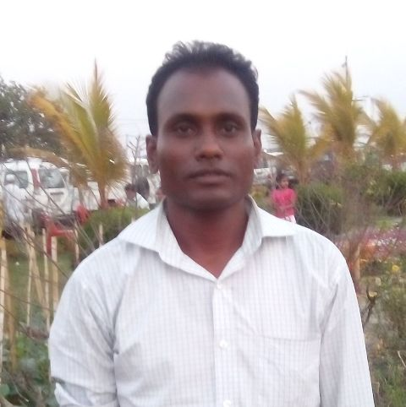
IDENTITY
Kallan Baran Sikder
Assistant Teacher(HRT)
Panchagram High School.
Lesson
ENGLISH GRAMMAR
TENSE
CLASS : Six

Slide 3
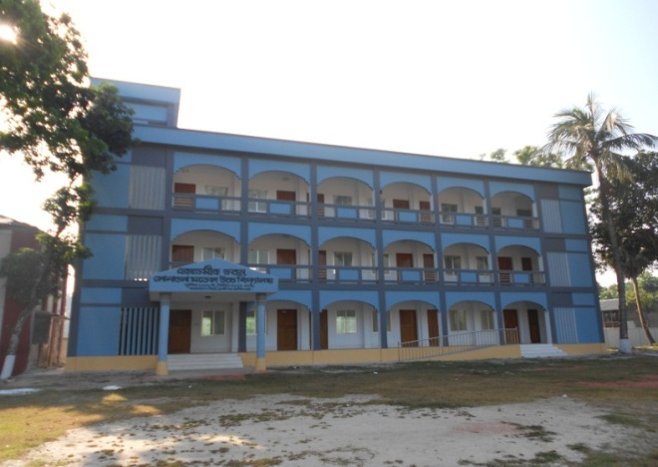
Look at the pictures and try to make Present, Past and Future Tense
I read in this school.
I was a student of this school.
I shall read in this school.
Notes:
At first pictures will be shown. Teacher can try to elicit the answer from the students. Then he/she can give feedback by clicking.

Slide 4
Again try to say their view.
I read in this
school.
I was a student of this school.
I shall read in this school.
T. Yes, Thanks a lot.
T. Do you know what does indicate the time of action.
S. Excuse me sir, It may be TENSE.
My dear students do you imagine what do have they expressed ?
S. Sir, I mean they have expressed the time of action.
Notes:
At first pictures will be shown. Teacher can try to elicit the answer from the students. Then he/she can give feedback by clicking.

Slide 5
So our today`s topic is TENSE
LESSON DICLARATION

Slide 6
LEARNING OUTCONES
After completing this lesson students will be able to
say how many kinds of Tense.
More classification of Tense.
Make correct sentence according to different rules of Tense.
Re-write sentences or passage present to past of future Tense.

Slide 7
DEFINITION AND CLASSIFICATION
Can anyone say the definition and classification of Tense.
Tense is the change of form in a verb to express the time of action.
There are three kinds of Tense.
They are : 1. Present Tense
2. Past Tense
3. Future Tense
Notes:
At first pictures will be shown. Teacher can try to elicit the answer from the students. Then he/she can give feedback by clicking.

Slide 8
Have there any more kinds of Tense ?
MORE CLASSIFICATION
Again these TENSES have divided into four forms.
They are : 1. Indefinite
2. Continuous
3. Perfect
4. Perfect Continuous
Notes:
. Teacher can try to elicit the answer from the students. Then he/she can give feedback by clicking.

Slide 9
Structure of Present Tense
Indefinite | Continuous | Perfect | Perfect continuous
Sub + main verb + obj | Sub + am,is, are + verb + ing | Sub + have/has+ past participle of verb`s | Sub + has been/have been + Verb + ing + since/ for
Now try to make four sentences according to above structure.
I eat rice.
I am eating rice.
I Have eaten rice.
I have been eating rice for one hour.
Notes:
Teacher can try to elicit the answer from the students. Then he/she can give feedback by clicking.

Slide 10
Structure of Past Tense
Indefinite | Continuous | Perfect | Perfect continuous
Sub + past form of verb + obj | Sub + was/were + verb + ing | Sub+ had + past participle of verb`s | Sub + had been +Verb + ing
Now try to make four sentences according to above structure.
I ate rice.
I was eating rice. We were eating rice.
I had eaten rice before the bell rang.
I had been reading in the primary school for 5 years.
Notes:
Teacher can try to elicit the answer from the students. Then he/she can give feedback by clicking.

Slide 11
Structure of Future Tense
Indefinite | Continuous | Perfect | Perfect continuous
Sub + shall/will + verb + obj | Sub + shall be / will be + verb + ing | Sub + shall have / will have + past participle of verb`s | Sub + shall have been/will have been + Verb + ing + since/ for
Now try to make four sentences according to above structure.
I shall eat rice.
I shall be eating rice.
I shall have eaten rice/ We will have eaten rice.
I shall have been reading in this school for 5 years.
Notes:
Teacher can try to elicit the answer from the students. Then he/she can give feedback by clicking.

Slide 12
INDIVIDUEL WORK
Make three sentences according to above picture:
Present Tense: …………………………………
Past Tense: ……………………………………
Future Tense: ……………………………………
Notes:
Teacher can try to elicit the answer from the students. Then he/she can give feedback by clicking.

Slide 13
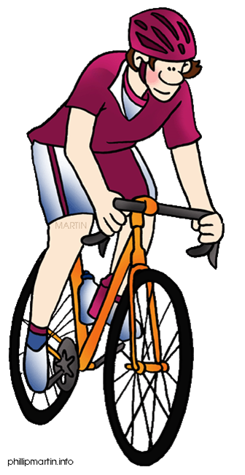
PAIR WORK
Fill in the gaps with the right from of verbs.
Read | Play | Go | Drink | love
Saad (a) ------------- in class six. He (b) -------- to school yesterday. He does not (c) --------- cricket. (d) Do you --------- milk everyday ? We should (e) ----------- our country.
Ans: (a) reads (b) went (c) play (d) drink (e) love
Notes:
Teacher can try to elicit the answer from the students. Then he/she can give feedback by clicking.

Slide 14
Group Works
Change the following sentences according to direction.
1. Sayeed reads in class one. ( present continuous tense).
2. Mother is cooking rice for us. ( Past continuous tense).
3. Father went to Dhaka. ( Present perfect tense).
4. They are playing cricket. ( Present perfect continuous tense).
5. Sadiya drinks milk everyday. ( make it negative).
Notes:
Teacher can try to elicit the answer from the students. Then he/she can give feedback by clicking.

Slide 15
HOME WORK
Make a chart of Tense.
Notes:
TEACHER CAN GIVE SOME INSTRUCTIONS TO DO THE HOME WORK.

Slide 16
THE END.

