Slide 1
Welcome

Slide 2
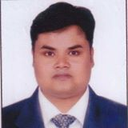
Teacher’s Identity
Md.Nasir uddin (Bahar)
Assistant teacher (English)
MA(English),MED
Jamila khatun Chowdhury High school
Mobile:01817204698
E-mail:nasiru141986@gmail.com

Slide 3
Follow the sentences
What type of sentences are these?
What type of sentences are these?
Only you can call me.
Alone he will go there.
He is not a regular student.
None can avoid death.
So today we are going to learn how to change affirmative to negative and vice versa.

Slide 4
Learning outcomes
Ss can be able to-
Format affirmative sentences
Format negative sentences.
Change affirmative to negative.
Change to negative to affirmative

Slide 5
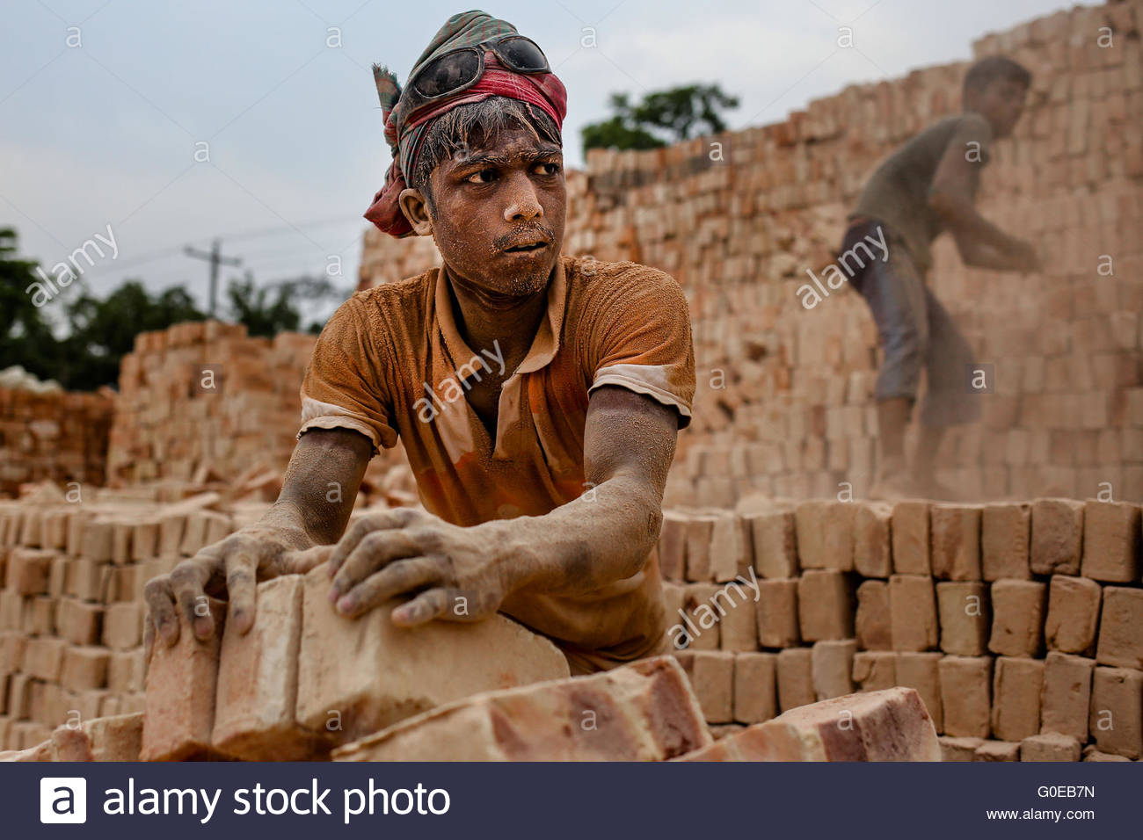
Affirmative to Negative
he can do the work.
= he can do the work.
Only
None but

Slide 6
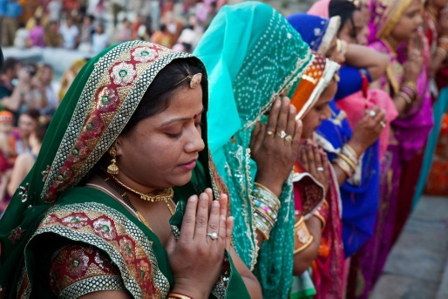
2. Allah can help us.
= Allah can help us.
Only
None but

Slide 7
For practice
Only he can play well.
Alone you are permit to go.

Slide 8
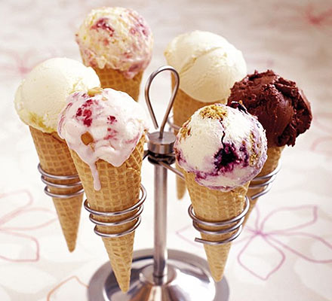
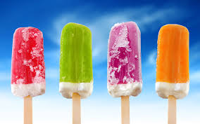
He likes Ice-cream.
= He likes Ice-cream.
Only
nothing but

Slide 9
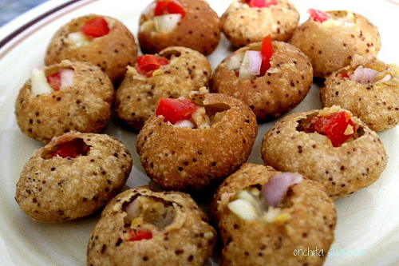
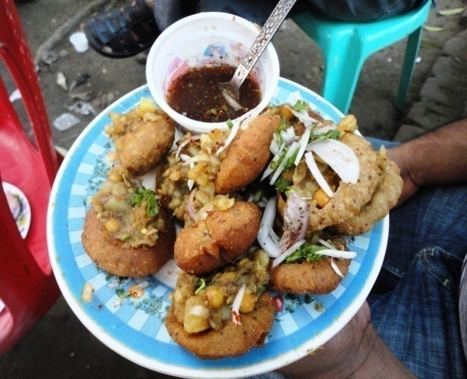
2. He likes Fusca.
= He likes Fusca
Only
nothing but

Slide 10
For practice
I like to eat only Junck food.
He likes to drink only milk.

Slide 11
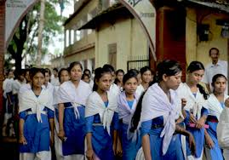
1. They are 13 years old
= They are thirteen years old.
Only
not more than

Slide 12
2. It is 50 kg.
= It is 50 kg
Only
50 Kg
not more than

Slide 13
For practice
I am only 15 years old.
It is only 25 kg.

Slide 14
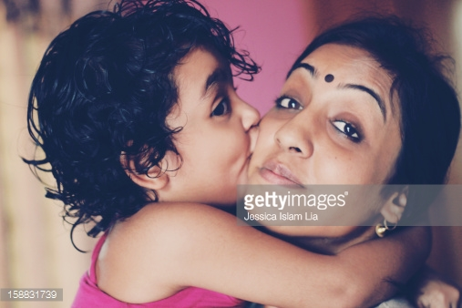
We love our mother.
= we love our mother.
must
cannot but
Apurba Kumar Basu (Facilitator in English) (BA honours MA in English, BEd 1st class)

Slide 15
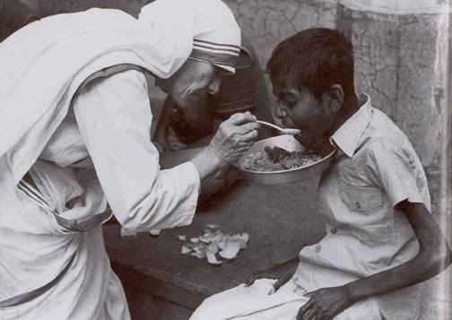
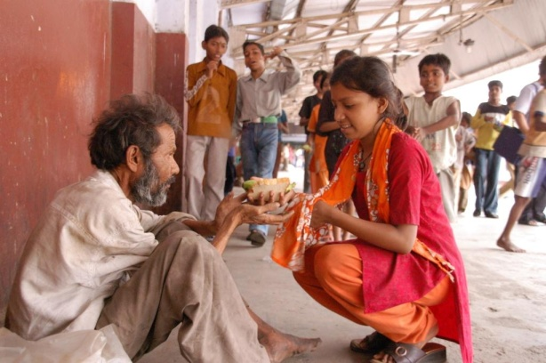
You help the poor.
= you help the poor
must
Cannot but

Slide 16
For practice
1.Every man must die.
2. Every one must present there.

Slide 17
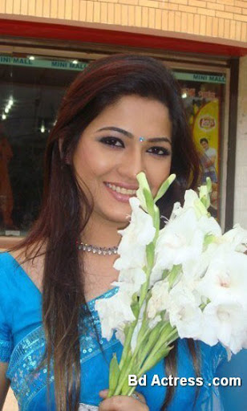
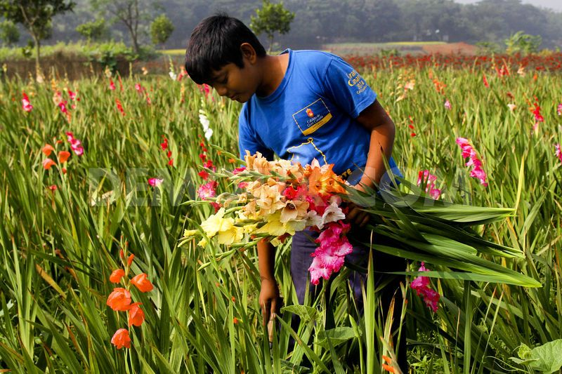
loves flower.
= loves flower. Or There is no none but loves flower.
Everybody
There is nobody but
Apurba Kumar Basu (Facilitator in English) (BA honours MA in English, BEd 1st class)

Slide 18
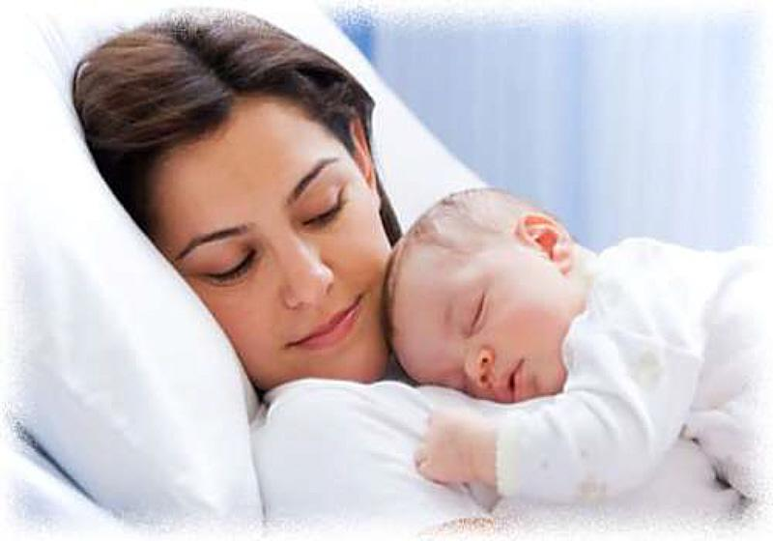
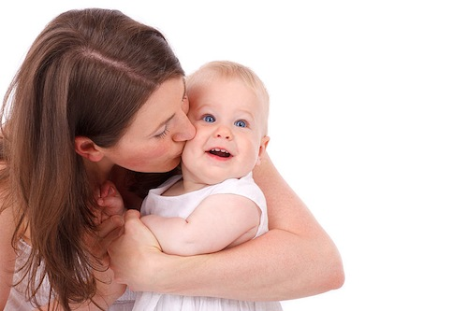
mother loves her child
= m mother but loves her child
Every
There is no
MD.Nasir uddin

Slide 19
For practice
Every one likes to play.
Every sister likes her brother.

Slide 20
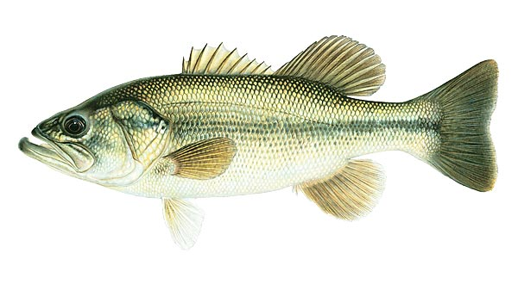
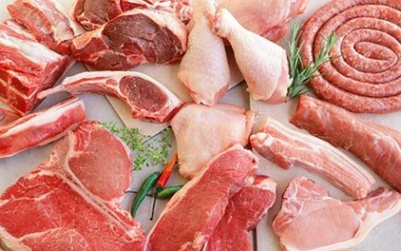
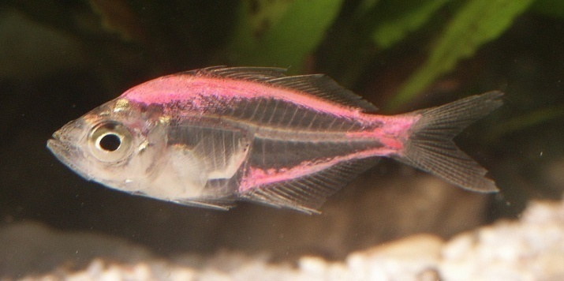
I like meat fish.
= I like meat fish.
both
and
not only
but also

Slide 21
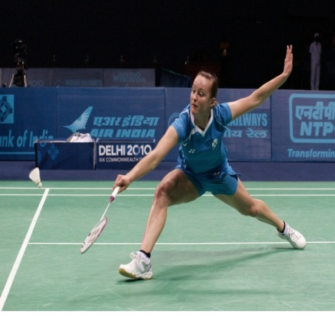
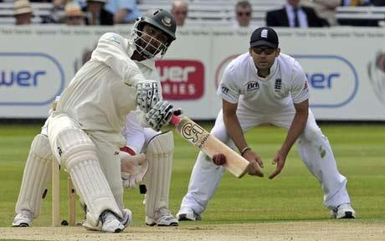
I like to play badminton cricket
I like to play badminton cricket.
both
and
not only
but also

Slide 22
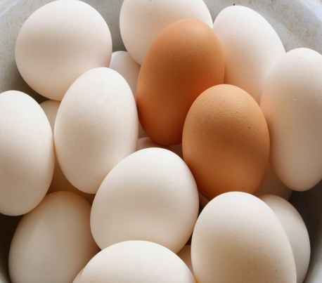
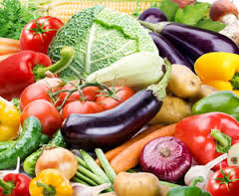
I want to eat egg vegetable.
= I want to eat not only egg vegetable.
and
but also

Slide 23
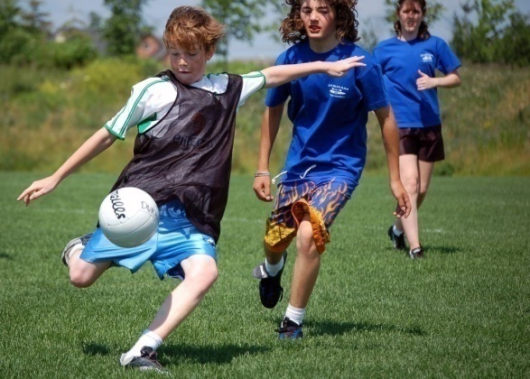
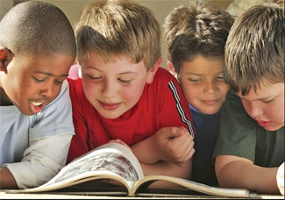
They like playing reading.
=They like not only playing reading.
And
but also

Slide 24
For practice
I like to eat butter and ghee.
They like to play cheese and ludu
They like games and sports.

Slide 25
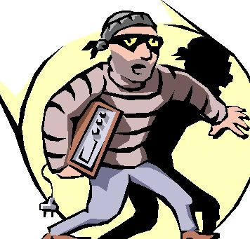
the thief saw the police he ran away.
= the thief seen the police than he ran away.
As soon as
,
No sooner had

Slide 26
Form some groups and change the sentences as directed-
We must obey our parents.( Neg)
None but he can deny the matter. (Affirmative)
They like to play nothing but cricket. (Affirmative)
I like both banana and apple. (Neg)
No sooner had I reached the station than the train left. (Affirmative)

Slide 27
Thank you.

