Slide 1
Welcome
Notes:
Welcome slide

Slide 2
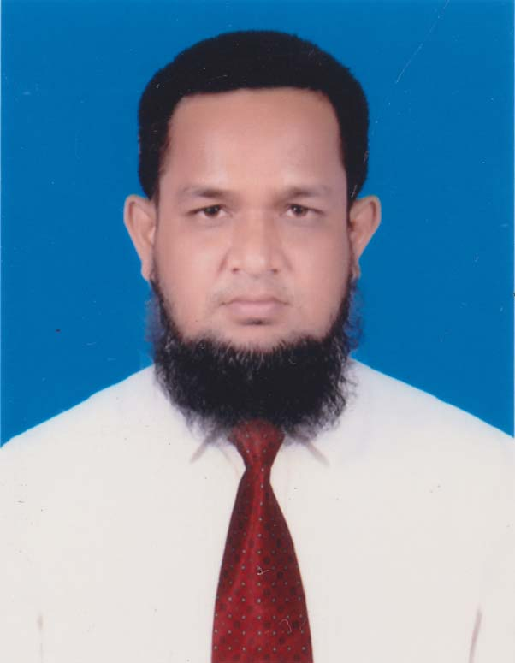
Presented
By
MD.ABDUR ROUF
Lecturer of English Khalna Islamia Fazil(Degree) Madrasah,Patnitala,Naogaon. Mob:01767650169 Email:rouf301285@gmail.com
Presentation made for
Class:Alim
Notes:
Introduction of the teacher & class.

Slide 3
An apple is eaten by John.
John eats an apple.
An apple
John
An apple
John
Notes:
Suspension 1 to lead the lesson.

Slide 4
I say my prayer regularly.
My prayer
is said
by me
regularly.
What is it related to?
Notes:
Suspension 2 to lead the lesson.

Slide 5
Voice change
Let us discuss about voice
change in our today’s class.
Notes:
Lesson declaration

Slide 6
Learning outcomes
After studied this lesson, we will be able to---
identify the definition of voice
identify the classification of voice
identify the structure s of active and passive voice
change voice from active to passive
Notes:
Basic rules of voice change will be taught from this content.

Slide 7
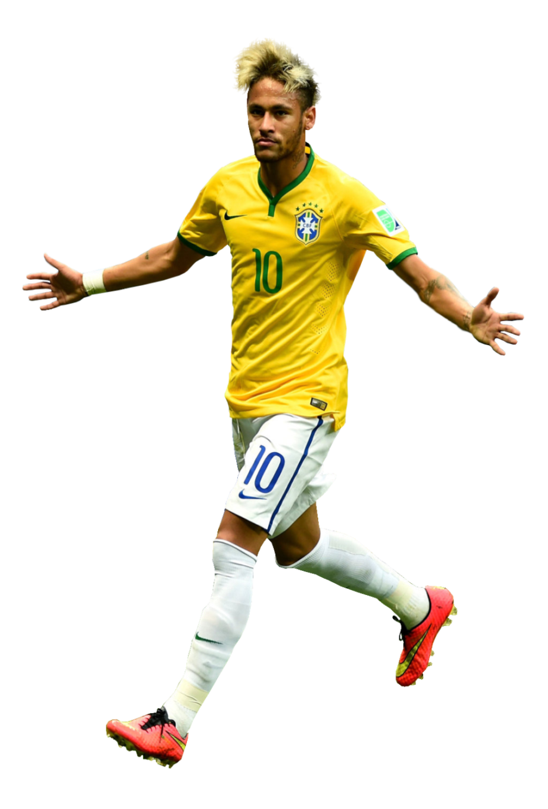
What is voice?
So, Voice is a formation of verb by which subject
does something itself or something is done by subject.
Neymar plays football.
Football is played by Neymar.
Notes:
Delimitation of the voice

Slide 8
Voice is classified into two kinds
Active voice
Passive voice
When the subject does
something itself.
When something is
done by the subject.
Notes:
Classification of voice is focused in this slide.

Slide 9
Active voice
Structure:
Subject
+
Verb transitive
+
object
He reads a book.
Verb
transitive
Subject
object
Notes:
Formation of active voice with example.

Slide 10
Passive voice
Subject of object
object of subject
+
Auxiliary verb
+
v₃
+
by/to/for
+
The book is read by him.
Subject of object
AV
V₃
by
Object of subject
He reads the book.
Subject
Verb transitive
object
Notes:
Formation of passive voice with example.

Slide 11
List of some subjects and their objects
Subject | object
I | me
We | us
You | you
They | them
He | him
She | her
Rahim/Karim | Rahim/Karim
The pen | the pen
Animals | animals
Notes:
Basic of all grammar items.

Slide 12
Auxiliary verbs of passive voice
If the active voice is- | Auxiliary of passive voice will be--
Present indefinite tense | am/is/are
Present continuous tense | am being/ is being/are being
Present perfect tense | have been/ has been
Present perfect continuous tense | have been being/ has been being
Past indefinite tense | was/ were
Past continuous tense | was being/ were being
Past perfect tense | had been
Past perfect continuous tense | had been being
Future indefinite tense | shall be/ will be
Future continuous tense | shall be being/ will be being
Future perfect tense | shall have been/will have been
Future perfect continuous tense | shall have been being/ will have been being
Modal verbs (can/ should/ must/ may etc) | can be/should be/must be/may be etc
Notes:
Fundamental items of voice change.

Slide 13
Active to passive
Assertive sentence.
He pulls a rickshaw (make it passive).
A rickshaw is pulled by him.
We should respect a rickshaw puller (Make it passive)
A rickshaw puller should be respected by us.
Notes:
How to change from active to passive shown here.

Slide 14
The fisherman is catching fish. (Make it passive)
Fish is being caught by the fisherman.
Notes:
Practice on changing into passive from present continuous tense.

Slide 15
Activities
Transform the sentences into passive voice
I visited the Nayagra waterfall last year.
Many people enjoy the waterfall all the year round.
The waterfall makes a beautiful view.
You may enjoy it if you want.
I will visit it again.
Notes:
Class work according to previous slides.

Slide 16
Let us know the voice change of double object.
He teaches us English.
Sub
Verb transitive
Obj
Obj
(us) = indirect object
Double object
(English) = direct object
Note: You can use any object as the subject of passive voice.
Notes:
Indirect object we mean man/woman that sit before direct object. Direct object we mean other than man/woman (object)

Slide 17
Let’s practice
He teaches us English.
We are taught English by him.
English is taught us by him.
Now try to change it into passive voice.
He gave me a book.
I taught him a lesson.
They feed me fruits.
We made him captain.
She informed me this.
Notes:
Practice on double object.

Slide 18
Passive voice of silent infinitive
I told him do this.
Sometime Infinitive remains silent in the active voice
He was told to do this by me.
Infinitive must be shown in
the passive voice
Notes:
How to change into passive voice from silent infinitive.

Slide 19
Class activities
Change the active voice into passive voice.
He advised me tell the truth.
They elected him go there.
He ordered Rahim solve it.
The bird made the wind blow.
The teacher told him do the sum.
Notes:
Practice or evaluation.

Slide 20
Exception-1
If the active voice is with reflexive pronoun--
Subject + auxiliary verb + v₃ +by + reflexive pronoun
She fans herself.
She is fanned by herself.
He killed himself.
He was killed by himself.
Note: If there is reflexive pronoun as object of the sentence, subject and object will not be changed to make it passive.
Notes:
How to change into passive from reflexive pronoun.

Slide 21
Exception-2
If the active voice is with quasi-passive verb-
Subject + auxiliary verb + v₃ +adjective
The rose smells sweet.
The rose is smelt sweet.
The sight looks charming.
The sight is looked charming.
Note: If there is an adjective after the verb of the sentence, subject and adjective will not be changed in the passive voice
Notes:
How to change into passive with quasi-passive active voice.

Slide 22
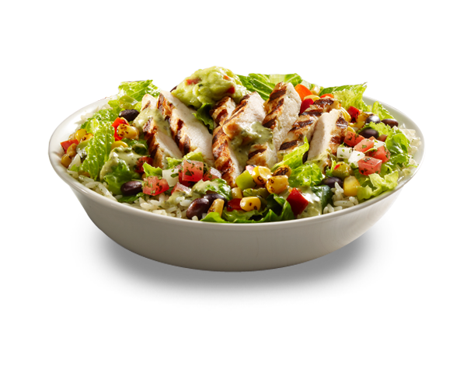
Class activities
Change the active voice into passive voice.
Honey tastes sweet.
The pill tastes bitter.
The food looks delicious.
The man seems strong.
The sky appears blue.
Notes:
Evaluation/Practice.

Slide 23
Thanks of All.
Notes:
Ending slide.

