Slide 1
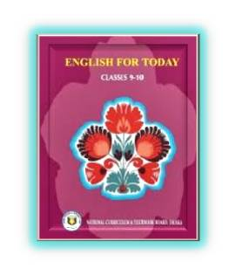
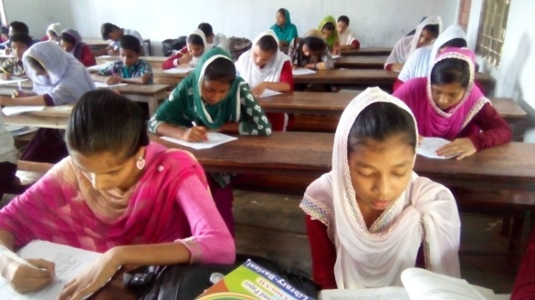
Wellcome

Slide 2
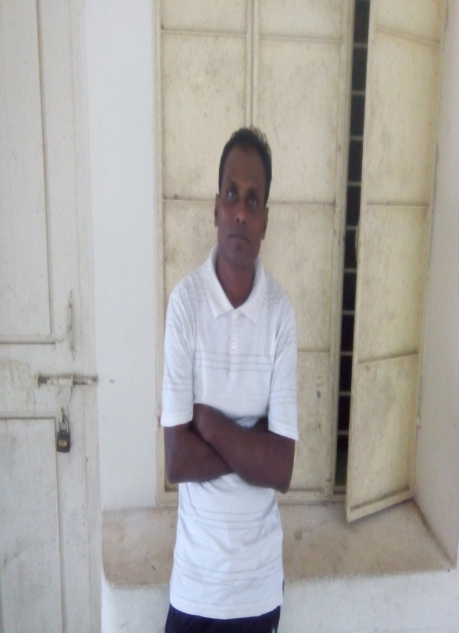
Kallan Baran Sikder
Asst. Teacher
Panchagram Secondaey School
E-mail: kbs.net001@gmail.com
01717098584
Class-Nine/ Ten
Subject: English 1ST paper
Unite: 07
Lesson:04 &05

Slide 3
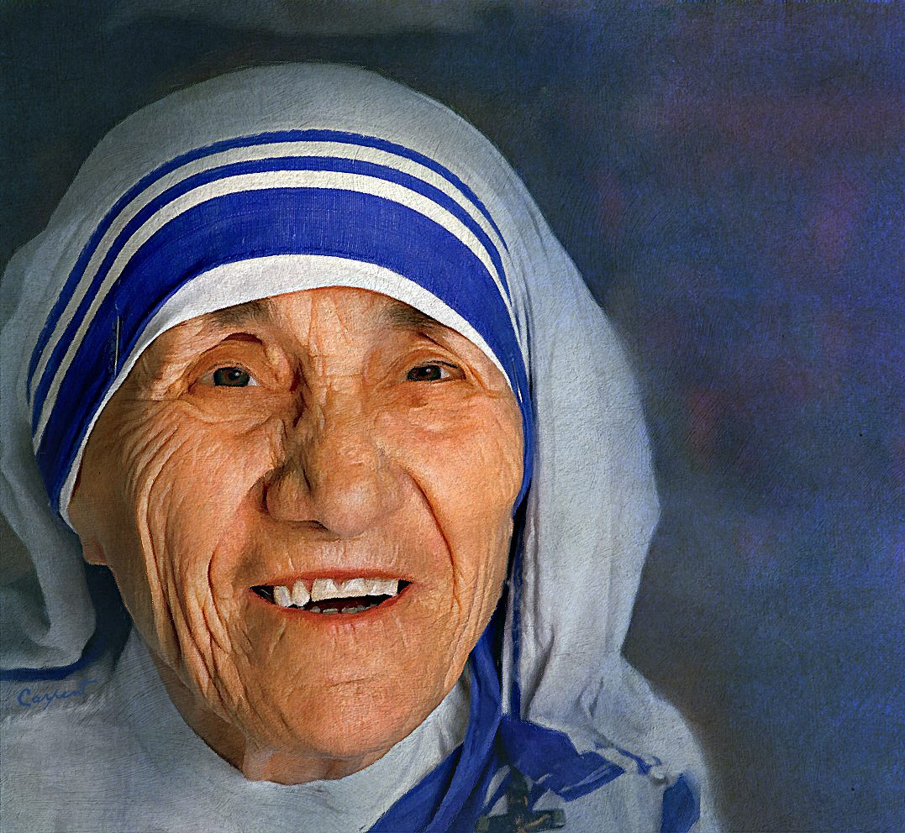
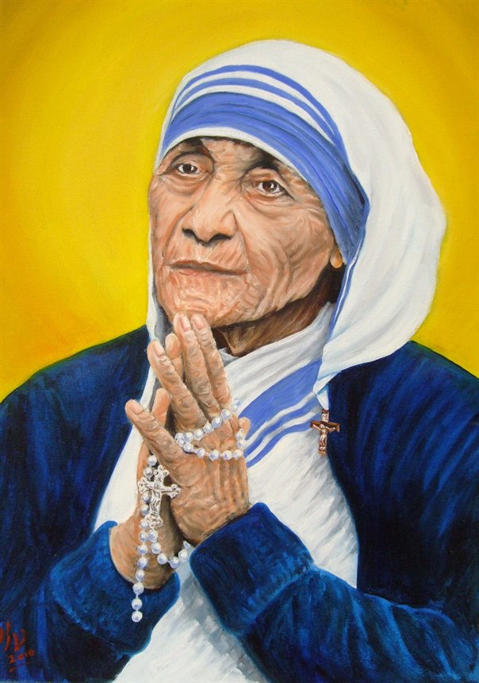
Who is this person?
Mother Teresa

Slide 4
Look at the pictures & say
Mother Teresa’s childhood pictures
So , childhood pictures refer to her beginning life

Slide 5
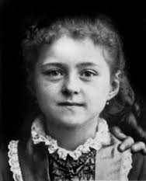
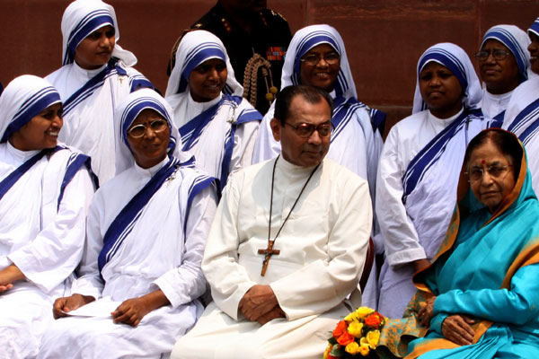
Today’s lesson
The beginning and the Missionary

Slide 6
Learning outcomes
At the end of the lesson ,the students will be able to-
talk about the pictures.
short describe of Mother Teresa’s early life.
ask & answer the question.
Complete the chart
give answer of MCQ.

Slide 7
Silent Reading

Slide 8
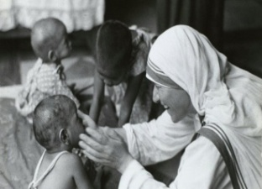
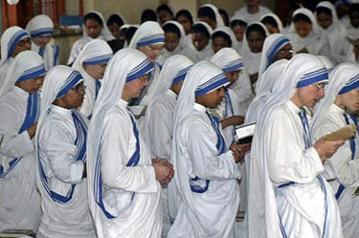
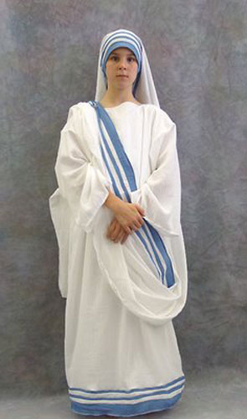
Vocabulary
humanity
mankind/manhood
missionary
preacher/propagandist,
virgin
maiden/vestal,

Slide 9
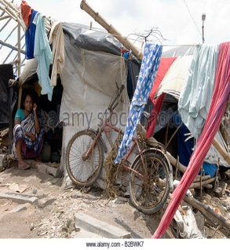
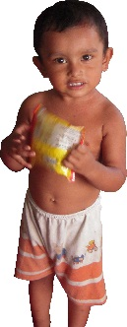
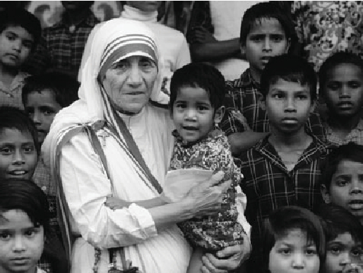
hick/over-populated
slums
Very small
Tiny
Nun
a woman living in a female religious community who was promised to serve God all her life

Slide 10
Let’s watch a video.

Slide 11
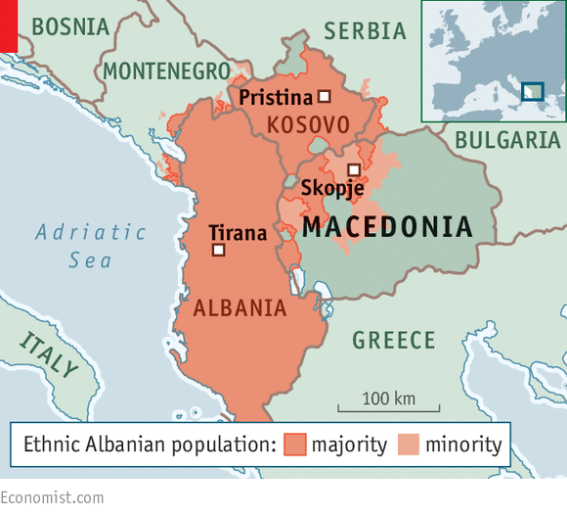
What do you see in the picture?
Where is situated in Skopje?
see a world map.
Skopje is situated in Macedonia.

Slide 12
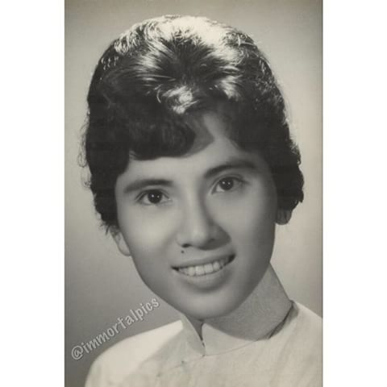
Early life
Born in Skopje.
Born: August 26,1910.
Albanian descent.
At the age of 18,left home.
Joined an Irish community
Nuns called Sisters of Loreto
Early life of Mother Teresa’s.

Slide 13
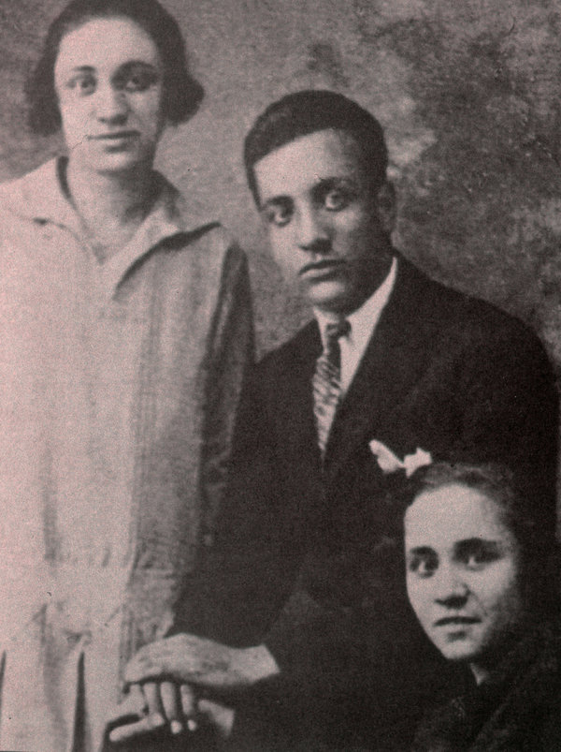
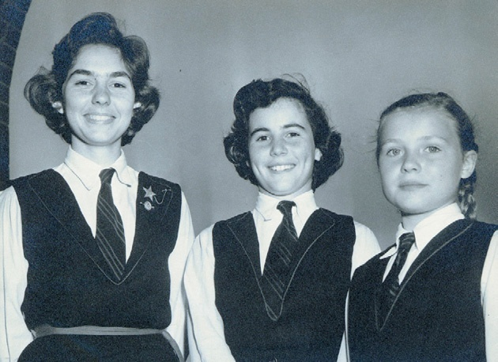
What do you see in the pictures?
Mother Teresa with her parents.
three siblings

Slide 14
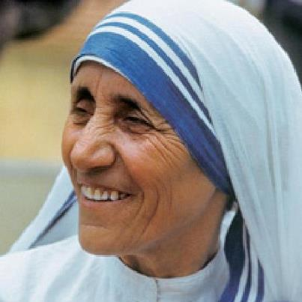
Talking who is she?

Slide 15
Individual work
a. Where was she born?
Ans: She was born Albanian descent, small town called Skopje , Macedonia.
b. When did she leave her parental home?
Ans: At the age of 18 she left her parental home.
c. In which season was Mother Teresa born?
Ans: Mother Teresa was born in Autumn.

Slide 16
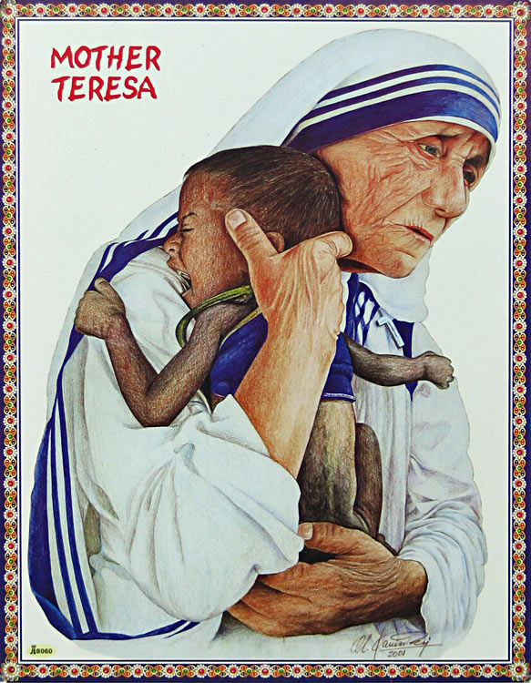
What are you looking in the picture?
Humanity

Slide 17
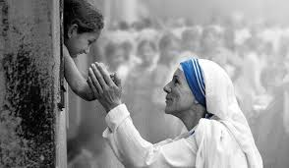
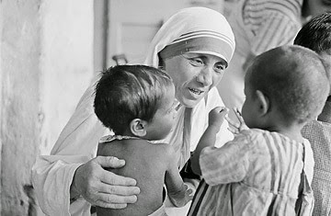
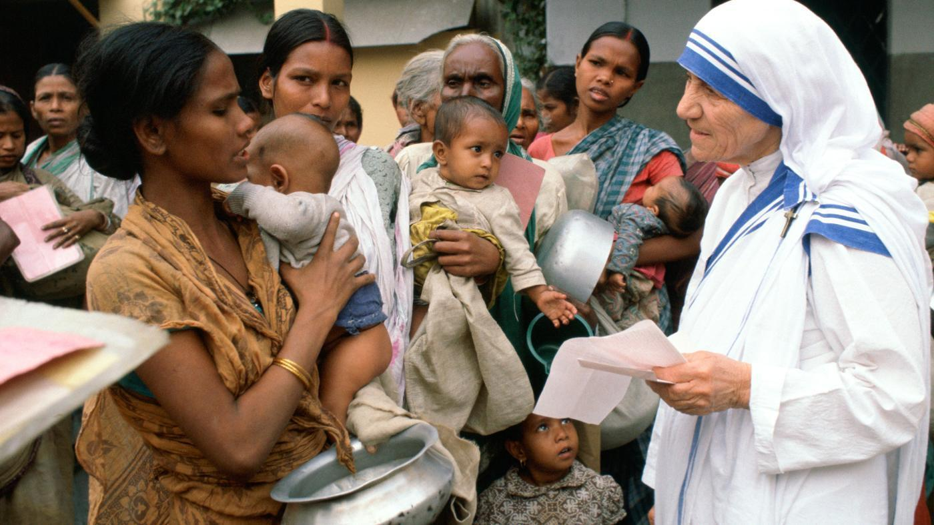
Mother Teresa’s humanity for the children
Those who were poorest & orphan

Slide 18
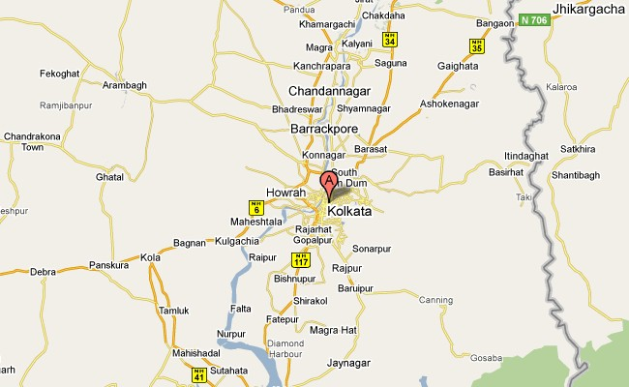
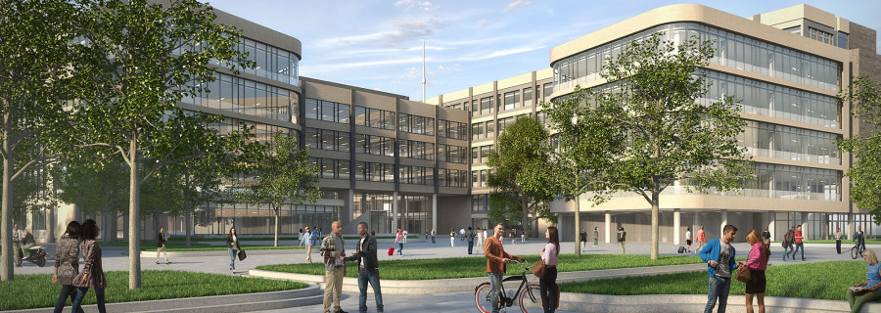
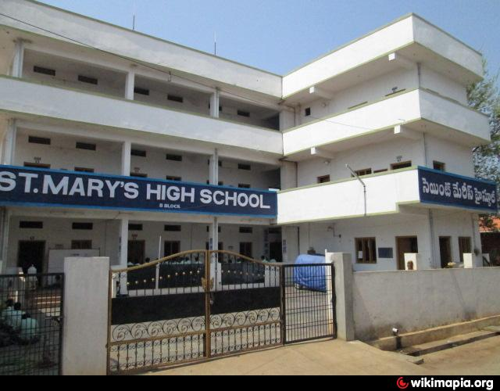
Where did she come back after training?
What is the name this Institute ?
Where did she teach geography & theology?
Came to India in Kolkata.
Institute of the Blessed Virgin Mary in Dublin.
Mother Teresa taught geography & theology St. Mary’s High school in kolkata,1931 to 1948.

Slide 19
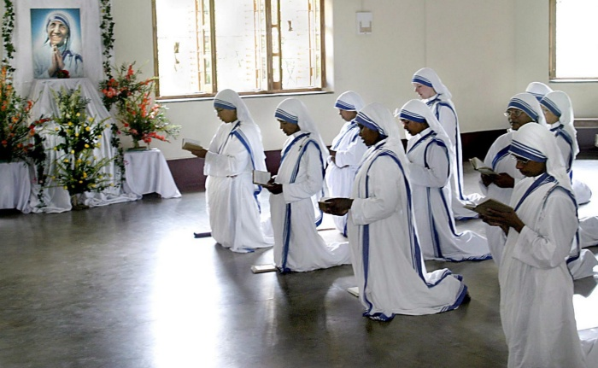
When did she take her initial vows as a nun?
She took her initial vows as a nun on May,1931.

Slide 20
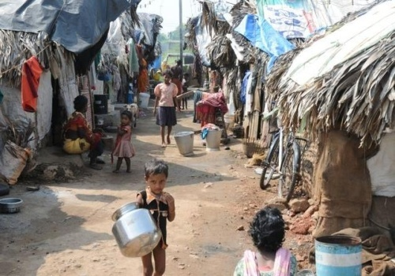
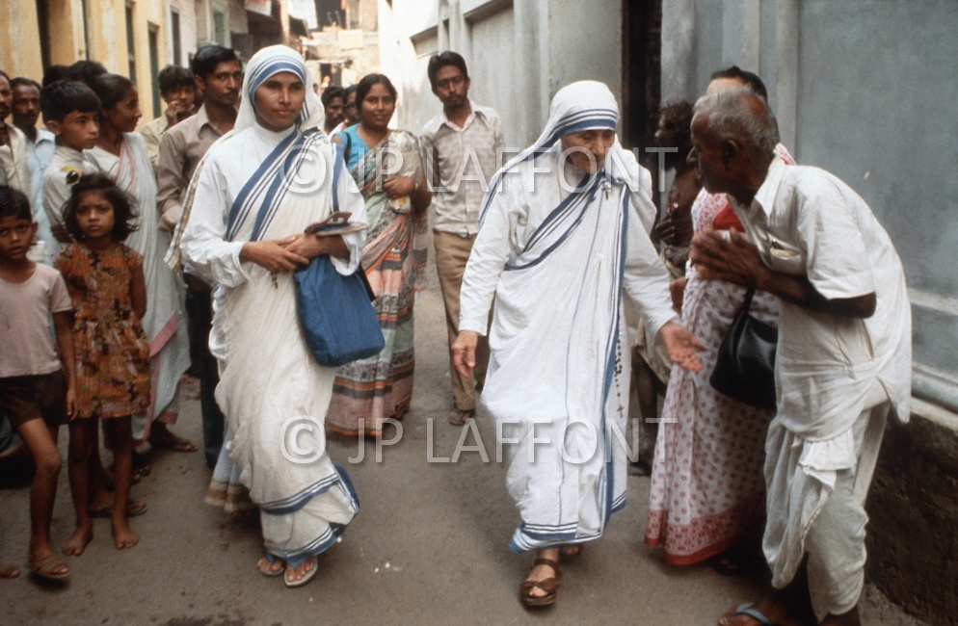
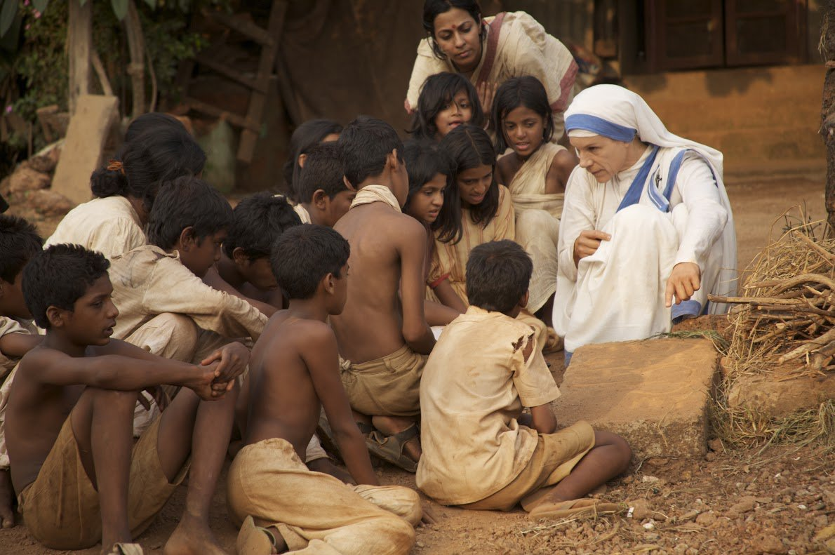
Mother Teresa worked among the poorest of the poor in the slums of Kolkata.
The prevailing poverty deep impact on Mother Teresa’s mind .

Slide 21
Pair work
1.What does ‘servant of humanity’ mean in the text?
Becoming a slave . b) to work in other people’s house.
c) To be oppressed . d) to serve the needy.
2. Mother Teresa set out to join the missionary of the Sisters of Loreto in the year------ .
a) 1927 b) 1928 c) 1929 d) 1930
3. Mother Teresa took her first vows at the age of ----- .
a) 18 b) 19 c) 20 d) 21

Slide 22
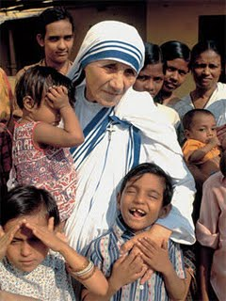
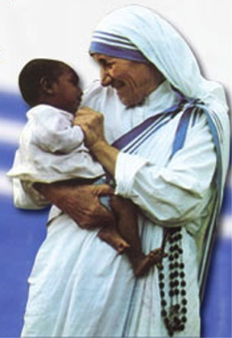
Mother Teresa’s humanity
She Protected Poorest child.
She Protected Orphan child

Slide 23
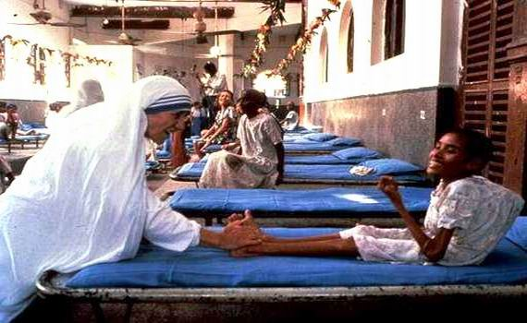
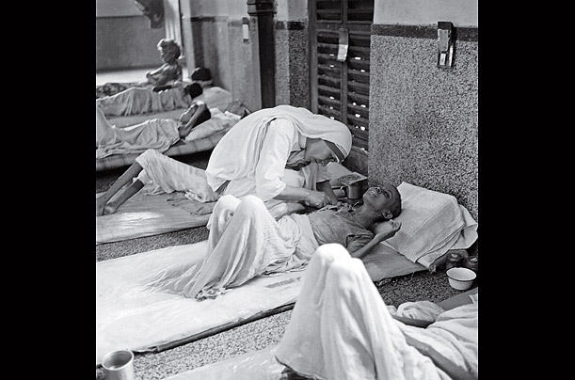
What type of people did She serve?
Destitute people

Slide 24
Fill in the chart
Group work
Dates | Events
1950 | Called the missionary of charity.
1957 | They began to work with lepers.
1970 | They continued to expand their missionaries
1979 | They worked in over twenty five countries

Slide 25
Evaluation
1.What is the real name of Mother Teresa?
2.When did Mother Teresa take her first vows?
Answer:
Agnes Gonxha Bojaxhiu
At the age of 21

Slide 26
Homework
Do you know anyone in your locality , who helps the needy and does so to make others happy? Write a short composition about him/her.

Slide 27
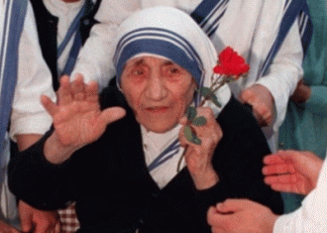
Thanks to all & keep well.

