Slide 1
Welcome

Slide 2
Introduction
Khandoker Mufakkher Hossain
Assistant Teacher (ICT)
AftabUddin School and College
Bajitpur ,Kishoregonj , Dhaka
Presentation made for
Class IX-X
English 2nd paper Grammar

Slide 3
wins the race.
slow and steady_____________

Slide 5
What are we going to discuss today?
Rules of completing sentence

Slide 6
Learning outcomes
At the end of the lesson , Students will be able to –
identify the ‘RULES ‘of completing sentence
use the rules of completing sentence
complete incomplete sentences

Slide 7
Had better / had rather, would better/ would rather এর পরে gap থাকলে শুধুমাত্র যেকোনো verb এর present form বসিয়ে gap পূরণ করতে হবে।
go.
You had better,__________

Slide 8
Wuold you mind এর পরে gap থাকলে ঐ gap এ main verb এর সাথে ing যোগ করে gap পূরণ করতে হবে।
going there?
Would you mind, ______________

Slide 9
Completing item -1
Rule 1: If + present indefinite tense -------(future indefinite tense )
If you read the book, you will get good marks in the exam.
Complete the following sentences.
If you come , ___________________.
If you sleep,_____________.
If you finish the work, ___________.
Note: Completed part must be underlined.

Slide 20
প্রবাদ বাক্যঃ
কোনো প্রবাদ বাক্যের আগের অংশ বা পরের অংশ দেওয়া থাকলে সেই প্রবাদ বাক্য অনুযায়ী gap পূরণ করতে হবে।
there is a way.
Where there is a will, _______________

Slide 25
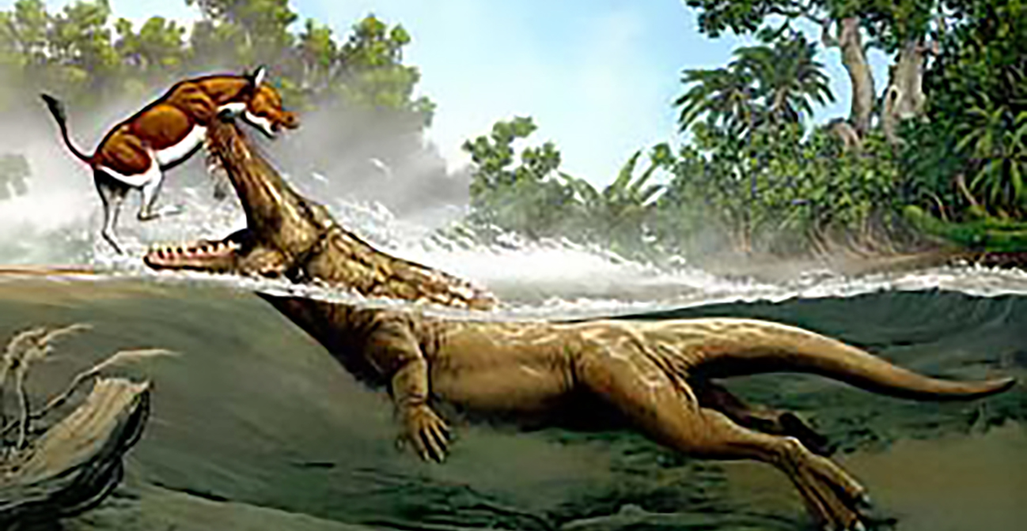
What is clotted, cannot be blotted

Slide 26
Some proverbs in Eenglish
The more you read, the more you learn.
As you so, so you reap.
No pain, no gain.
A little learning is a dangerous thing.
What is clotted, cannot be blotted
While there is life, there is hope.
Strik the iron, while it is hot.
Many men, many minds.
Something is better than nothing.
United we stand, divided we fall.
Cut your coat, according to your cloth.
A barking dog, seldom bites.

Slide 27
Some proverbs in Eenglish
The more you read, the more you learn.
As you so, so you reap.
No pain, no gain.
A little learning is a dangerous thing.
What is clotted, cannot be blotted
While there is life, there is hope.
Strik the iron, while it is hot.
Many men, many minds.
Something is better than nothing.
United we stand, divided we fall.
Cut your coat, according to your cloth.
A barking dog, seldom bites.

Slide 28
Some proverbs in Eenglish
The more you read, the more you learn.
As you so, so you reap.
No pain, no gain.
A little learning is a dangerous thing.
What is clotted, cannot be blotted
While there is life, there is hope.
Strik the iron, while it is hot.
Many men, many minds.
Something is better than nothing.
United we stand, divided we fall.
Cut your coat, according to your cloth.
A barking dog, seldom bites.

Slide 29
Complete the sentences
He ran away fast lest _________________________
Read diligently lest___________________________
The thief ran quickly lest_______________________
Go sharp lest________________________________
He came to the station quickly lest_______________

Slide 30
Continue to next content

