Slide 1
Welcome

Slide 2
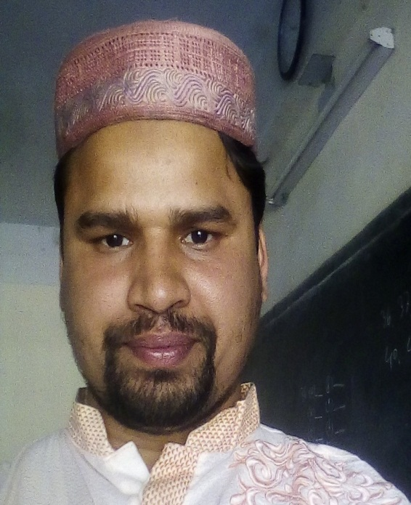
Identity
Md. Farid Uddin
Assistant Teacher
Dupchanchia D.S Fazil Madrasah
English 2nd paper
Class-VI-X

Slide 3
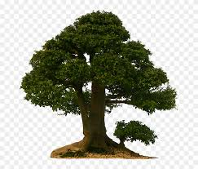
largest
larger
large

Slide 4
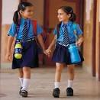
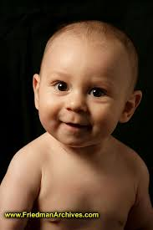
What do the pictures show in this slide?

Slide 5
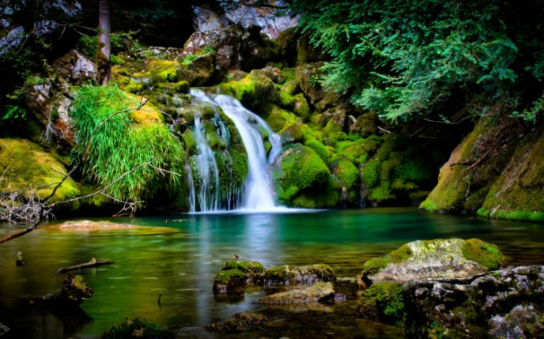
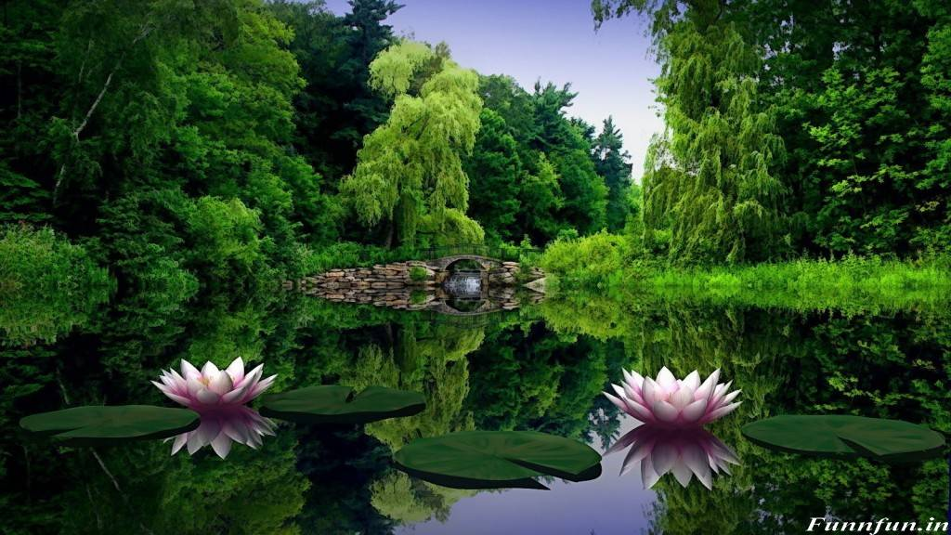
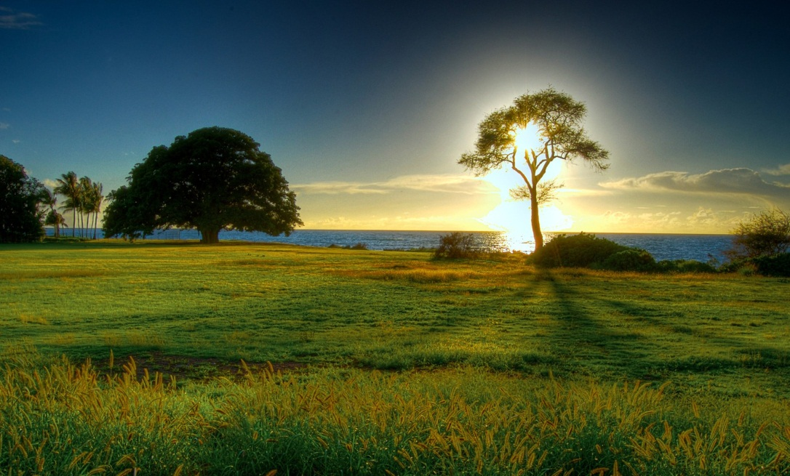
It is the most beautiful of all sceneries.
It is more beautiful than the first scenery.
beautiful
more beautiful
It is a beautiful scenery.
most beautiful

Slide 6
What are we going to discuss today?
Degree
Degrees of comparison
Unit-6 lesson-1
Notes:
Lesson declaration.

Slide 7
Learning outcomes
After completing this lesson, we will be able to---
tell the definition of degree
identify various forms of degree
apply the forms of degree in different categories

Slide 8
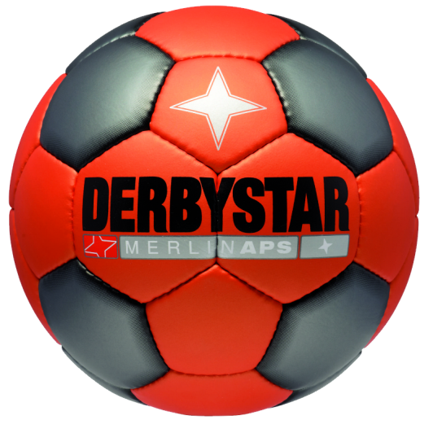
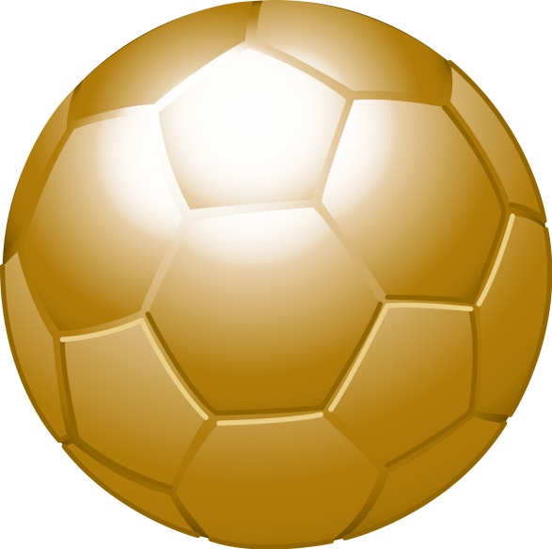
YELLOW BALL
JUBILANY
GOLDEN BALL
This is a big ball.
This ball is bigger than the yellow ball.
The golden ball is the biggest of all balls.
What is degrees of comparison?
Degrees of comparison means to compare with one, two or more persons, places and things in three forms of adjectives.

Slide 9
There are three forms of adjectives
Positive form
Comparative form
Superlative form
Basic form of adjective
Compared with other
Highest form of adjective
Notes:
Division of degree shown here.

Slide 10
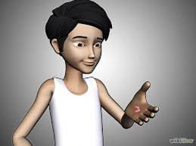
Positive degree
Lisan is a tall boy.
Structure: Subject + verb + a/an +adjective + extension.
The positive degree of an adjective is used to describe a single thing or person. It simply describes the existence of a quality.
Positive degree does not refer to any compare. It just talks about a person or thing. It is the base form of adjective. It describes a single person or thing.
Notes:
Please make the students understand the structure giving them more examples of your own.

Slide 11
Make five different sentences with the following adjectives.
nice, charming, attractive, interesting, excellent and awesome.
First one is done for you –
“This is a nice picture”
1.
2.
3.
4.
5.
Notes:
This is a part of activity on the previous slides.

Slide 12
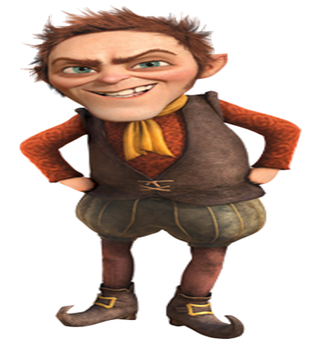
Comparative degree
Labib is taller than Lisan.
Structure: Subject + verb + comparative (er/more/less) form of adjective + than +extension.
The comparative degree is used to compare two or more things or persons. It simply describes the higher or lower quality.
Comparative degree is formed adding ‘er’ with an adjective or ‘more/less’ before an adjective when it is pronounced at least three times break.
Notes:
Please make the students understand the structure giving them more examples of your own.

Slide 13
How comparative degree is formed.
Note: If the adjective ends with ‘e’ you have to add only ‘r’ ,if the adjective ends with ‘y’ with a consonant before it, ‘y’ will be turned into ‘i’ then you have to write ‘ier.’ The adjective that ends with ‘ful’ does not take ‘er’ while changing into comparative. ‘More/less’ is then used before the word.
Notes:
Please discuss about the item in the box to clear the ideas of the students.

Slide 14
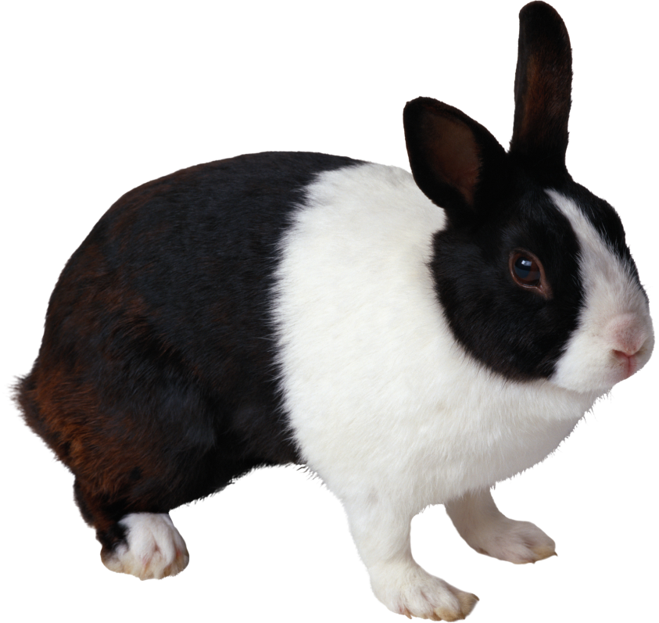
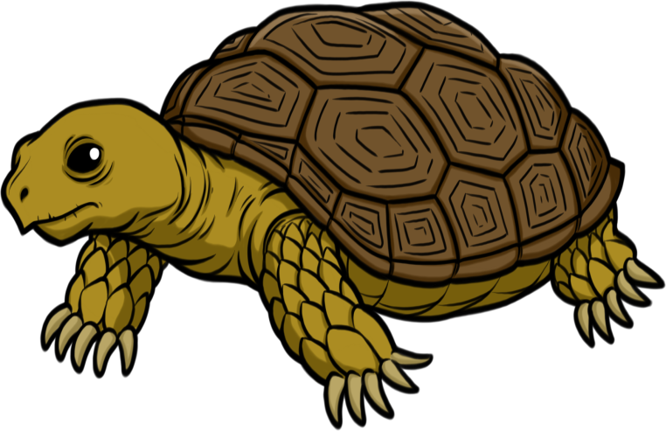
Make three comparative sentences with the following adjectives. One is with a negative.
fast , slow
Notes:
Negative: The tortoise is not faster than the rabbit.

Slide 15
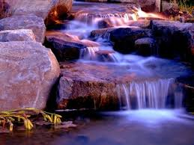
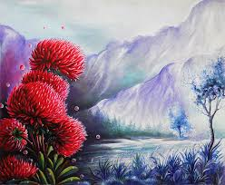
Second sight
First sight
Make a comparative sentence with ‘attractive’ with the pictures above.
The first sight is more attractive than the second sight.
Notes:
Practice on the negative use of comparative sentences. Use of ‘less’ may be shown here. “The first sight is not less attractive than the second sight.”

Slide 16
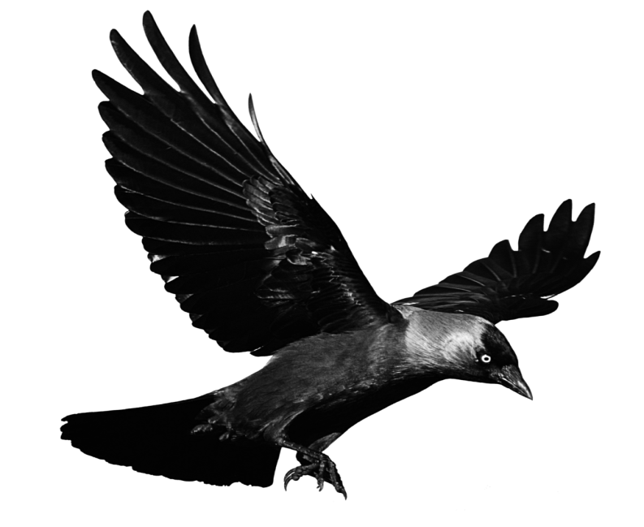
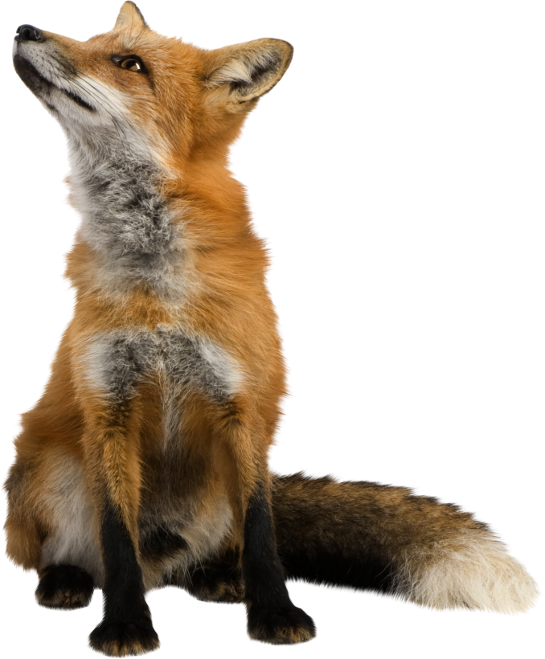
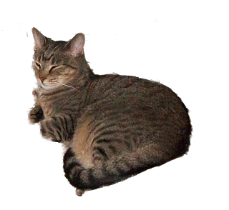
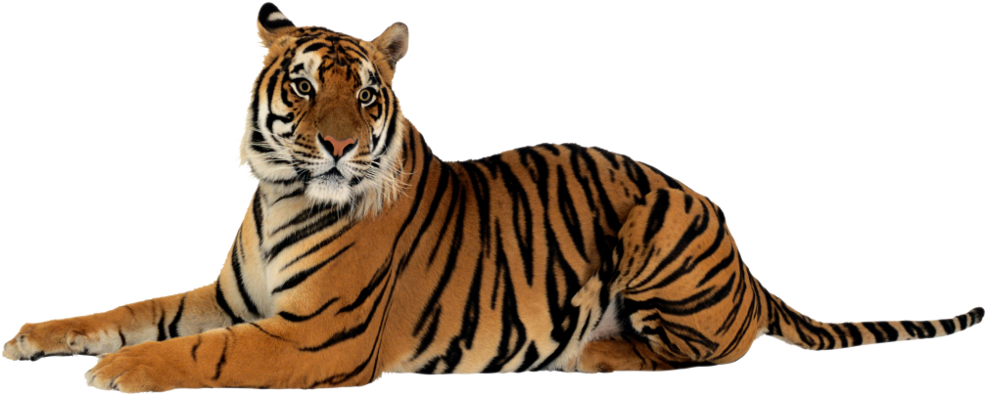
Change the sentences into comparative degree.
The bird cannot fly as fast as the plane.
The crow is as clever as the fox.
The tiger is not as small as the cat.
Notes:
Showing the pair of pictures teacher may ask the students what it is about. Then he may advance next.

Slide 17
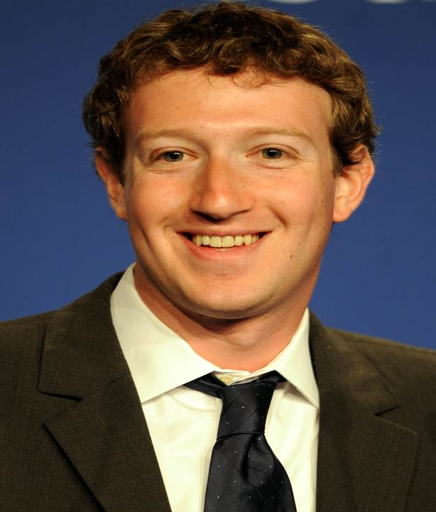
Superlative degree
Zakarbag is the tallest of all boys.
Structure: Subject + verb + the + superlative (est/most/lest)form of adjective + extension.
The superlative degree refers to the highest quality of things or persons.
Superlative degree is formed adding ‘est’ with an adjective or ‘most/lest’ before an adjective when it is pronounced at least three times break.
Notes:
Use of ‘most and lest’ is the main focus of this slide.

Slide 18
How superlative degree is formed
adjective | est /most form
small | smallest
deep | deepest
heavy | heaviest
short | shortest
intelligent | most intelligent
interesting | most interesting
Note: If the adjective ends with ‘e’ you have to add only ‘st’ ,if the adjective ends with ‘y’ with a consonant before it, ‘y’ will be turned into ‘i’ then you have to write ‘iest.’ The adjective that ends with ‘ful’ does not take ‘est’ while changing into superlative. ‘Most/lest’ is then used before the word.
Notes:
Box item is the main focusing here.

Slide 19
Exceptions
There are some adjectives which do not follow any rule and for this they are called irregular adjectives. Such as--
Positive | Comparative | Superlative
good | better | best
bad, evil, ill | worse | worst
late | later/latter | latest/last
many | more | most
much | more | most
old | older/elder | oldest/eldest
fore | former | foremost, first
Notes:
Exceptions of adjectives shown here.

Slide 20
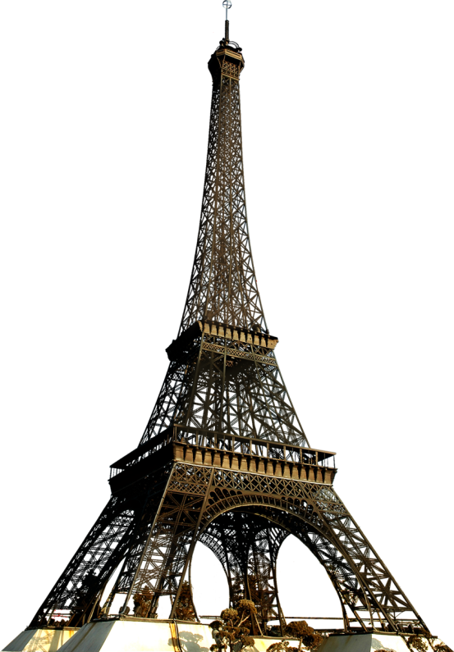
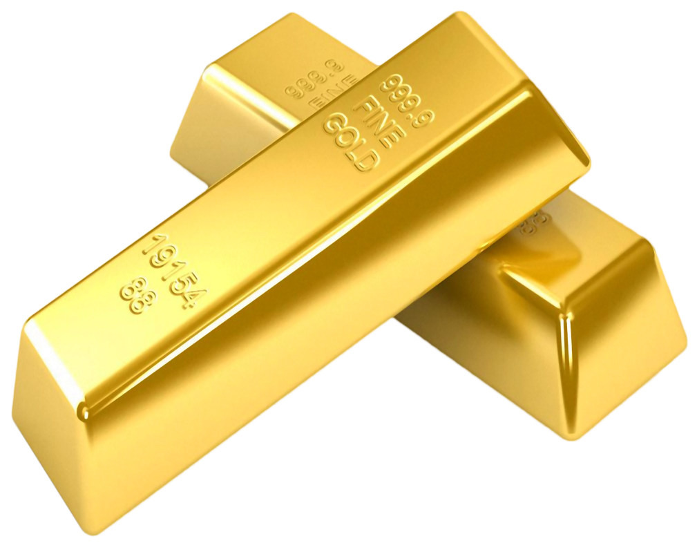
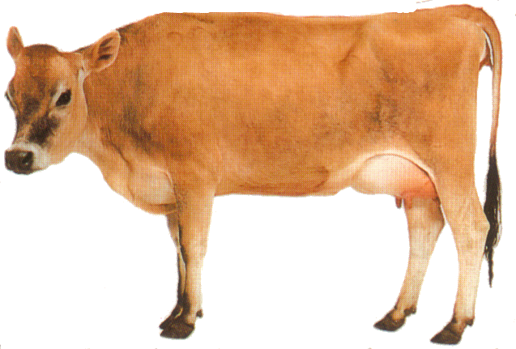
Make sentences with the pictures applying the adjectives in superlative degree.
high
precious
useful
Eifel Tower
Gold bar
The cow
Notes:
Evaluation option.

Slide 21
Change the sentences into superlative degree.
The Padma is a wide river.
The rose is better than any other flower.
The elephant is bigger than all other animals.
He is a wise man in our locality.
It is an excellent idea.
Notes:
Transformation from positive and comparative into superlative.

Slide 22
THANK YOU ALL

