Slide 1
ACTIVITY NUMBER: 05
SUBJECT: CLASSROOM DECORATION
PHOTO ALBUM OF: SHARING ACTIVITIES
School’s Name: Ranachandi School and College, Kishoreganj, Nilphamari, Bangladesh
Coordinator’s name: Ebnulhassan Tushar
E-mail: tusharbd89@gmail.com
Partner School’s Name: CARE Adopted C.D.G. Girls High School, Momin pura, Lahore, Pakistan
Coordinator’s name: Sumra Izhar
E-mail: sumraizhar@carepakistan.com
Sharing activities between Ranachandi School and College, Bangladesh and CARE Adopted C.D.G. Girls High School, Pakistan

Slide 2
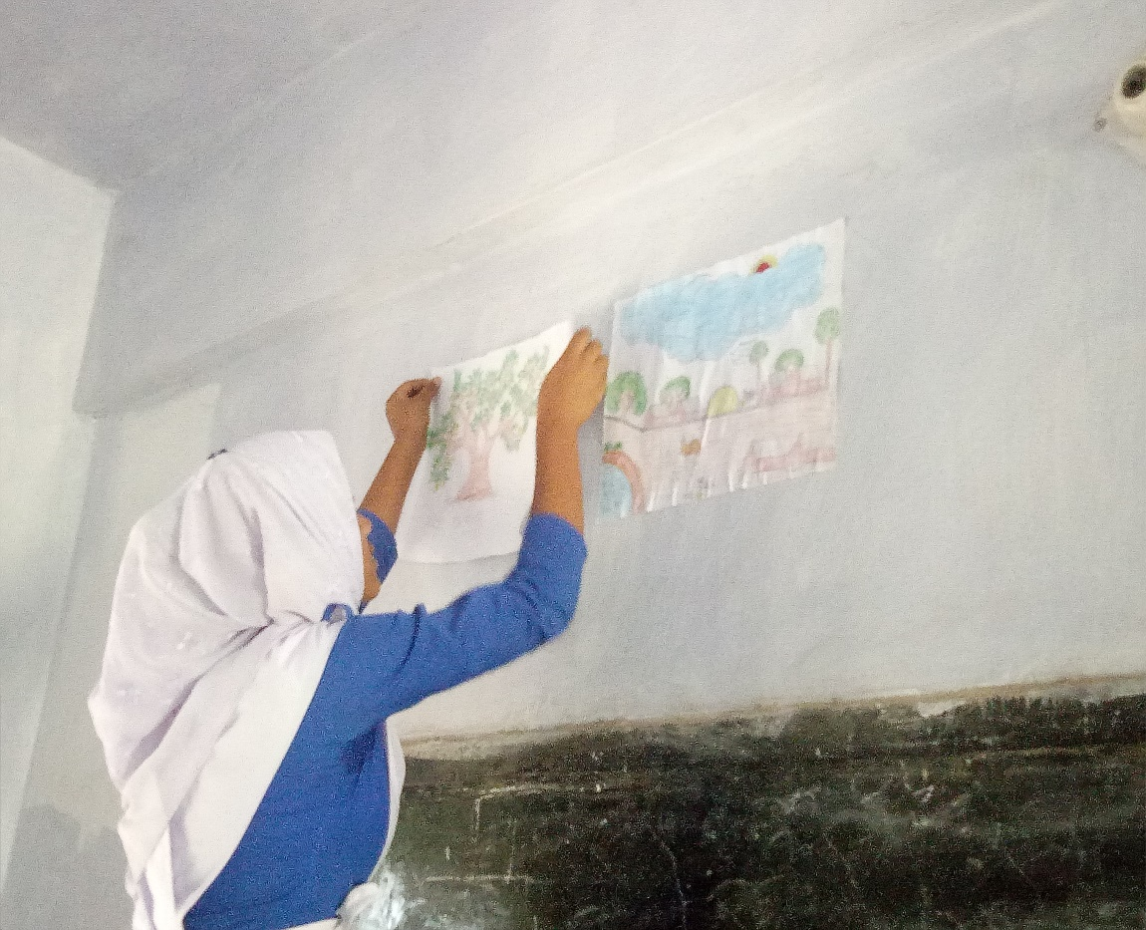
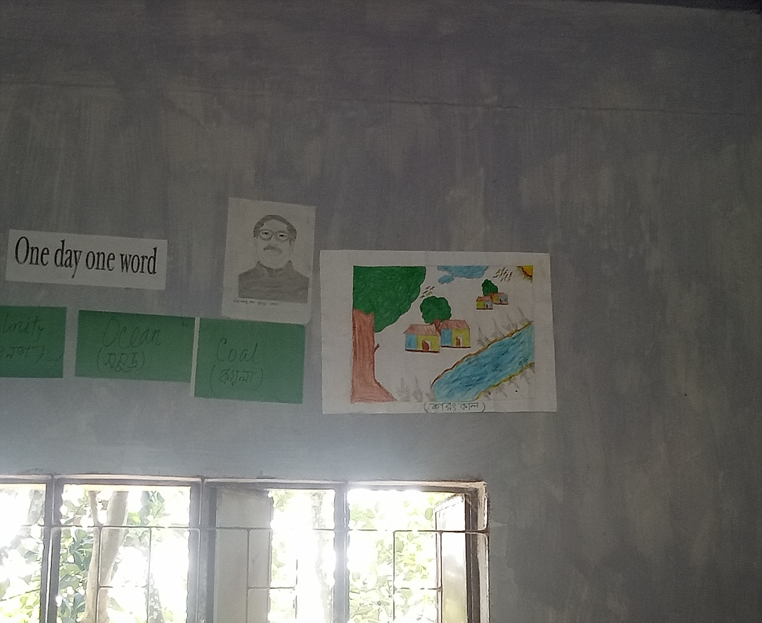
ACTIVITY NO:05 (CLASSROOM DECORATION)
SCHOOL: RANACHANDI SCHOOL AND COLLEGE, BANGLADESH

Slide 3
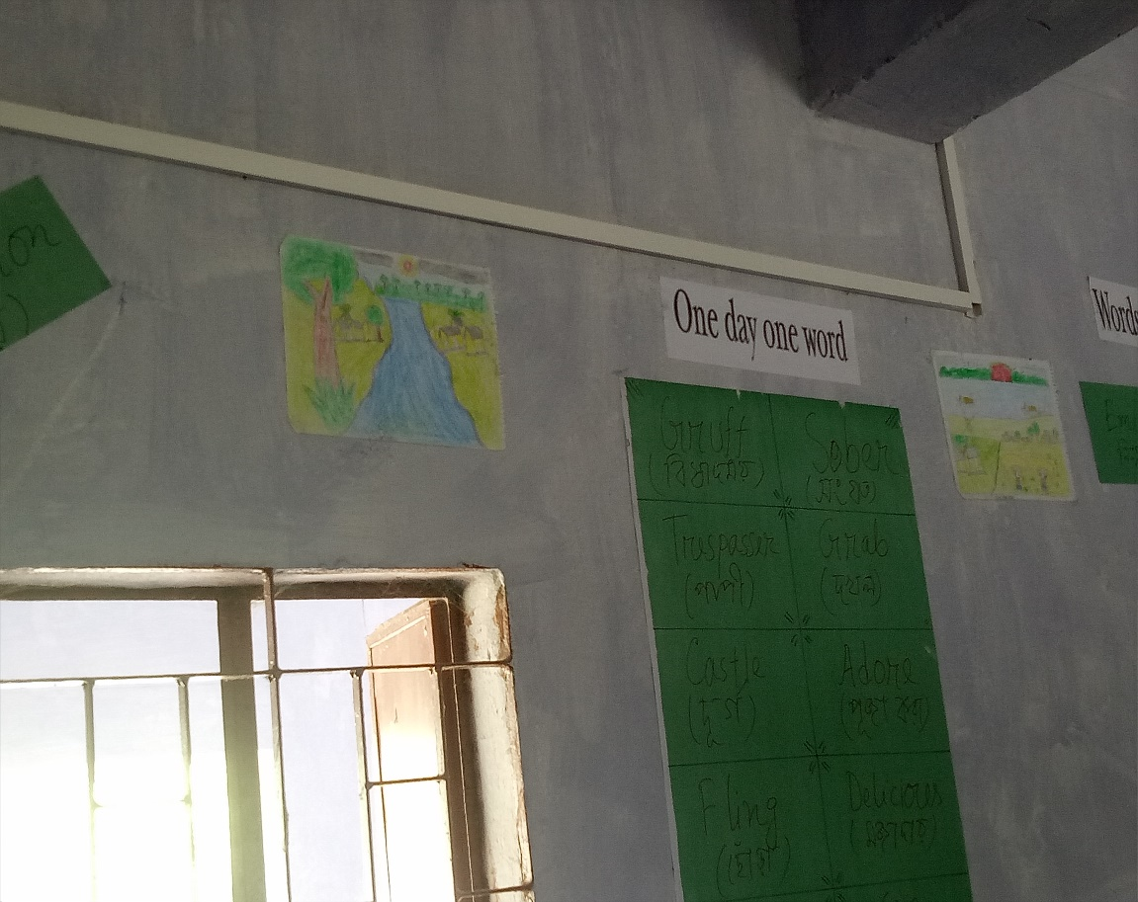
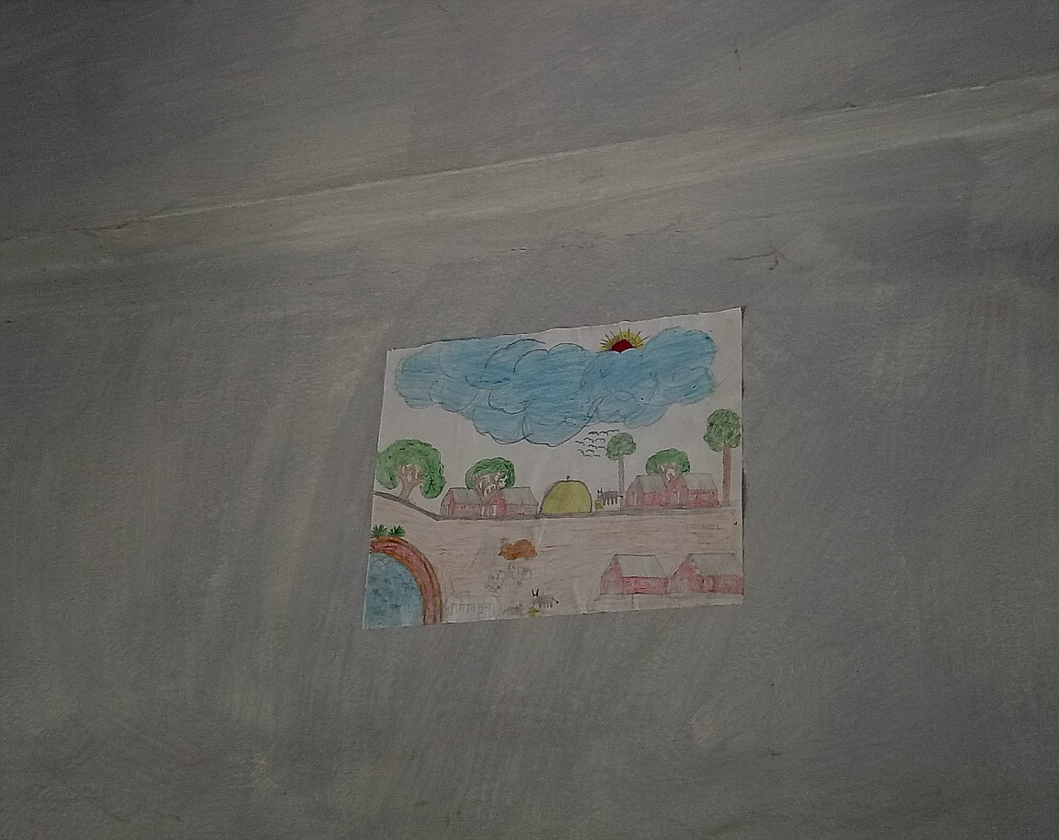
ACTIVITY NO:05 (CLASSROOM DECORATION)
SCHOOL: RANACHANDI SCHOOL AND COLLEGE, BANGLADESH

Slide 4
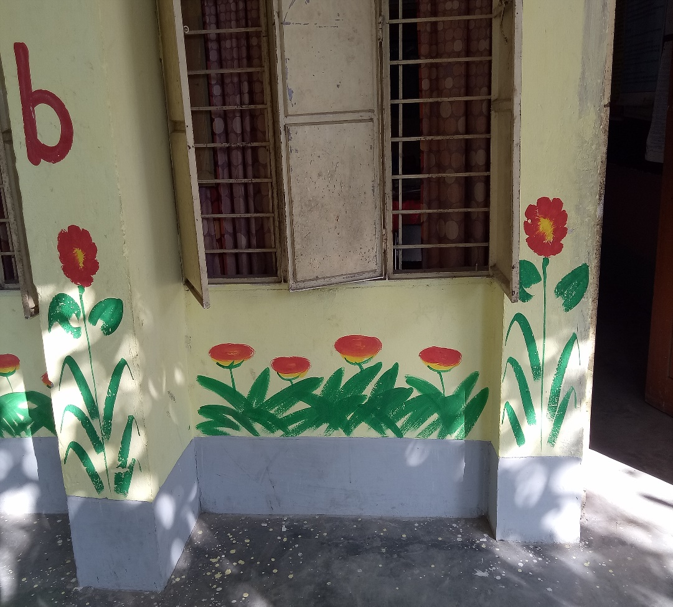
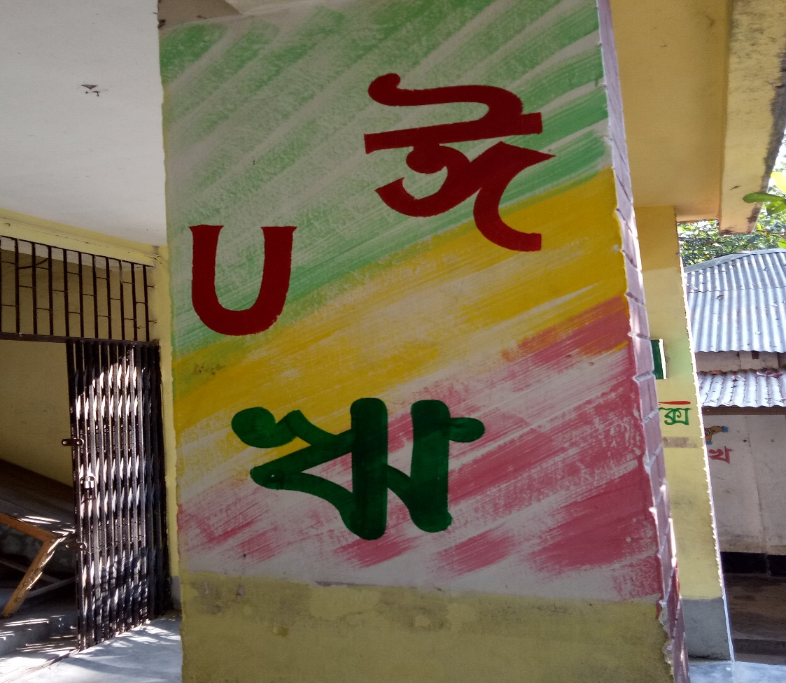
ACTIVITY NO:05 (CLASSROOM DECORATION)
SCHOOL: RANACHANDI SCHOOL AND COLLEGE, BANGLADESH

Slide 5
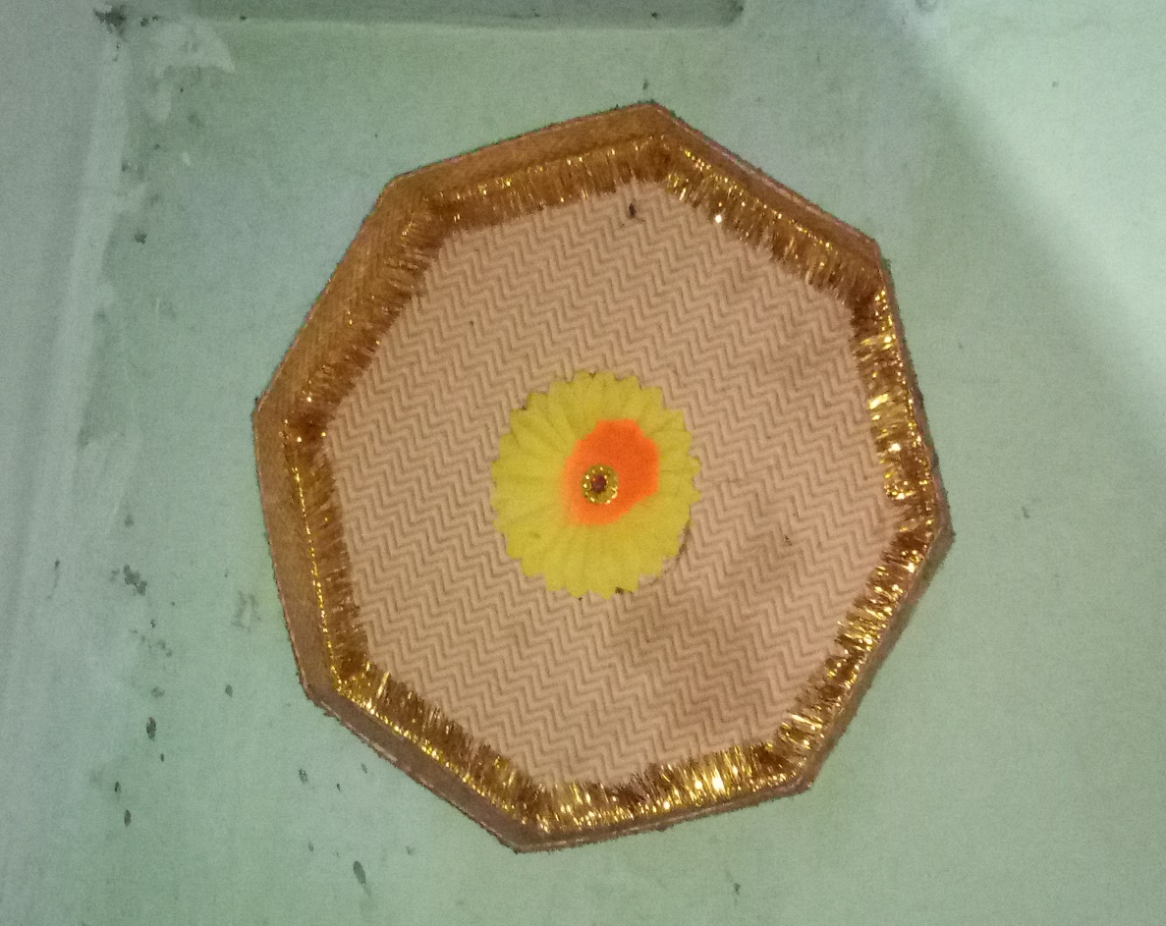
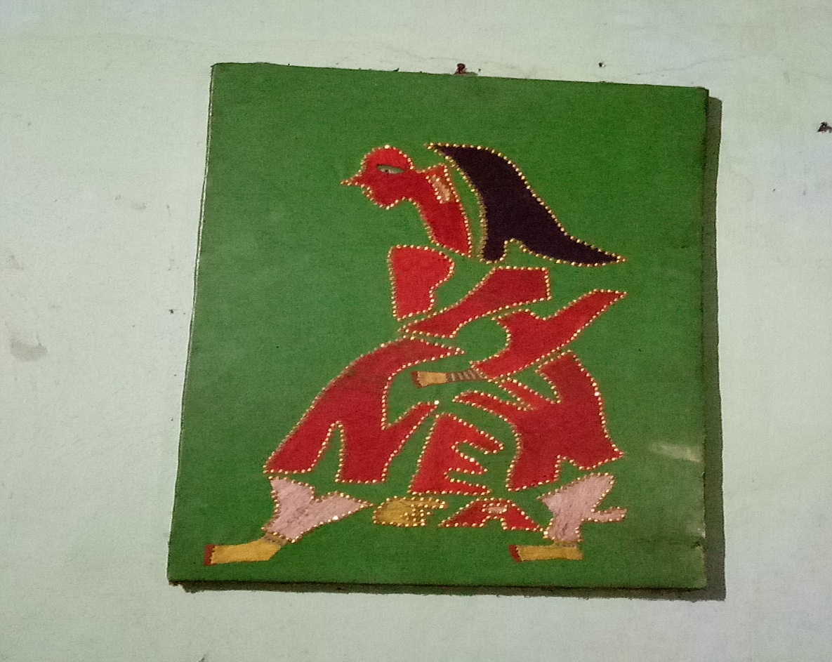
ACTIVITY NO:05 (CLASSROOM DECORATION)
SCHOOL: RANACHANDI SCHOOL AND COLLEGE, BANGLADESH

Slide 6
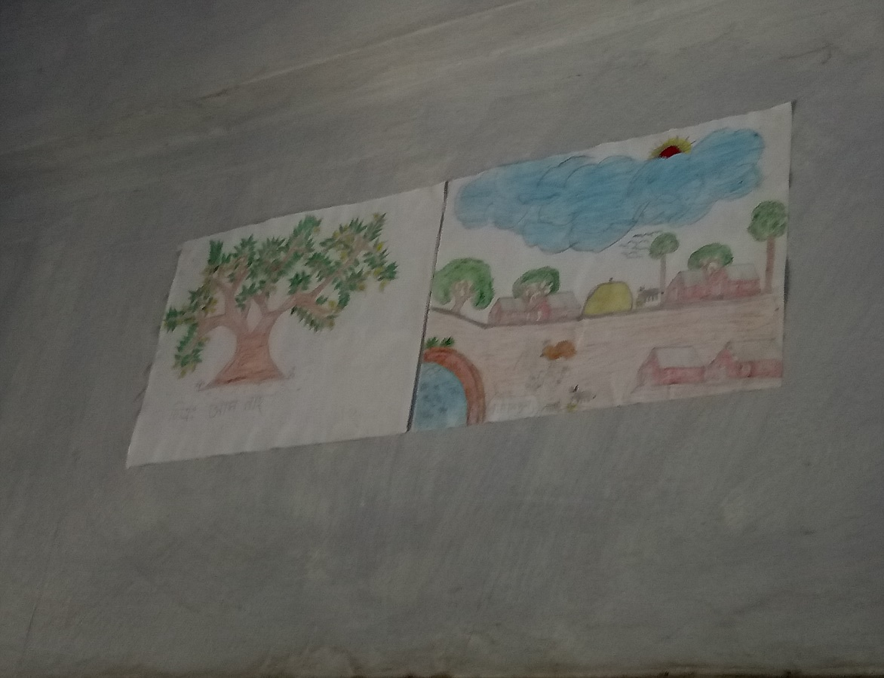
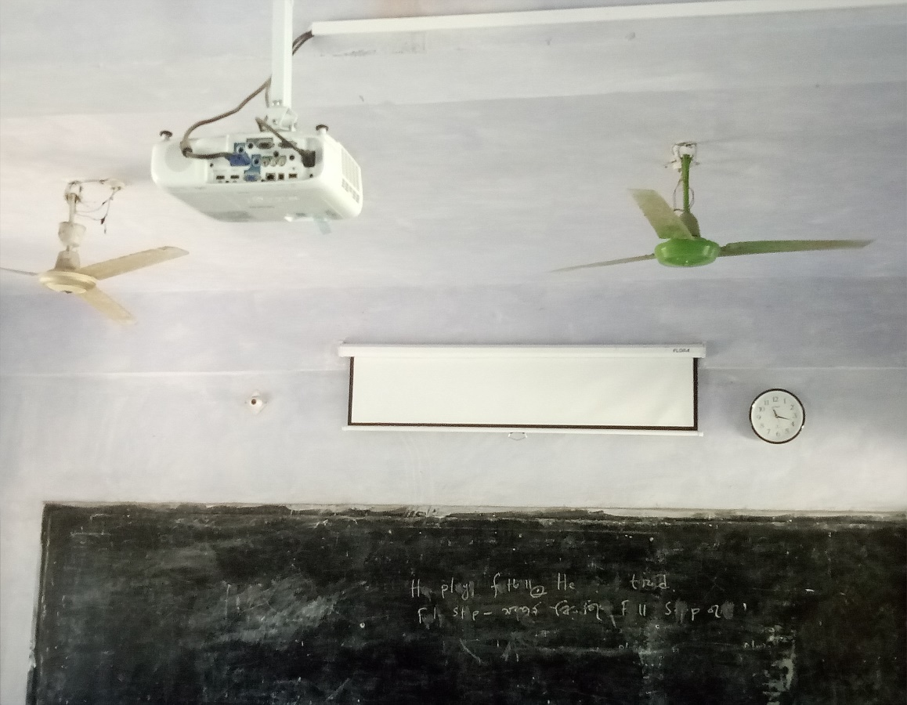
ACTIVITY NO:05 (CLASSROOM DECORATION)
SCHOOL: RANACHANDI SCHOOL AND COLLEGE, BANGLADESH

Slide 7
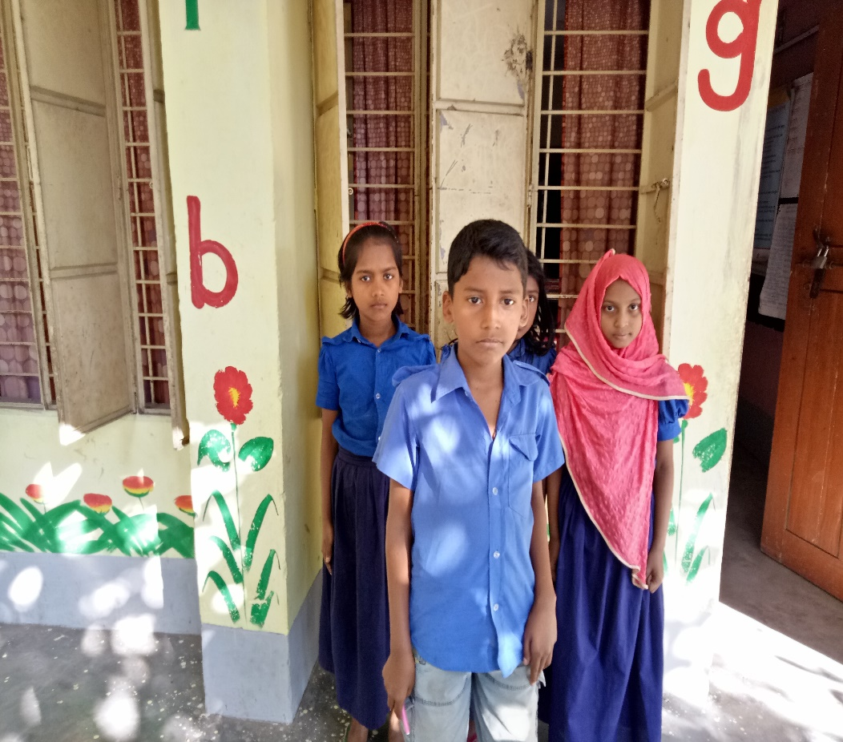
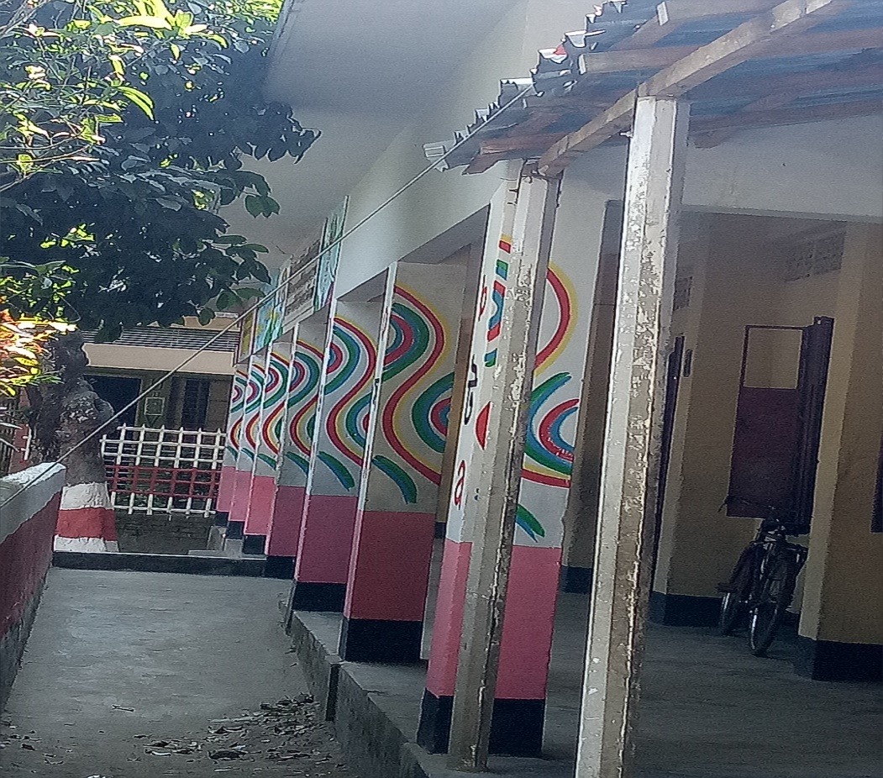
ACTIVITY NO:05 (CLASSROOM DECORATION)
SCHOOL: RANACHANDI SCHOOL AND COLLEGE, BANGLADESH

Slide 8
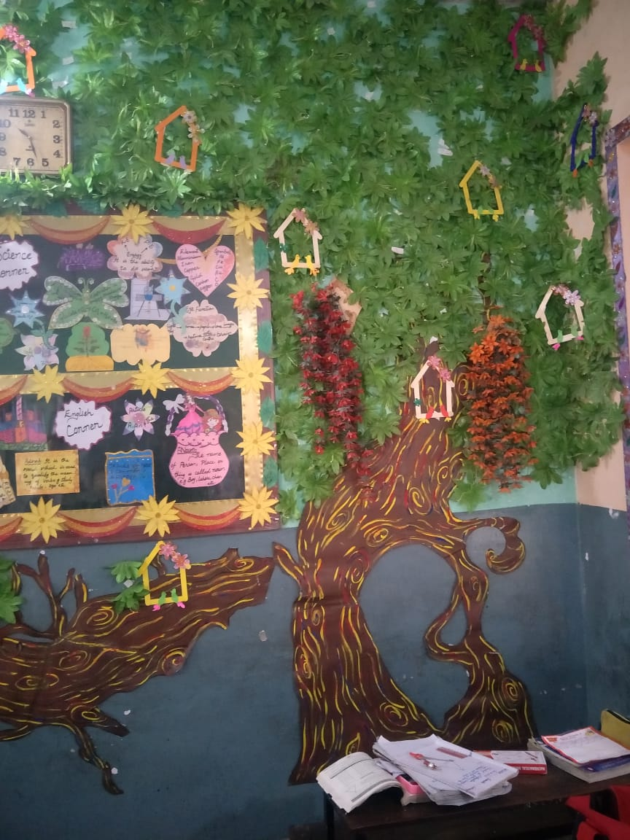
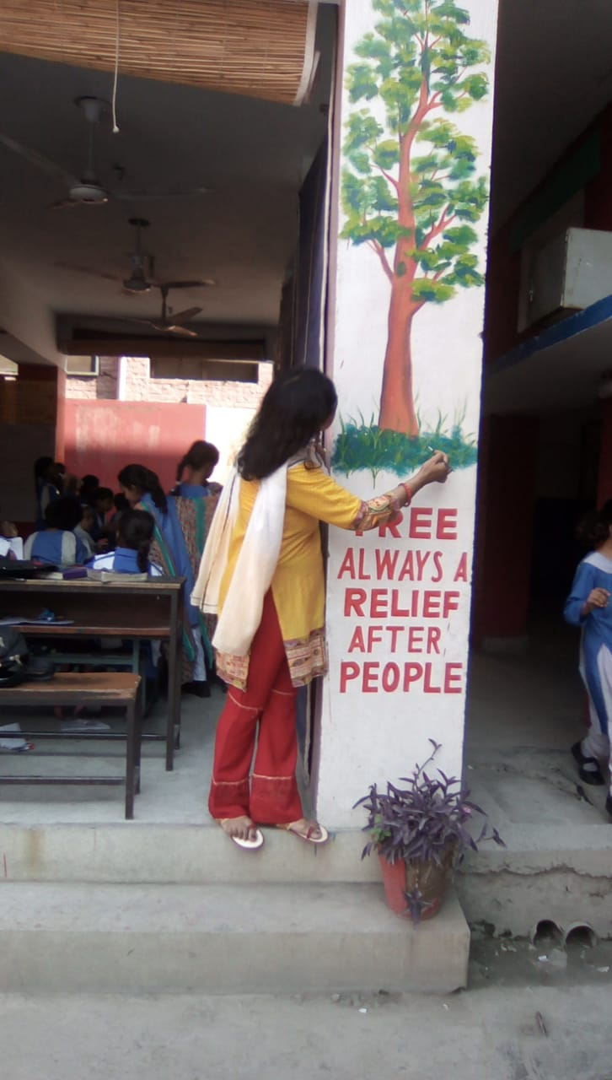
ACTIVITY NO:05 (CLASSROOM DECORATION)
SCHOOL: CARE ADOPTED CDG GIRLS HIGH SCHOOL, PAKISTAN

Slide 9
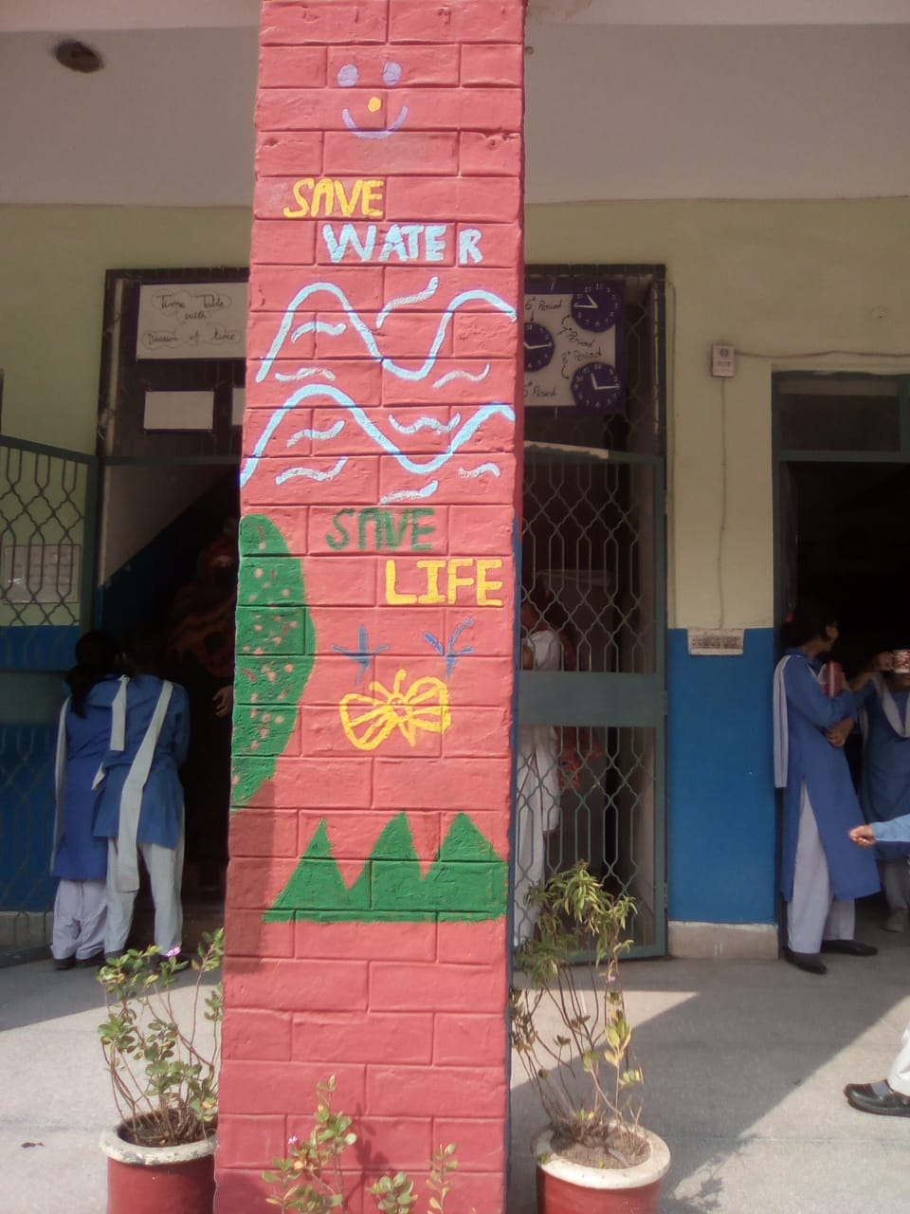
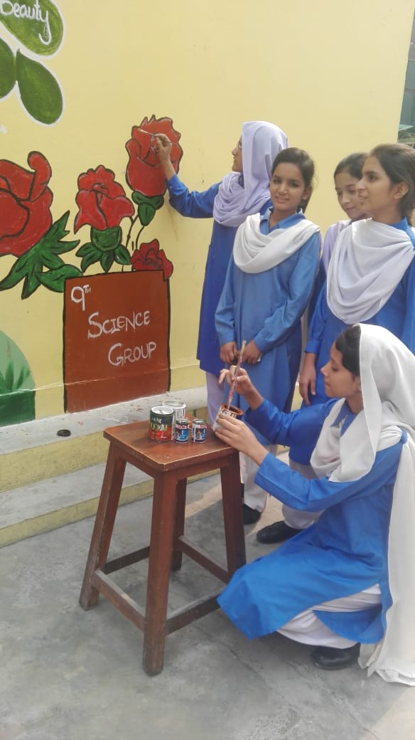
ACTIVITY NO:05 (CLASSROOM DECORATION)
SCHOOL: CARE ADOPTED CDG GIRLS HIGH SCHOOL, PAKISTAN

Slide 10
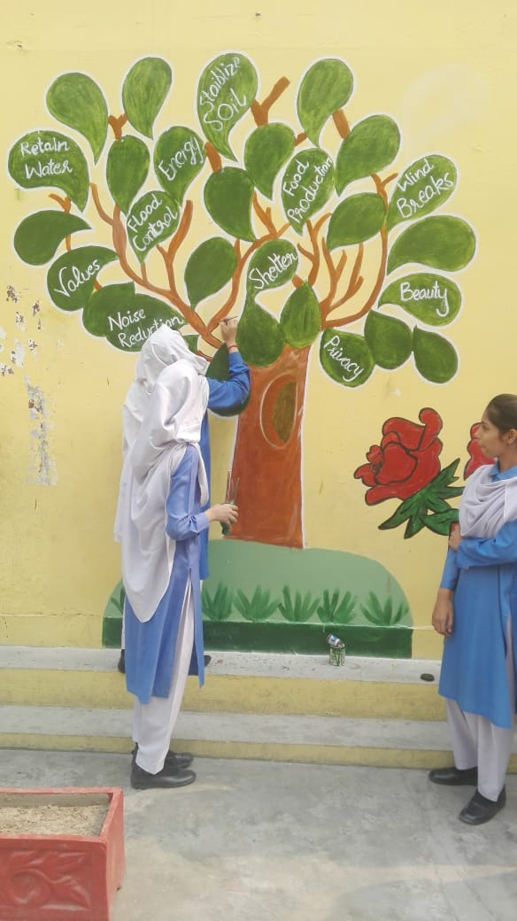
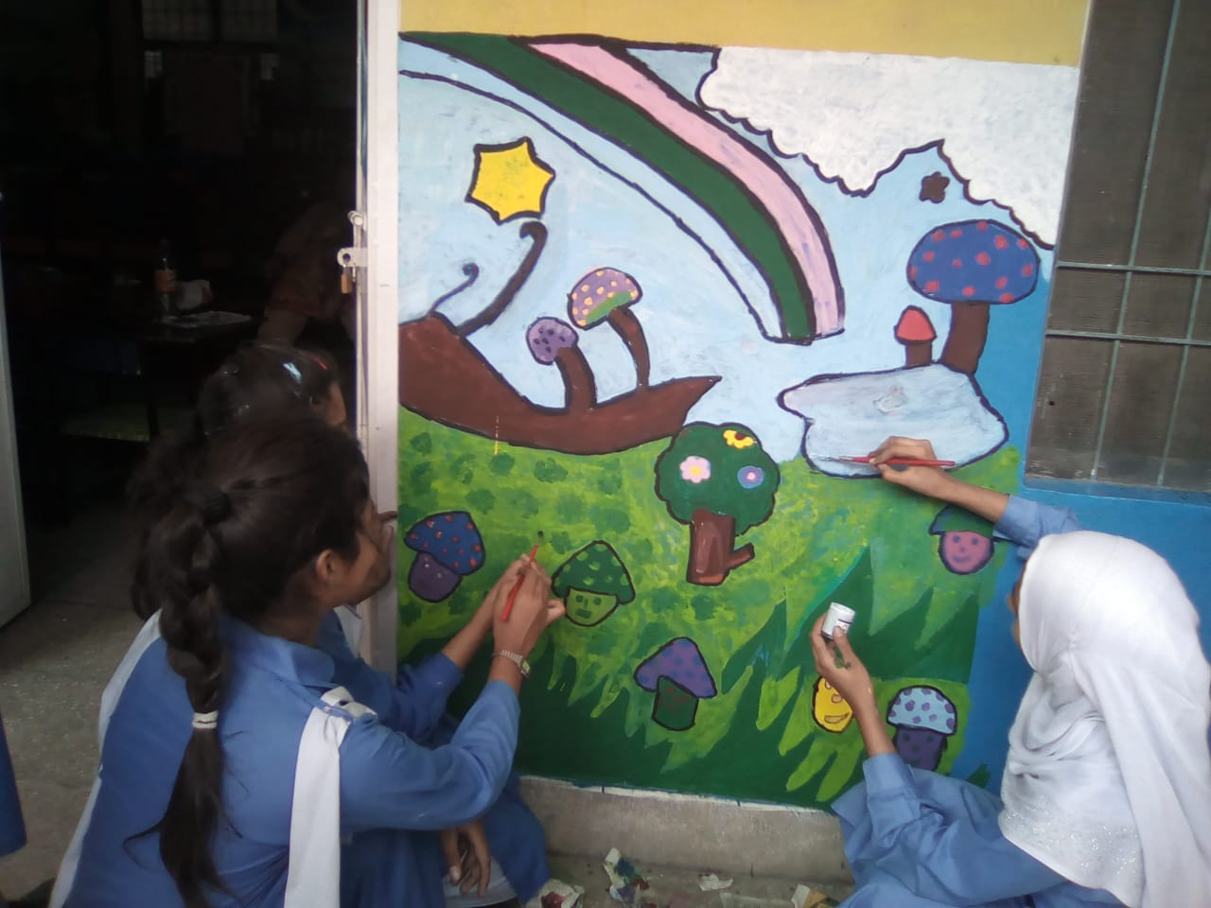
ACTIVITY NO:05 (CLASSROOM DECORATION)
SCHOOL: CARE ADOPTED CDG GIRLS HIGH SCHOOL, PAKISTAN

Slide 11
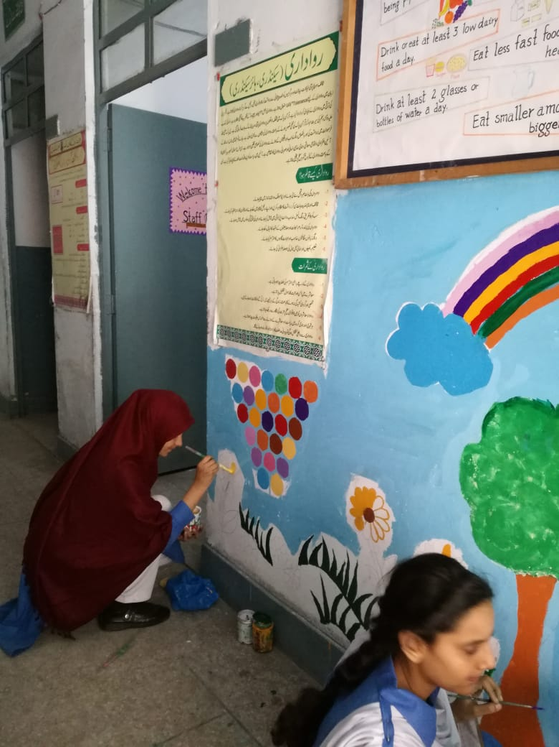
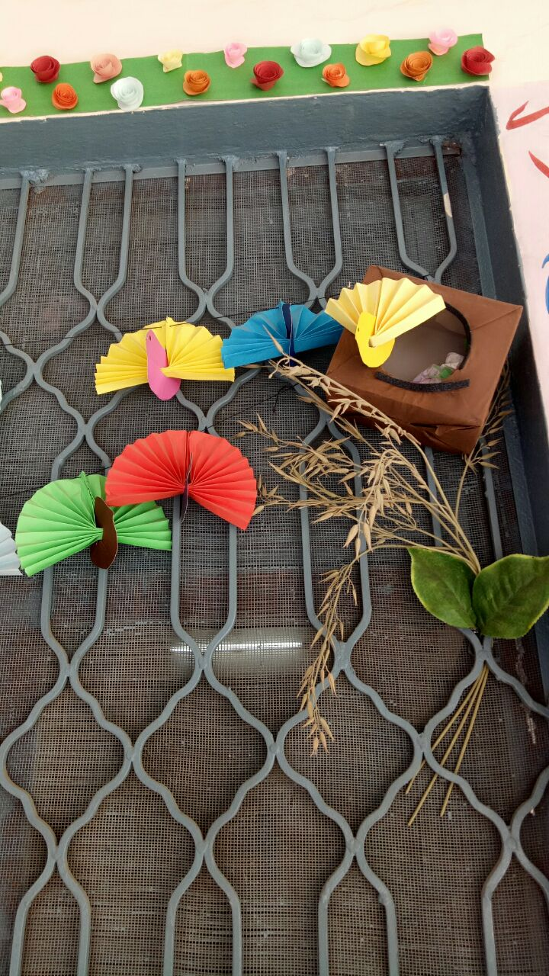
ACTIVITY NO:05 (CLASSROOM DECORATION)
SCHOOL: CARE ADOPTED CDG GIRLS HIGH SCHOOL, PAKISTAN

Slide 12
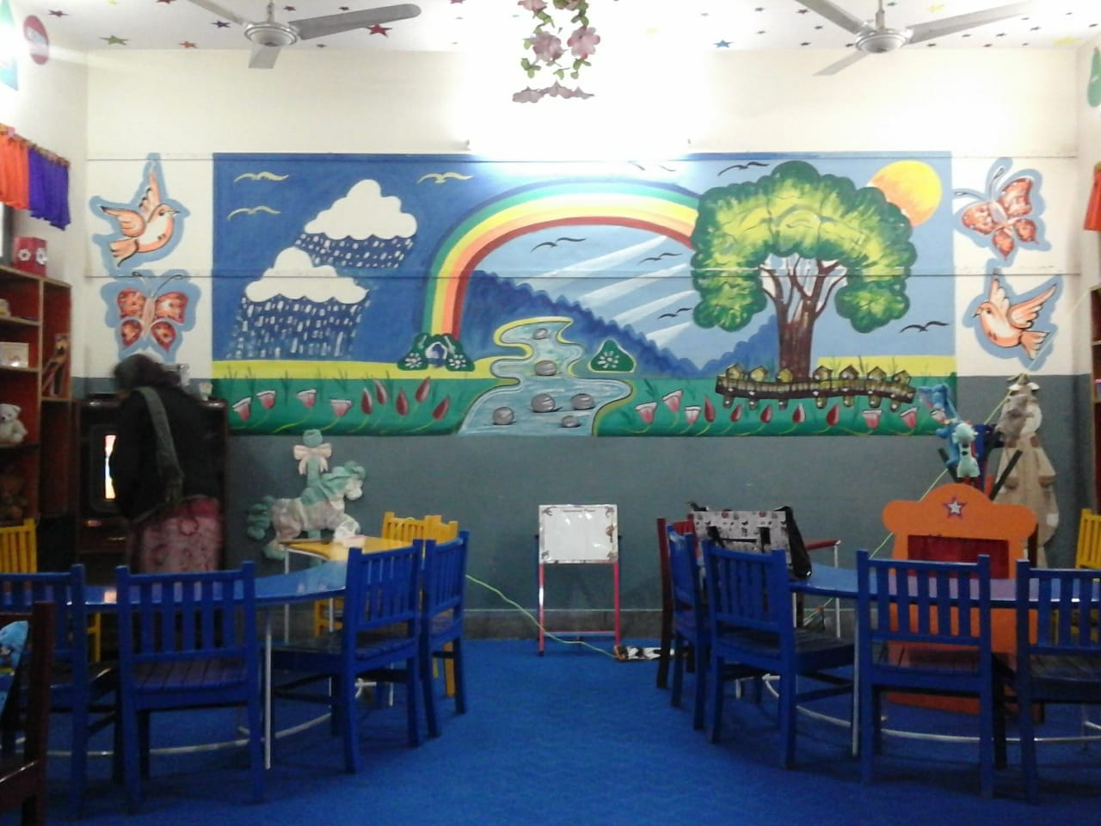
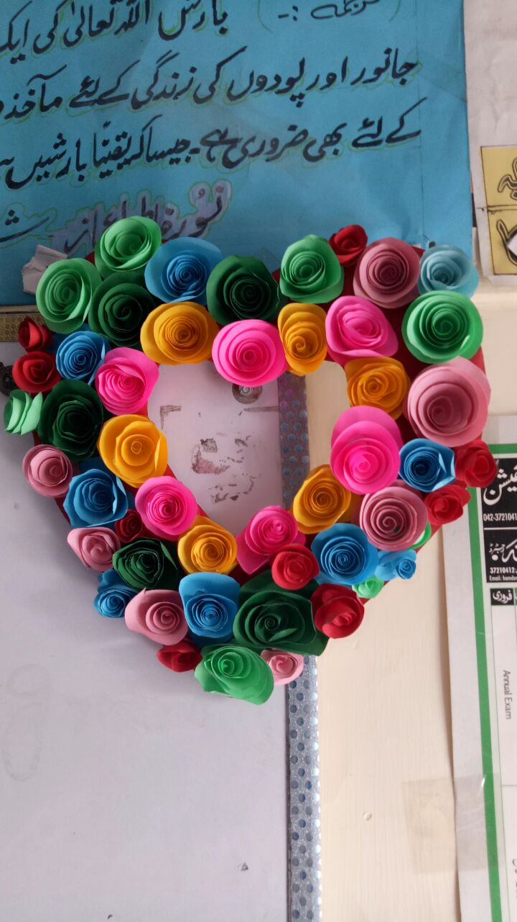
ACTIVITY NO:05 (CLASSROOM DECORATION)
SCHOOL: CARE ADOPTED CDG GIRLS HIGH SCHOOL, PAKISTAN

Slide 13
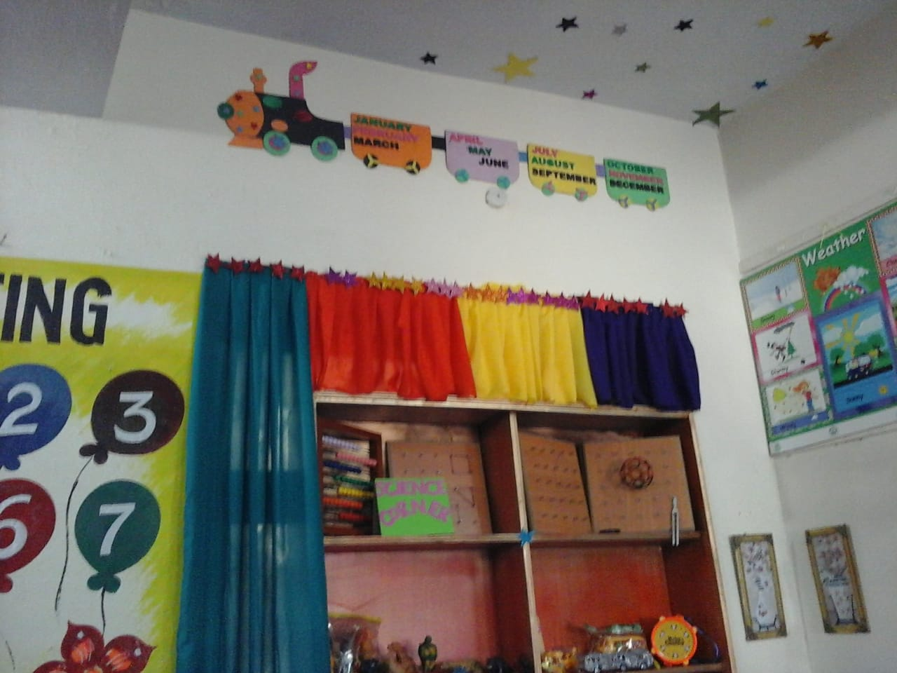
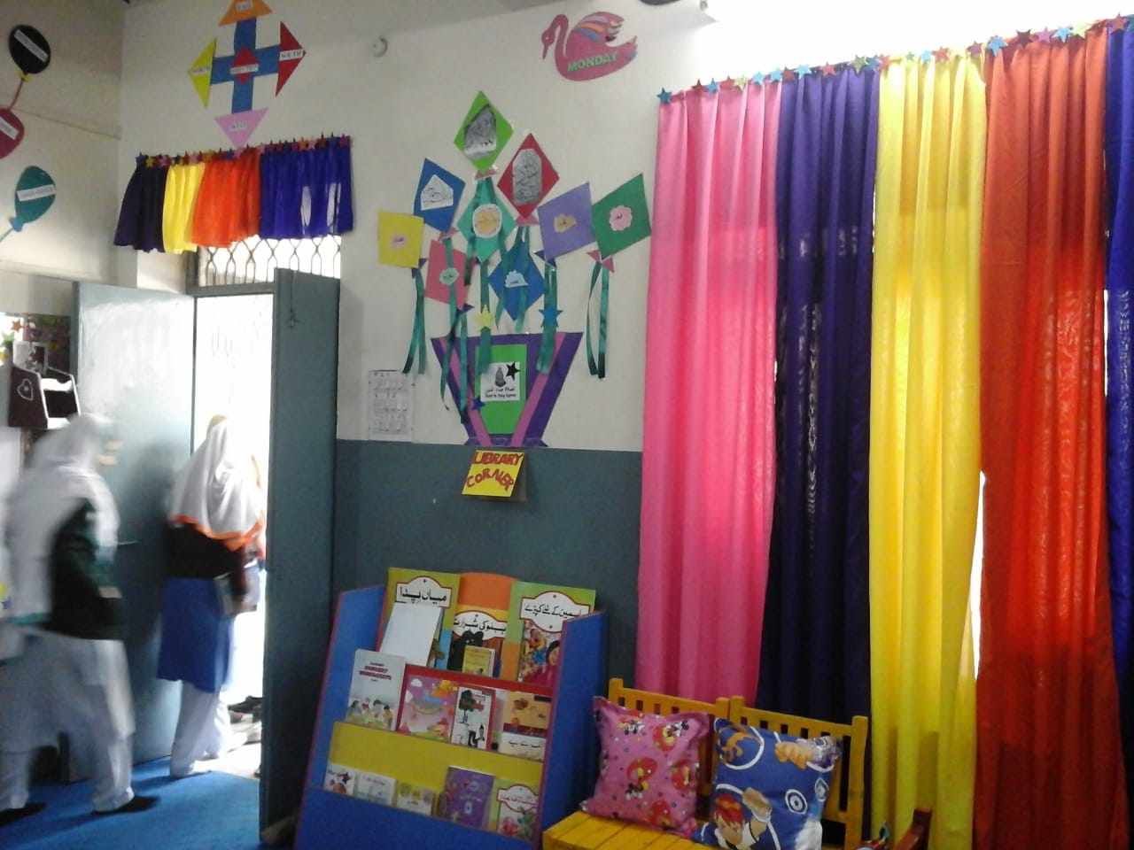
ACTIVITY NO:05 (CLASSROOM DECORATION)
SCHOOL: CARE ADOPTED CDG GIRLS HIGH SCHOOL, PAKISTAN

Slide 14
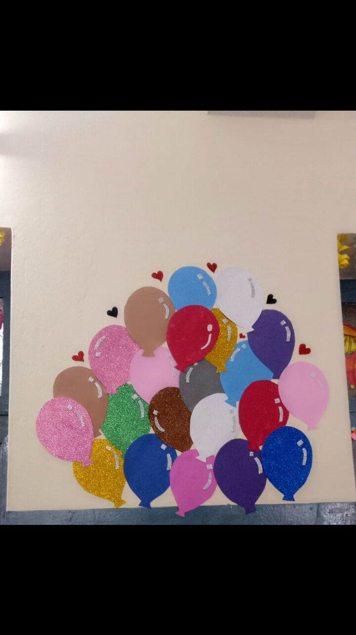
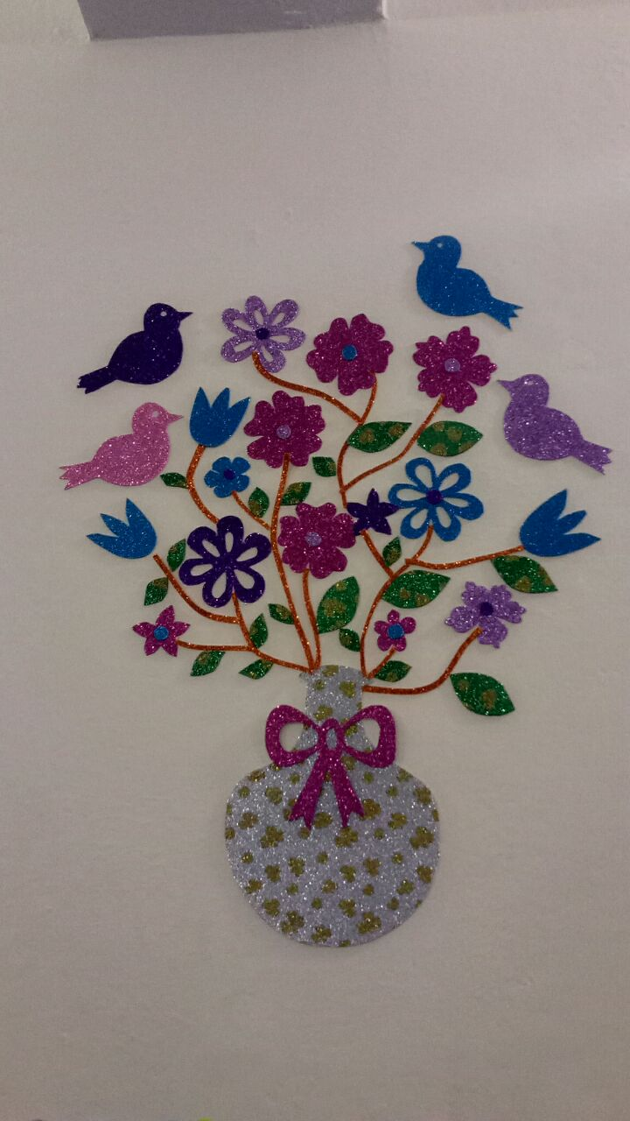
ACTIVITY NO:05 (CLASSROOM DECORATION)
SCHOOL: CARE ADOPTED CDG GIRLS HIGH SCHOOL, PAKISTAN

Slide 15
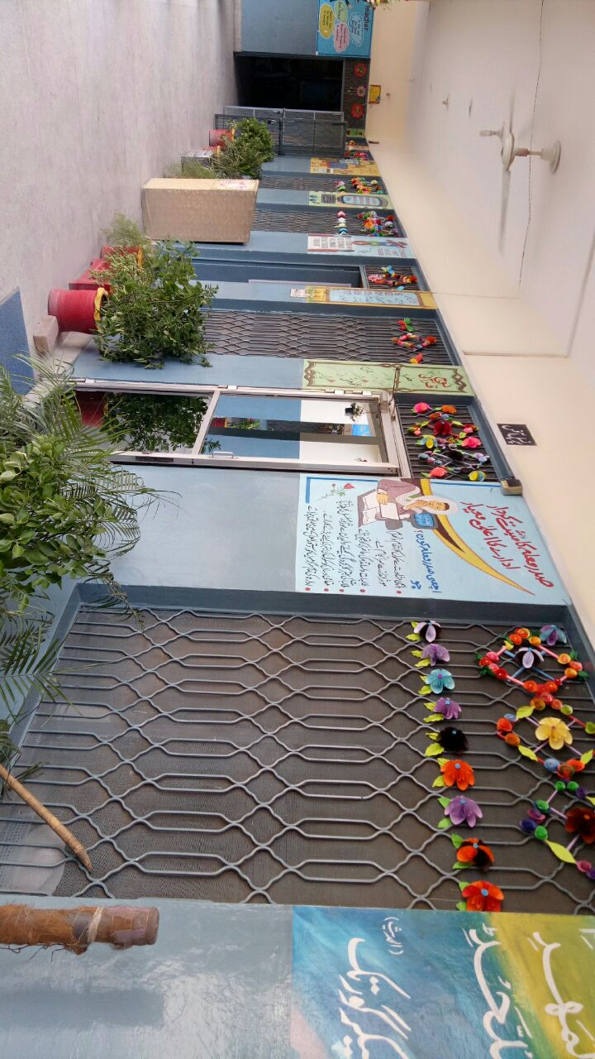
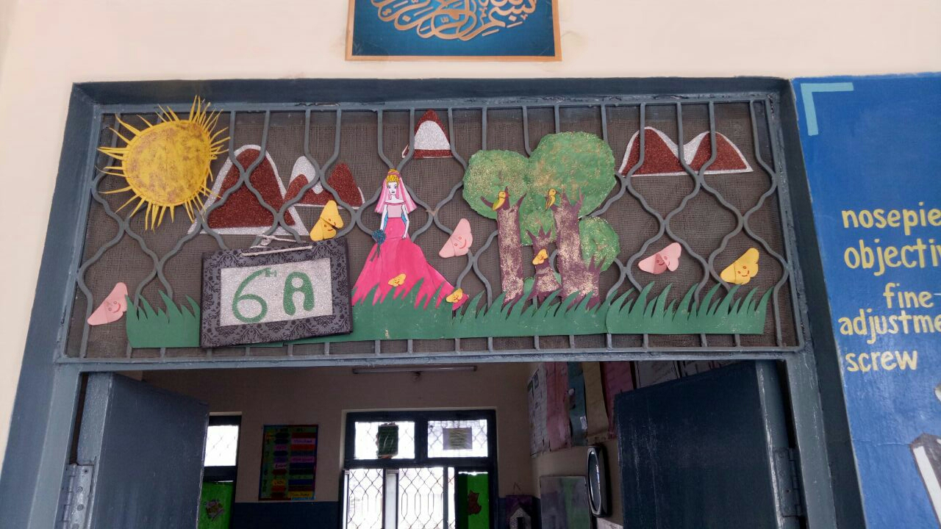
ACTIVITY NO:05 (CLASSROOM DECORATION)
SCHOOL: CARE ADOPTED CDG GIRLS HIGH SCHOOL, PAKISTAN

Slide 16
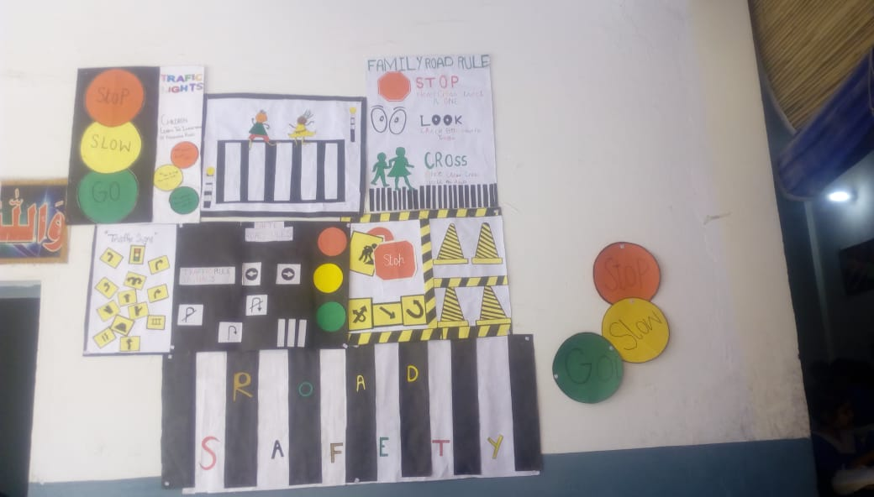
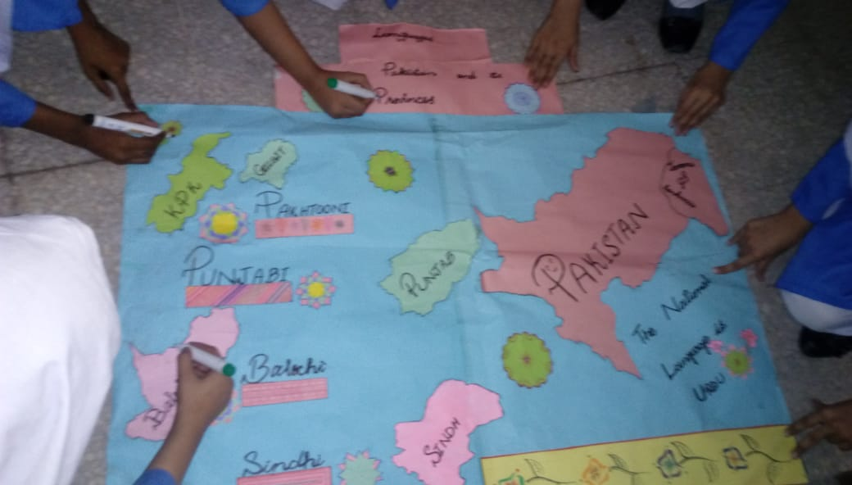
ACTIVITY NO:05 (CLASSROOM DECORATION)
SCHOOL: CARE ADOPTED CDG GIRLS HIGH SCHOOL, PAKISTAN

Slide 17
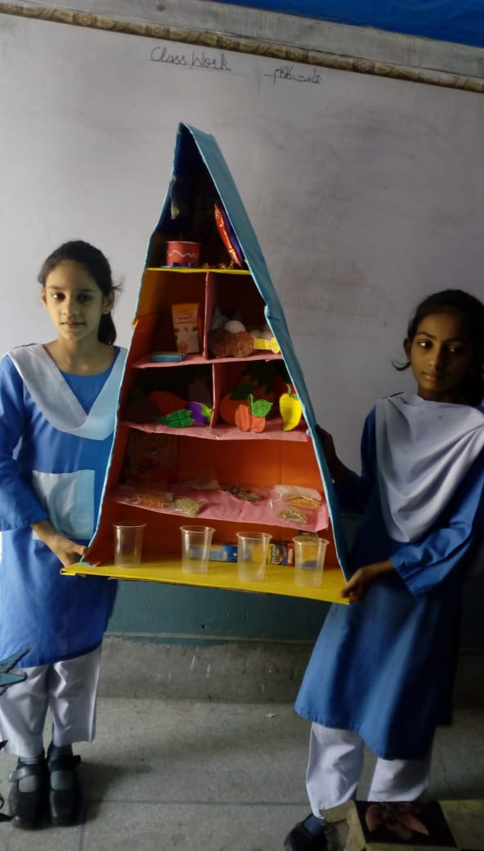
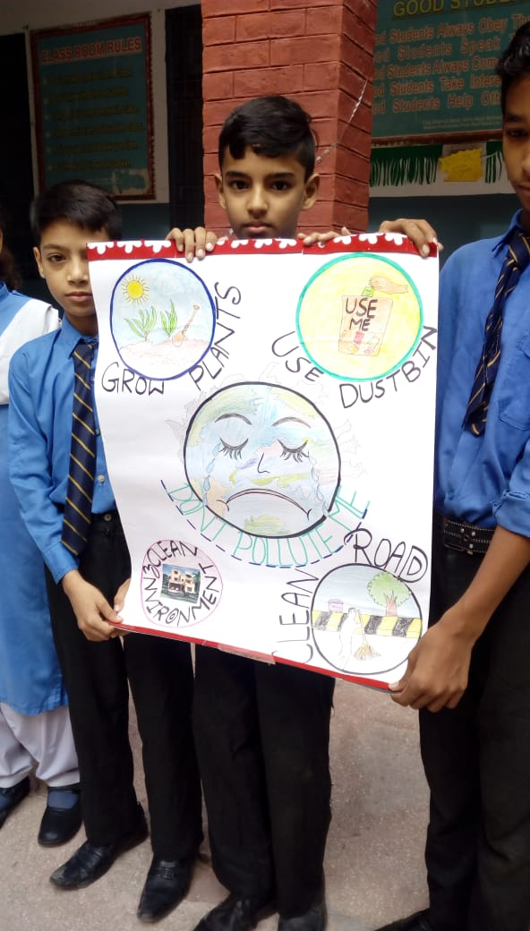
ACTIVITY NO:05 (CLASSROOM DECORATION)
SCHOOL: CARE ADOPTED CDG GIRLS HIGH SCHOOL, PAKISTAN

Slide 18
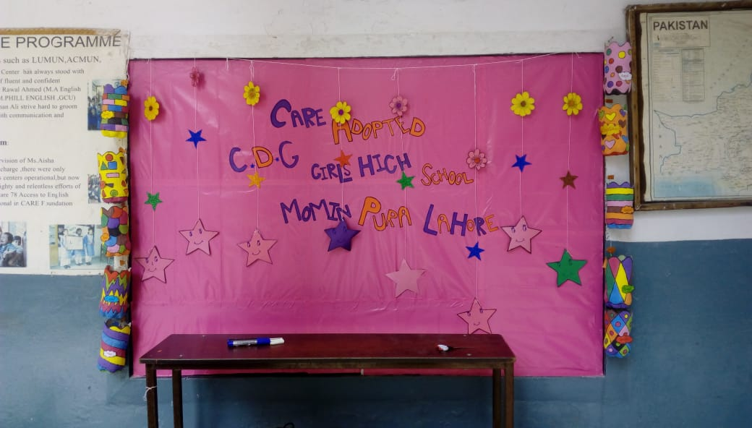
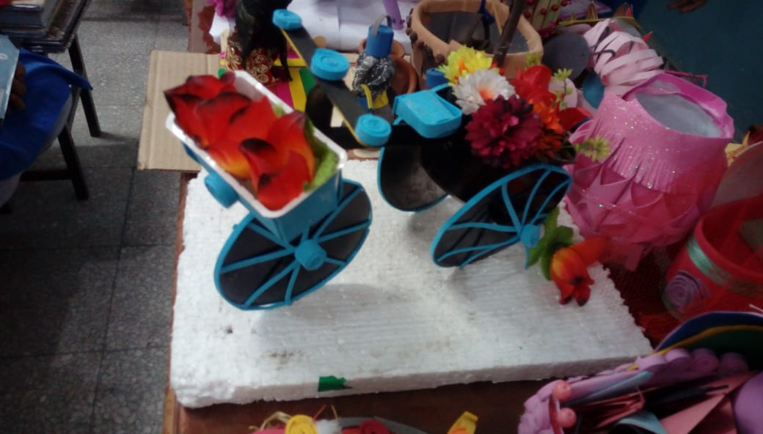
ACTIVITY NO:05 (CLASSROOM DECORATION)
SCHOOL: CARE ADOPTED CDG GIRLS HIGH SCHOOL, PAKISTAN

Slide 19
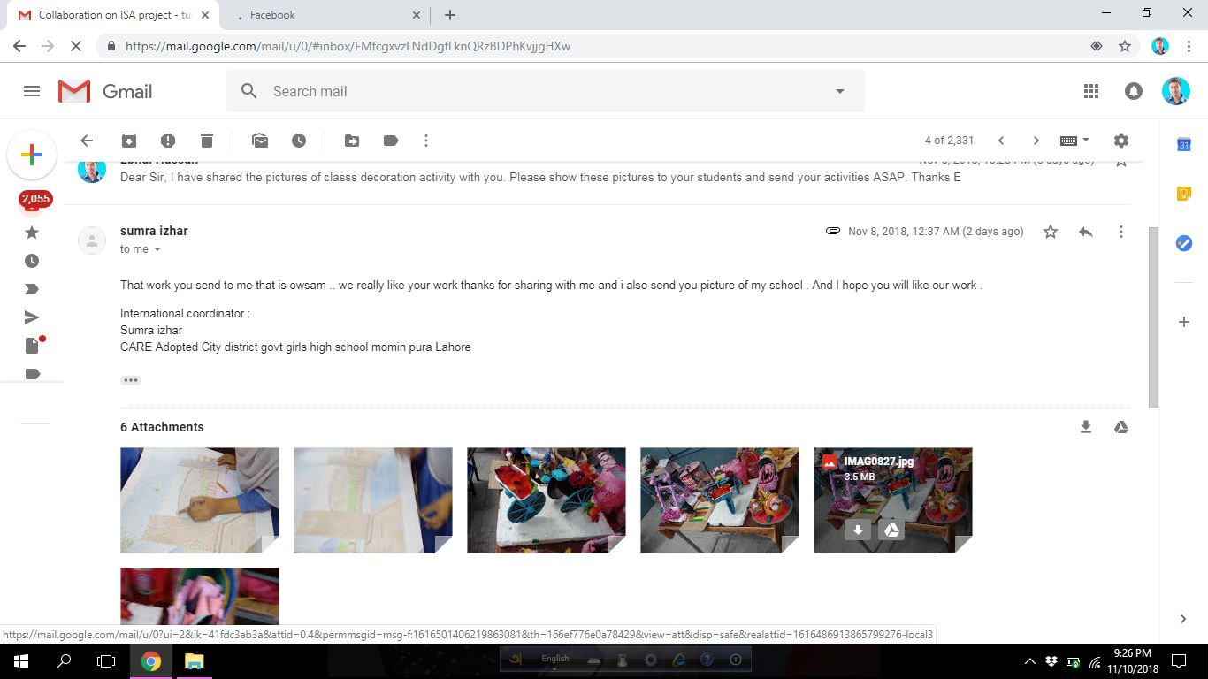
Evidence Of Activities

Slide 20
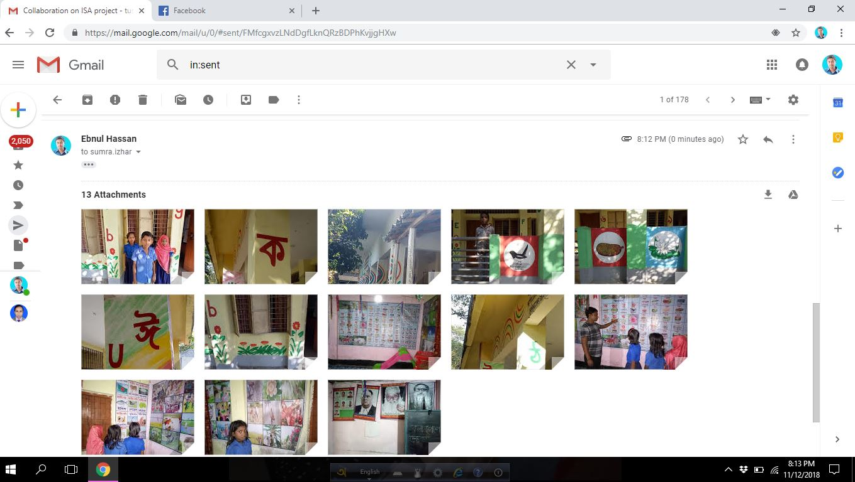
Evidence Of Activities

Slide 21
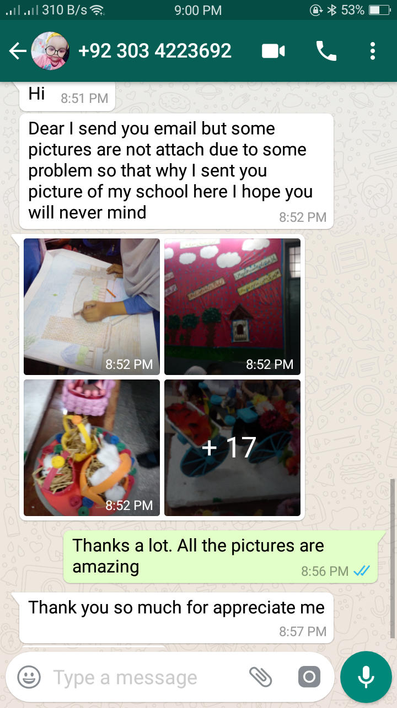
Evidence Of Activities

