Slide 1
ACTIVITY NUMBER: 03
SUBJECT: SCHOOL SPORTS
PHOTO ALBUM OF: SHARING ACTIVITIES
School’s Name: Ranachandi School and College, Kishoreganj, Nilphamari, Bangladesh
Coordinator’s name: Ebnulhassan Tushar
E-mail: tusharbd89@gmail.com
Partner School’s Name: City District Govt. High School, Kot Khawaja Saeed Ihr, Pakistan
Coordinator’s name: Nadia Shoukat
E-mail: nadia.shoukat@carepakistan.org
Sharing activities between Ranachandi School and College, Bangladesh and City District Govt. High School, Pakistan.

Slide 2
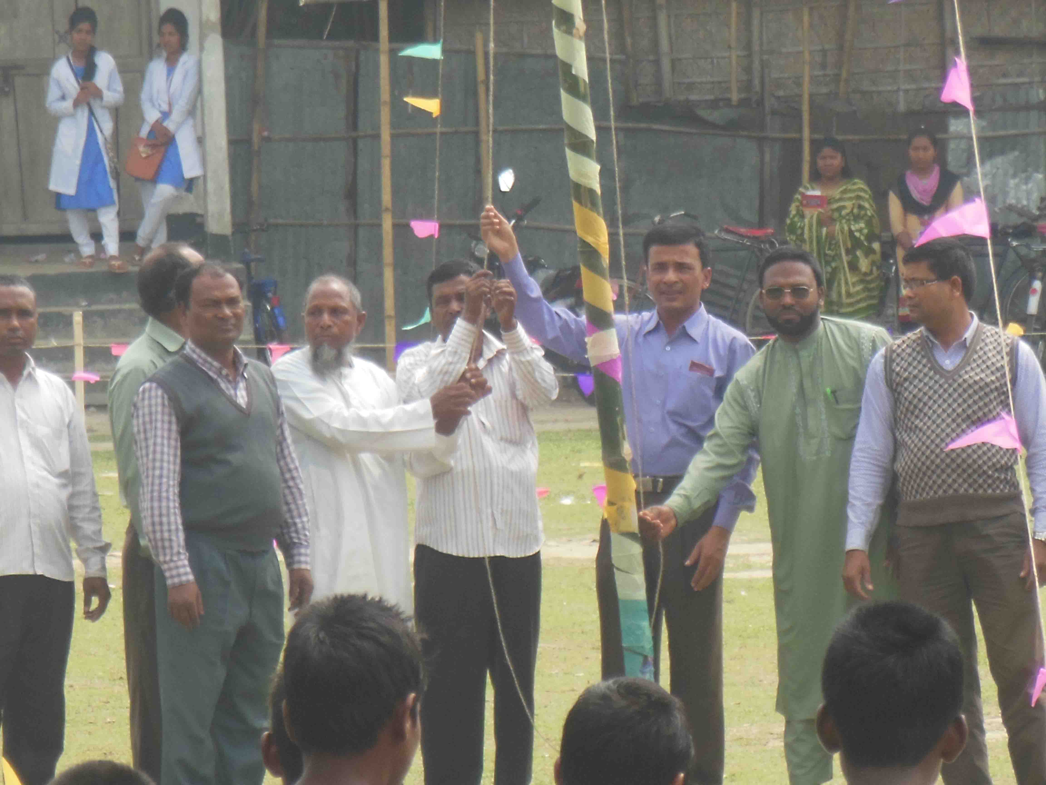
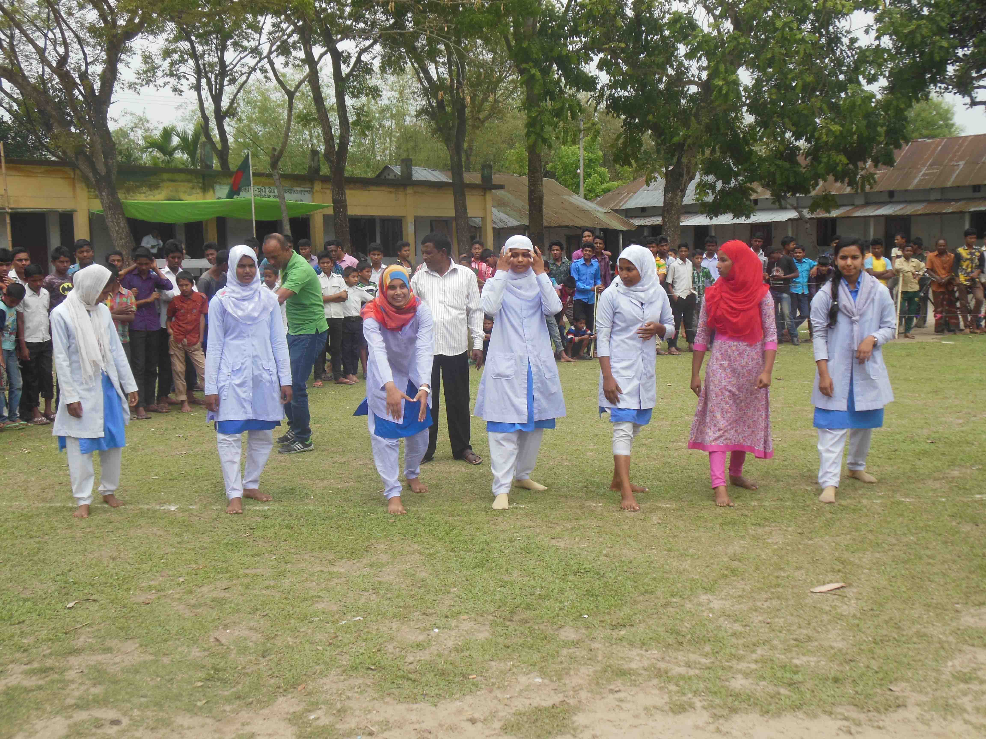
ACTIVITY NO: 03 (SCHOOL SPORTS)
SCHOOL: RANACHADI SCHOOL AND COLLEGE, BANGLADESH

Slide 3
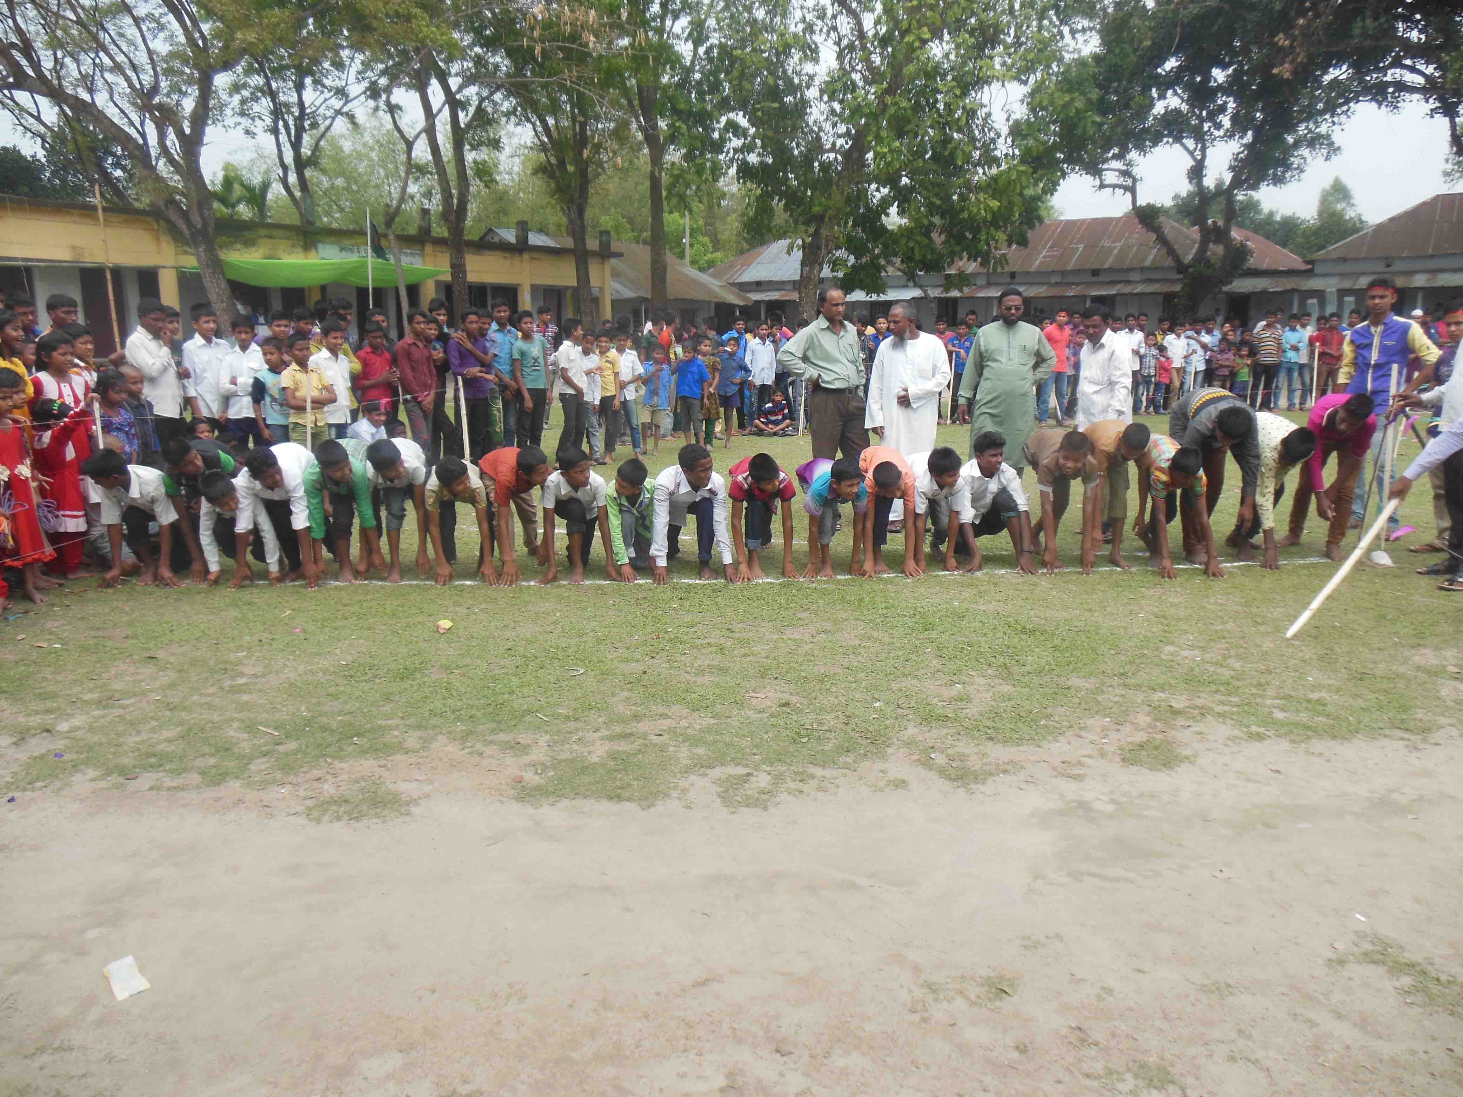
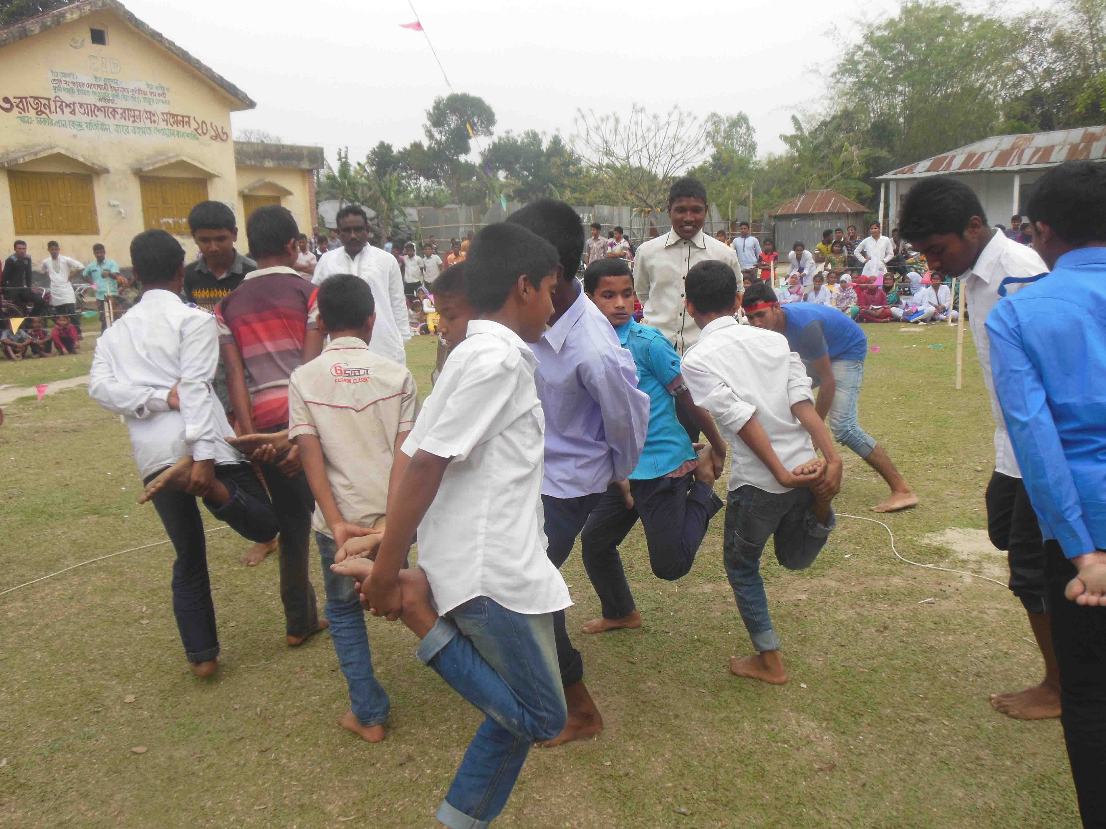
ACTIVITY NO: 03 (SCHOOL SPORTS)
SCHOOL: RANACHADI SCHOOL AND COLLEGE, BANGLADESH

Slide 4
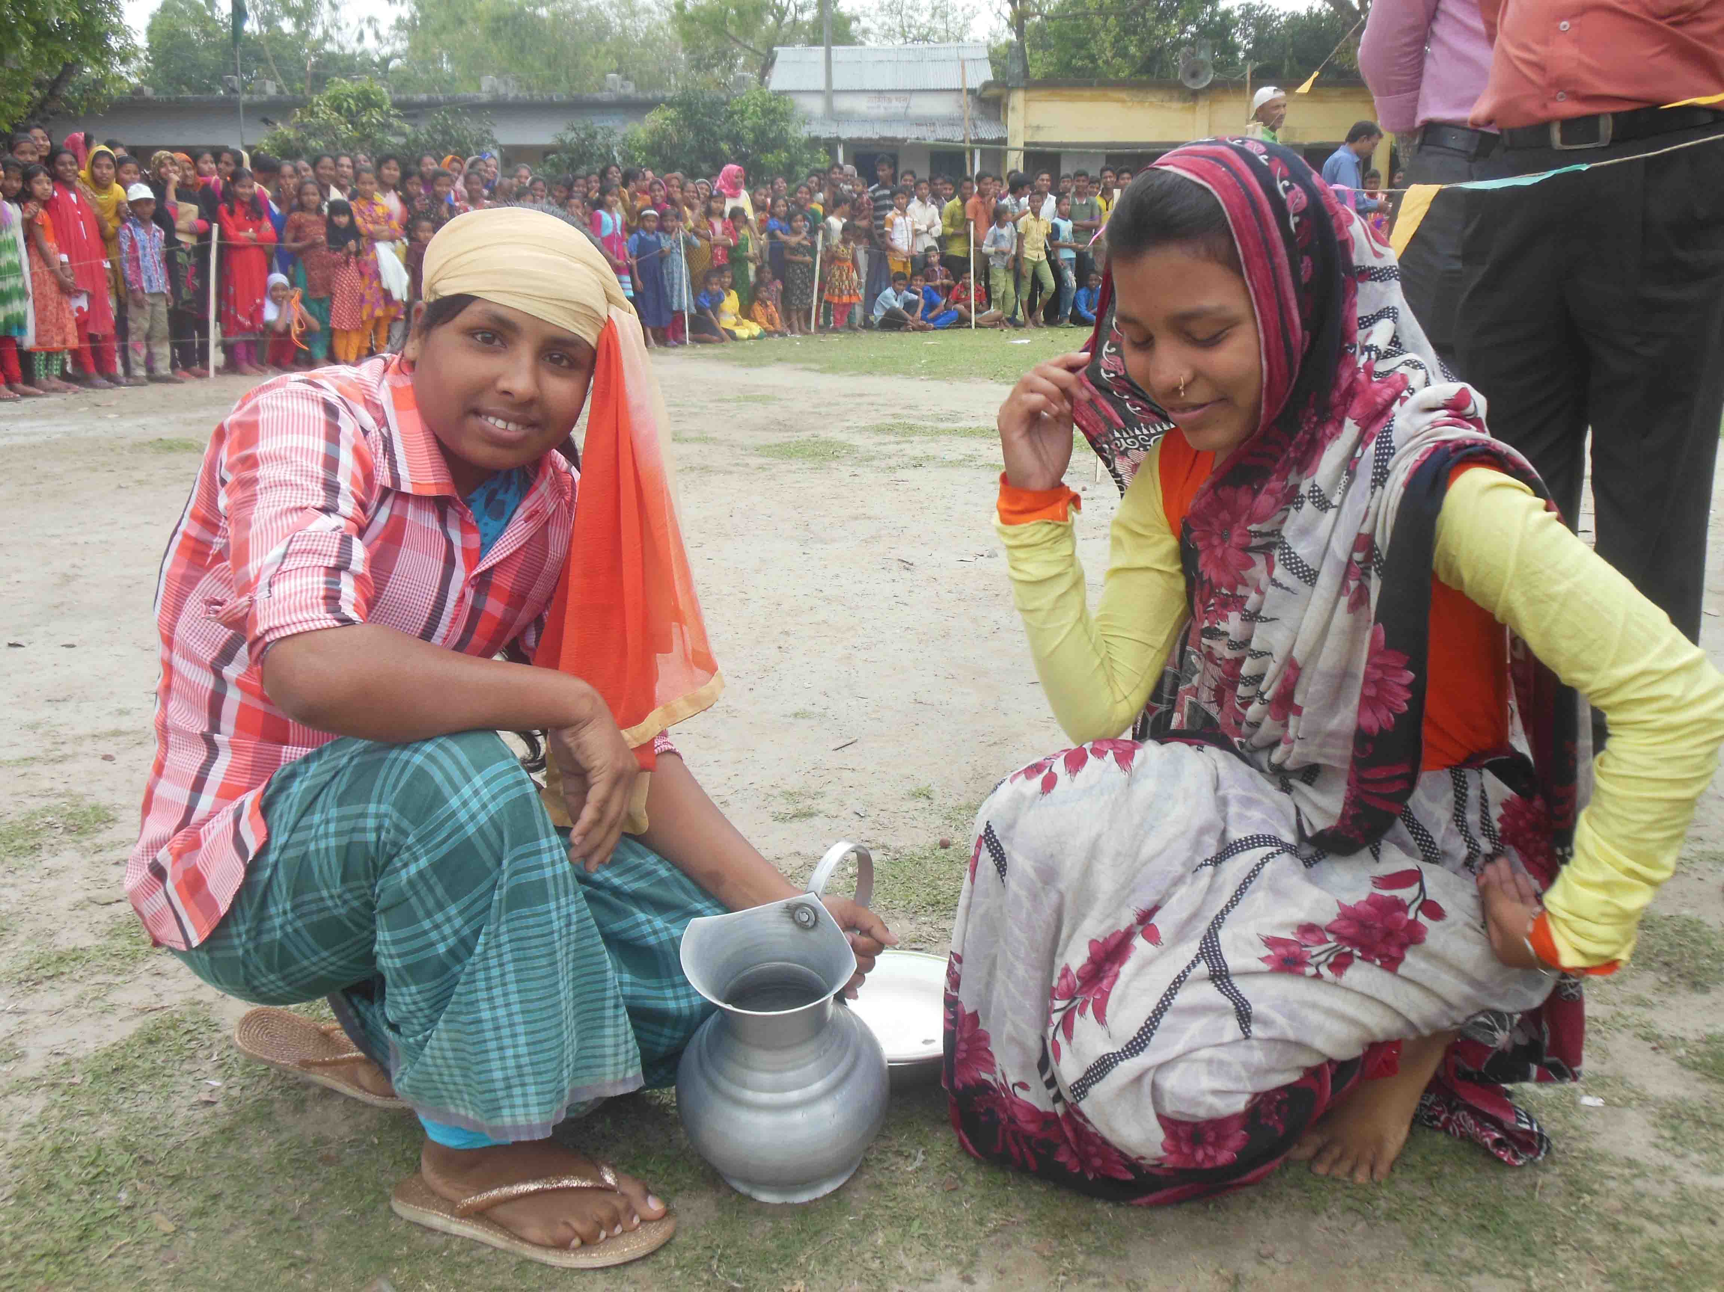
ACTIVITY NO: 03 (SCHOOL SPORTS)
SCHOOL: RANACHADI SCHOOL AND COLLEGE, BANGLADESH

Slide 5
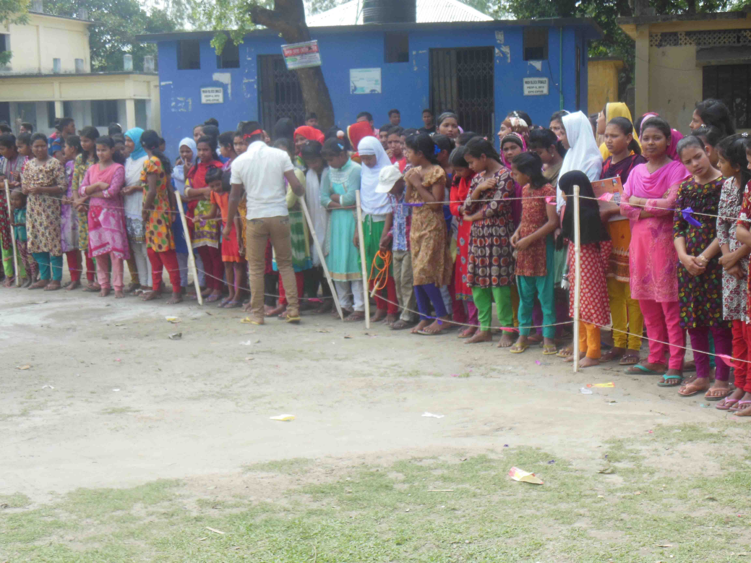
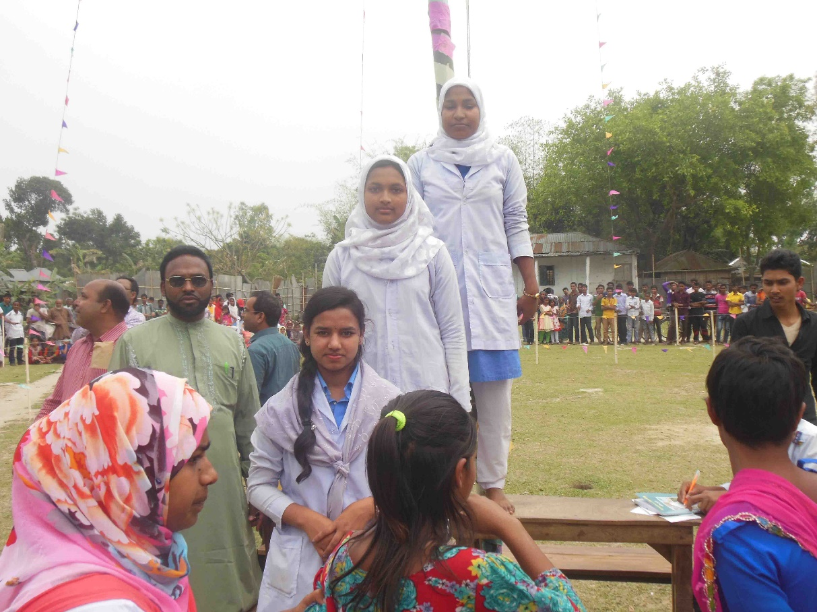
ACTIVITY NO: 03 (SCHOOL SPORTS)
SCHOOL: RANACHADI SCHOOL AND COLLEGE, BANGLADESH

Slide 6
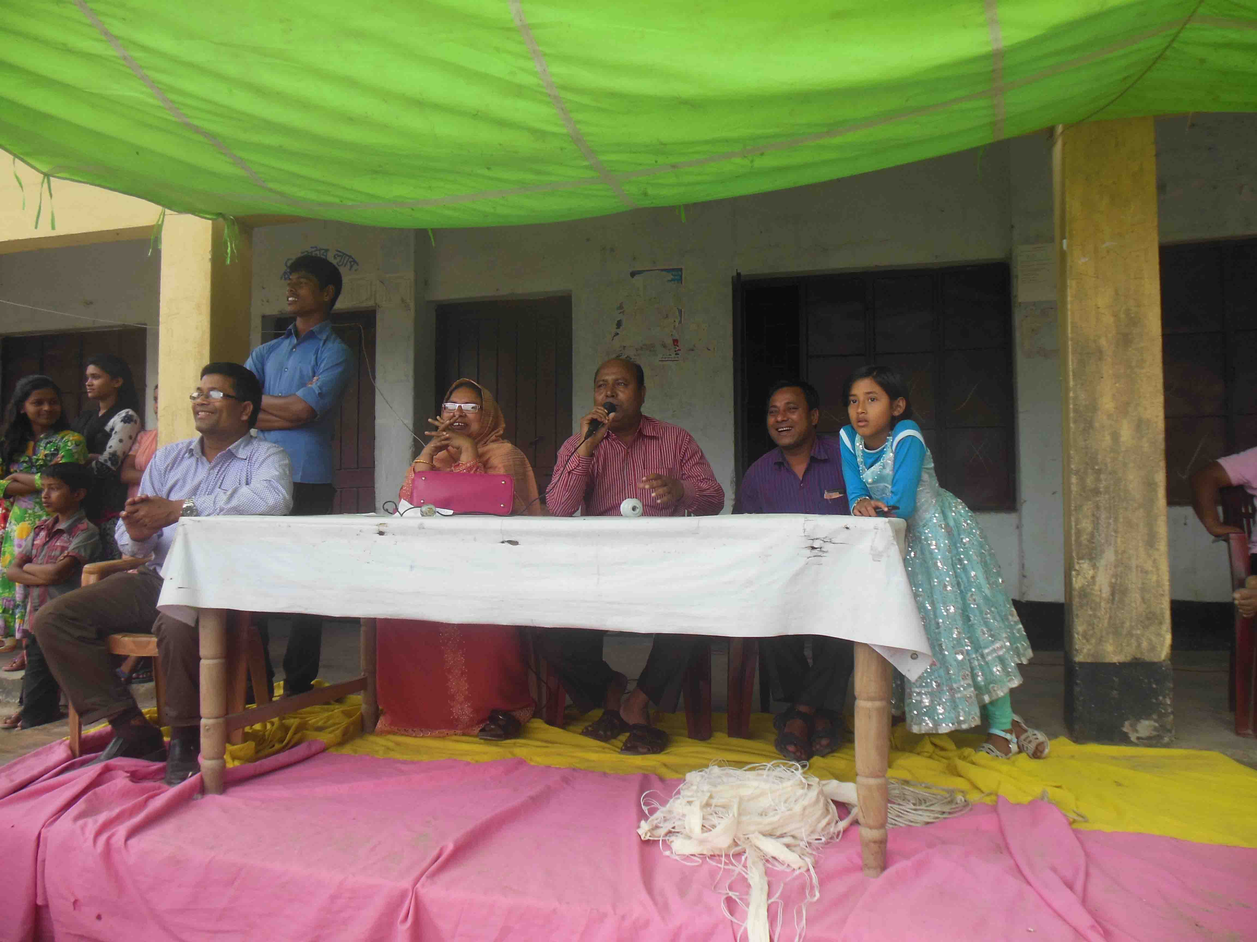
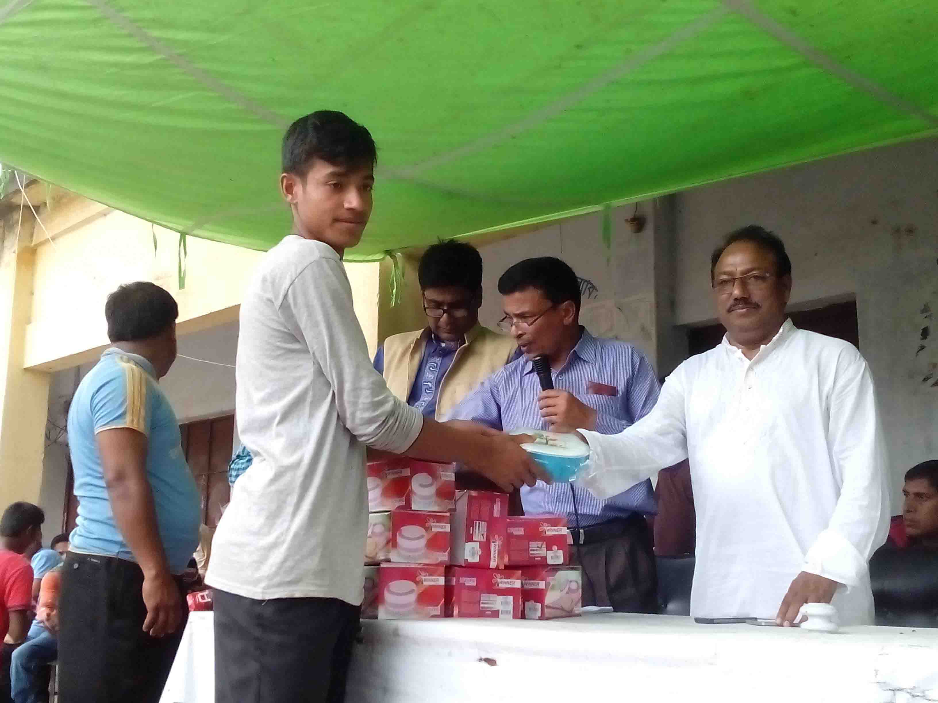
ACTIVITY NO: 03 (SCHOOL SPORTS)
SCHOOL: RANACHADI SCHOOL AND COLLEGE, BANGLADESH

Slide 7
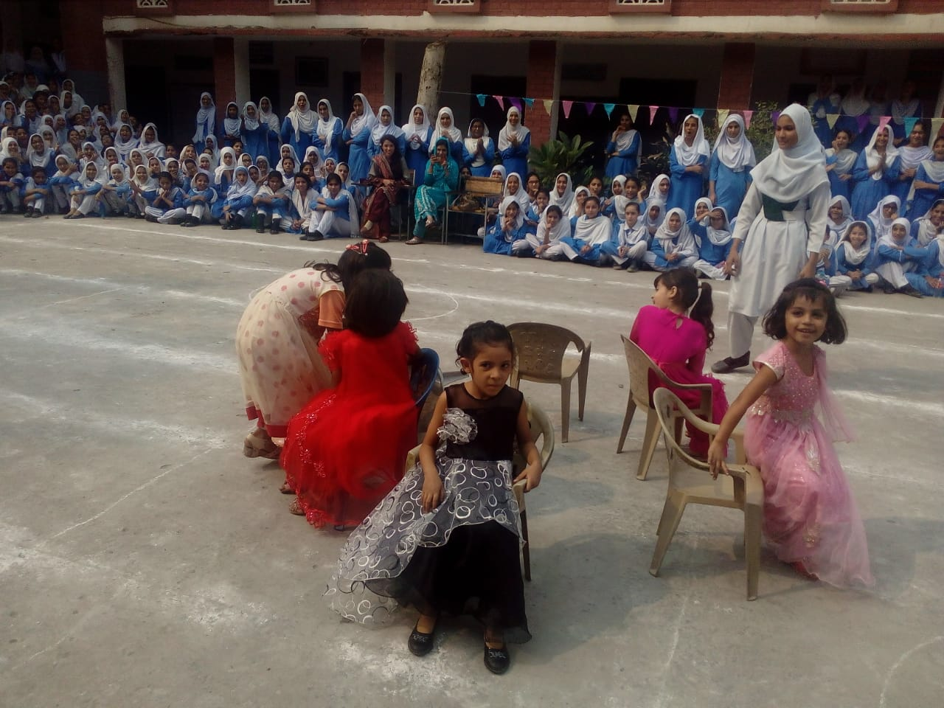
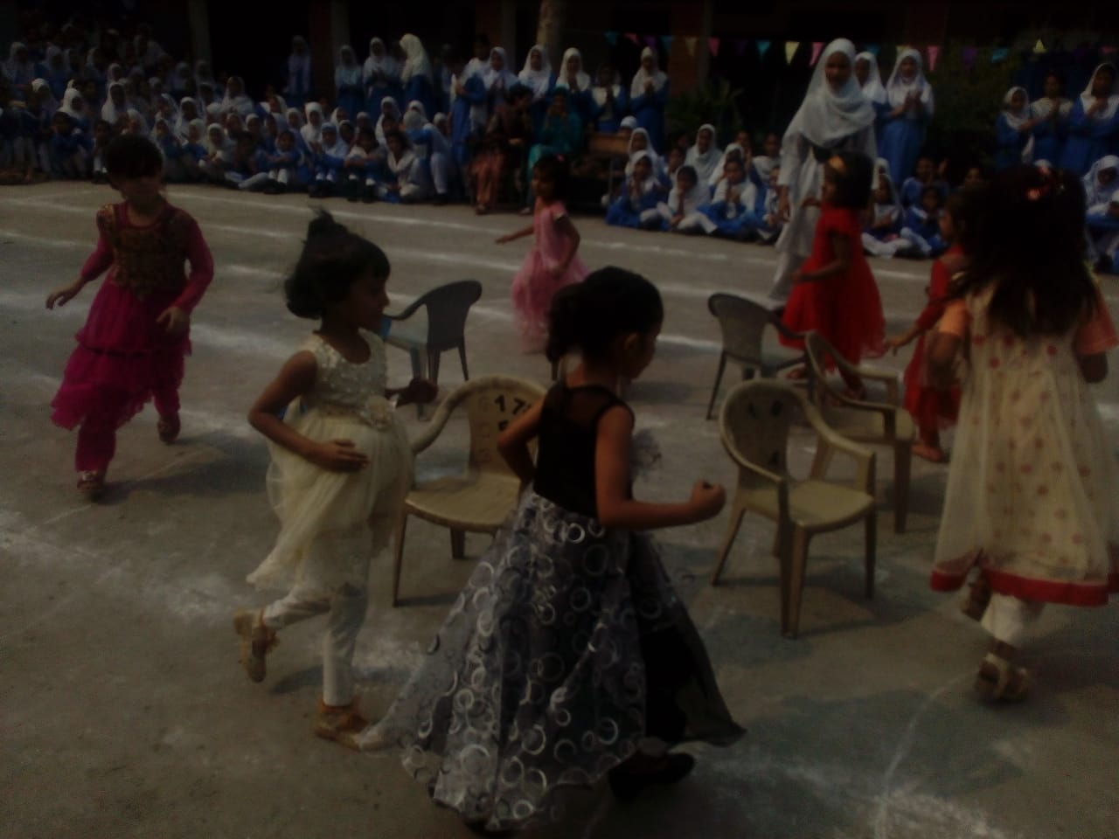
ACTIVITY NO: 03 (SCHOOL SPORTS)
SCHOOL: CITY GOVT. DISTRICT HIGH SCHOOL, PAKISTAN

Slide 8
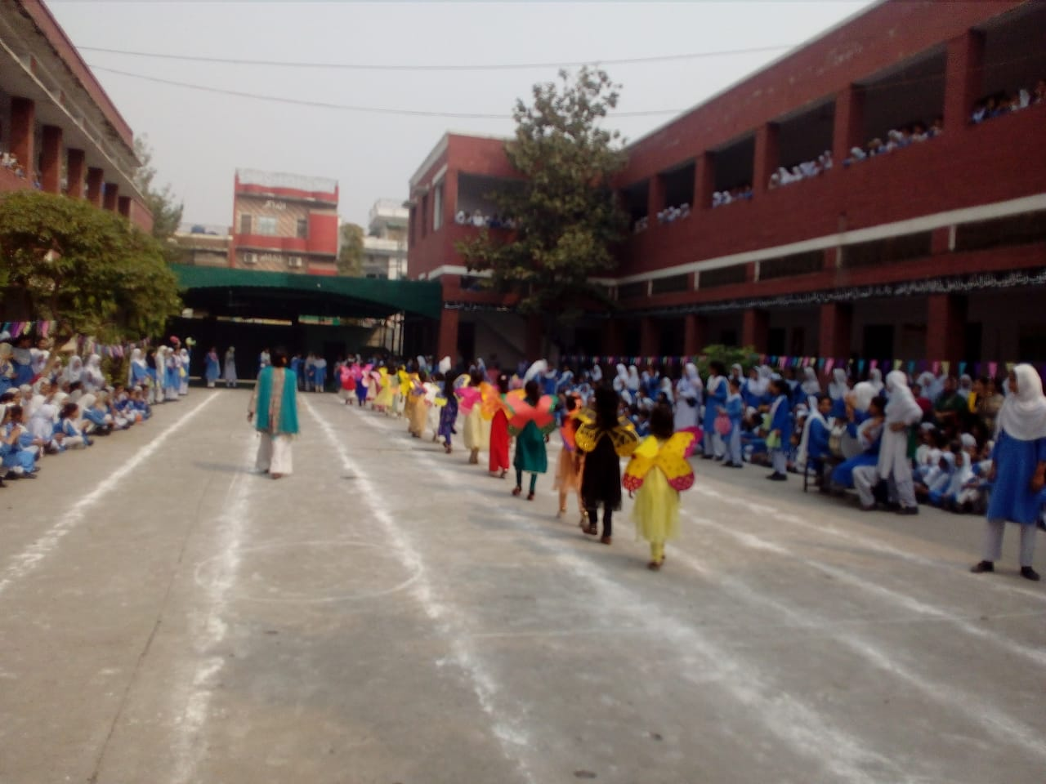
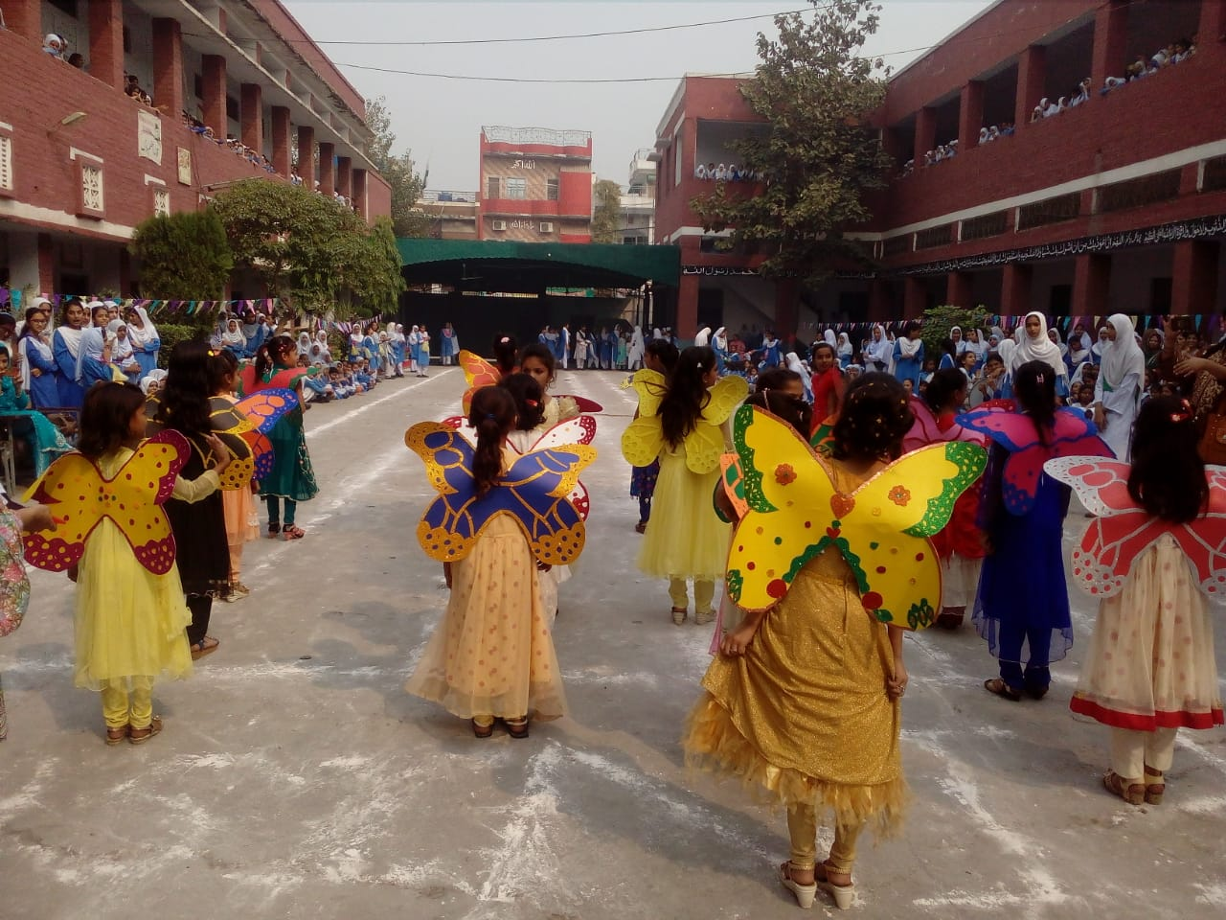
ACTIVITY NO: 03 (SCHOOL SPORTS)
SCHOOL: CITY GOVT. DISTRICT HIGH SCHOOL, PAKISTAN

Slide 9
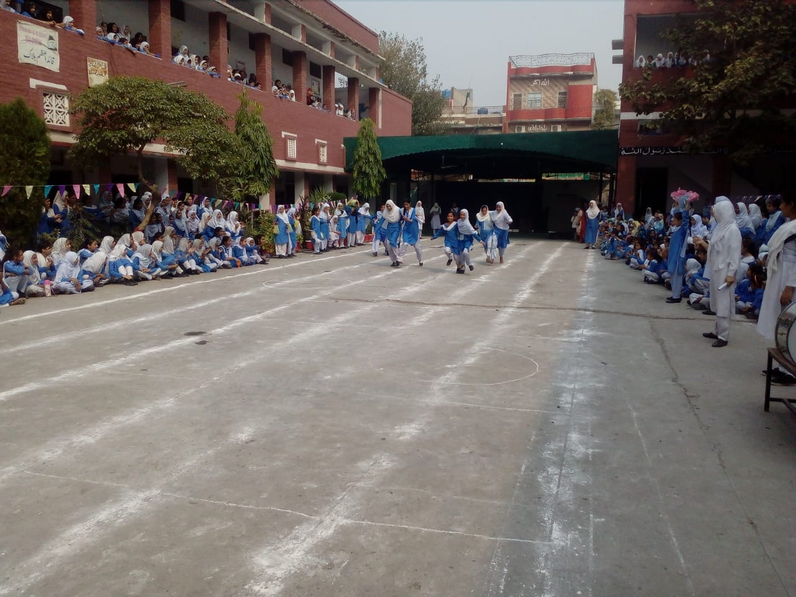
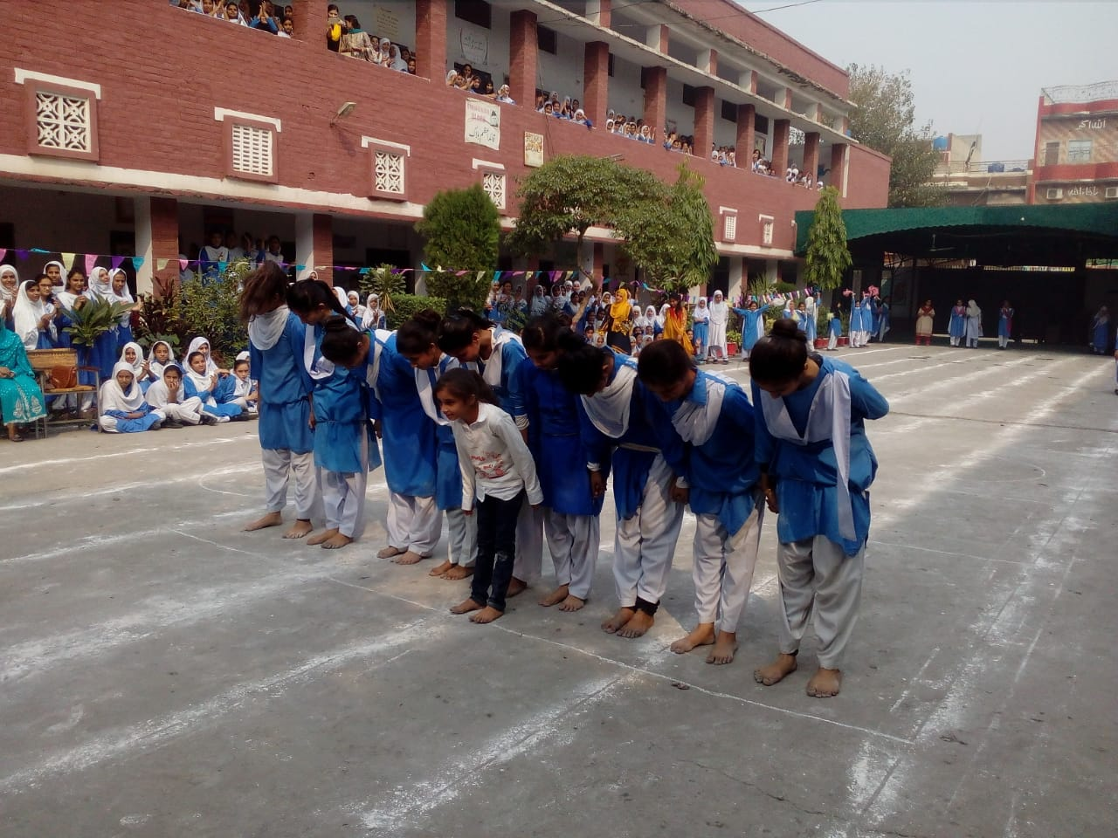
ACTIVITY NO: 03 (SCHOOL SPORTS)
SCHOOL: CITY GOVT. DISTRICT HIGH SCHOOL, PAKISTAN

Slide 10
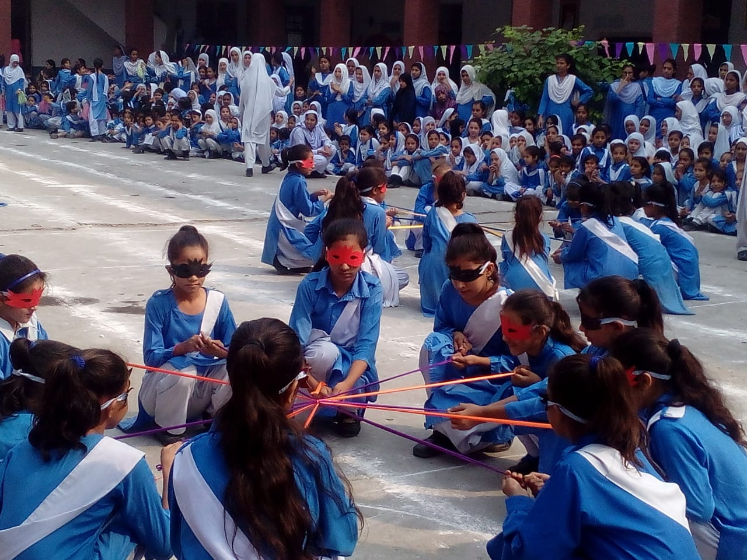
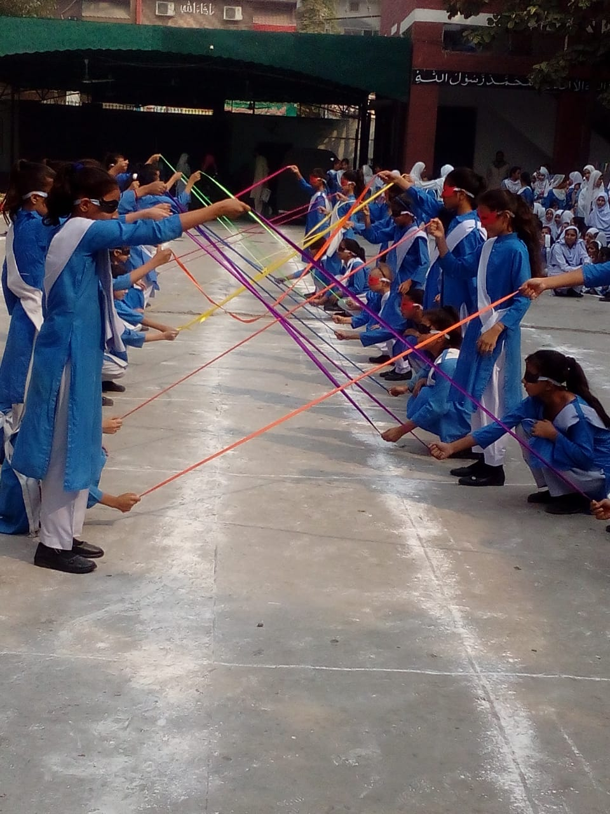
ACTIVITY NO: 03 (SCHOOL SPORTS)
SCHOOL: CITY GOVT. DISTRICT HIGH SCHOOL, PAKISTAN

Slide 11
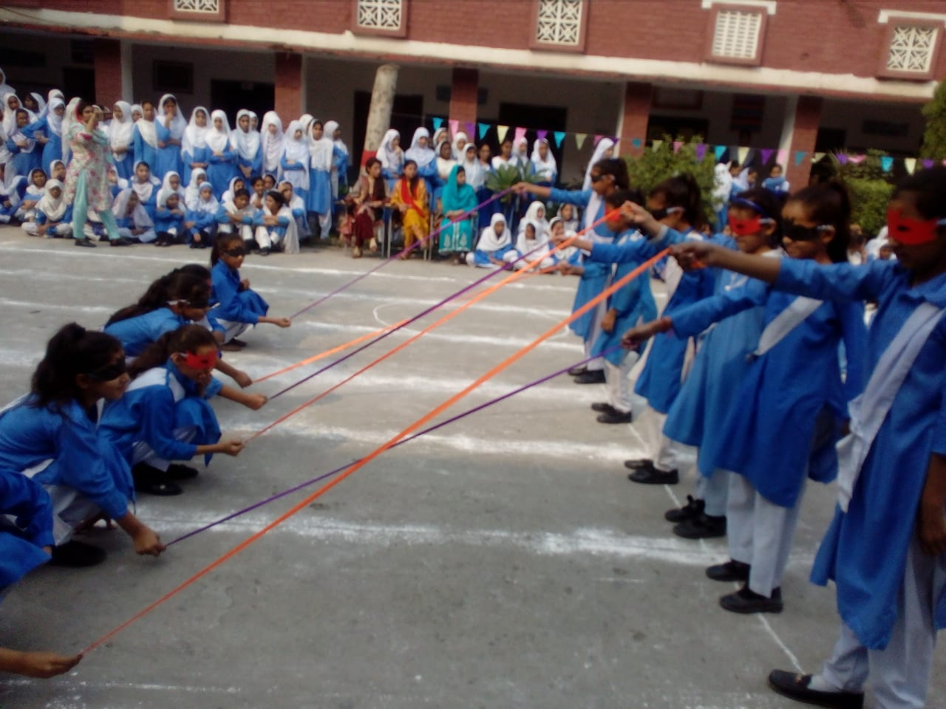
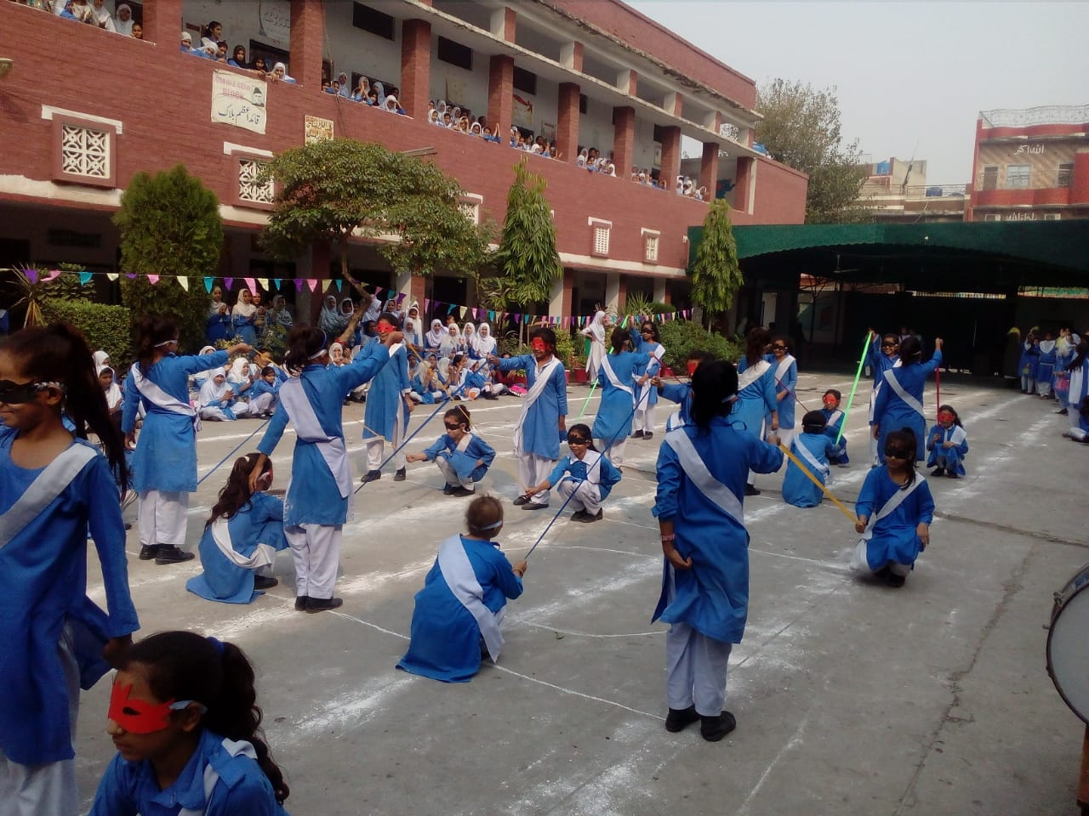
ACTIVITY NO: 03 (SCHOOL SPORTS)
SCHOOL: CITY GOVT. DISTRICT HIGH SCHOOL, PAKISTAN

Slide 12
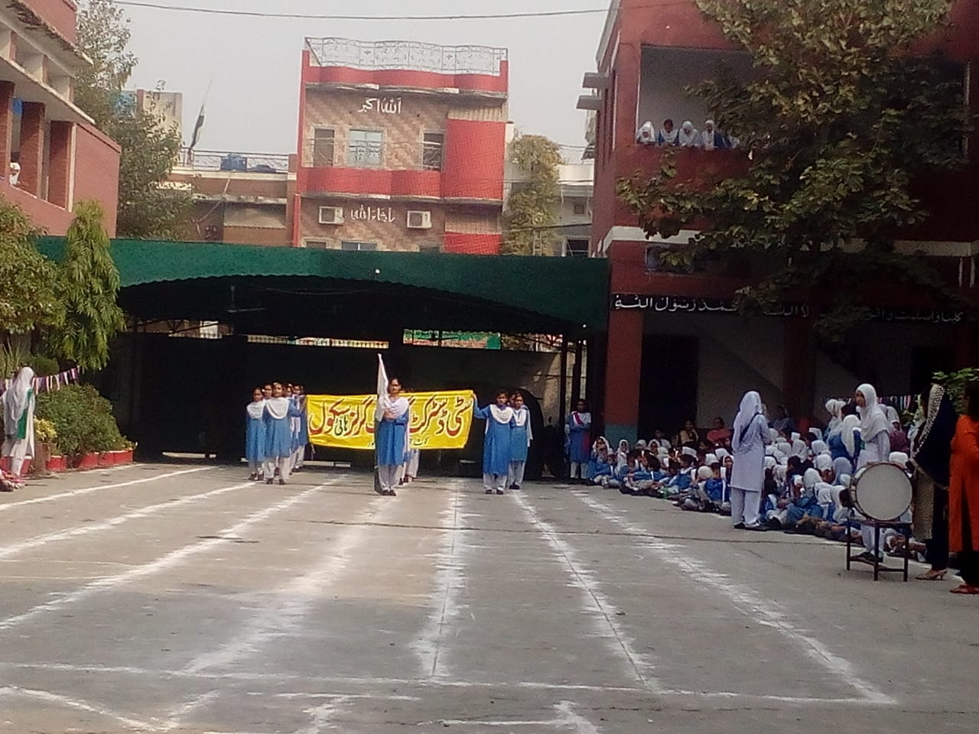
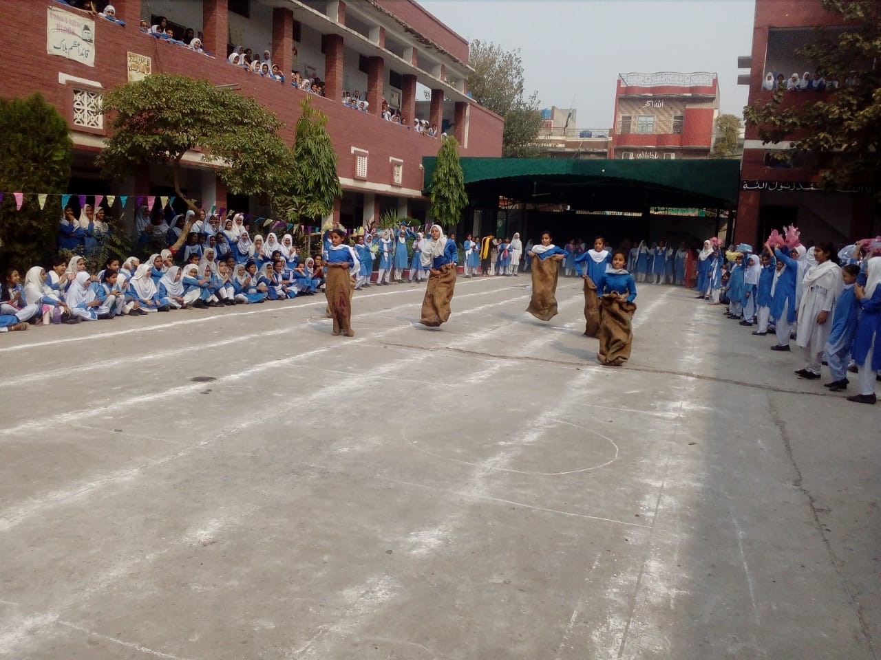
ACTIVITY NO: 03 (SCHOOL SPORTS)
SCHOOL: CITY GOVT. DISTRICT HIGH SCHOOL, PAKISTAN

Slide 13
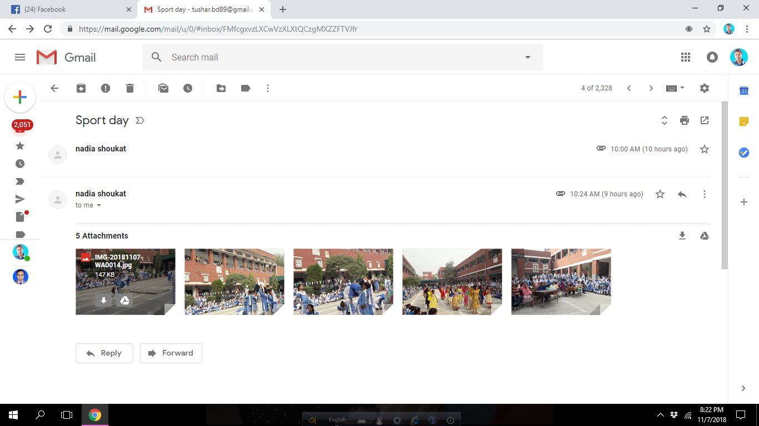
Evidence Of Activities

Slide 14
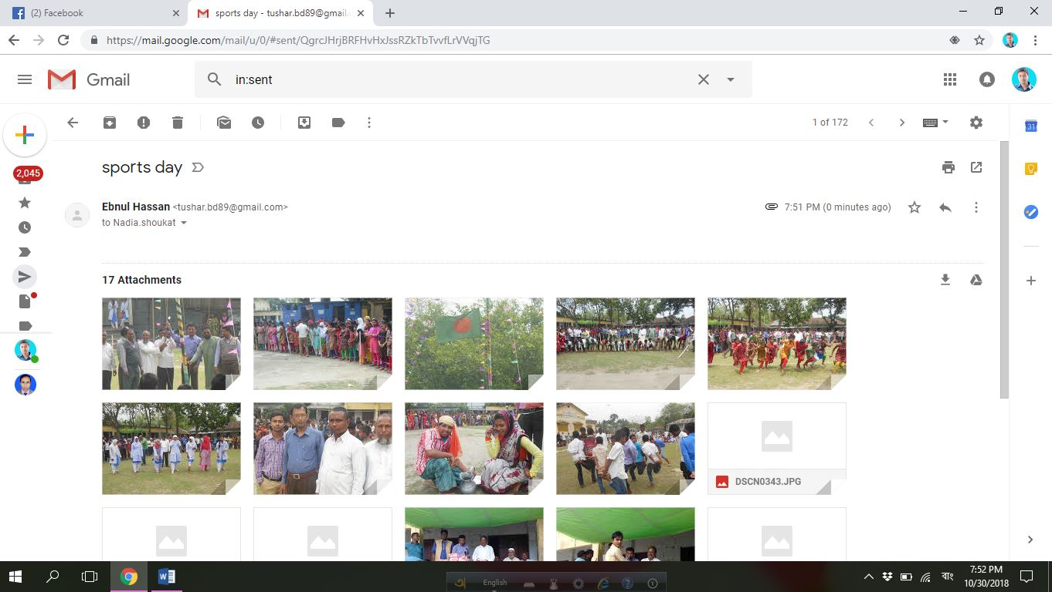
Evidence Of Activities

