Slide 1
ACTIVITY NUMBER: 04
SUBJECT: TREE PLANTATION
PHOTO ALBUM OF: SHARING ACTIVITIES
School’s Name: Ranachandi School and College, Kishoreganj, Nilphamari, Bangladesh
Coordinator’s name: Ebnulhassan Tushar
E-mail: tusharbd89@gmail.com
Partner School’s Name: CARE Adopted C.D.G. Girls High School, QLS, Lahore, Pakistan
Coordinator’s name: Tutheera Tul Zoohra
E-mail: tutheeratulzoohra@carepakistan.org
Sharing activities between Ranachandi School and College, Bangladesh and CARE Adopted C.D.G. Girls High School, Pakistan

Slide 2
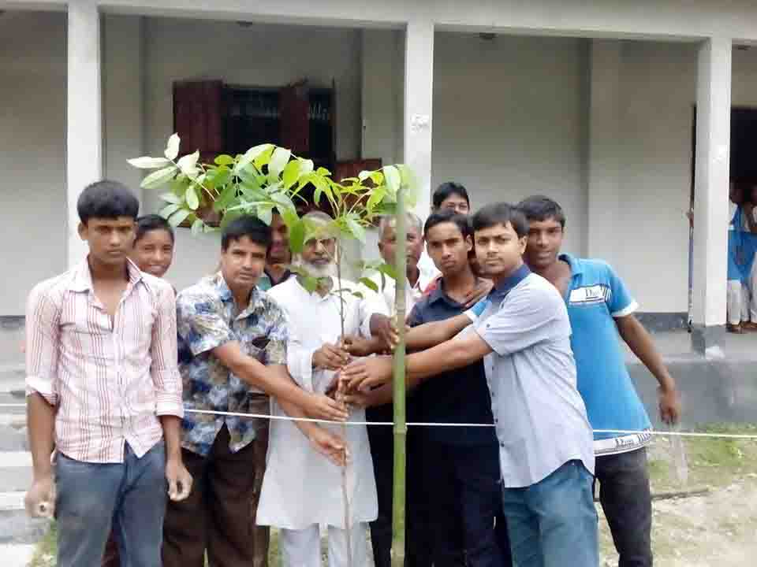
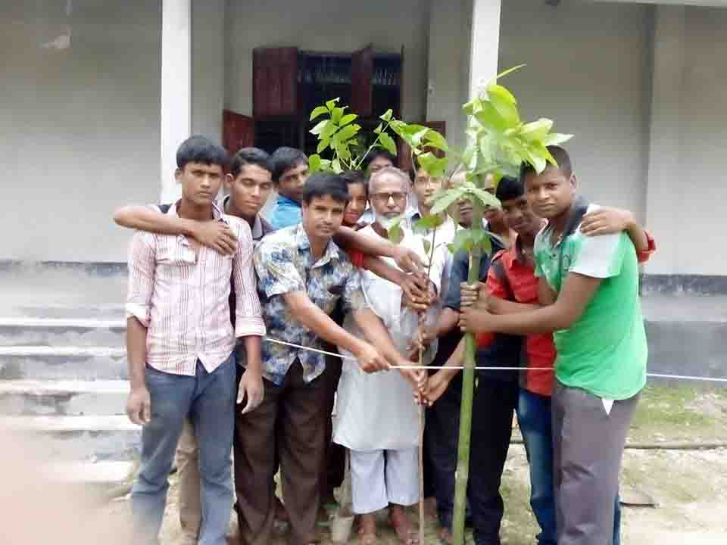
ACTIVITY NO: 04 (Tree Plantation)
SCHOOL: RANACHANDI SCHOOL AND COLLEGE

Slide 3
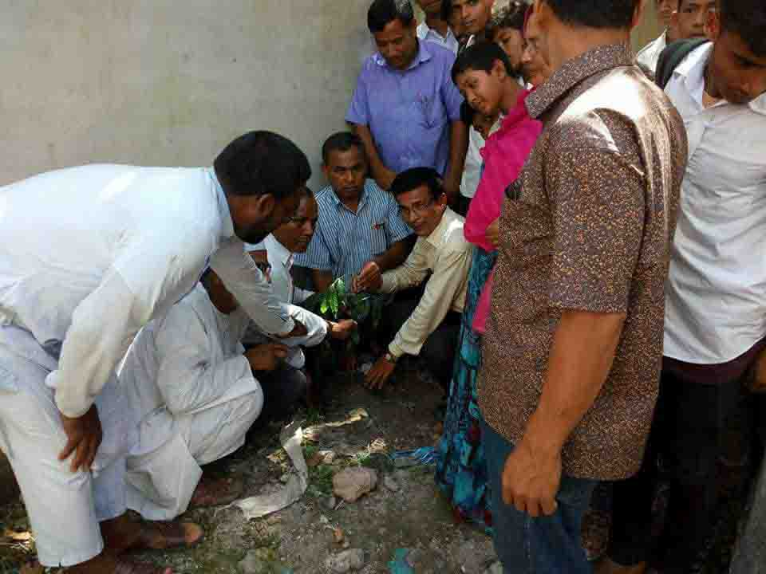
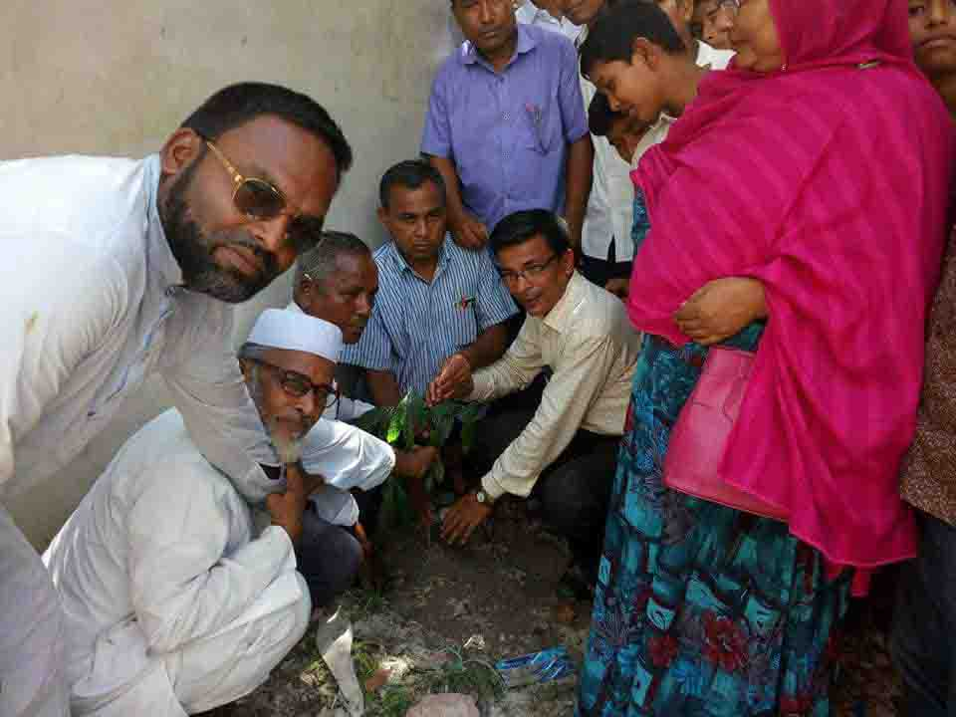
ACTIVITY NO: 04 (Tree Plantation)
SCHOOL: RANACHANDI SCHOOL AND COLLEGE

Slide 4
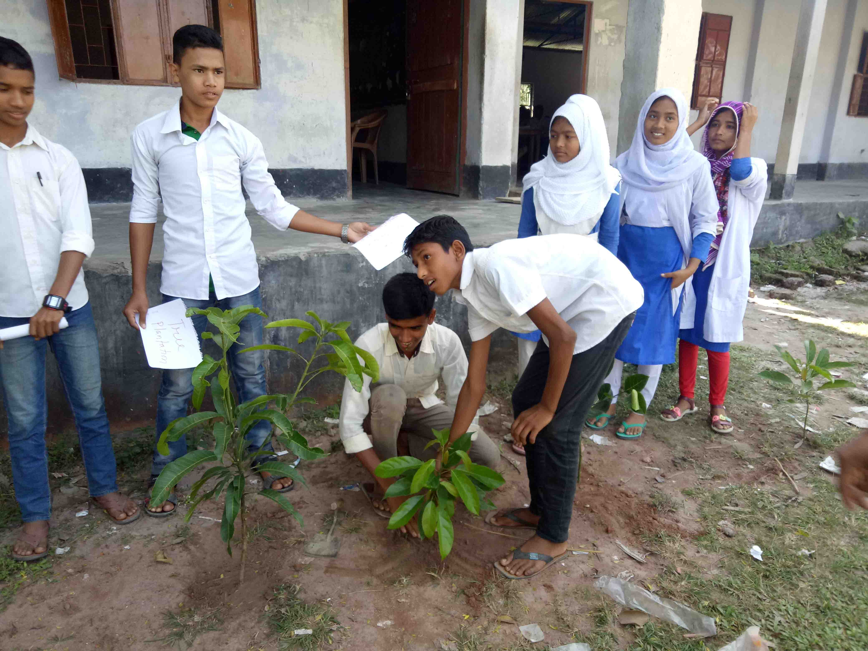
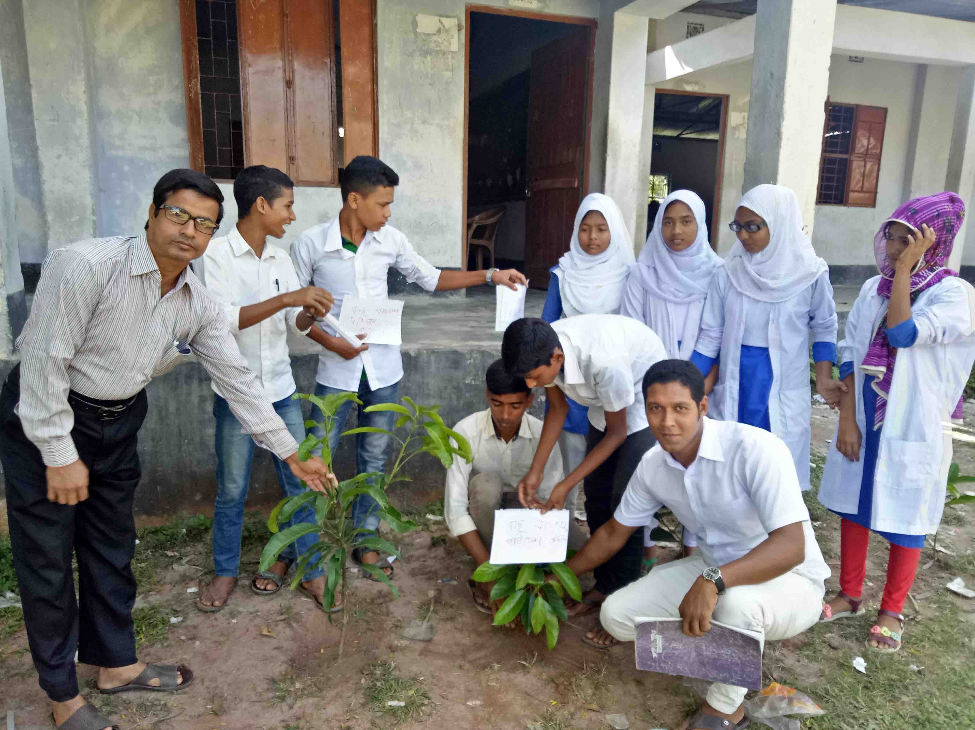
ACTIVITY NO: 04 (Tree Plantation)
SCHOOL: RANACHANDI SCHOOL AND COLLEGE

Slide 5
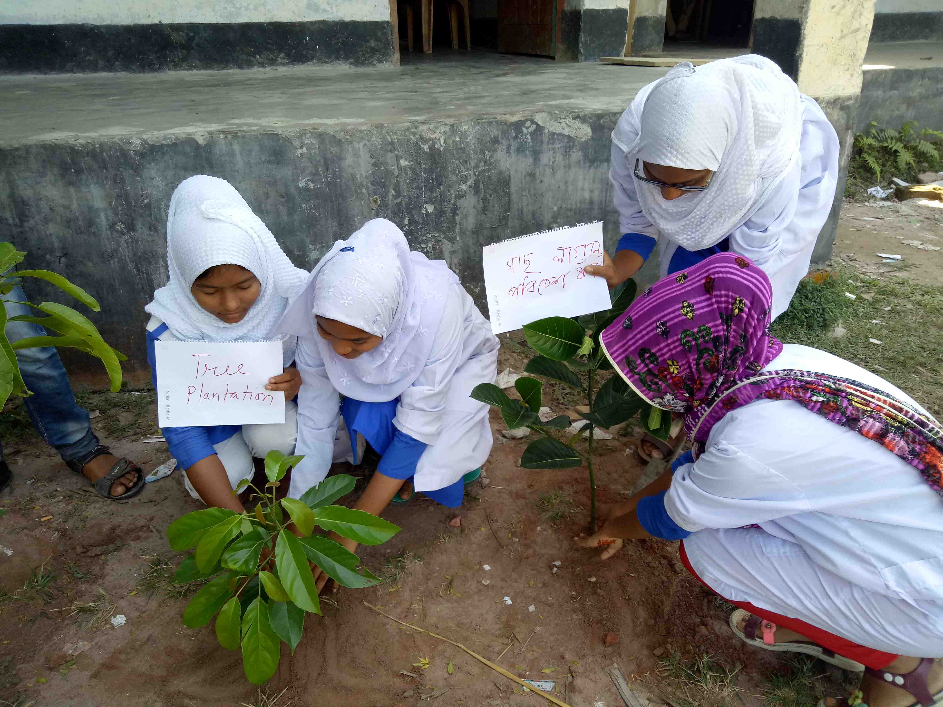
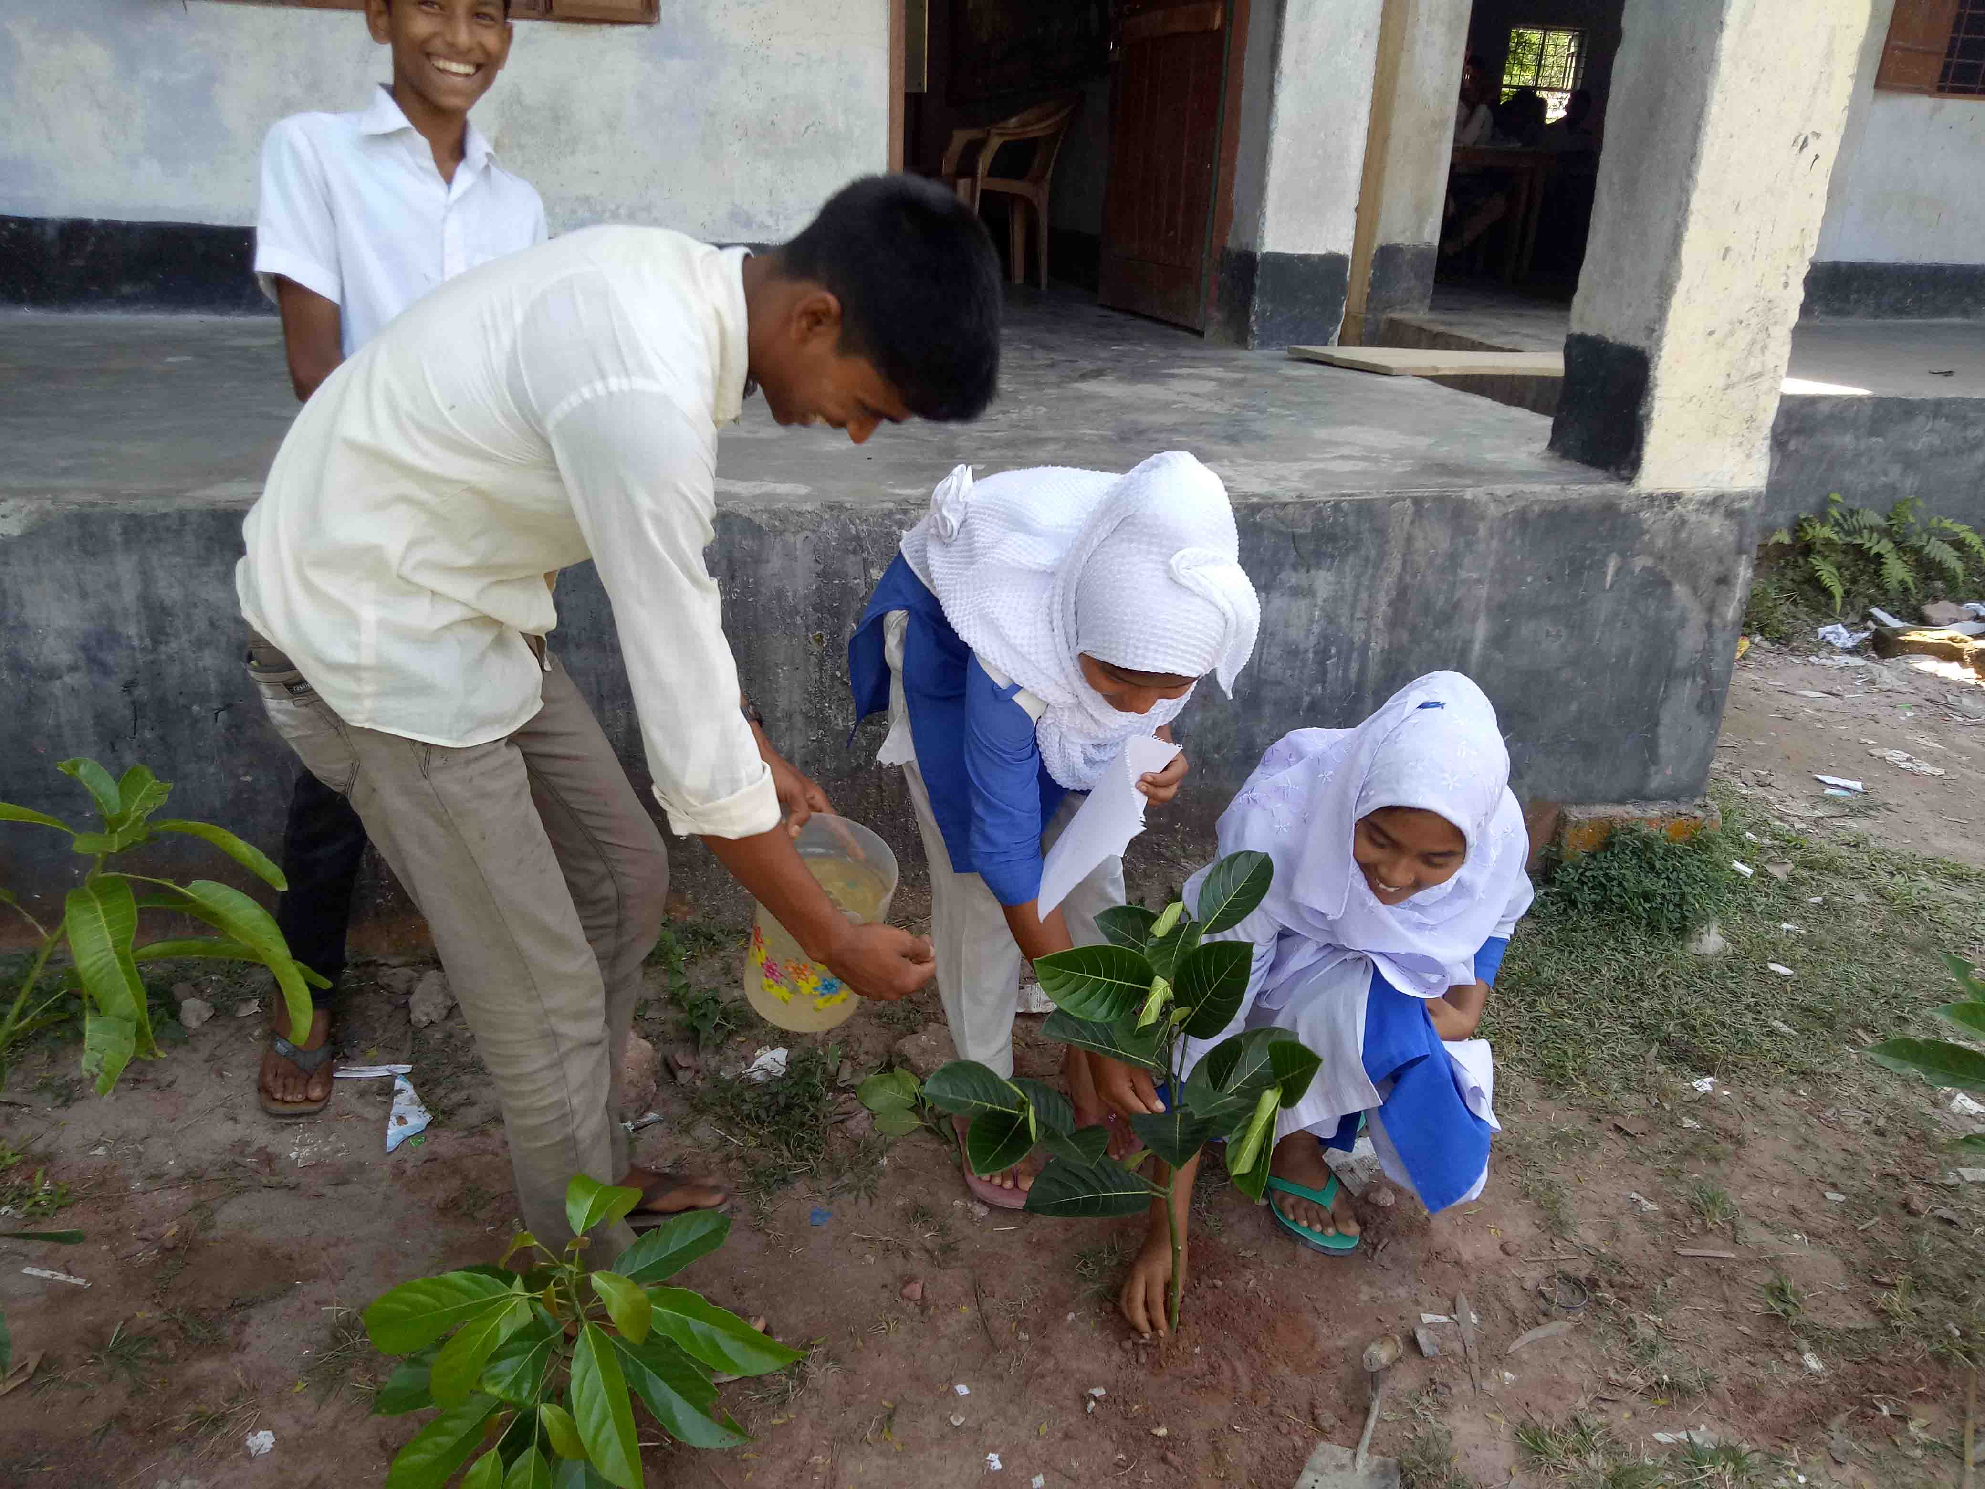
ACTIVITY NO: 04 (Tree Plantation)
SCHOOL: RANACHANDI SCHOOL AND COLLEGE

Slide 6
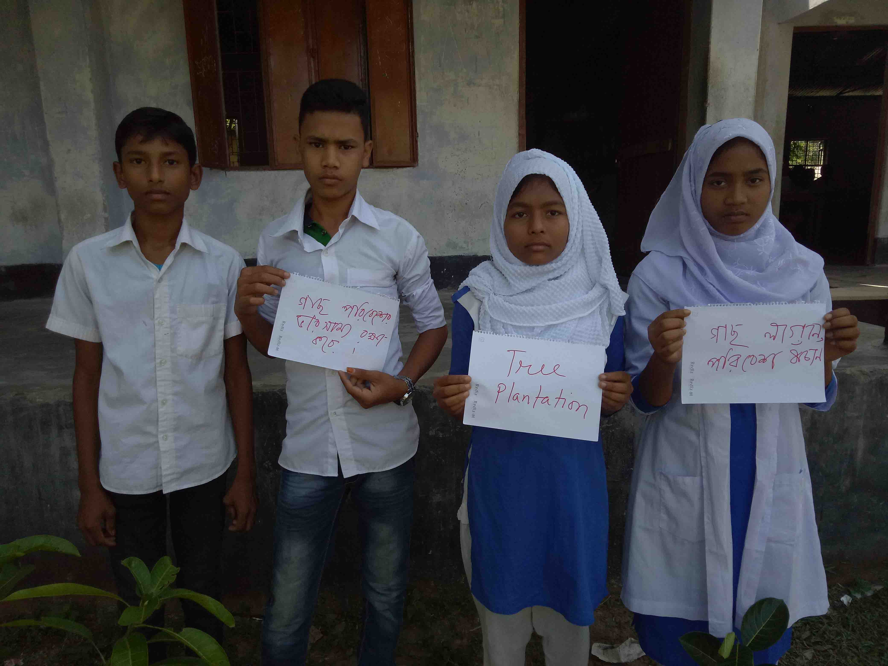
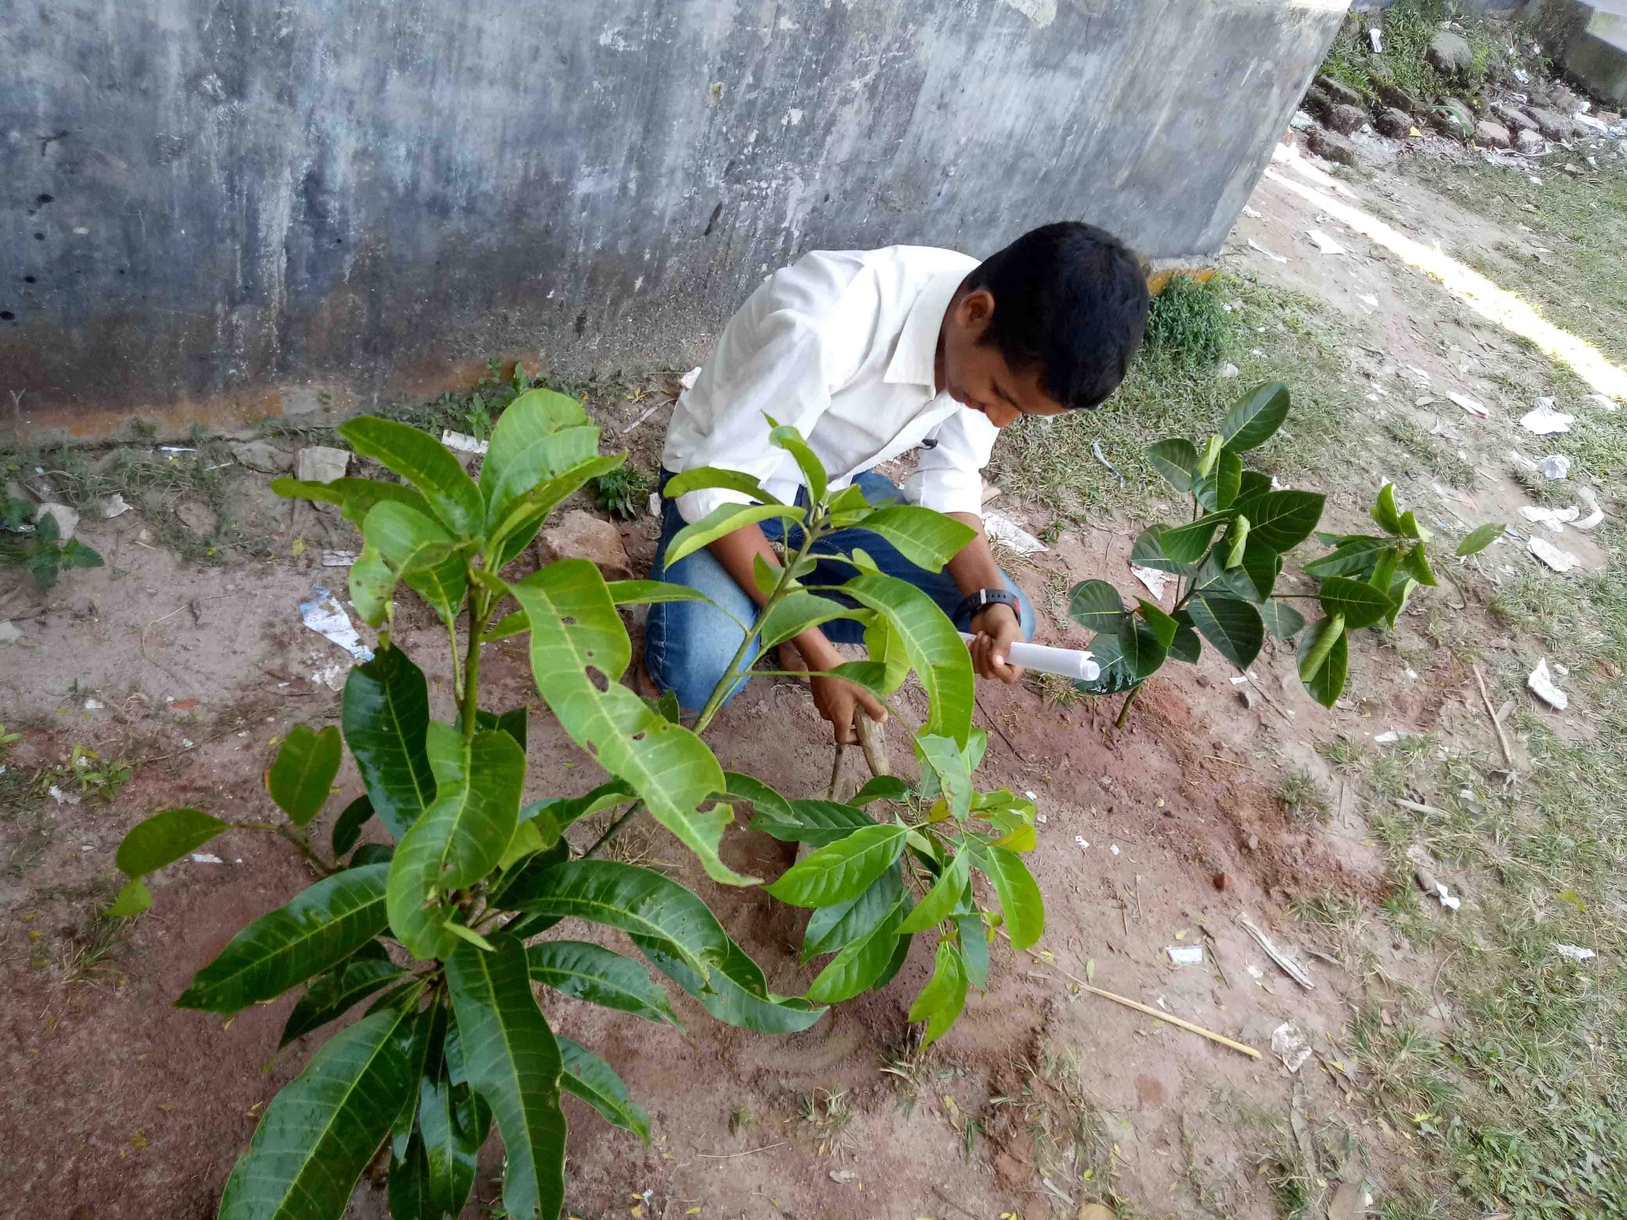
ACTIVITY NO: 04 (Tree Plantation)
SCHOOL: RANACHANDI SCHOOL AND COLLEGE

Slide 7
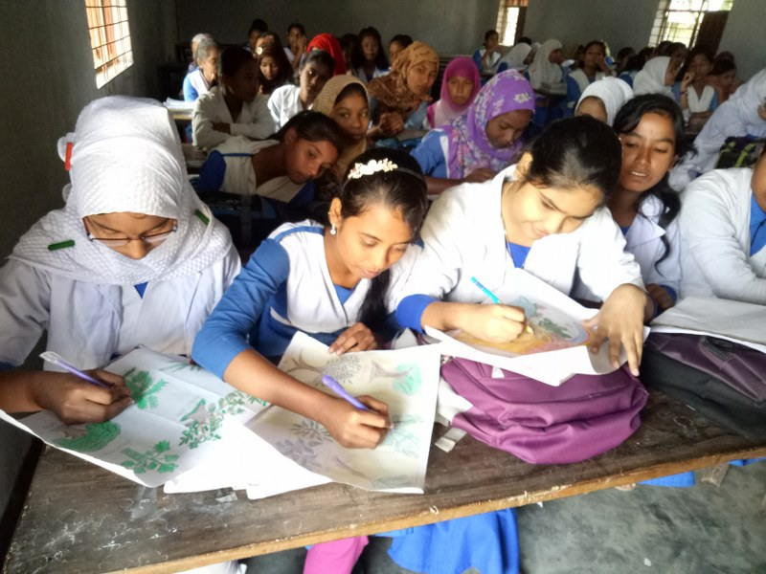
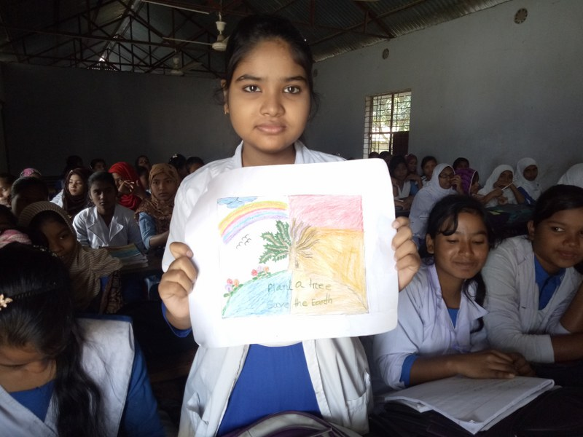
ACTIVITY NO: 04 (Tree Plantation)
SCHOOL: RANACHANDI SCHOOL AND COLLEGE

Slide 8
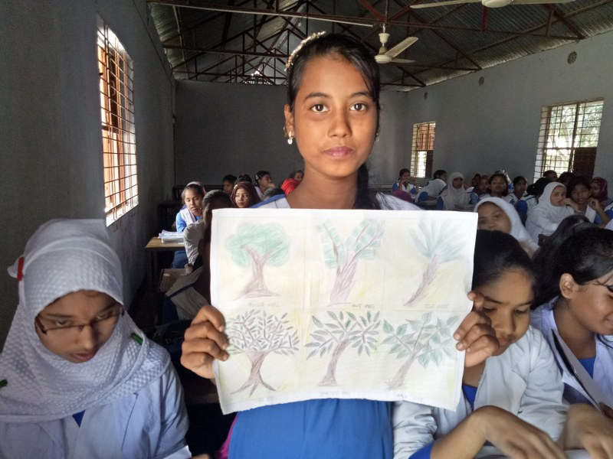
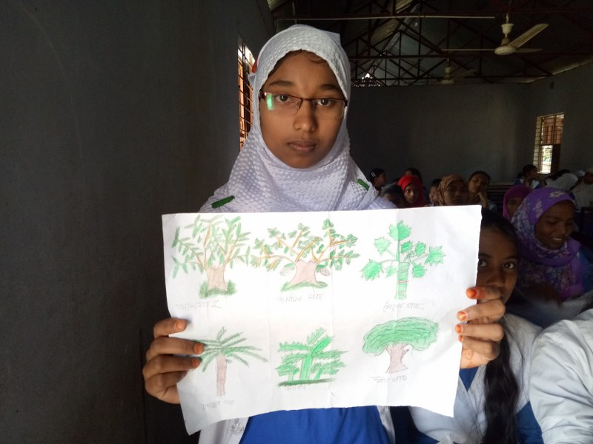
ACTIVITY NO: 04 (Tree Plantation)
SCHOOL: RANACHANDI SCHOOL AND COLLEGE

Slide 9
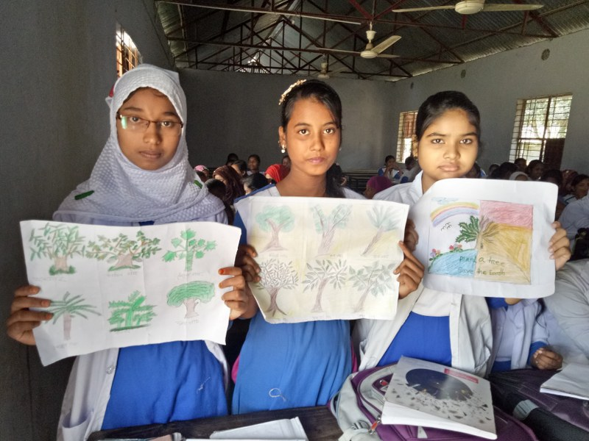
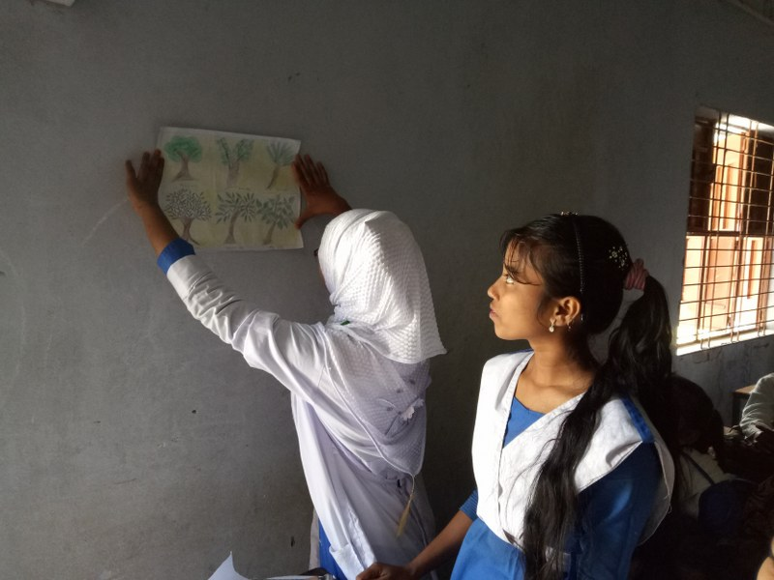
ACTIVITY NO: 04 (Tree Plantation)
SCHOOL: RANACHANDI SCHOOL AND COLLEGE

Slide 10
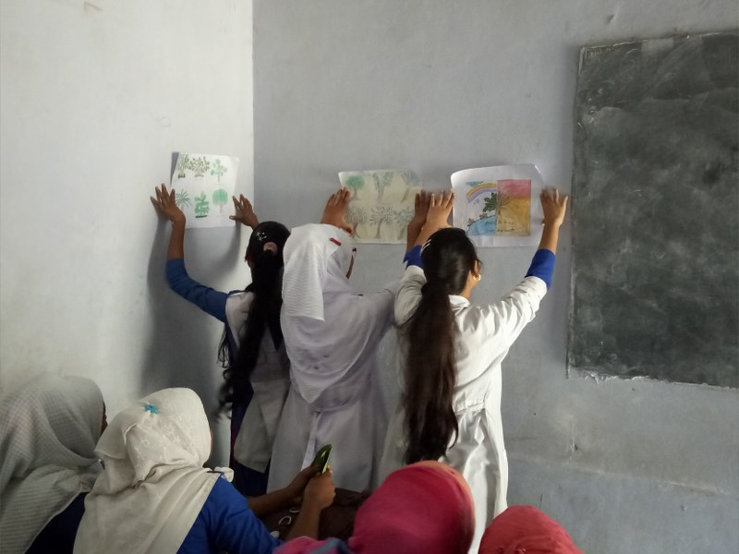
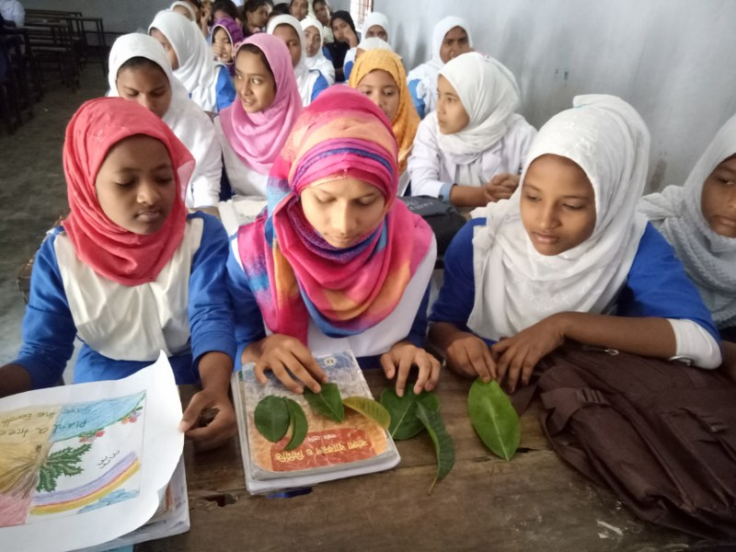
ACTIVITY NO: 04 (Tree Plantation)
SCHOOL: RANACHANDI SCHOOL AND COLLEGE

Slide 11
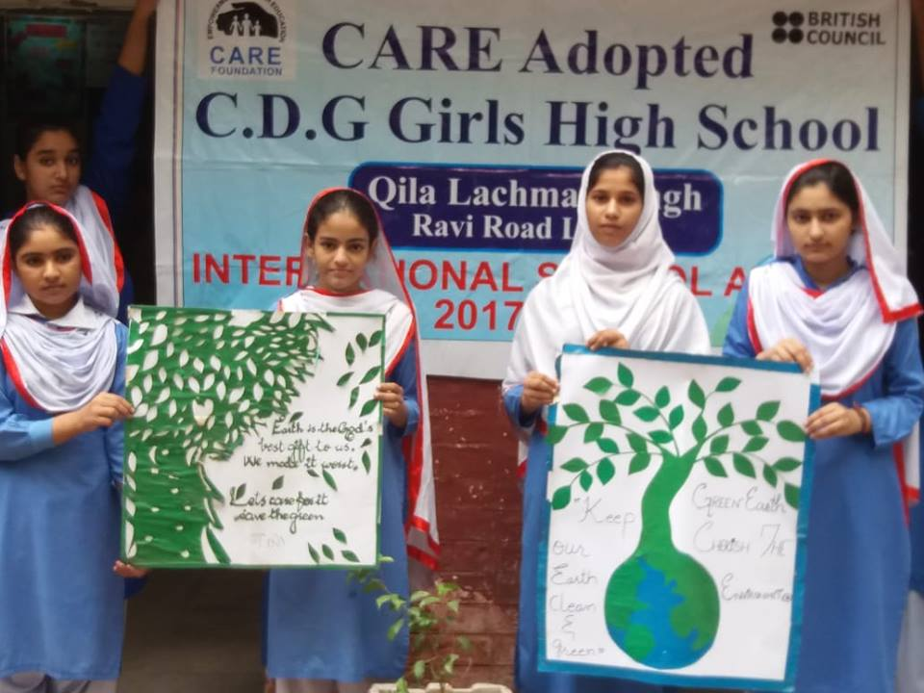
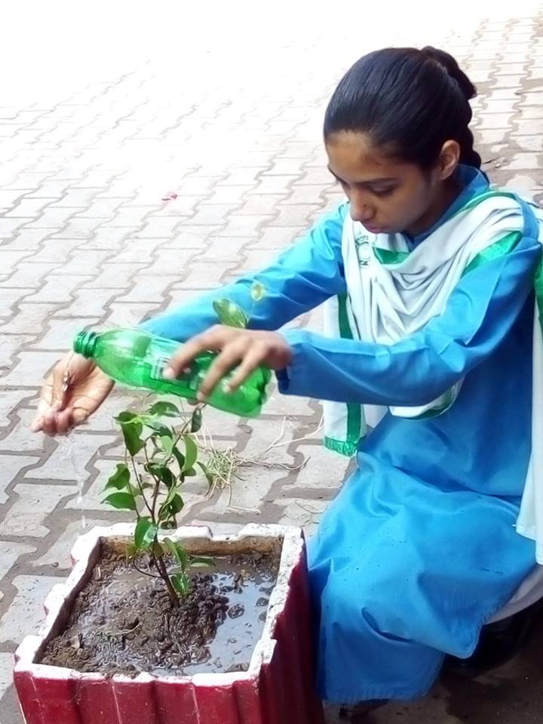
ACTIVITY NO: 04 (Tree Plantation)
SCHOOL: CARE ADOPTED C.D.G. GIRLS HIGH SCHOOL, PAKISTAN

Slide 12
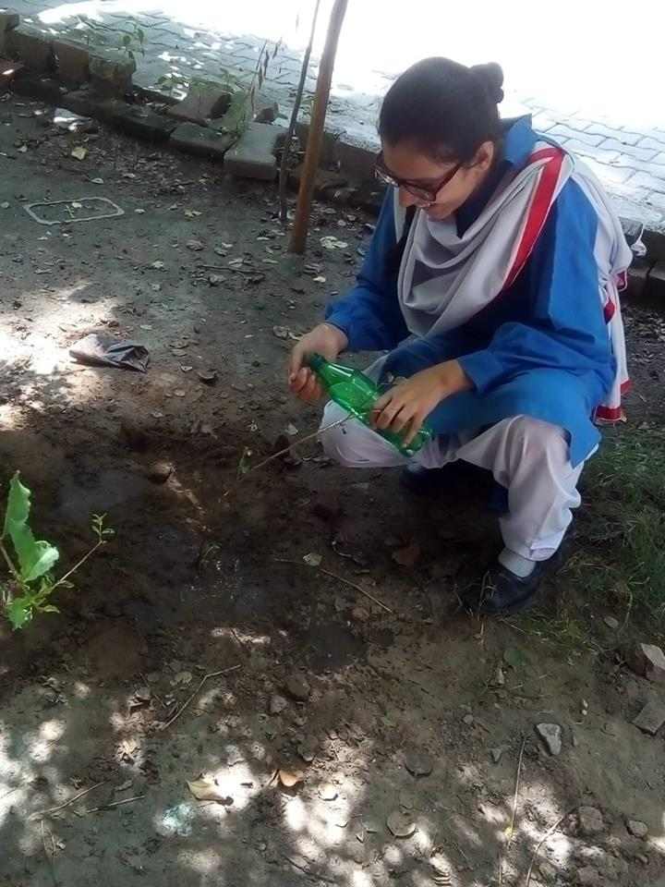
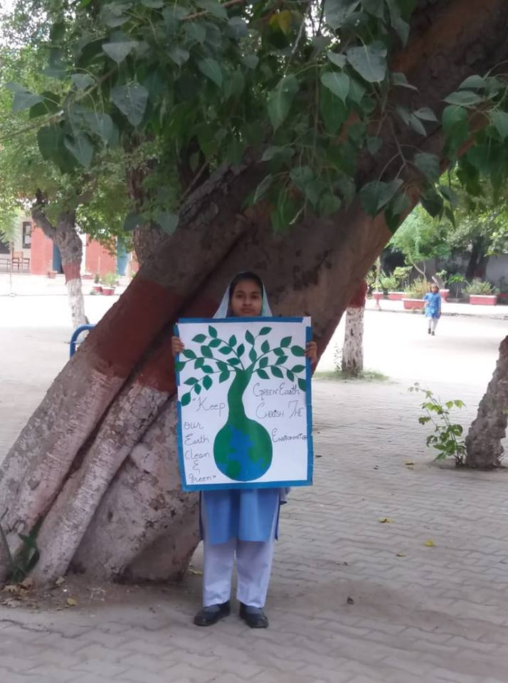
ACTIVITY NO: 04 (Tree Plantation)
SCHOOL: CARE ADOPTED C.D.G. GIRLS HIGH SCHOOL, PAKISTAN

Slide 13
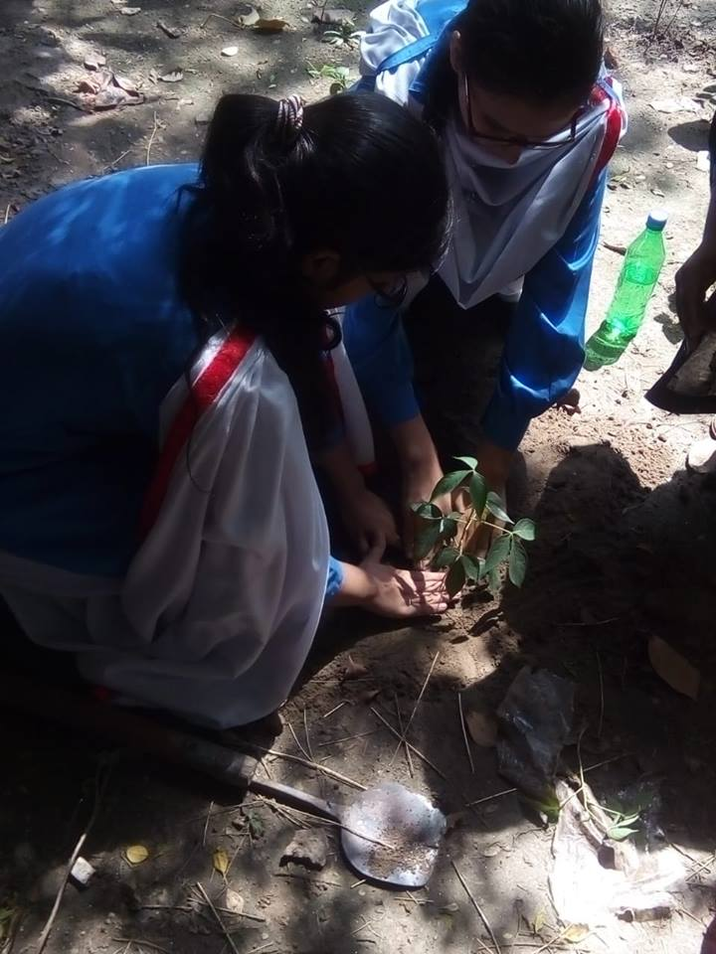
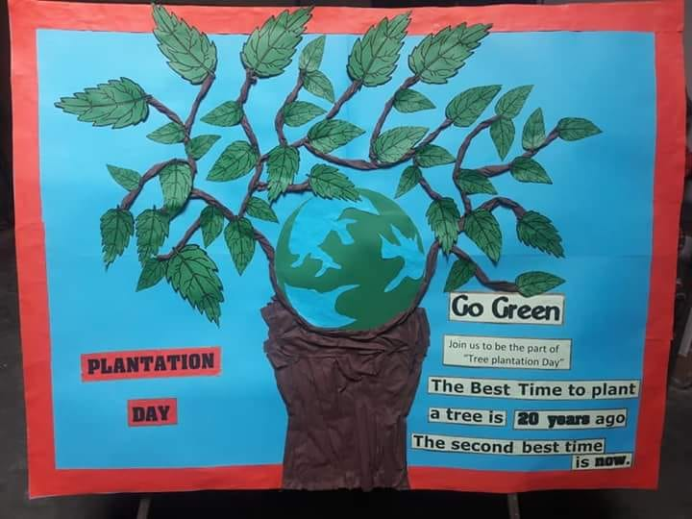
ACTIVITY NO: 04 (Tree Plantation)
SCHOOL: CARE ADOPTED C.D.G. GIRLS HIGH SCHOOL, PAKISTAN

Slide 14
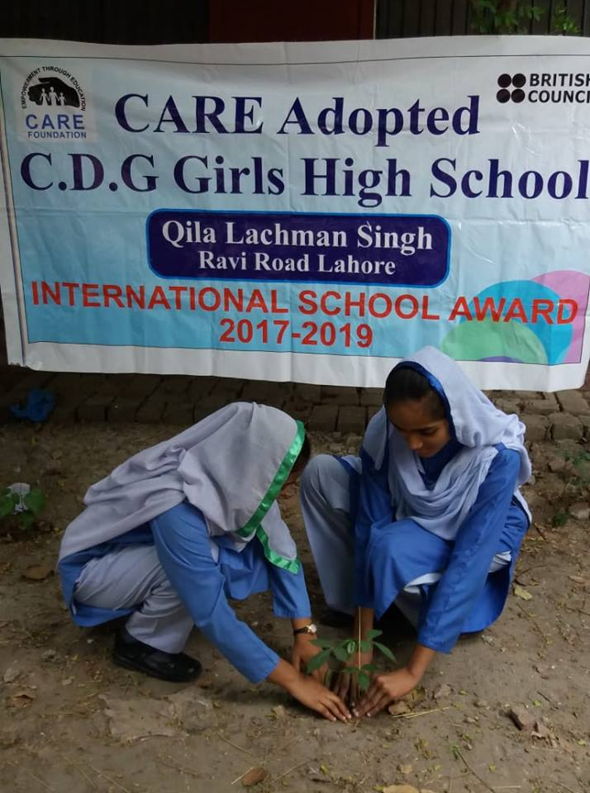
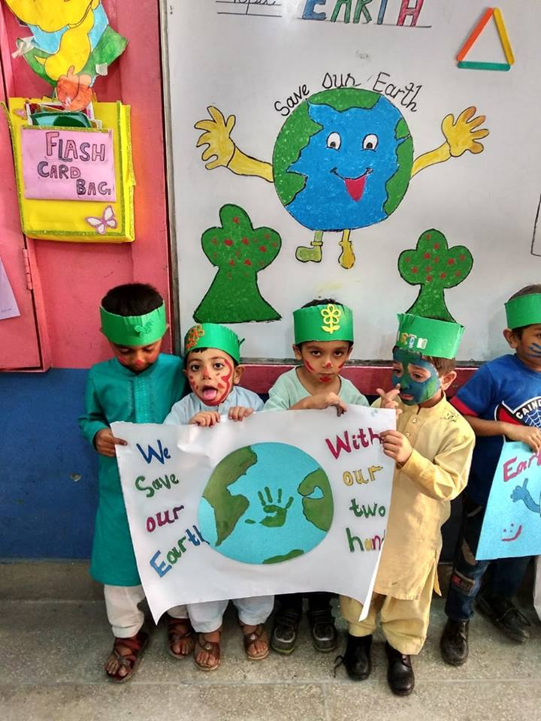
ACTIVITY NO: 04 (Tree Plantation)
SCHOOL: CARE ADOPTED C.D.G. GIRLS HIGH SCHOOL, PAKISTAN

Slide 15
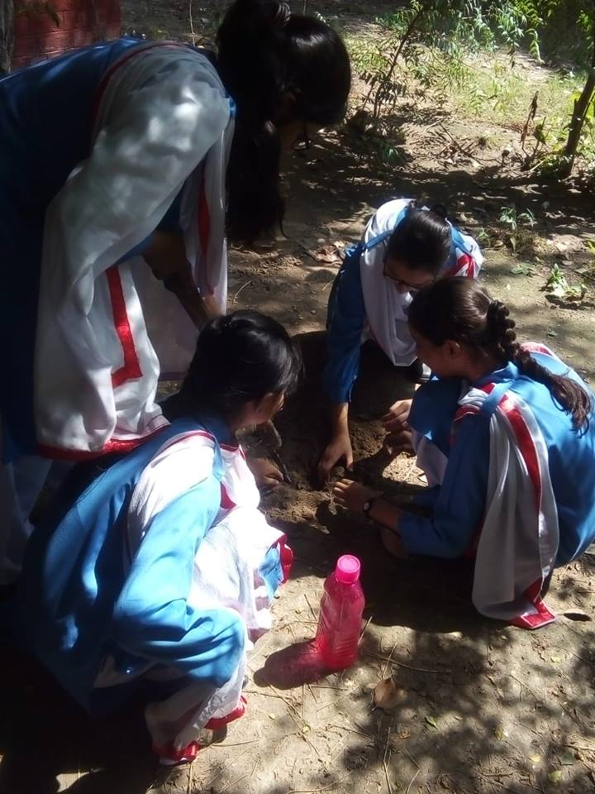
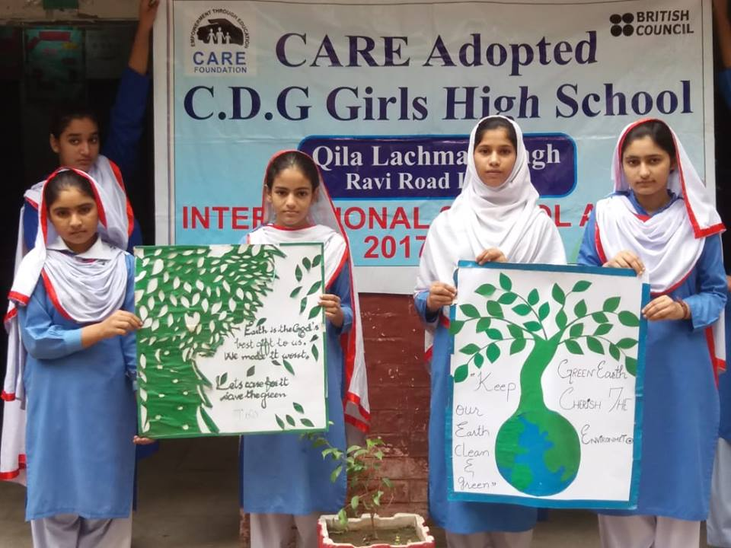
ACTIVITY NO: 04 (Tree Plantation)
SCHOOL: CARE ADOPTED C.D.G. GIRLS HIGH SCHOOL, PAKISTAN

Slide 16
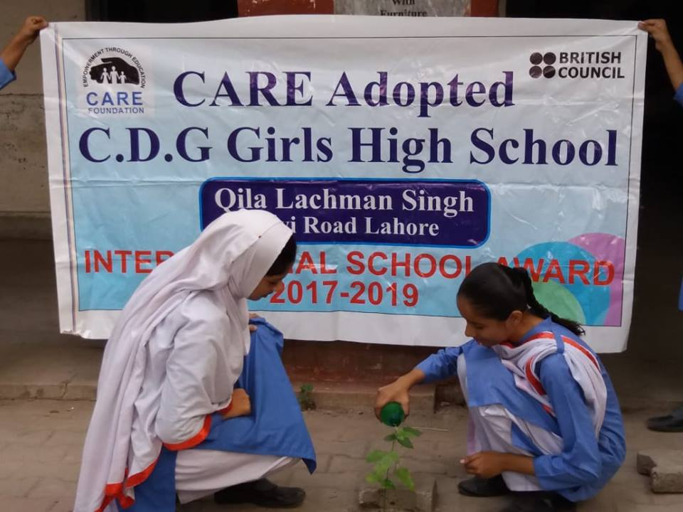
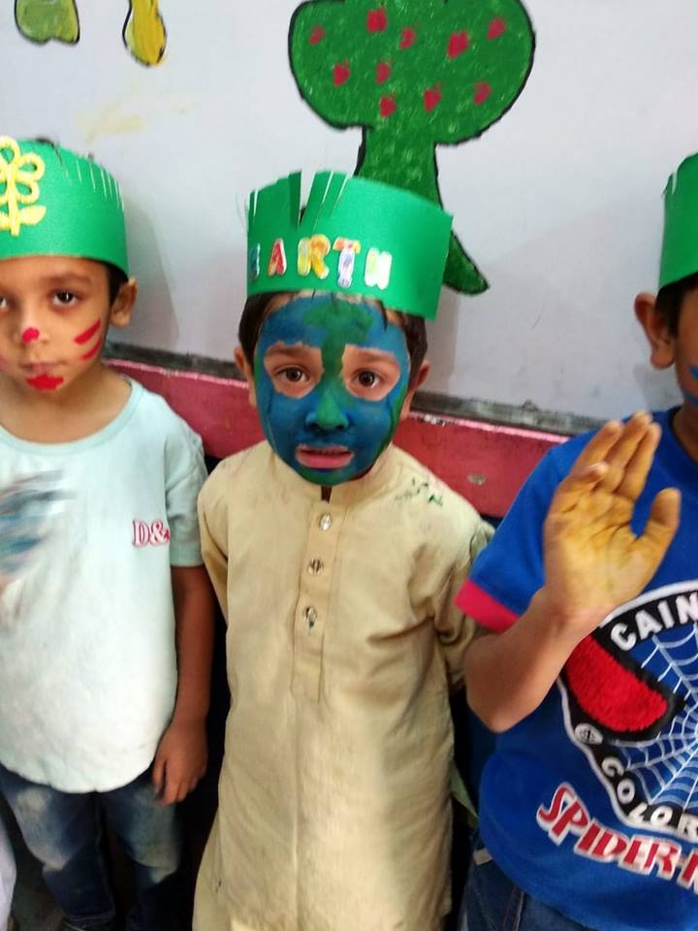
ACTIVITY NO: 04 (Tree Plantation)
SCHOOL: CARE ADOPTED C.D.G. GIRLS HIGH SCHOOL, PAKISTAN

Slide 17
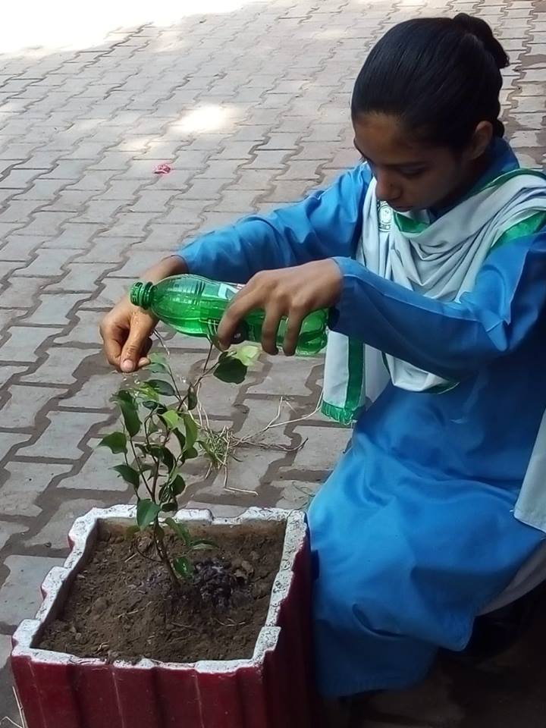
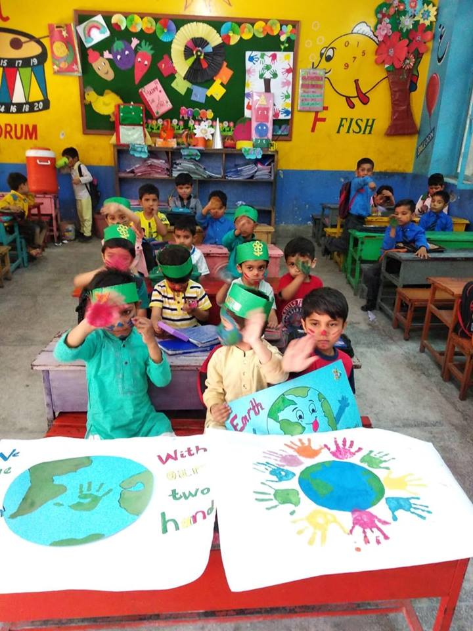
ACTIVITY NO: 04 (Tree Plantation)
SCHOOL: CARE ADOPTED C.D.G. GIRLS HIGH SCHOOL, PAKISTAN

Slide 18
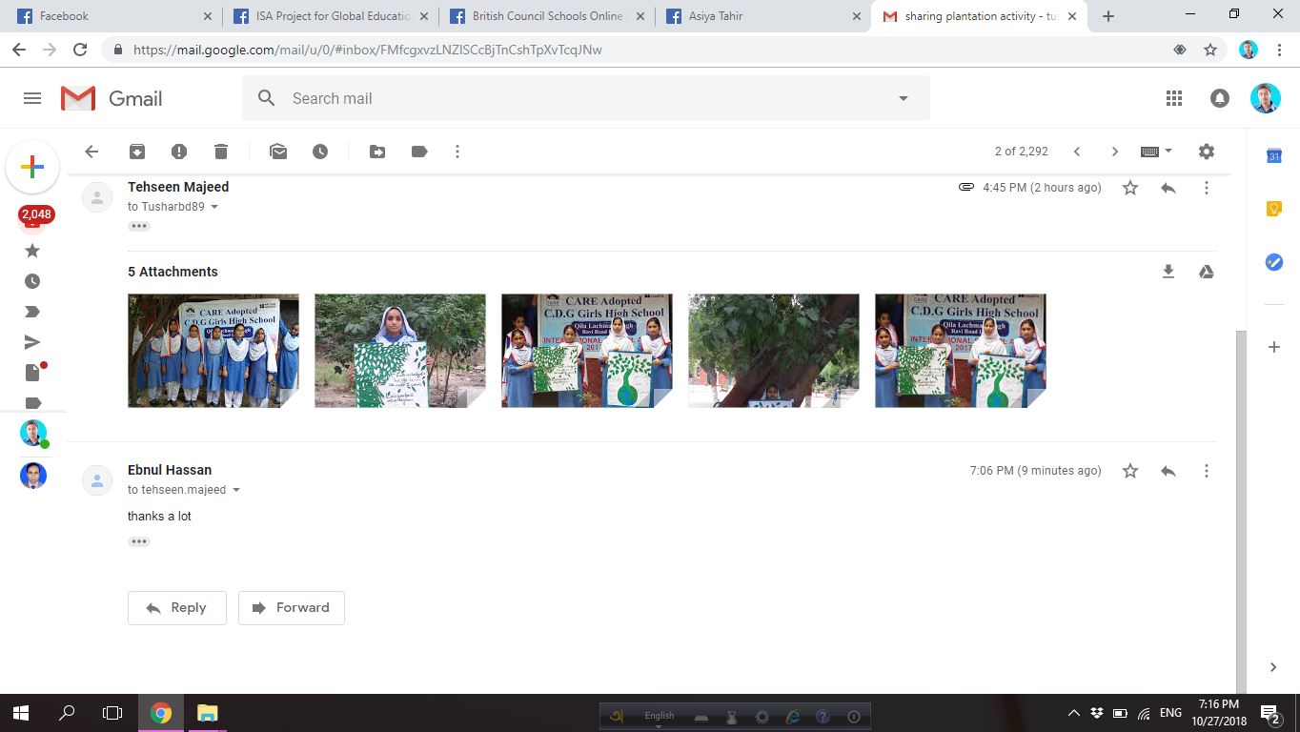
Evidence Of Activities

Slide 19
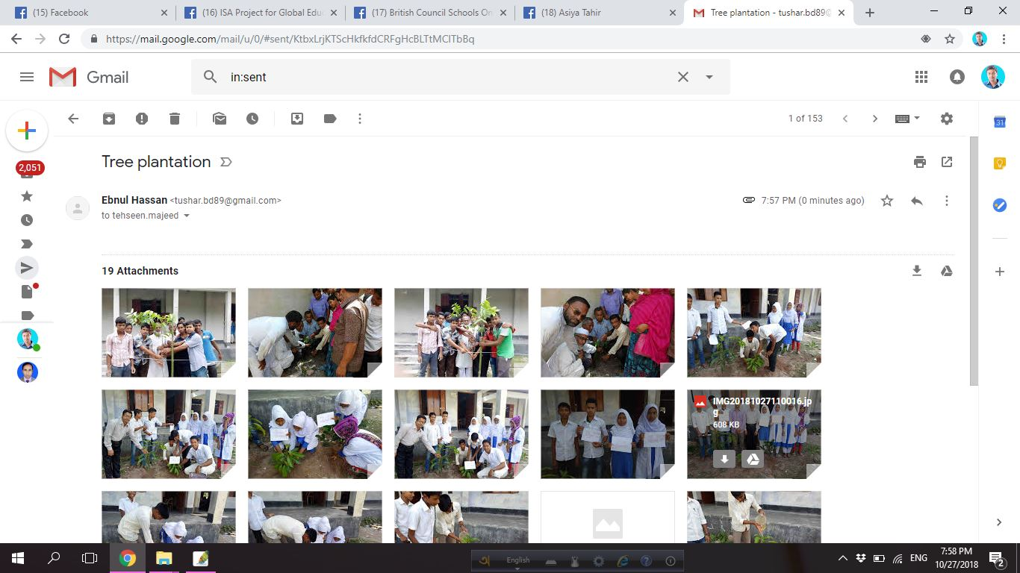
Evidence Of Activities

Slide 20
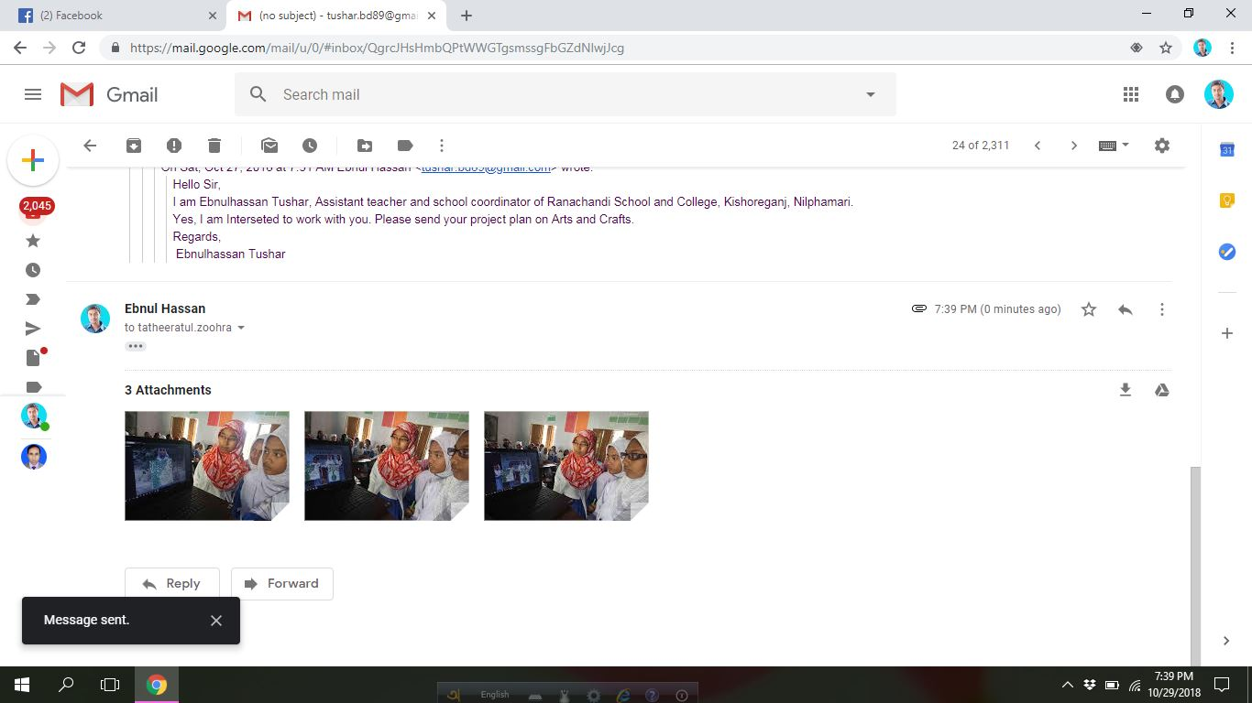
Evidence Of Activities

