Slide 1
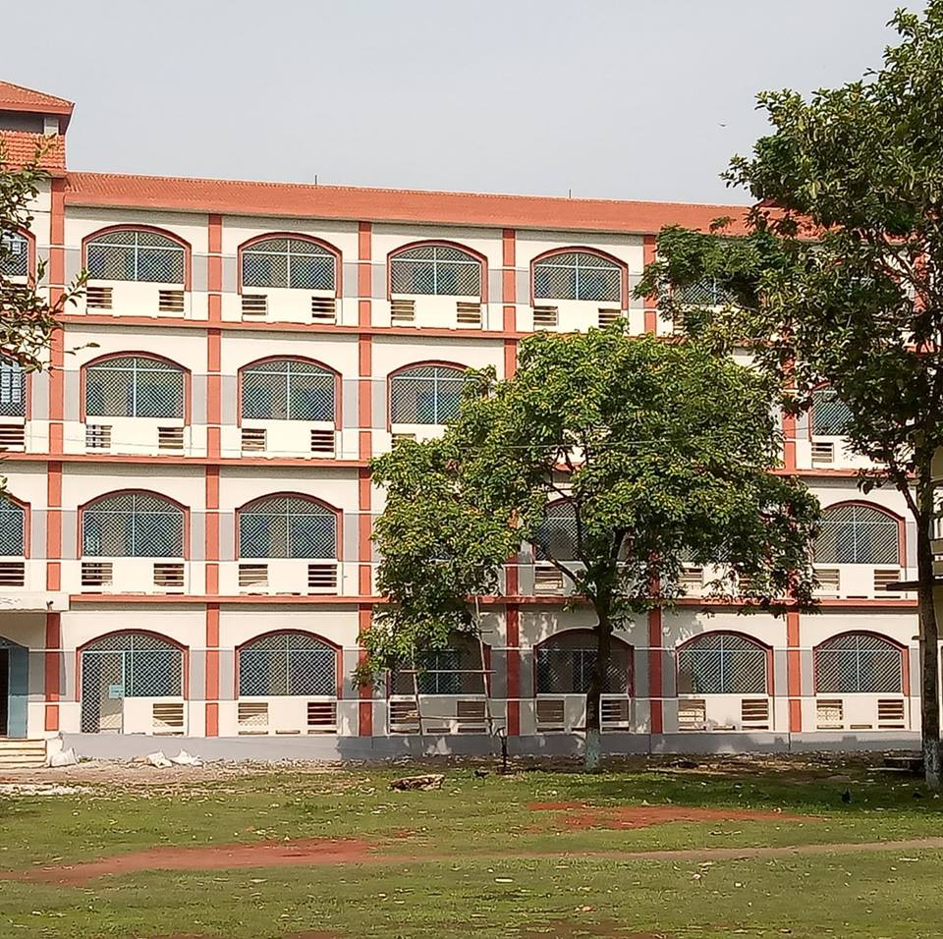
Welcome
Ranachandi School and College, Kishoreganj, Nilphamari, Bangladesh

Slide 2
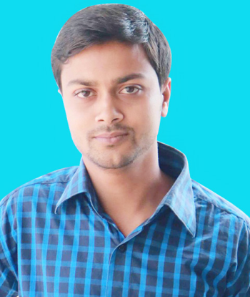
Identity
Ebnulhassan Tushar
Assistant Teacher (English)
Ranachandi High School and College
Kishoreganj, Nilphamari.
Contact: 01719-245814
E-mail: tusharbd89@gmail.com

Slide 3
Core Outcomes
Critical Thinking and Problem Solving
(Different Perspective)

Slide 4
Project name-
The Solar System and Use of Solar Energy

Slide 5
Aims and Objectives of this project
1. To provide students a chance for learning the best use of solar system.
2. To develop students understanding of the solar system.
3. To enhance Students knowledge about the planets of the solar system, particularly their ordering and relative sizes.
4. To give Students a sense of the scale of the solar system and the Universe.

Slide 6
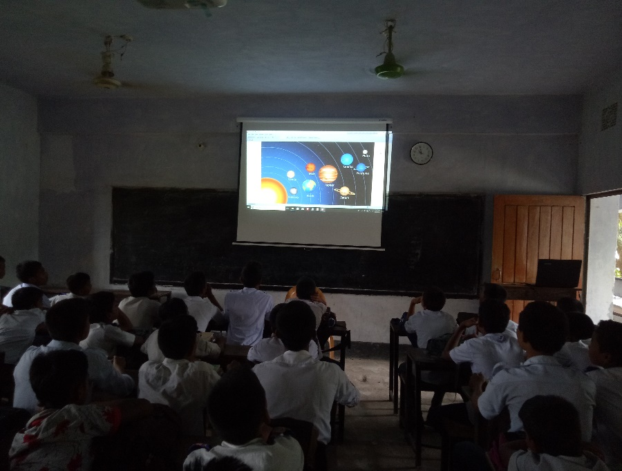
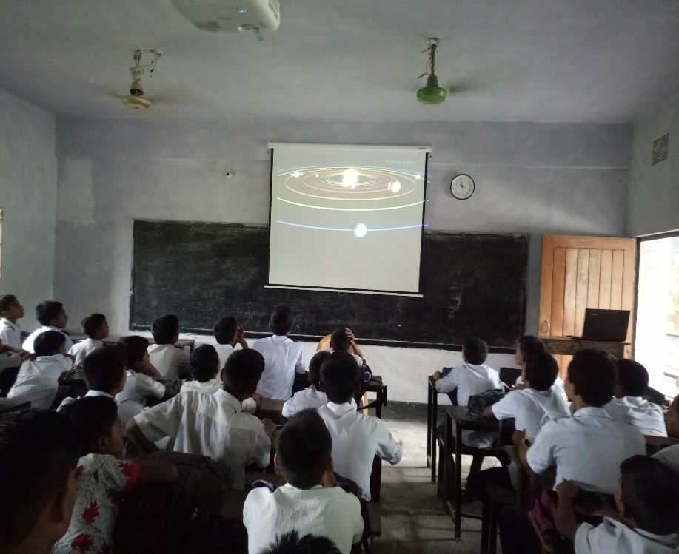
Teacher inform about the solar system and discuss about its function in the classroom.

Slide 7
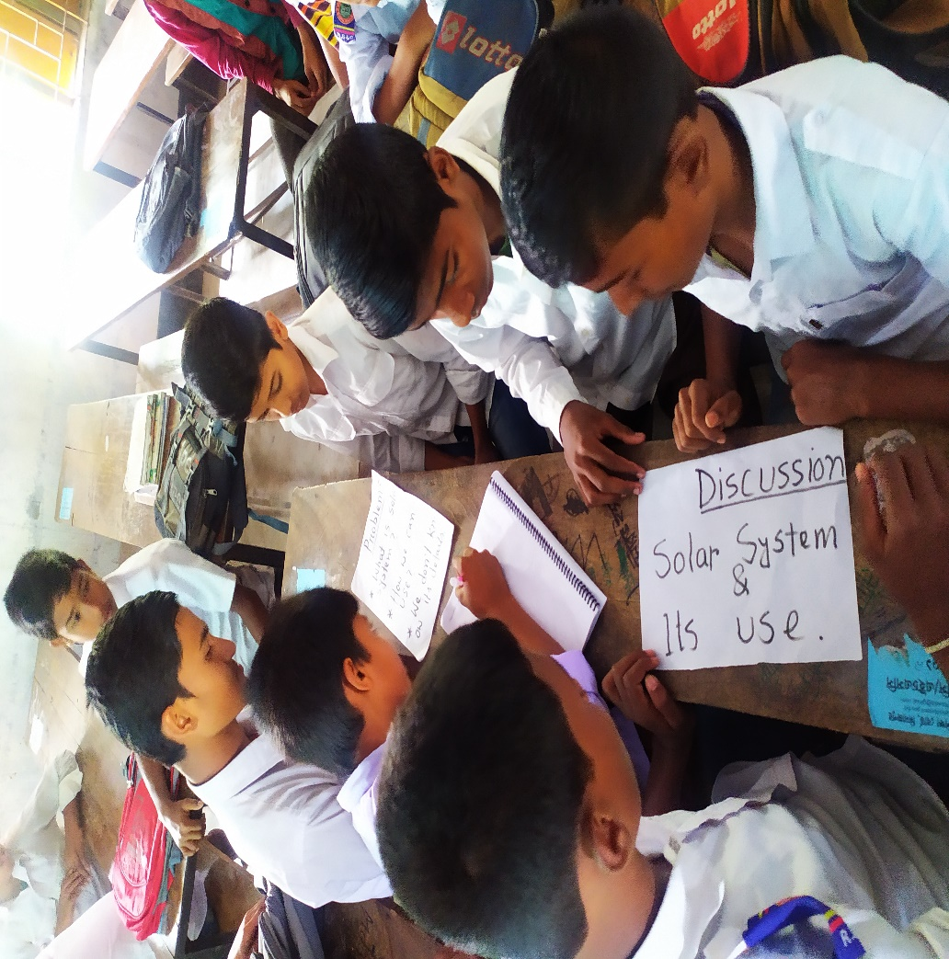
Students discuss about the project among themselves.

Slide 8
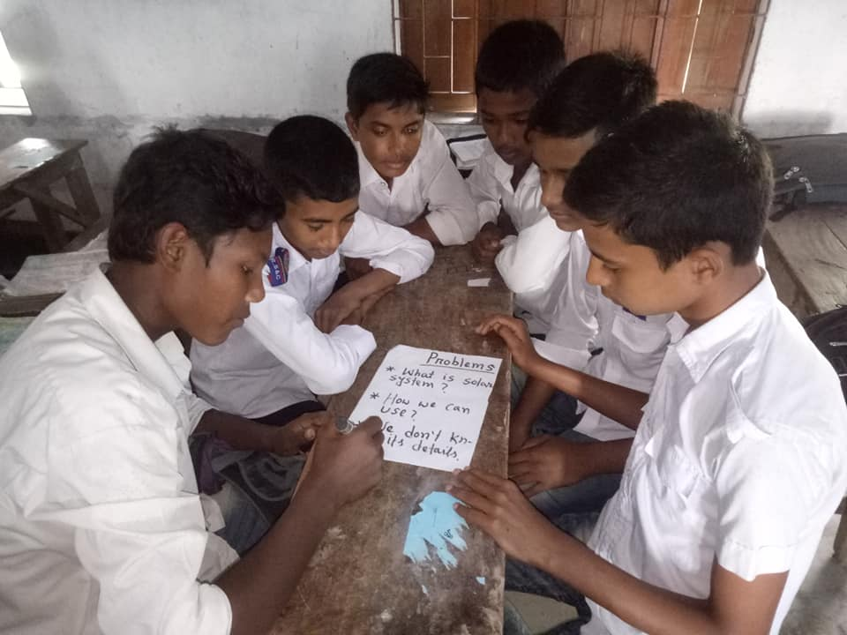
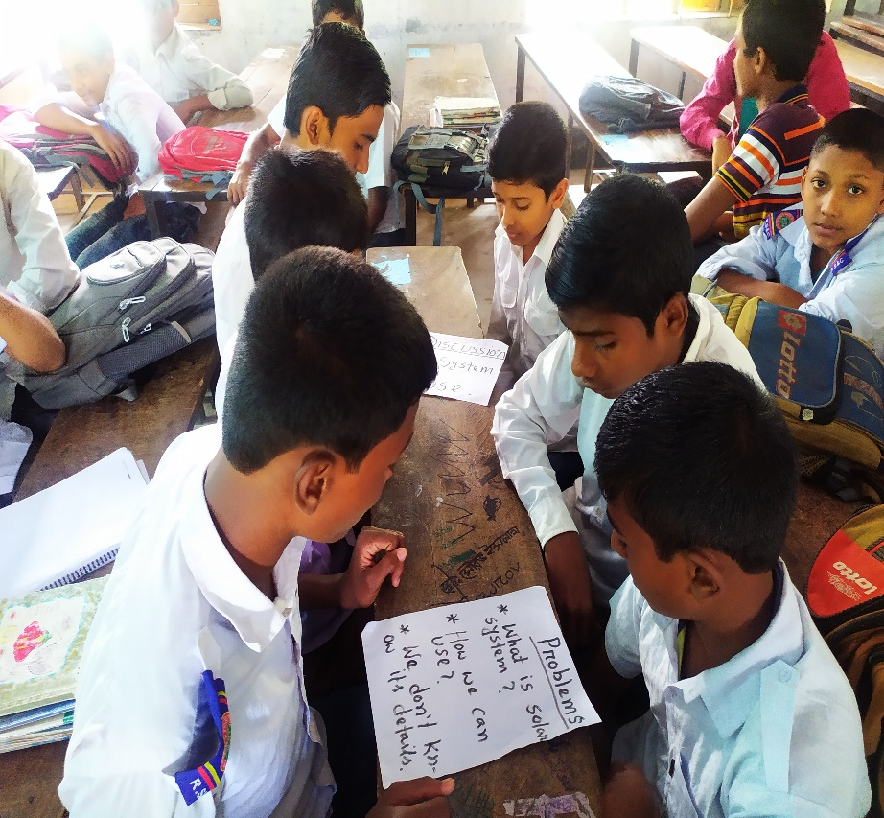
They face some problems and note some questions.

Slide 9
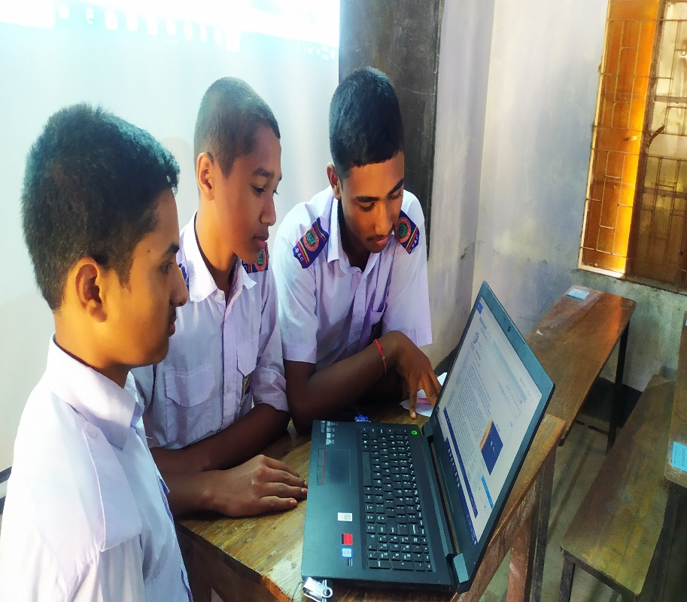
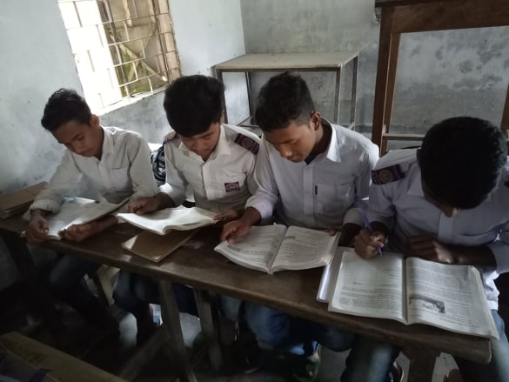
Then they seeking information on Internet and textbook about the project.

Slide 10
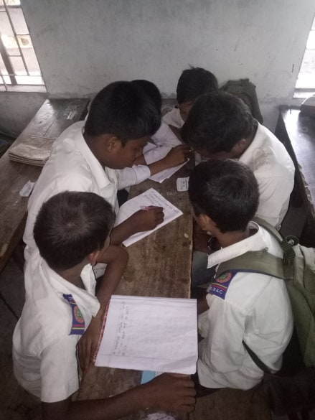
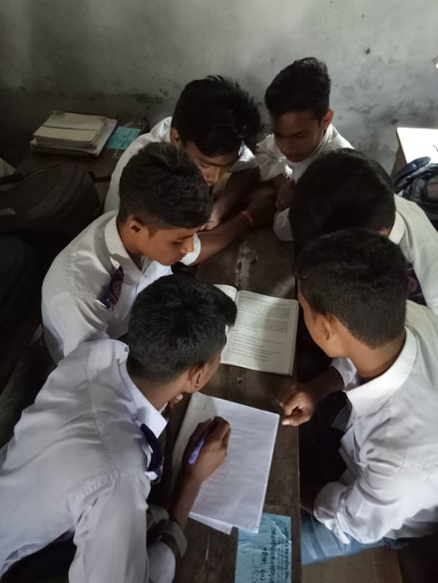
Students discuss about the collected information on their Group.

Slide 11
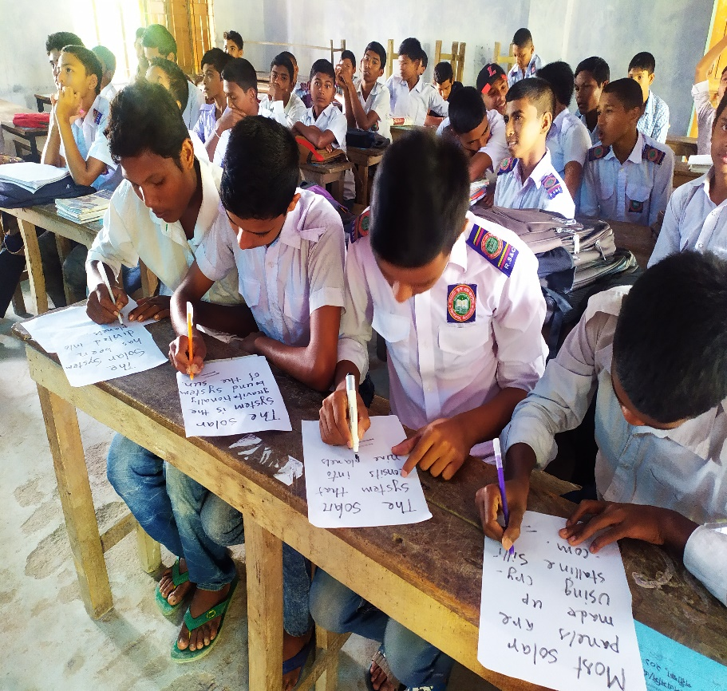
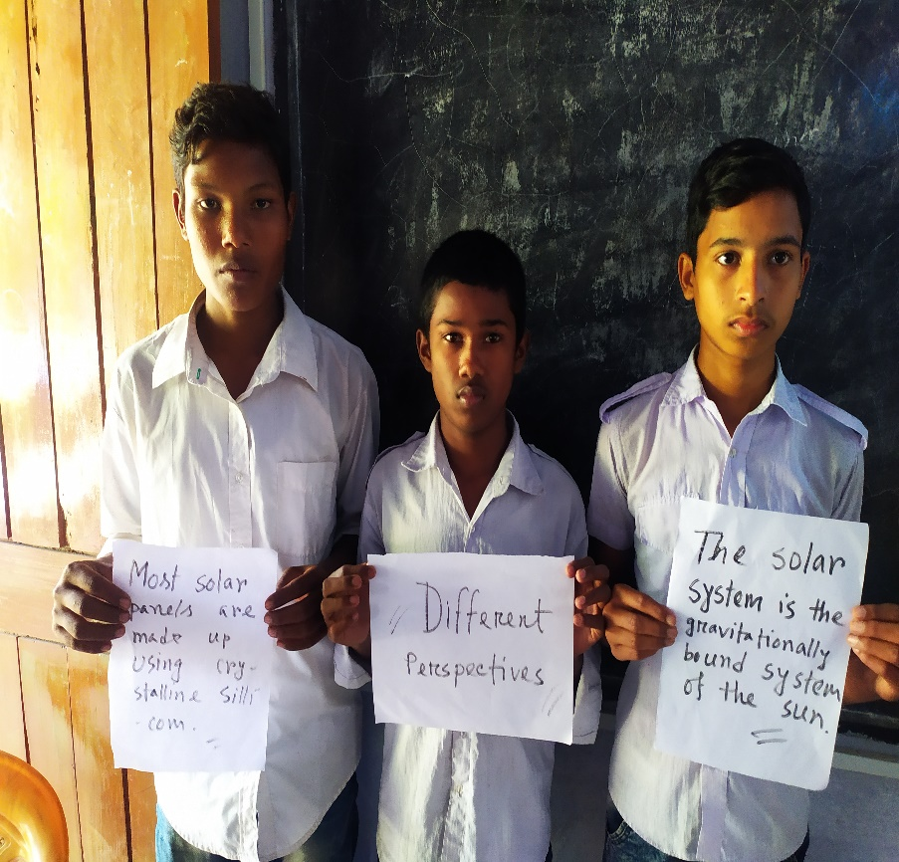
The students consider different perspective.

Slide 12
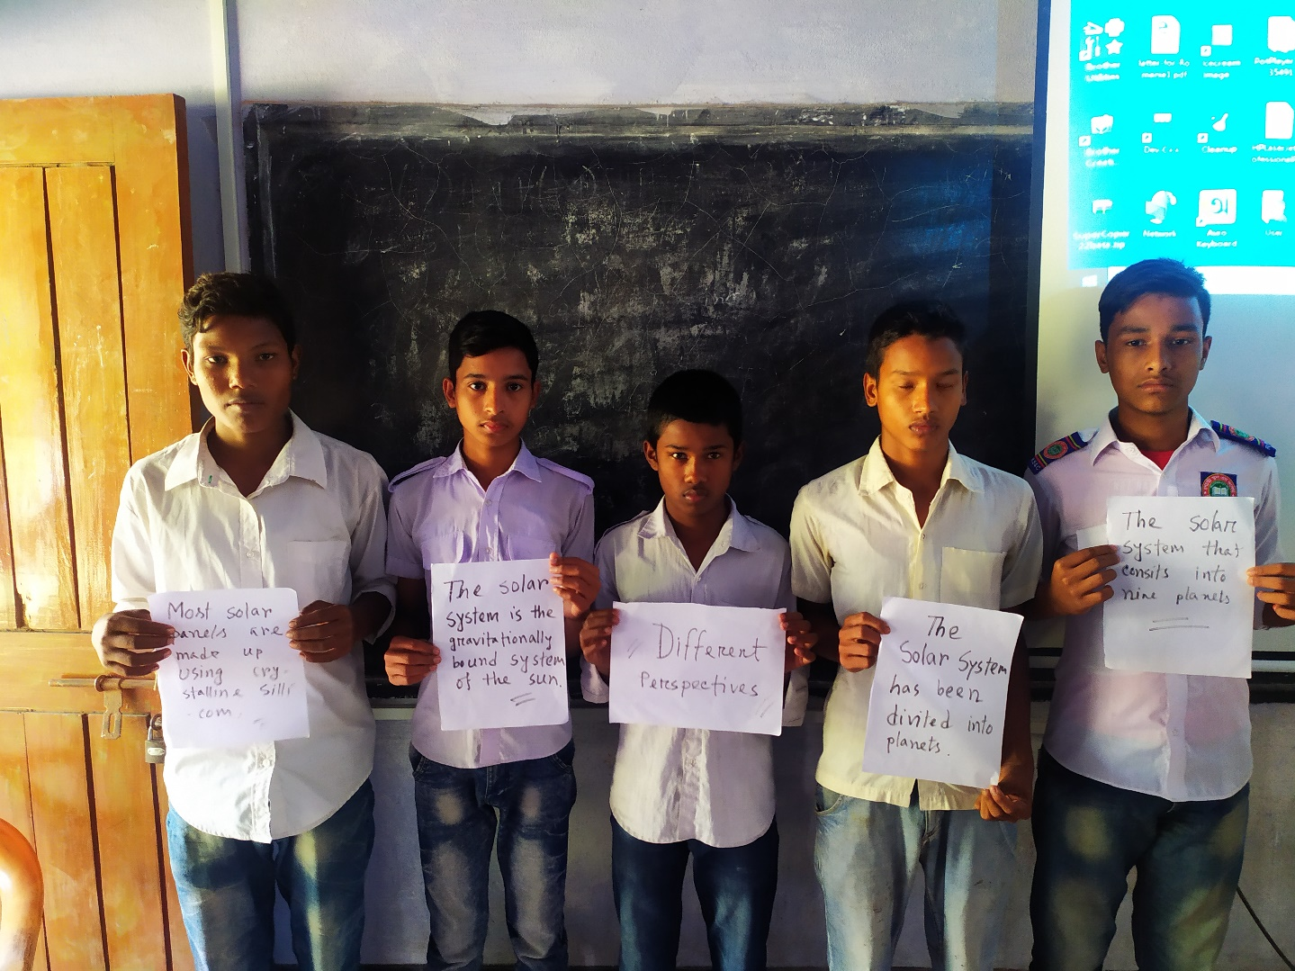
The students consider different perspective.

Slide 13
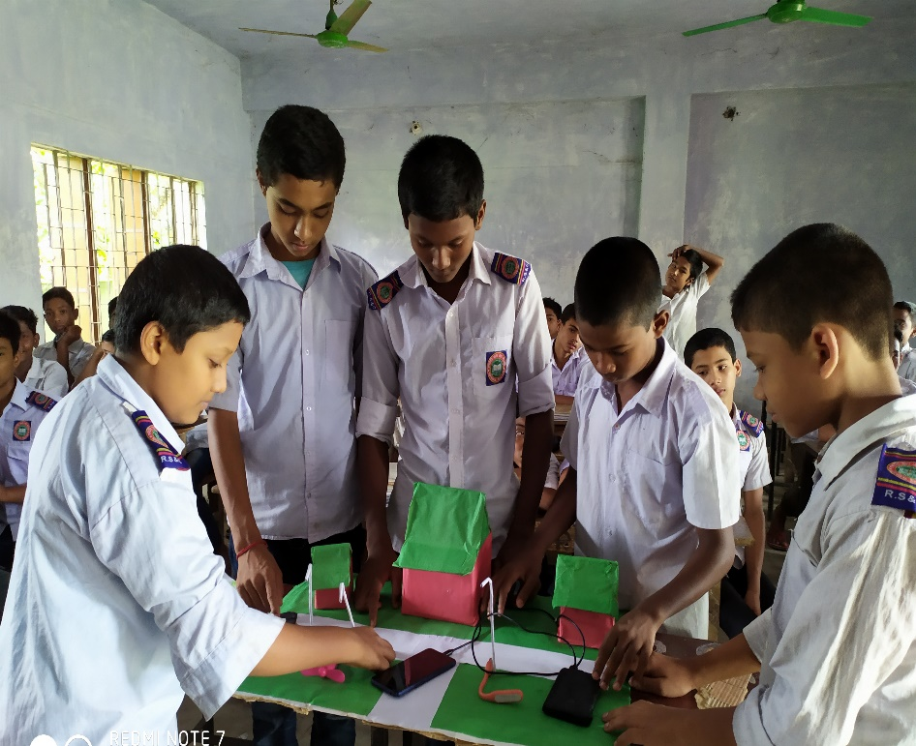
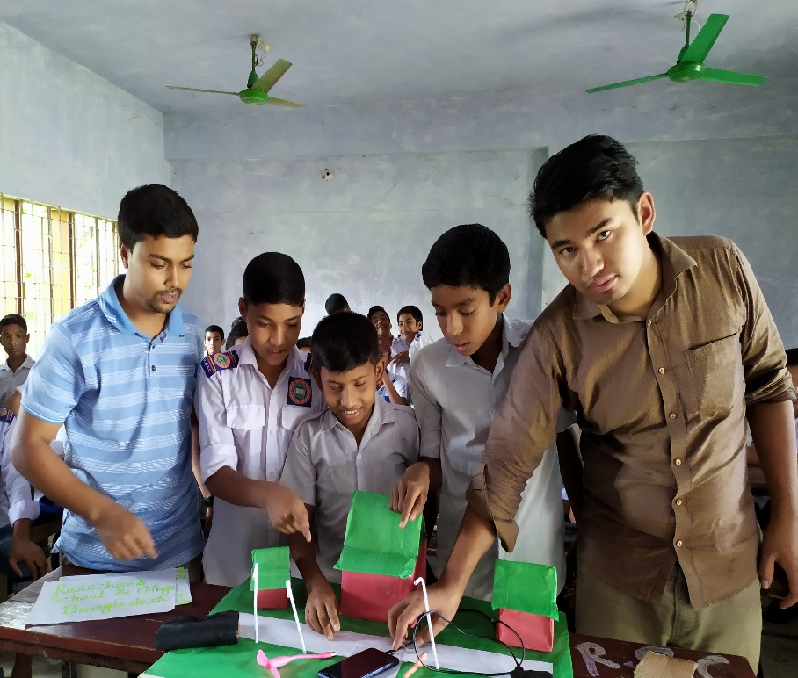
Finally they integrate and apply their ideas and thoughts.
Step-01
Students make a clean environment and also make a solar panel.

Slide 14
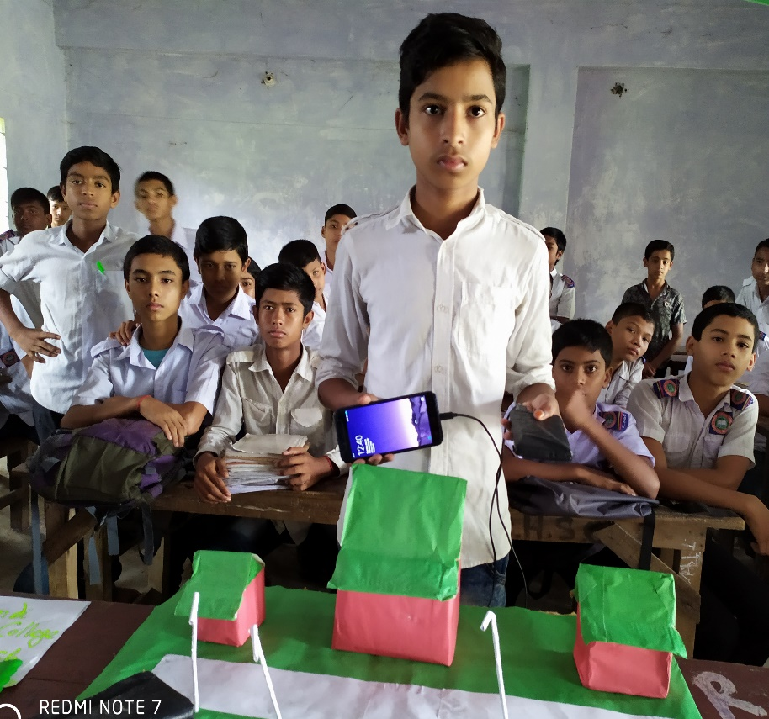
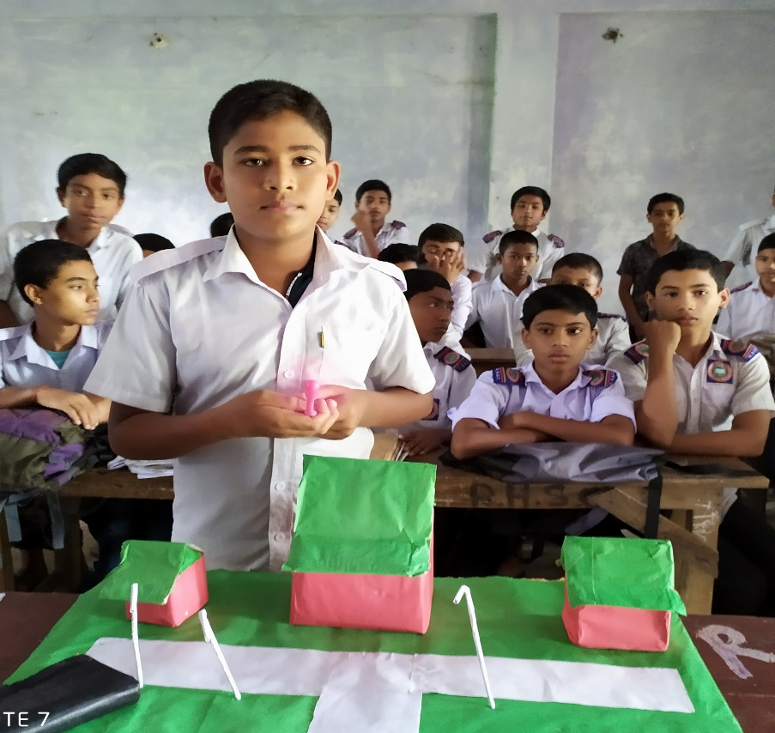
Finally they integrate and apply their ideas and thoughts.
Step-02
They charge the mobile phone and switch on a fan by the solar energy.

Slide 15
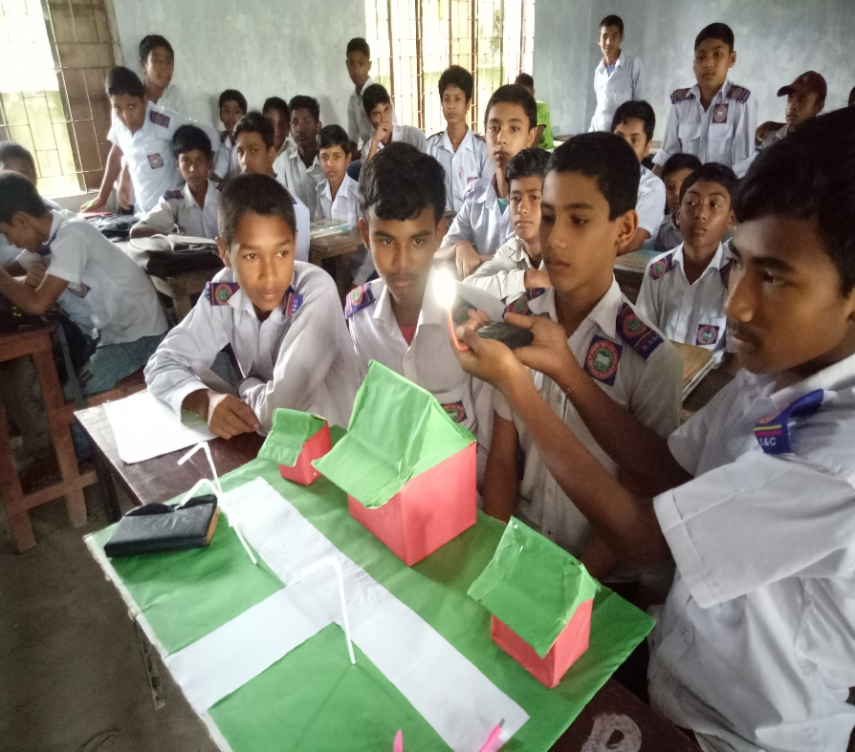
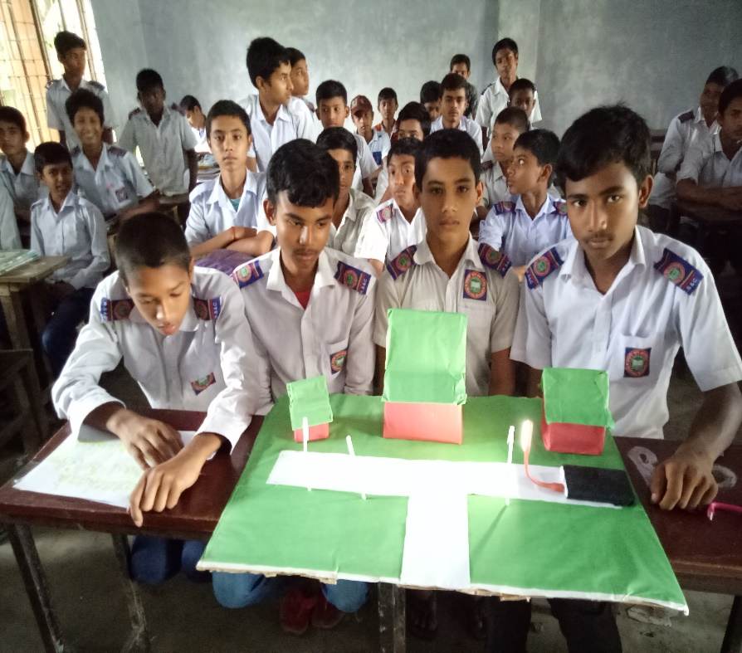
Finally they integrate and apply their ideas and thoughts.
Step-03
They also fire up a light by the solar energy.

Slide 16
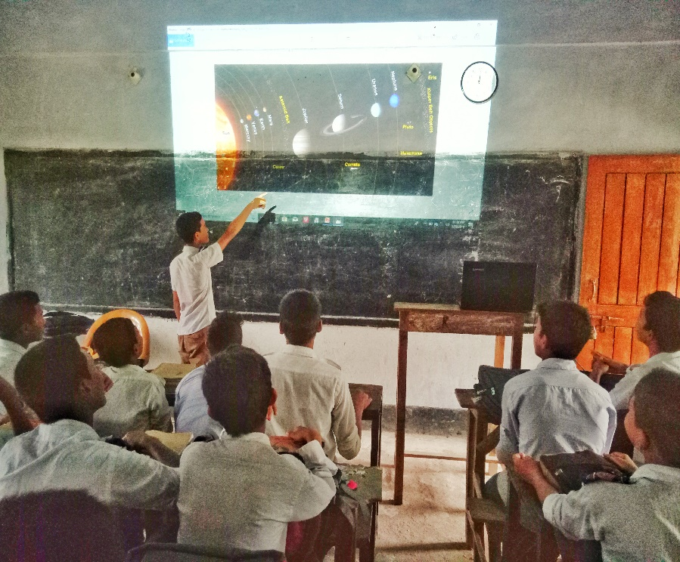
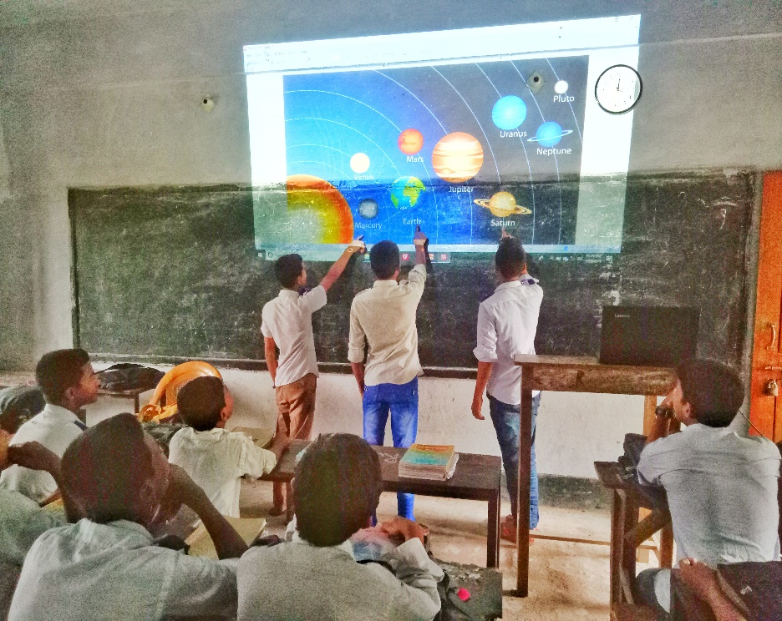
Problem solving-01
They can identify the planets and constellations clearly.

Slide 17
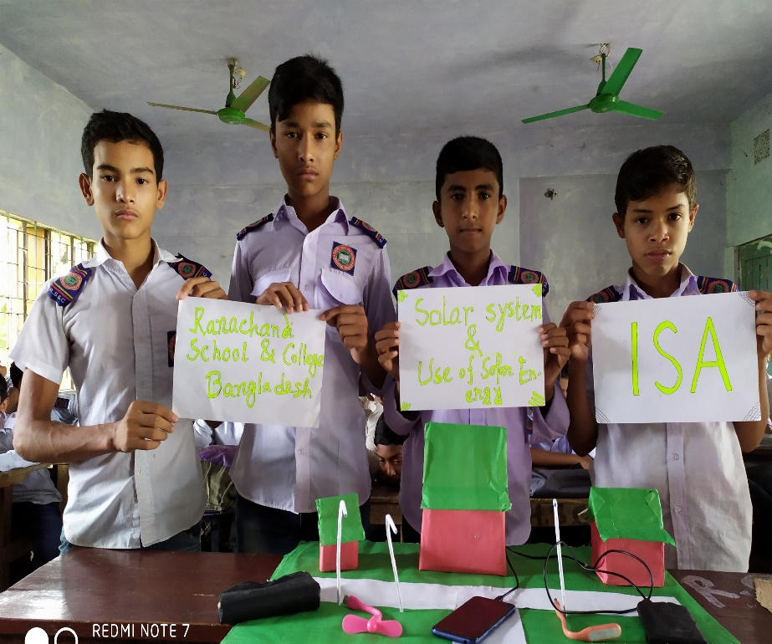
Problem solving-02
The students can achieve clear concept about the solar system and its best use.

Slide 18
Output of this project-
Engage the imagination to explore new possibilities.
Formulate and articulate ideas.
Access the needed information effectively.
Evaluate information and its sources critically.

Slide 19
Thanks for watching

