Slide 1
1 Minute

Slide 2
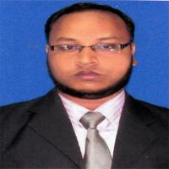
Identity
1 Minute
Class : XI-XII
Subject : English 1st Paper
Time : 45 minutes
Md. Rafi Uddin Shamim
Lecturer (English)
Mohammadpur Anowar Ali Islamia Alim Madeasa
Mohammadpur, Chatlhil, Noakhali.
Cell: 01837526799
Email: idbshamim@gmail.com

Slide 3
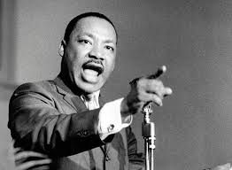
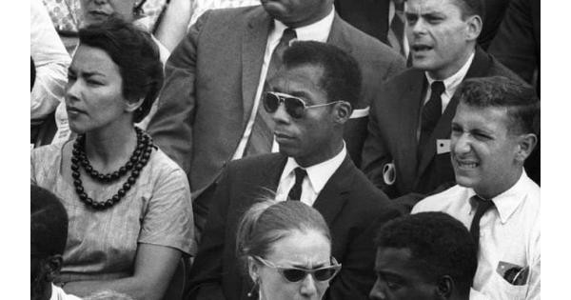
Who is he?
Who are they?
2 Minutes
Martin Luther King Jr.
They are the Negro People.

Slide 4
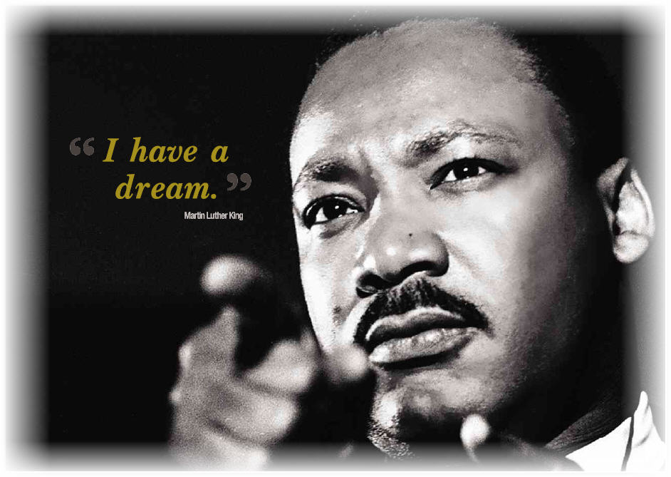
1 Minute

Slide 5
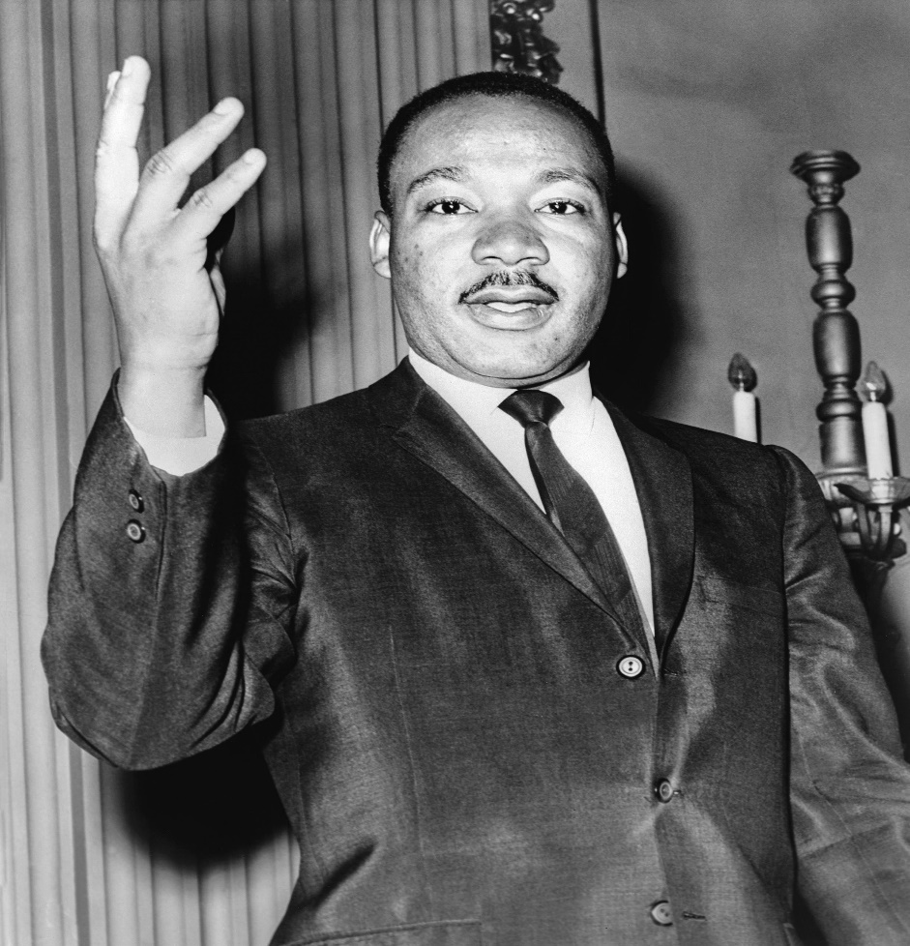
What is our today’s topic?
2 Minutes
Our today’s topic is…
I have a dream
Unit : Ten
Lesson : Three

Slide 6
Learning Outcome::
1. Students can explain the conditions of the Negro in America.
2. They are able to describe Martine Luther King’s dream.
3. They can understand the meaning of some difficult words.

Slide 7
Lets read the passage silently….
10 Minutes
The Negro is still not free. The life of the Negro is sadly crippled (বিকল হওয়া) by the manacles (হাতকড়া) of segregation (বিভাজন) and the chain of discrimination (বৈষম্য). The Negro lives on a lonely island of poverty in the midst of a vast ocean of material (জাগতিক) prosperity (সমৃদ্ধি). The Negro is still languishing (নিস্তেজ হওয়া/ ধুকতে থাকা) in the corners of American society and finds himself an exile (নির্বাসন) in his own land. So we have come here today to dramatize a shameful condition.
I say you today, my friends, so even though we face the difficulties of today and tomorrow, I still have a dream. It is a dream deeply rooted (নিহিত) in the dream.
I have a dream that one day this nation will rise up and live out the true meaning of its creed (ধর্মমত): ``We hold these truths to be self-evident; that all men are created equal.”

Slide 8
I have a dream that one day on the red hills of Georgia, the sons of former slaves (ক্রীতদাশ) and the sons of former slave owners will be able to sit down together at the table of brotherhood (ভ্রাতৃত্ব).
I have a dream that one day even the state of Mississippi, a state sweltering (উত্তপ্ত) with the heat of injustices, sweltering with the heat of oppression will be transformed into an oasis (মরুদ্যান) of freedom and justice.
I have a dream that my four little children will one day live in a nation where they will not be judged by the color of their skin but by the content (ধরন) of their character.
I have a dream today.
I have a dream that one day down in Alabama, with its vicious (নিষ্ঠুর) racists (বর্ণবাদী), with its governor having his lips dripping (উচ্চারিত হয়) with the word of `interposition’ (হস্তক্ষেপ) and `nullification, (বাতিলকরণ) that one day right down in Alabama little black boys and black girls will be able to join hands with white boys and white girls as sisters and brothers.
I have a dream today.

Slide 9
3 Minutes
Important words used in the passage need to pronounced correctly and learn meaning
crippled (বিকল হওয়া) /ˈkrɪp.əld/
manacles (হাতকড়া) /ˈmæn.ə.kəlz/
segregation (বিভাজন) /ˌseɡ.rɪˈɡeɪ.ʃən/
discrimination (বৈষম্য) /dɪˌskrɪm.ɪˈneɪ.ʃən/
material (জাগতিক) /məˈtɪə.ri.əl/
prosperity (সমৃদ্ধি) /prɒsˈper.ə.ti/
languish (নিস্তেজ হওয়া/ ধুকতে থাকা) /ˈlæŋ.ɡwɪʃ/
exile (নির্বাসন) /ˈek.saɪl/
rooted (নিহিত) /ˈruː.tɪd/

Slide 10
creed (ধর্মমত) /kriːd/
slave (ক্রীতদাশ) /sleɪv/
brotherhood (ভ্রাতৃত্ব) /ˈbrʌð.ə.hʊd/
sweltering (উত্তপ্ত) /ˈswel.tər.ɪŋ/
oasis (মরুদ্যান) /əʊˈeɪ.sɪs/
vicious (নিষ্ঠুর) /ˈvɪʃ.əs/
racists (বর্ণবাদী) /ˈreɪ.sɪst/
dripping (উচ্চারিত হয়) /ˈdrɪp.ɪŋ/
interposition (হস্তক্ষেপ) /ˌɪn.tə.pəˈzɪʃ.ən/
nullification (বাতিলকরণ) /ˈnʌl.ɪ.fɪ.keɪ.ʃ.ən/

Slide 11
5 Minutes
Group Work
Team A (boys)
Note the miserable condition of Negro in America According to Martin Luther King’s Speech.
Team B (Girls)
Find out and write speaker’s point of dream. What his dream is?

Slide 12
Class Word
10 Minutes
Now answer the Questions from the following Text
Briefly describe the condition of the Negro in the state of Mississippi.
Ans: Martin Luther king Jr. says that the Negro is not still free because the life of Negro is still sadly crippled by the manacles of segregation and the chains of discrimination.
What kind of nation is in the dream of Martin Luther King Jr. where his four children will live?
Ans: Martin Luther King Jr. dreams that his four little children will one day live in a nation where they will not be judged by the color of their skin but by the content of their character.

Slide 13
Martin Luther King Jr. is an advocate of a creating land free from segregation and discrimination. Do you agree? Give reasons for your answers.
Ans: Yes, I agree with the statement that Martin Luther King Jr. is an advocate of a creating land free from segregation and discrimination. Every line of his ardent love of freedom and brotherhood.
Describe in brief the dream of Martin Luther King Jr. regarding the red hills of Georgia.
Ans: The dream of Martin Luther King Jr. regarding the red hills of Georgia is that one day on these hills, the sons of former slaves and the sons of former slave owners will be able to sit down together at the table of brotherhood.

Slide 14
5 Minutes
Evaluation
Choose the correct answer from the alternatives.
1. The word ‘vicious’ mentioned in the passage means …………..
a. co-operative
b. friendly
c. kind
d. barbarous
2. The word ‘poverty’ mentioned in the passage means …………..
a. richness
b. affluences
c. poorness
d. wealth
3. The word ‘injustice’ mentioned in the passage means ………….
a. justice
b. equality
c. fairness
d. inequity
4. The word ‘nullification’ mentioned in the passage means ………….
a. building
b. creation
c. construction
d. abolishment

Slide 15
3 Minutes
Home Work
The Negro lives in a lonely island of poverty in the midst of a vast ocean of material prosperity. Explain.
b) What is the dream of Martin Luther King Jr. regarding the nation and its creed?
c) Describe the condition of the Negro in the state of Mississippi?
d)Describe the condition of Alabama with reference to its racists and the governor.

Slide 16
2 Minutes

