Slide 1
W
E
L
M
E
C
O
Notes:
Masjid Sultan Qaboos in Oman.

Slide 2
INTRODUCTION
Md Amir Hossain
AssistantTeacher(English)
Madinatul Ulum Dakhil Madrasah
79hossainamir@gmail.com
Mobil No: 01714-315772

Slide 3
English Ist Paper
Class- Nine
Unit-9
Lesson-3
Date:23/07/2020

Slide 4
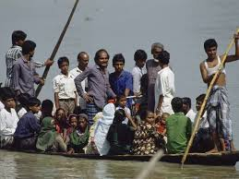
What about the picture?
Discuss with your partner then answer the following questions.
Where can you fine this kind of boat ?
Why does the boatman carry passengers across a river ?
Why do people use country boats ?
Notes:
This slide only for mind set up. Teacher can ask another questions for grow class arrange.

Slide 5
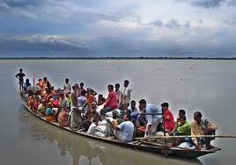
So today we’ll discuss about
The ferry boat.

Slide 6
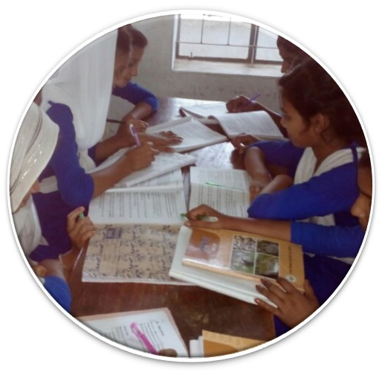
Silent Reading

Slide 7
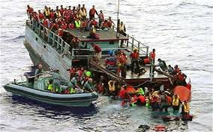
Let’ watch a video clip
Discuss in pair. What were the causes of this accident? And say how we can avoid it?
Notes:
Showing the video teacher can ask question to the whole class. SS will raise their hands. Teacher can ask 5/6 students to narrate the video.

Slide 8
Learning Outcomes Of The Lesson
After completing this lesson, students will be able to------------
ask and tell about problems.
seek and give suggestions.
listen for specific information.
narrate something in writing.

Slide 9
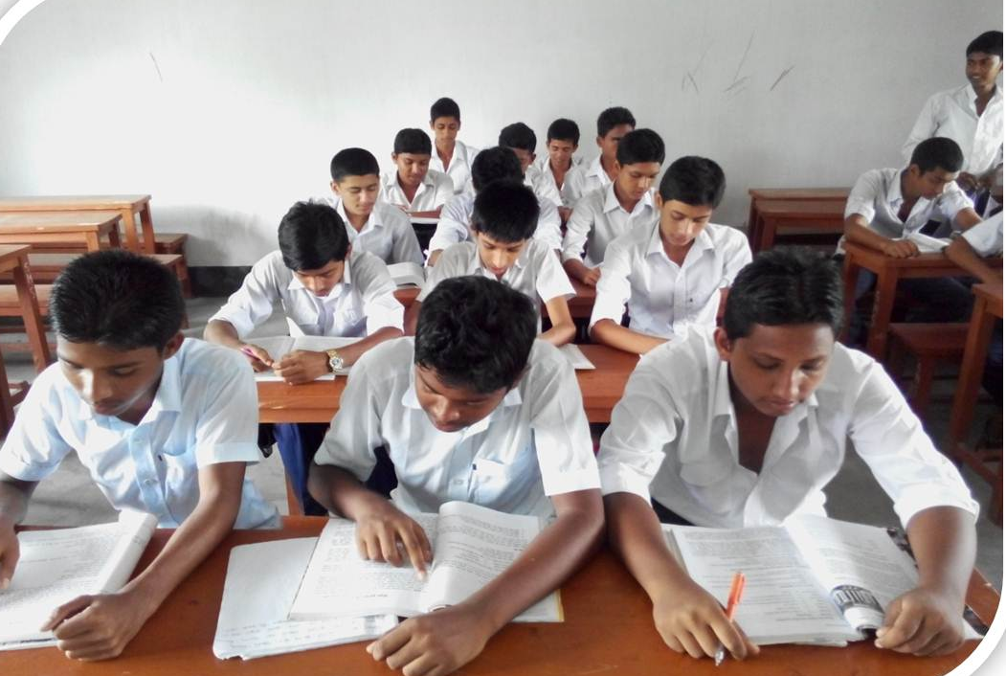
Individual Work
Read the text silently then answer the multiple choices questions that has given in the text.
Notes:
Teacher will monitor the class and can help them.

Slide 10
Ferry boat
Can you make a sentence with the word “ferry boat”.
After shopping they are returning home by a ferry boat.
A kind of boat by that`s people cross the river to paying fare.
Meaning
(Click here)
Notes:
At first teacher will show the words then ask his/her students to tell the meaning and making sentences. If they fail teacher will show the picture again. For feedback click on meaning button.

Slide 11
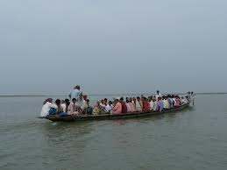
Cross the river
Can you make a sentence with the word “cross the river”.
They are crossing the river by boat.
Meaning
(Click here)
To go another side of a river.
Notes:
At first teacher will show the words then ask his/her students to tell the meaning and making sentences. If they fail teacher will show the picture again. For feedback click on meaning button.

Slide 12
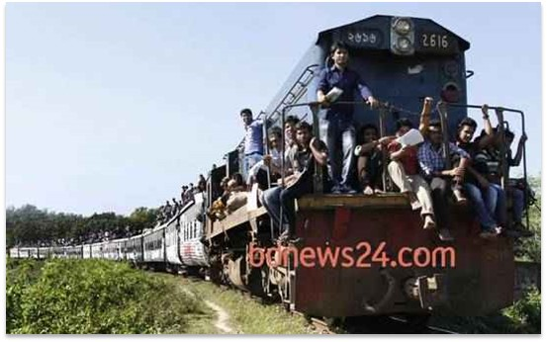
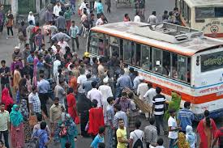
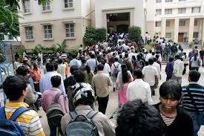
Population problems?
Look at the above pictures and guess if we have too many people in a town, bus and train then what will happen?
Notes:
Teacher can discusses about our population problems.

Slide 13
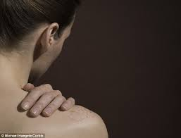
Shoulder
Can you make a sentence with the word “shoulder”.
Often country people carry their bags on shoulder.
Meaning
(Click here)
A organ of human body
Notes:
At first teacher will show the words then ask his/her students to tell the meaning and making sentences. If they fail teacher will show the picture again. For feedback click on meaning button.

Slide 14
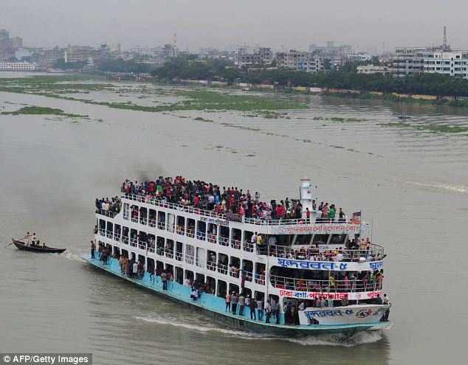
Outskirts
Meaning
The outer parts of a town or city.
The Buriganga river is at the outskirts of Dhaka city.

Slide 15
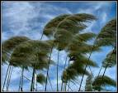
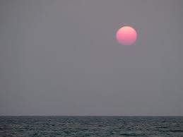
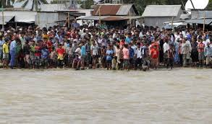
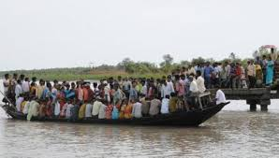
Pair work
Look at the pictures and guess why do many people have little or no patience in situations as in the ferry boat?

Slide 16
Homework
Write a paragraph with in ten sentences about ‘The ferry accident’

Slide 17
Thank You

