Slide 1
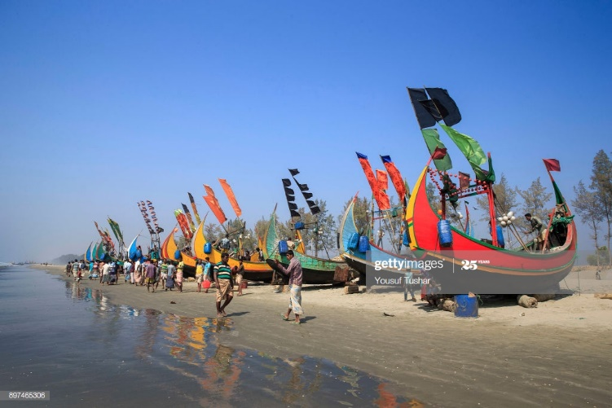
WELCOME

Slide 2
Teacher Identification
SHAMPA RANI DAS
ASSISTANT TEACHER
SATKORAKANDI GOVT.PRIMARY SCHOOL
BARLEKHA ,MOULVIBAZAR.

Slide 3
Lesson Identification
Class:Five
Sub:English
Unit: 12
Lesson: How far is Saint Martin’s?
Lesson unit: 1
Time:40 minutes

Slide 4
Learning outcomes
Students will be able to……
5.1.3 Read silently with understanding dialogues
8.1.1 Make sentences using words and phrases given in the textbook.

Slide 5
Lets watch a video
What can you see in the video?

Slide 6
Our todays lesson is..
How far is Saints Martin’s ?

Slide 7
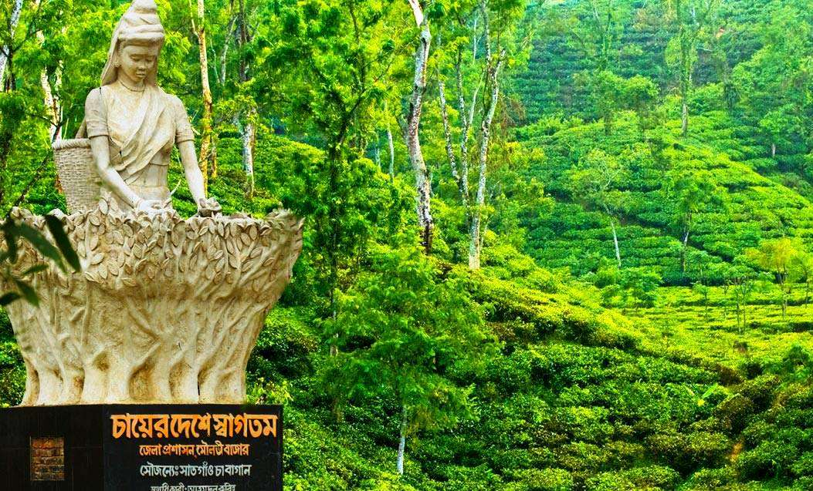
Tourist spot
Wanderer place
The tea garden is attractive tourist spot.

Slide 8
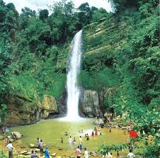
Waterfalls
A source of water over a hill.
Madhapkundu waterfalls is located in Moulobhibazar.

Slide 9
Special
Something particular
Birthday is the special day to me.

Slide 10
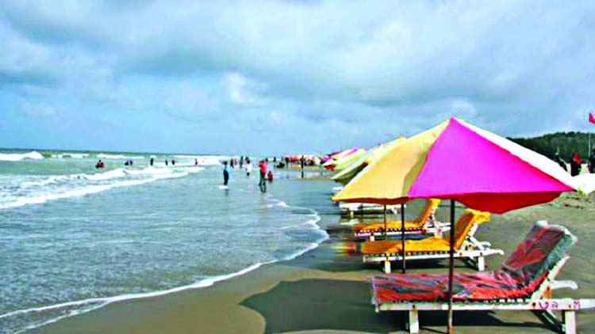
Wonderful
Something strange
Cox’s bazar is a wonderful place.

Slide 11
IW
Bingo game
Tourist
Visit
Popular
Island
Beach
Wonderful
Waterfall
Special

Slide 12
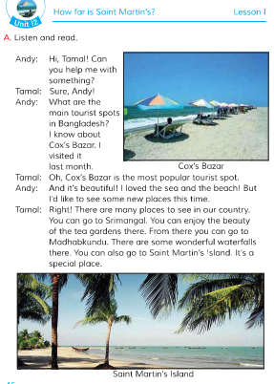
Open at page -46
Teachers loud reading

Slide 13
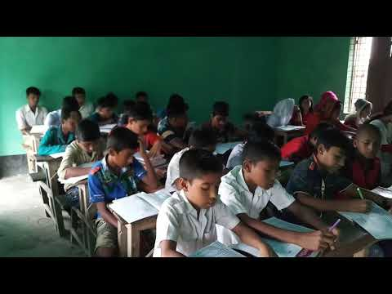
Students reading
Lets read by change role.

Slide 14
G.W
Answer the questions
1.What is the most tourist spots in Bangladesh?
2.Where is the beautiful tea garden?
3.What is the name of special places?

Slide 15
P.W
Make WH questions by underline word.
Now check the answer.
1.This Island is the Bay of Bengal.
Where is this Island?
2.We can go by wooden boats or sea truck.
How can you go the coral Island?
3.Tamal tells Andy about is the name of St Martin Island.
What is the name of the Island Tamal tells Andy about?

Slide 16
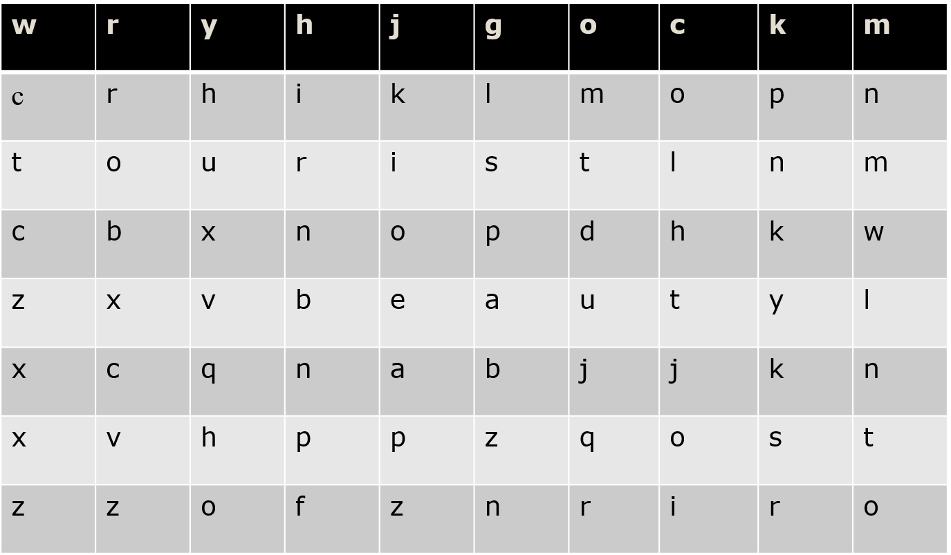
Checking learning
Word puzzle

Slide 17
Home Work
You will write five sentences about your recent visits place.

Slide 18
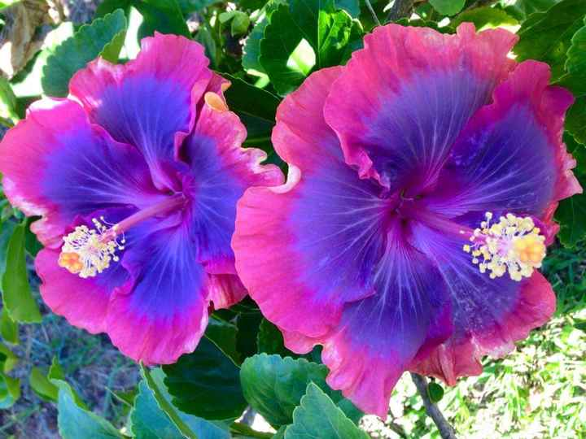
THANKS ALL

