Slide 1
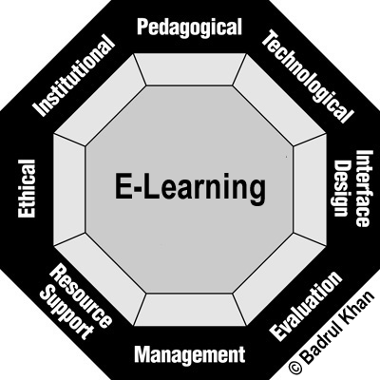
Welcome to the presentation

Slide 2
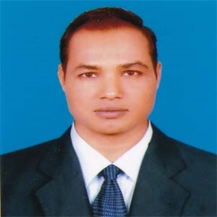
Introduction
Md. Mizanur Rahman
B.A.(Hons.), M.A. in English, B.Ed.
Assistant Teacher
Police Lines School and College, Pabna.
E-mail: mizanplsc@gmail.com
Cell Phone :01737979719
Class: X
Subject: English 1st Paper
Unit: Thirteen ( Media and modes of e- communication)
Lesson: Three
Lesson Title: E- learning
Class Duration: 40 minutes
Date: 25/07/2020

Slide 3
Look at the picture. What objects do you see in the picture? How are they related? Discuss with your partner and say what these are.

Slide 4
Today’s Lesson
E- learning

Slide 5
Learning Outcomes
At the end of the lesson, the students will be able to:
read and understand text .
write the answer of questions.
Fill in the gaps.
Write e-mails.

Slide 6
Key words presentation
Word: Thrilled
Adjective
Synonym: excited, delighted
Meaning: feeling intense; pleasurable, excitement
Antonym : disappointed
Example: The students are thrilled to hear the class without a printed book or a writing pad or even pen/ pencil.

Slide 7
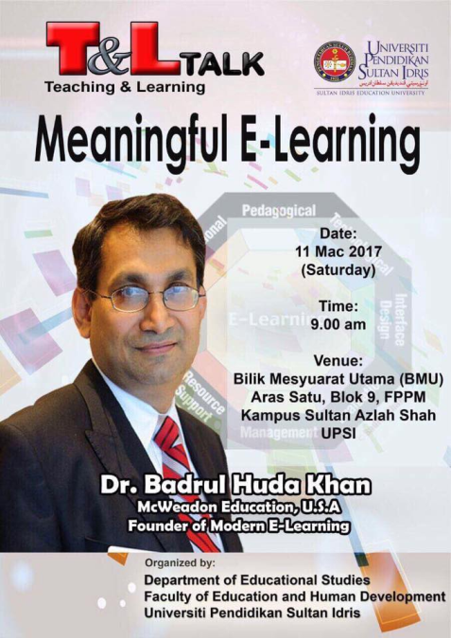
Word: Pundit
Noun
Synonym: Scholar
Meaning: a person who knows a lot about a particular subject
Antonym: amateur
Example: Dr. Badrul Huda Khan is a pundit of e-learning.

Slide 8
Word: Virtual
adjective
Meaning: made to appear to exist by the use of computer software
Example: In a virtual campus everything takes place electrically through computer and internet technology.

Slide 9
Read the text .
Can you think of a classroom where there is no blackboard or desk? Do you believe that you can be a student without a printed book or a writing pad or even pen/ pencil?
Are you not thrilled to imagine that you have asked a question and your turor is answering it while flying in a Boeing from Dubai to Dhaka?
These are all possible in a ‘virtual campus’ in the system of e- learning

Slide 10
No kidding! For quite a long time, educationists have been utilizing the advantages of computer technology. The social networking services have a huge potential to help educationists in this sector. They have access to millions of people worldwide.
Educationists have noticed that a large number of social network users come from young generation who especially belong to student community. So side by side with computer assisted teaching- learning software, online education programmes are evolving fairly rapidly to assist conventional education system. Is that e- learning?

Slide 11
We may confuse distant education or computer – based learning or computer- assisted training or even online education programmes with e- learning . But we should be cautious about the mix- up.
What happens in an online education programme? Maybe you get some materials online from your tutor. Maybe submit your assignment through e- mail. Or even you may take your test online. But there must be some conventional campus, a department / institute from where your certificate will come.

Slide 12
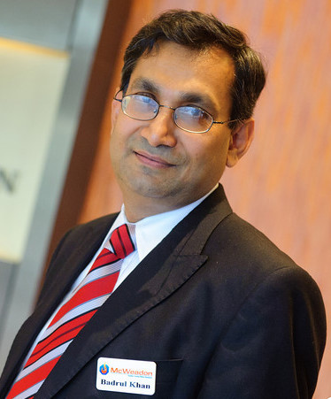
But in e- learning as said by global e- learning guru Dr Badrul H. Khan*,
every step such as registration, admission, classroom entry and exit, class work, attendance, discussion with course mates, feedback, exams and finally certification must take place electronically through computer and the Internet technology in a virtual campus.
Everything is digitized and conducted by a system called Learning Management System (LMS). So online education programes blend various components of e- learning.

Slide 13
The revolutionary concept of e- learning is already in its practice phase in many parts of the world. Professor Khan has developed a framework and important literatures on e- learning which have been praised by pundits worldwide including from Bangladesh. Professor Khan is especially enthusiastic about the prospect of e- learning in Bangladesh. How would you feel if Bangladesh contemplates establishing South Asia’s first virtual university? Won’t it be a pioneering step for us in the world of e- learning? Let’s keep our fingers crossed

Slide 14
Individual Work
Suppose, Dr. Badrul Huda Khan has come to visit your school and intends to meet students for apresentation on e-learning.
Write a text message to invite your friend to attend the presentation.

Slide 15
Pair Work
Work in pairs. Discuss the following questions.
Have you ever experienced any digital education programmes in multimedia or CD/ DVD?
Have you ever used any digitalized educational resources such as Oxford Dictionary, Banglapedia or Wikipedia?
Have you ever heard of any online education course?
Have you ever seen a classroom teaching programme on TV?

Slide 16
Group Work
Complete the following sentences with suitable words.
Education experts utilizing the advantages of computer technology a long time.
2. In e- learning, everything from admission to certification must
electronically through computer and the Internet technology in a virtual campus.
3. In some online courses, you take your test online.
have been
for
be done/ be taken place
may take

Slide 17
Evaluation
Answer the questions in your own words.
Give a definition of virtual campus? What does it promote?
How do the social networking services help the educationists?
How does online education help a student?
What is the definition of e- learning by Dr Badrul H Khan/
What is the present state of e- learning?

Slide 18
Home Work
Write an e- mail to your teacher expressing your feelings and opinion regarding the next mode of education – e – leraning.

Slide 19
Thanks to all
See you again in the next class.

