Slide 1
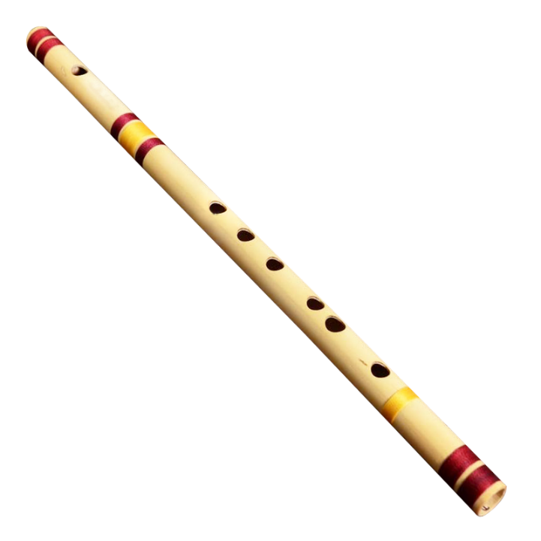
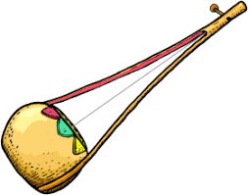
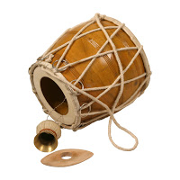
Welcome

Slide 2
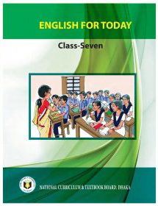
Identity
Ebnulhassan Tushar
Assistant Teacher (English)
Ranachandi High School and College
Kishoreganj, Nilphamari.
District Ambassador(ICT4E),Best content maker of the week (Teachers Portal), MIE Expert (2018-2019)
E-mail: tusharbd89@gmail.com
Contact no: 01719-245814
English For Today
Class: Seven
Time: 45 minutes

Slide 3
Lets enjoy the video?
What can you see in the video?
Folk Song.
So, can you guess what is our todays topic?

Slide 4
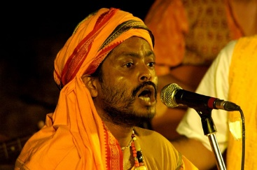
Today`s topic
Unit-Eight
Lesson-One
I like folk songs

Slide 5
After we have studied this unit, we will be able to—
Read and understand texts and dialogues.
Listen to and understand conversation
on familiar, everyday topics.
3. Ask and answer question about like
and dislikes.
Learning Outcomes

Slide 6
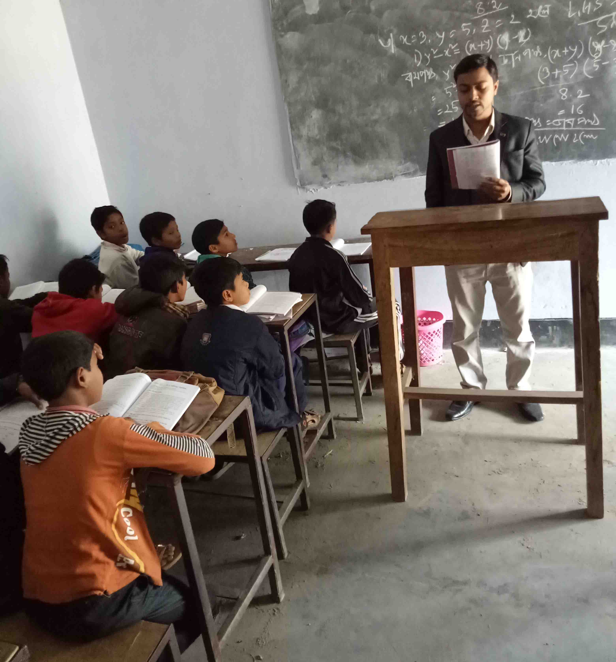
Teachers model reading
Listen attentively

Slide 7
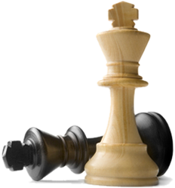
Key word
Chess
Meaning: a board game of strategic skill for two players.
Rahim likes chess.

Slide 8
Key word
Photography
Meaning: the art or practice of taking and processing photographs.
Photography is one of Rahim's hobby.

Slide 9
Key word
Adore
Meaning: love and respect someone deeply.
He adored his mother.

Slide 10
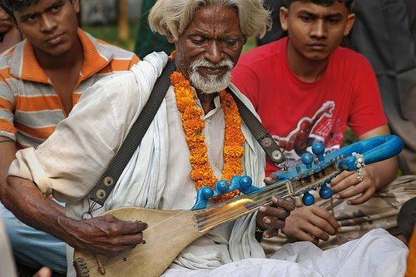
Key word
Folk music
Meaning: music that originates in traditional popular culture.
Kobita likes Folk music.

Slide 11
Key word
Bloom
Meaning: a flower.
Kobita loves to watch the full bloom flowers.

Slide 12
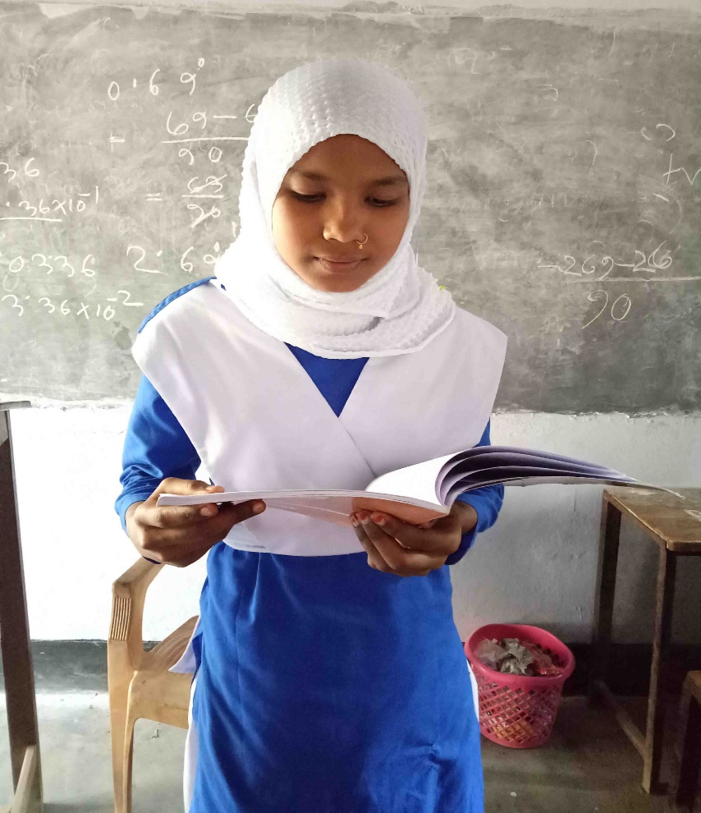
Individual Works
Time: 03 minutes
Read aloud

Slide 13
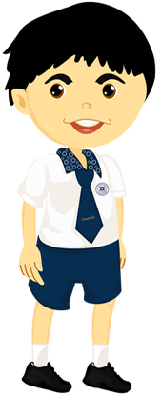
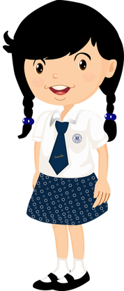
Listen to and understand the conversations.
I like fishing. Would you like to come with me next time?
Yes, I love. What shorts of things do you like?
I am ok. I have just finished a course on photography.
I am not sure but I try my best.
Great. Did you like the course?
I am fine and you?
Sounds great. Thanks!
How are you?

Slide 14
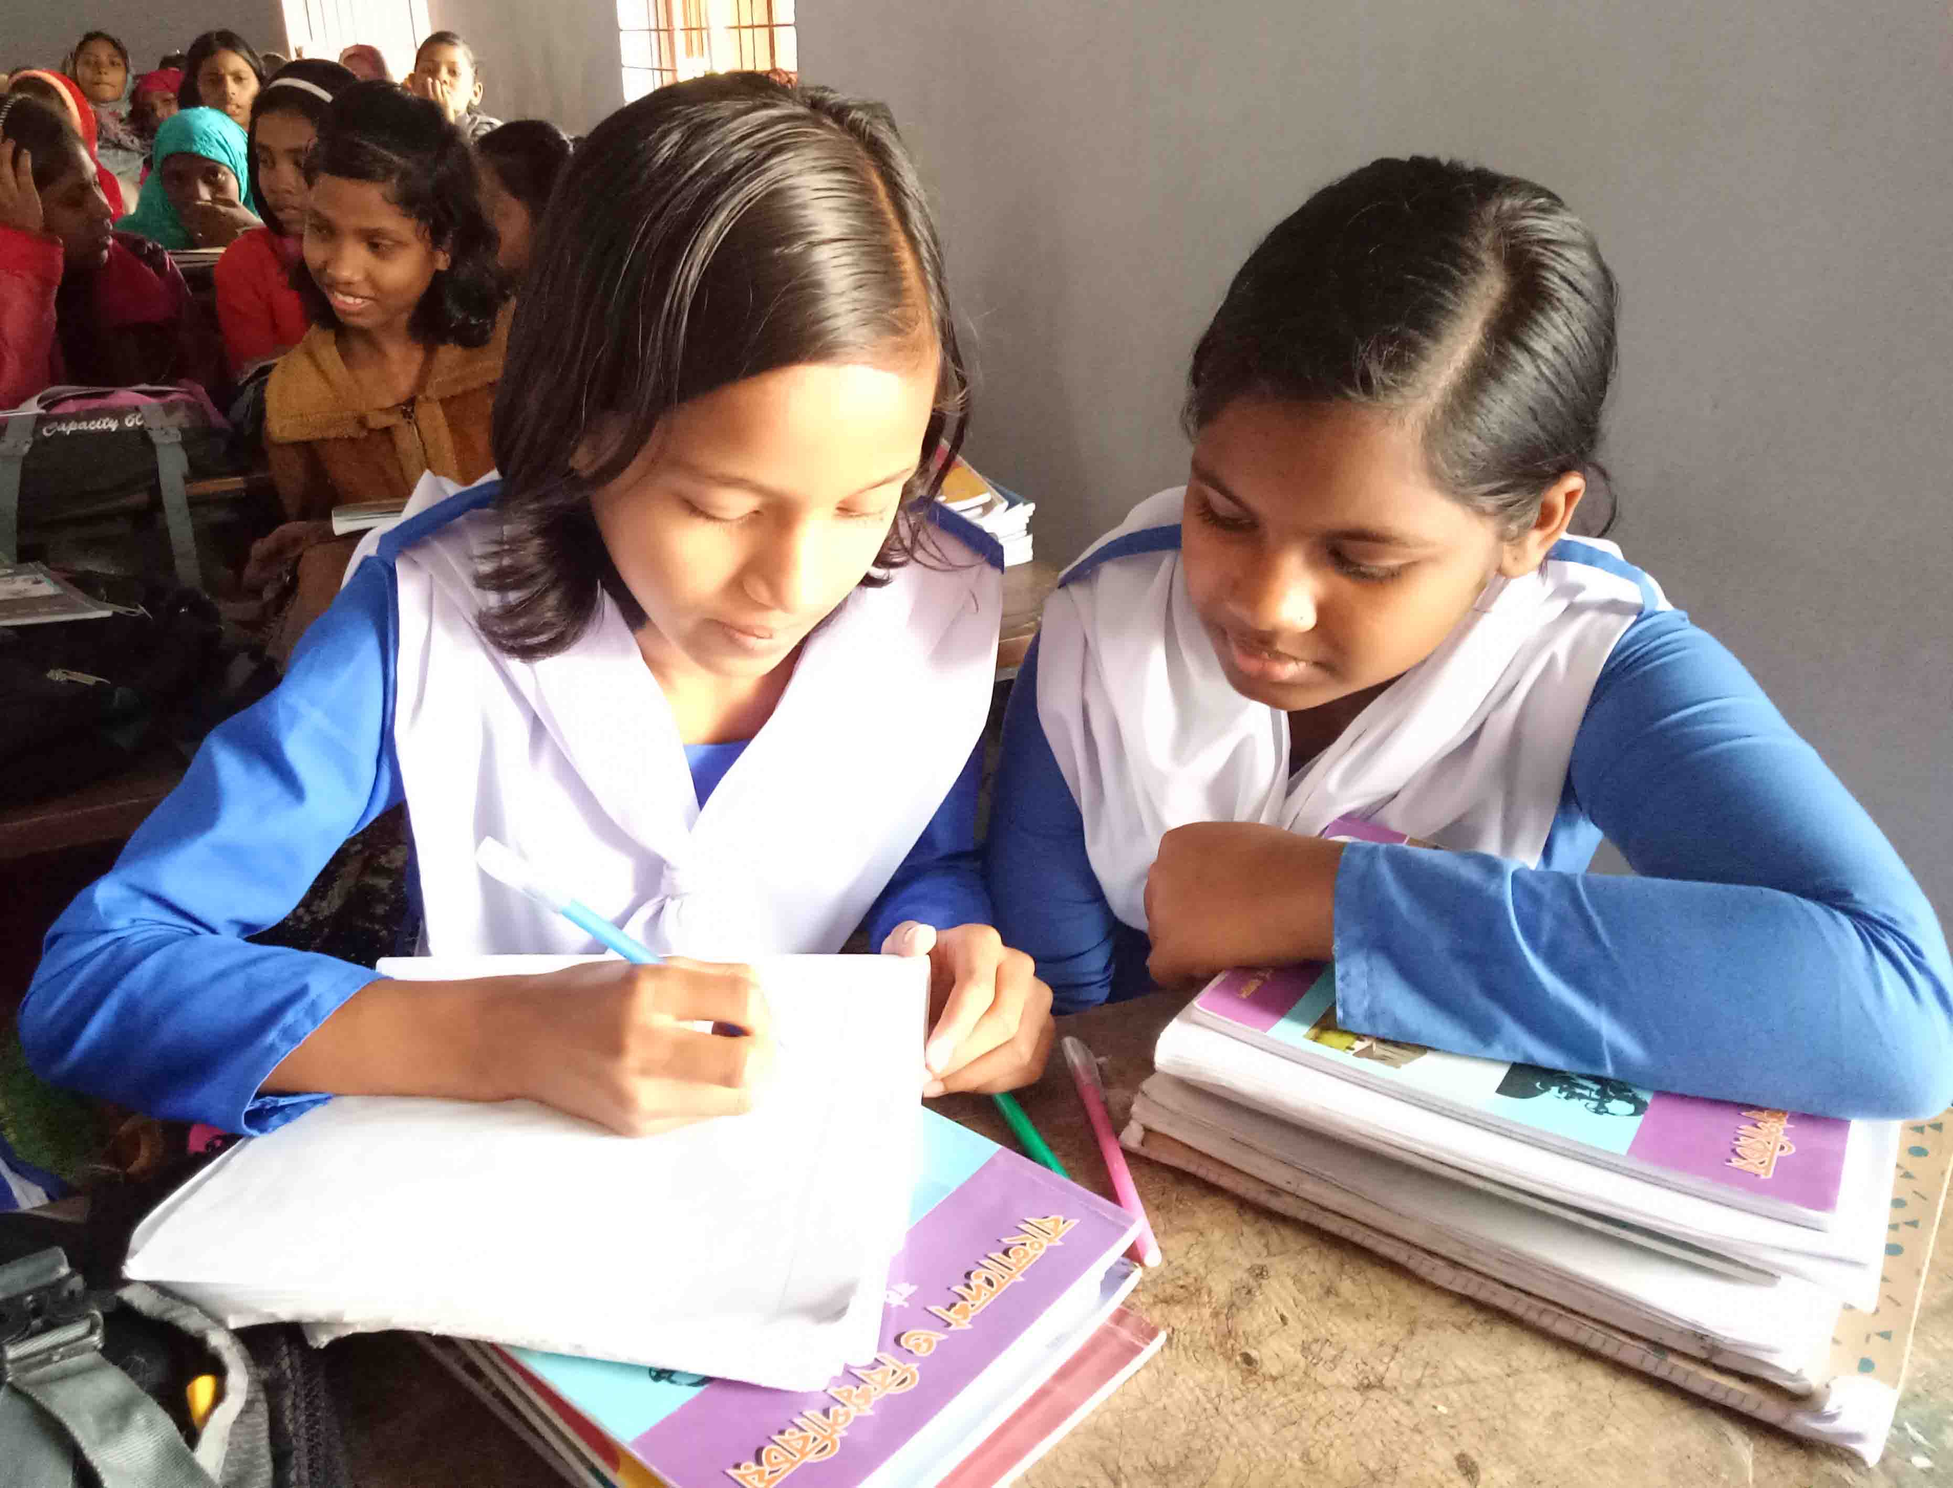
Pair works
Time: 04 minutes
Act out a dialogue in pairs on the basis of your likes and dislikes.

Slide 15
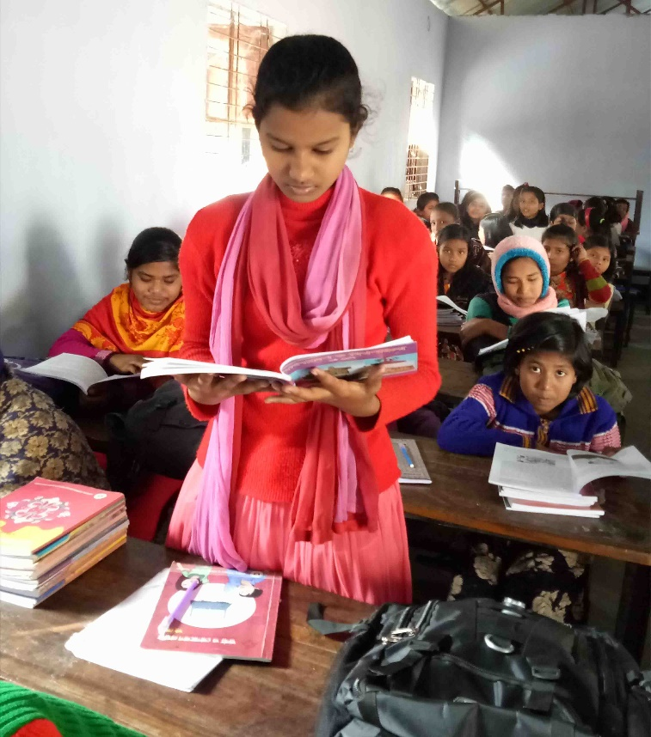
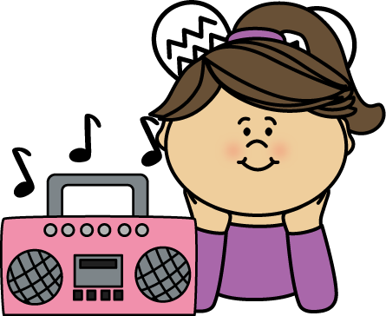
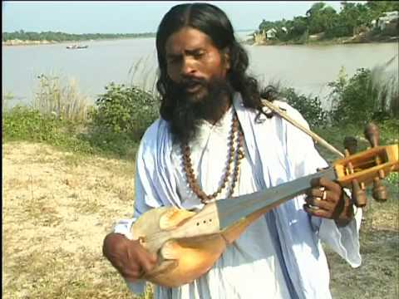
Look at the pictures
Kobita is a class seven student of Sundarpur High School.
She likes listening to music.
She likes folk song.

Slide 16
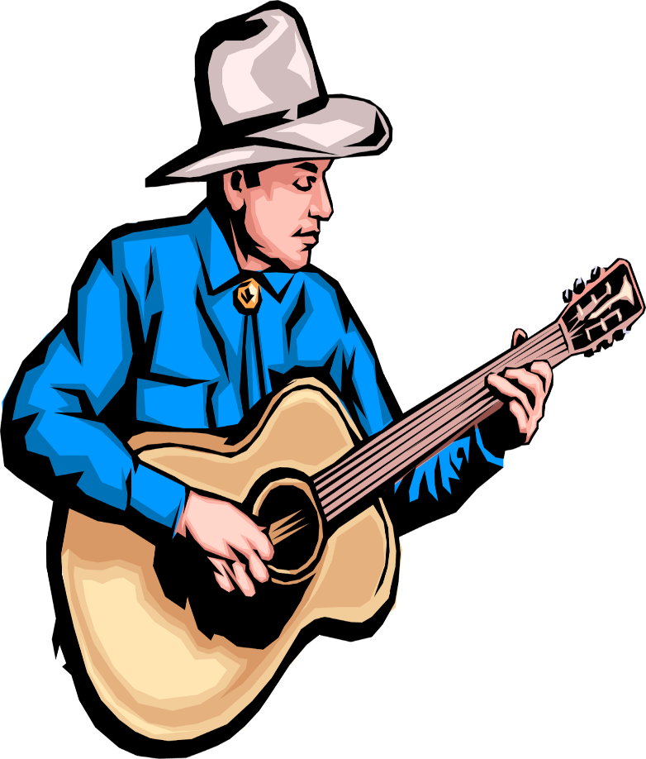
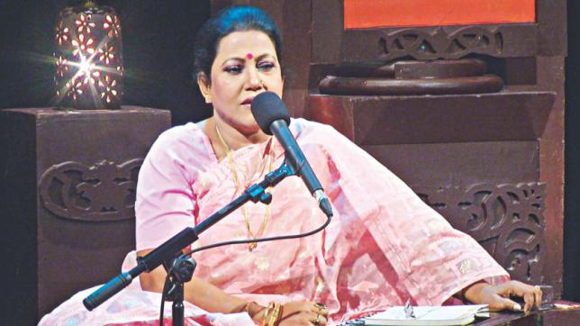
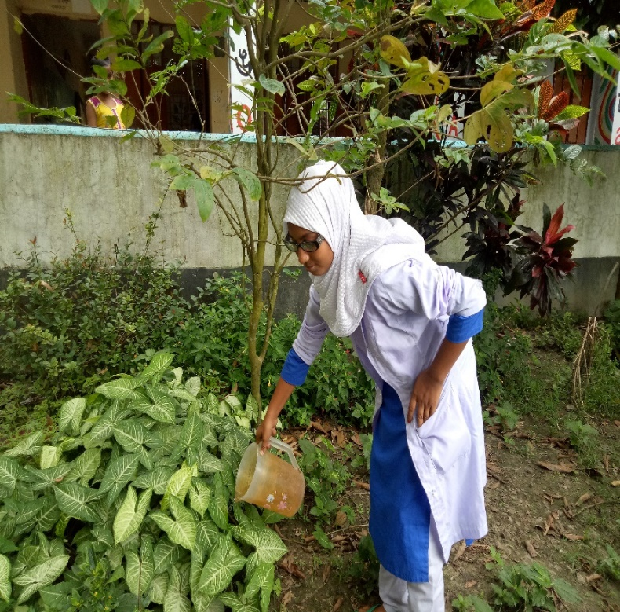
Look at the pictures
Kobita’s father does not like pop music.
Kobita’s favourite singer is Farida Parvin.
She likes gardening.

Slide 17
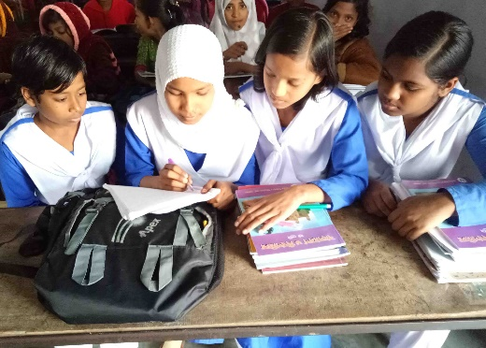
Group works
Time: 05 minutes
Answer the following question.
1. What class Kobita reads in?
2. What does she like?
3. Who is Kobita’s favorite singer?
Match the answer:
1. Kobita reads in class seven.
2. She likes gerdening.
3. Farida Parvin.

Slide 18
Assessment of Learning
Choose the correct answer.
1. Kobita read in-
a) Class Six.
b) Class Seven.
c) Class Eight.
d) Class Nine.
2. Kobita likes-
a) Music.
b) Gardening.
c) Folk songs.
d) All.
3. Who adore the flowers?
a) Rahim.
b) Narayon.
c) Mukul.
d) Kobita.
Answer:
1
2
3

Slide 19
Home works
Write five sentences about what you adore, love and like?

Slide 20
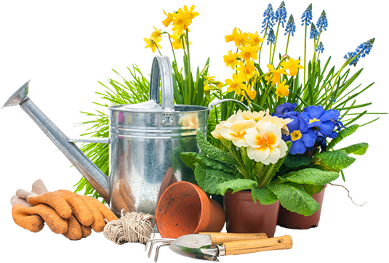
Thanks all

