Slide 1
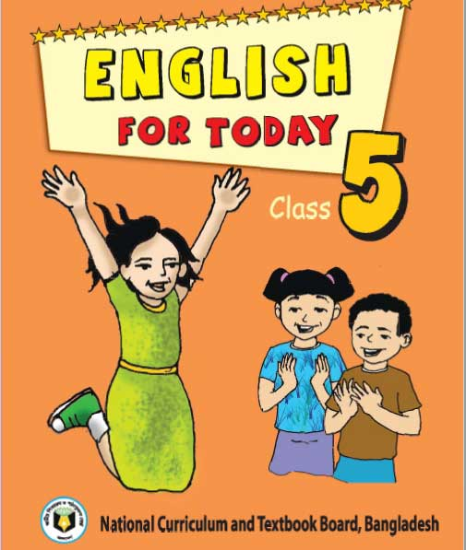
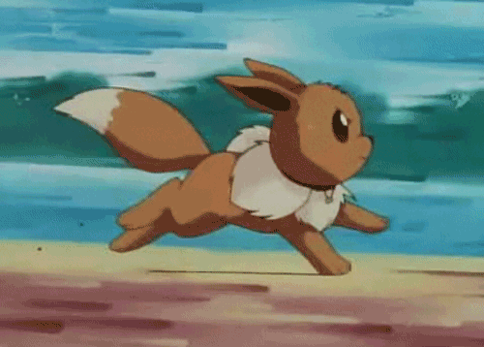
Class : Five
Subject : English
Lesson: The hare and the tortoise .
unite : 14(A)One day---the race began.
Page No.: 54
Time : 40 minutes.
Date :26/07/2020
Nahid akhtar parvin
Assistant Teacher
Jagodishpur Govt. Primary school
Taragonj,rangpur.

Slide 2
LEARNING OUTCOMES
Students will be able to-
LISTENING:
4.2.1-understand and enjoy simple stories.
SPEAKING:
1.1.2-say sentences with proper intonation.
READING:
1.5.1-read words ,phrases and sentences in the text with proper pronounciation , stress and intonation.

Slide 3
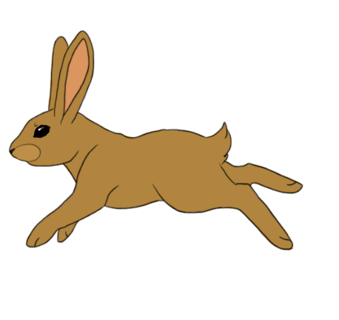
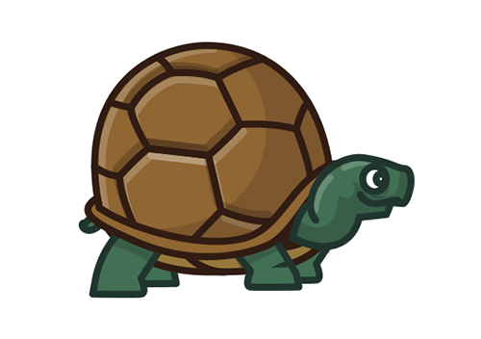
What can you see in this picture?
Who are there in the picture?
What are they doing?
Tortoise
Hare

Slide 4
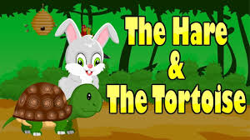
Where are they?

Slide 5
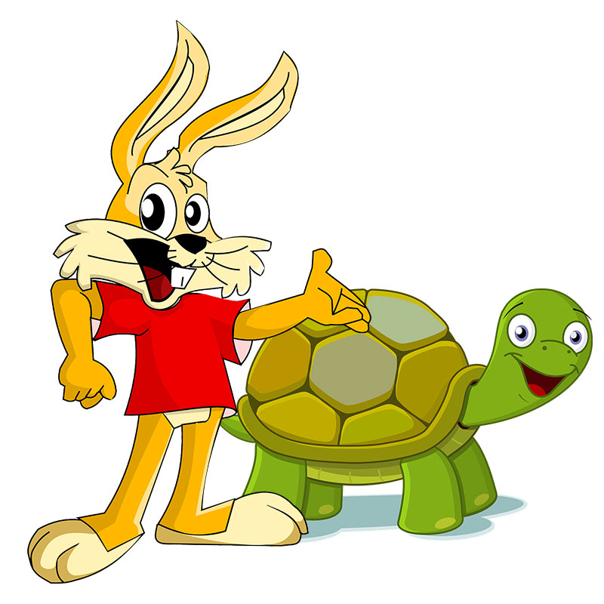
Todays lesson is-
The hare and the tortoise

Slide 6
new words
Race
Running competition
দৌড় প্রতিযোগিতা ।
win
To be victorious
জয়লাভ করা।

Slide 7
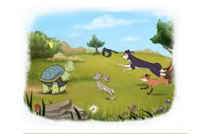
Open your book page:54.

Slide 8
One day, a hare was walking in the forest when he saw a tortoise .The hare was the fastest animal in the forest.the tortoise was the slowest animal in the forest.The hare called out to the tortoise, “Hurry up ! You are so slow! Can’t you walk faster ?can’t you ran?
The tortoise felt angry and said to the hare,”why don’t we have a race ?may be I can win!”

Slide 9
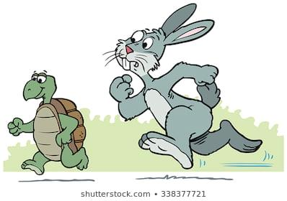
The hare laughed and laughed.”sure! I will win!”The hare said.They agreed to start next to a big tree and finish at the river .Then they called their friends to watch.The hare stood beside the tortoise and the race began.

Slide 10
Pronounciation
TORTOISE
TOR
TOISE
FASTER
FAS
TER
BEGAN
BE
GAN

Slide 11
Match the words in column A with column B
A
B
Angry
Begins
Furious
Fast
Beside
Quick
Next to
Furious
Beside
Quick
Begin
Start

Slide 12
Fill in the blanks with the correct word from the box-
fasted
passed
raced
slowest
took
The hare was the -----------------animal, but the tortoise was the -----------.One day ,the tortoise and the hare--------.
fasted
slowest
raced

Slide 13
evaluationa
1) Who was the fasted and who was the slowest animal in the forest?
Ans: Hare was the fasted and tortoise was the slowest animal in the forest.
2) Where did they start the race from?
Ans:They start the race next to a big tree.

Slide 14
Home work
Why do you think the tortoise want to have a race with the hare?

Slide 15
One day one word
NAP
THE HARE WAS TAKE A NAP UNDER A TREE.

Slide 16
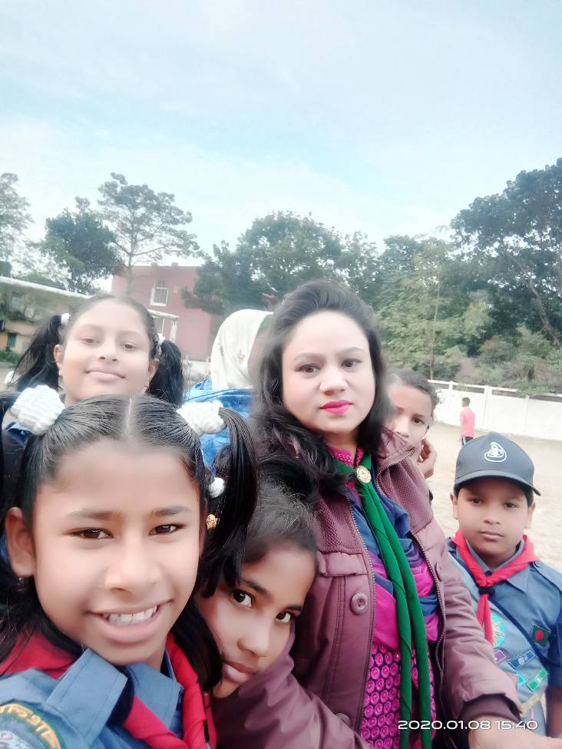
Thank you everyone

