Slide 1
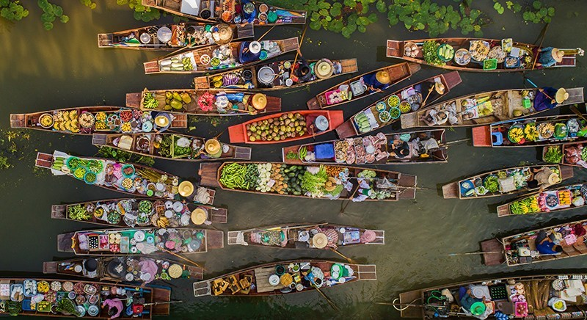
Welcome to our English Class

Slide 2
Class: 8
Unit: 6; Lesson:2
35 minutes
July 23, 2019.
Coordinated by
Md Rayhan Abbas
Assistant Teacher
Ahmed Bawany Academy School & College

Slide 3
After we have studied this lesson, we will be able to-
read and understand texts.
ask and answer questions.
write answers to questions.
describe a new place.

Slide 4
Tha Kha Floating Market
Talat Nam ThaKha
Address: Tha Kha, Amphawa District, Samut Songkhram 75110, Thailand.
Alongside the Tha Sala canal, Tha Kha floating market is set in a small village in Samut Songkhram province.

Slide 5
The ThaKha Floating Market is a meeting point for vendors on boats carrying local culinary curiosities, vegetables and fruit, often homemade or home-grown. These include chilis, shallots, garlic, coconut sugar, guavas, rose apples and pomelos, which are just a few of the many uniquely Thai tastes on offer. A boat service is available for visitors who wish to explore the village and nearby fruit orchards as well.

Slide 6
At Tha Kha they will paddle you along the narrow canals in peace and quiet so that you can better appreciate your environment. You can find two old houses that are more than 100 years old and also a sugar palm factory.

Slide 7
Let’s enjoy a short video

Slide 8
There were boats everywhere. The sellers were mainly elderly Thai women. Their small boats were laden with bundles of lotus flowers, farm-fresh coconuts, fruits, vegetables, local food, and delicious sweets.

Slide 9
The sellers and buyers rowed their boats slowly. The sellers displayed their goods for sale and the buyers chose their pick. They could have a little chit-chat as buying and selling was going on.

Slide 10
The Tha Kha floating market is more traditional with a few tourists visiting than other floating markets. Originally, the Tha Kha floating market used to sit only six or seven days a month depending on the phase of the moon. Nowadays, the trade takes place on Fridays, Saturdays and Sundays from 6 am to 2 pm too. The earlier you go the better.

Slide 11
Discuss the following questions in groups:
Q₁ Where is the Tha Kha Floating market located?
Q₂ Is Tha Kha the only floating market in Thailand?
Q₃ When does the market sit nowadays?
A₁ The Tha Kha floating market is located on Sala canal in Amphawa district of Thailand.
A₂ No, besides Tha Kha there are other floating markets in Thailand.
A₃ The market sits every Friday, Saturday and Sunday now.

Slide 12
The main buyers here are the Tha Kha natives. People seem to know each other very well. Everyone was seen smiling and calling each other by name. The locals did not notice Mita and others much. They were all busy buying and selling.

Slide 13
They passed an hour and a half at the market and enjoyed the business. Then all of them were hungry. They rowed near the boat of an elderly woman, who was selling food. She welcomed them with a smile and showed them the foods.

Slide 14
They bought the traditional and very popular food called ‘Pad Thai’, a kind of noodles with shrimps, tomato and some vegetables, with freshly roasted crushed peanut. The food was served in a bowl made from banana leaf. After Pad Thai, they ate `Kanom Krok'. It is a coconut pancake which is very sweet.

Slide 15
The Tha Kha people are simple and easy going. They are very friendly and polite. They do not understand English or any other language. Yet they have a way to communicate with Mita and others. Mita was delighted to see a traditional Thai floating market. She took a lot of pictures with the elderly sellers.

Slide 16
Home work
There is a popular floating market in your country.
Produce 8 sentences about it.

Slide 17
Thank you for making it a fruitful session.

