Slide 1
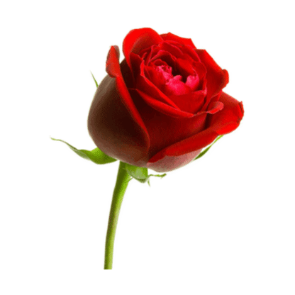
Welcome

Slide 3
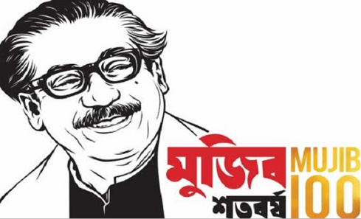
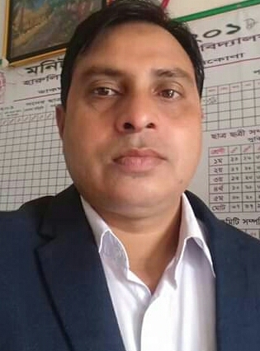
Identity
English For Today
Class:5
Unit:17
Activity: H
Md.kamruzzaman.
Assistant teacher
Harulia govt. primary school.
Kendua,netrakona.

Slide 4
Good afternoon students.
How are you today?

Slide 5
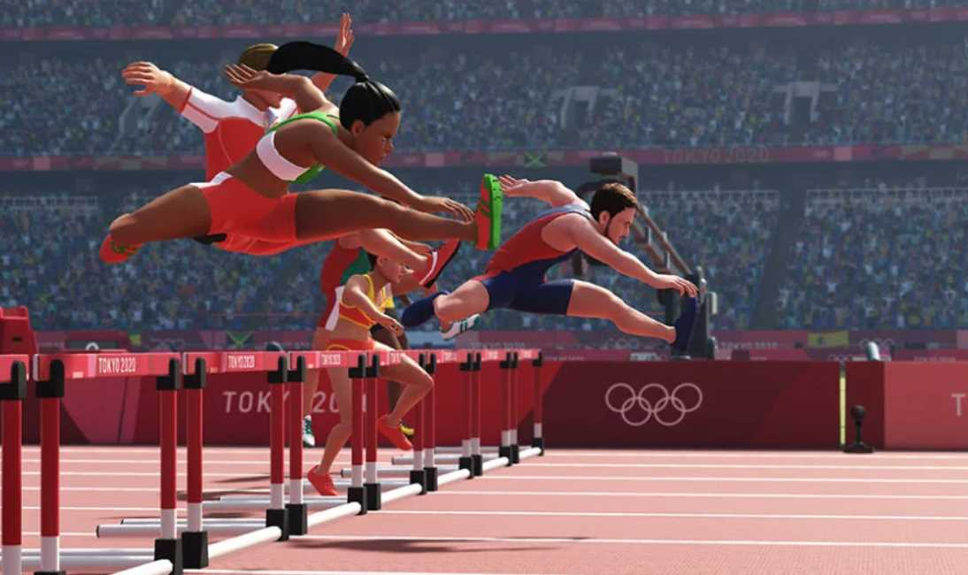
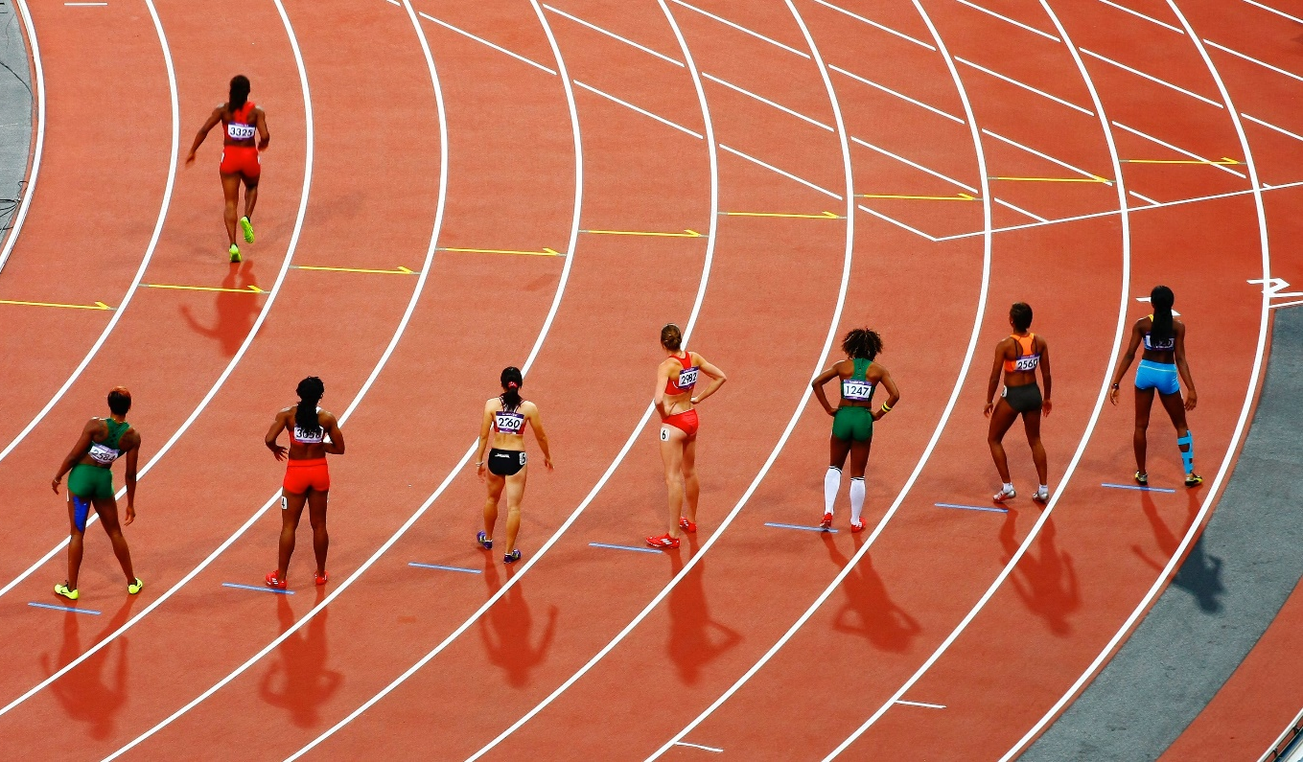
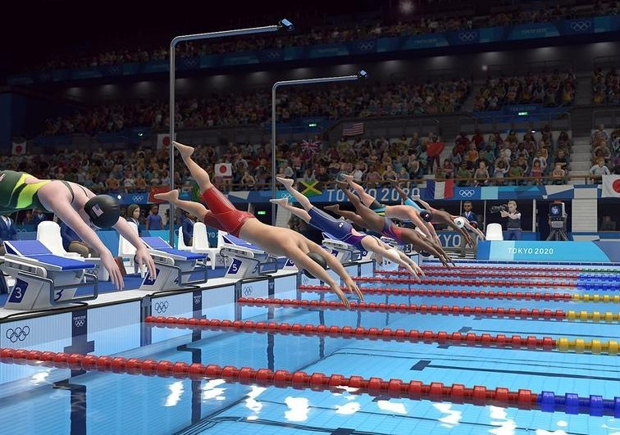
Look at the pictures
Can you guess, what are the pictures about?

Slide 6
Our today’s lesson is…
Sport

Slide 7
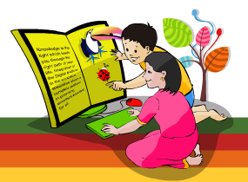
Learning outcomes
Students will be able to…
understand questions about objects around them;
say words, phrases, and sentences with proper
sounds and stress;
read paragraphs, dialogues stories, letters and
other texts;
recognize and read ordinal numbers up to 20th.

Slide 8
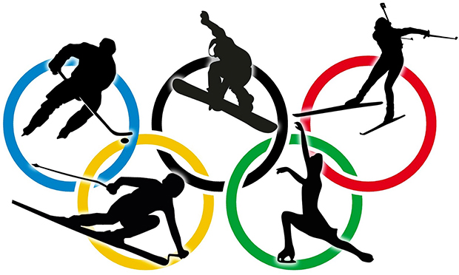
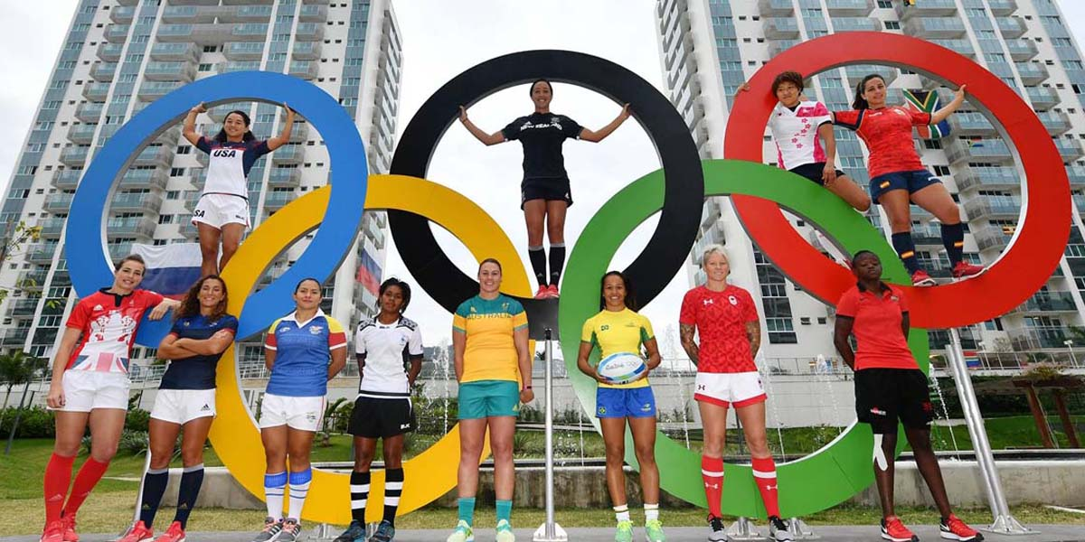
Look and read
The Olympic games is the biggest sports competition in
The world. The Olympics are held every four years in a
different host city. More than 200 nations send a total of
about 13,000 athletes to compete in more than 30
different sports.

Slide 9
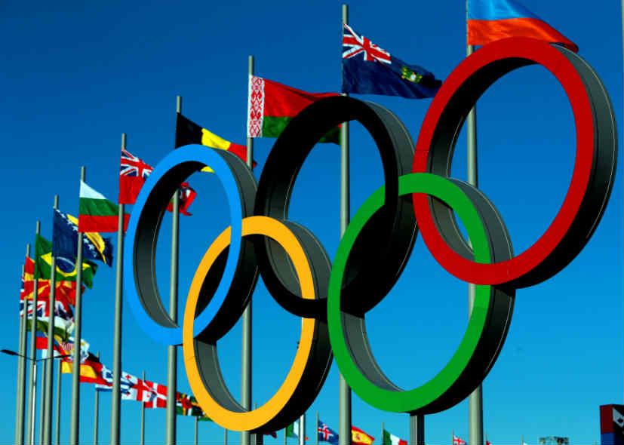
Look and read
The first Olympic Games were held in Greece almost
3,000 years ago. The modern Olympic Games started
in 1896, and there have been 31 Olympic competition
since then.

Slide 10
Listen to the audio very carefully.
Listen to the audio once again.

Slide 11
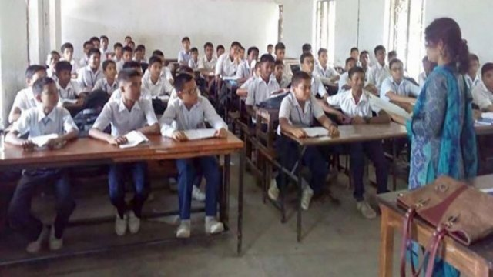
Teacher’s reading
I’ll read the text and you will
follow me very carefully.

Slide 12
Match the words in column A with their meaning in column B
Column A | Column B
Games | Earth
Biggest | Sportsman
World | Sports
Athlete | Before
Ago | Largest

Slide 13
Students’ silent reading.
Read the text silently and answer the following questions.

Slide 14
Write True or False.
The Olympics are held every three years.
More than 200 countries participate in Olympics.
About 1300 athletes compete in Olympic.
The first Olympics were held in Greece.
The modern Olympic games started in 1896.
a) False b) True c) False d) True e) True

Slide 15
Home work
Answer the following questions discussing in groups.
How often are the Olympics held?
How many countries compete in the Olympics?
How many athletes compete in the Olympics?
How many sports are there in the Olympics?
When was the first Olympics?
When did the modern Olympic games begin?

Slide 16
Homework
Write a short composition about “Olympic Games”
in 10 sentences.

Slide 17
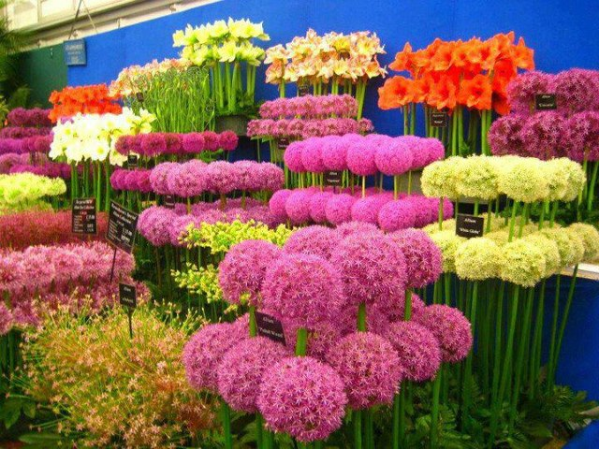
Thank you to all.

