Slide 1
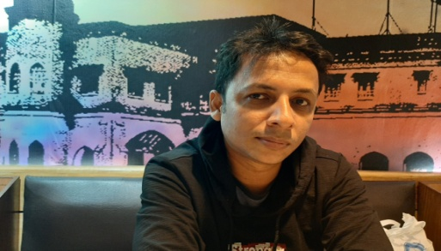
Md. Sohrab Hossain Teacher in English Railway Public High School Chattogram
Given Words Vs Opposite Words

Slide 2
Given word | Opposite word
All | None
Allow | Forbid
Already | Not yet
Always | Never
Ancient | Modern
Amateur | Professional
Amused | bored
Ancestor | Descendant
Angel | Devil
Animal | Human
Annoy | Satisfy
Answer | Ask/question
Antonym | Synonym
Apart | Together

Slide 3
Given word | Opposite word
Argue | Agree
Arrest | Free
Arrival | Departure
Arrive | Depart
Artificial | Natural
Ascent | Descent
Asleep | Awake
Attack | Defence /protect
Attic | Cellar
Awful | Nice
Alive | Dead
Backward | Forward
Empty | Full
Back | Front

Slide 4
Given word | Opposite word
End | Begin
Enemy / Foe | Friend
Enjoy | Hate
Enter | Leave
Entrance | Exit
Equal | Different
Even | Uneven
Excited | Calm
Exciting | Boring
Exclude | Include
Failure | succeed
Failed | Successful
False | True
Far | Near

Slide 5
Given word | Opposite word
Few | Many
Final | First
Find | Lose
Finish | Begin
Fix | Break
Flat / Plain | Hilly
Floor | Ceiling / Roof
Follow | Lead
Forbid | Allow
Foreign | Domestic
Foreigner | Native
Form | Destroy
Fortune | Bad luck
Fortunate | Unfortunate

Slide 6
Given word | Opposite word
Forever | Never…….again
For the last time | Never…….again
For good | Never…….again
Life | Death
Light | Dark
Like | Dislike
Love | Hate
Long | Short
Lose | Win
Loud | Quiet
Lovely | Terrible
Low | High
Major | Minor
Male | Female
Miss | Get on

Slide 7
Given word | Opposite word
Moon | Sun
Lunar | Solar
More | Less
Much | Little
Nasty | Nice
New | Ancient
Nice | Awful
Night | Day
Plant | Harvest
Forestation | Deforestation
Plenty | Lack
Pleasant | Unpleasant
Pleased | Displeased
Ordinary | Extraordinary

