Slide 1
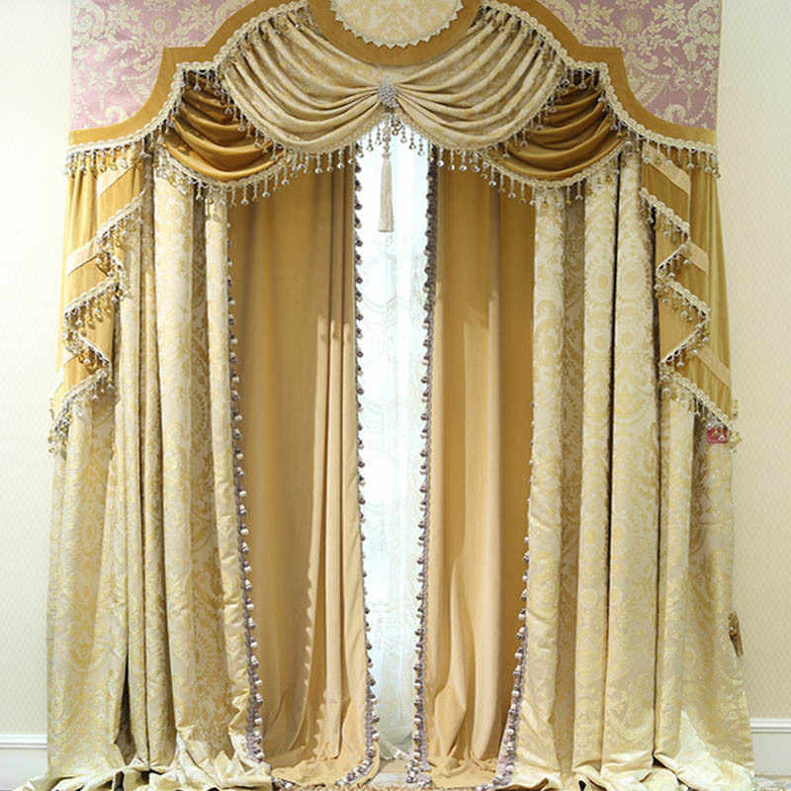

Slide 2
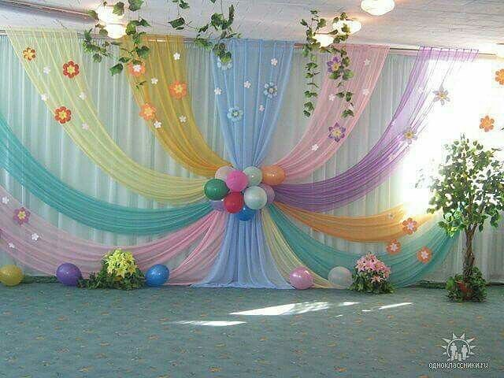

Slide 3
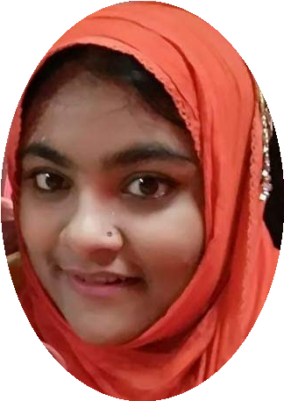
Introduction
Mahfuza Yesmeen Srabonee
Assistant teacher
Alokdia Govt. Primary School
Narail Sadar, Narail.
Mobile number: 01725875692
Email ID: m.y.srabonee@gmail.com
Class: One
Subject: English For Today
Unit: 12
Lessons: 4-6
Page: 25

Slide 4
Learning outcomes:
At the end of the lesson the students will be able to –
Listening :
1.1.1 become familiar with English sounds by listening to common English words.
Speaking :
1.1.1 repeat after the teacher simple words and phrases.
1.1.2 say simple words and phrases.
Reading :
1.2.1 recognize and read the alphabet both small and capital. (non-cursive)
Writing :
1.1.1 to practice letter shapes/ simple writing patterns, etc.
1.2.1 write non-cursive capital and small letter.

Slide 5
https://www.youtube.com/watch?v=s4ePFtMGBrw

Slide 6
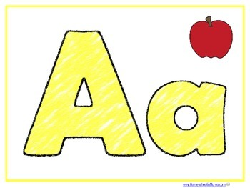

Slide 7
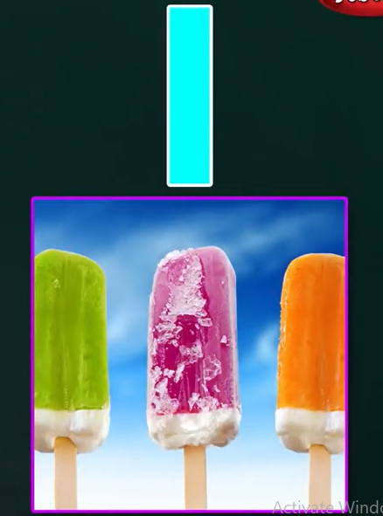
Now I’ll show you some pictures.
I i
for

Slide 8
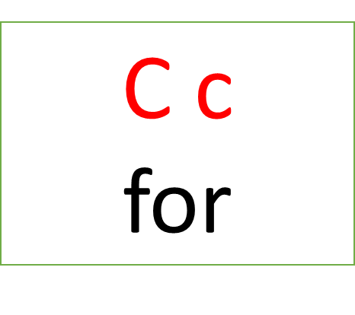
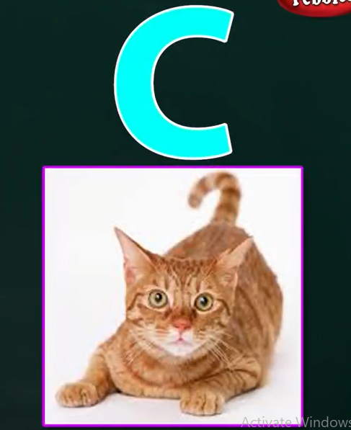
Now I’ll show you some pictures.

Slide 9
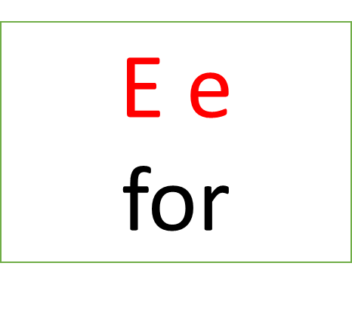
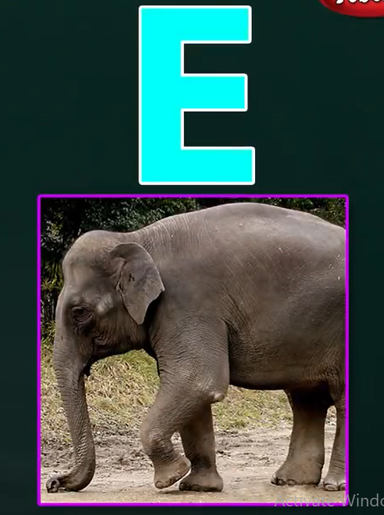
Now I’ll show you some pictures.

Slide 10
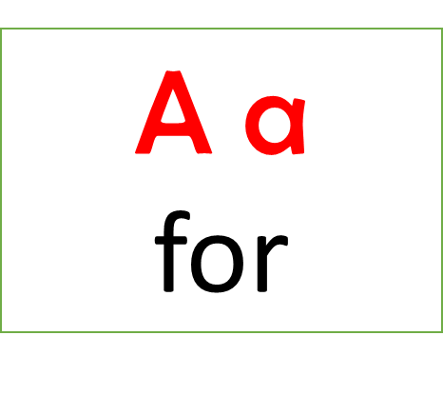
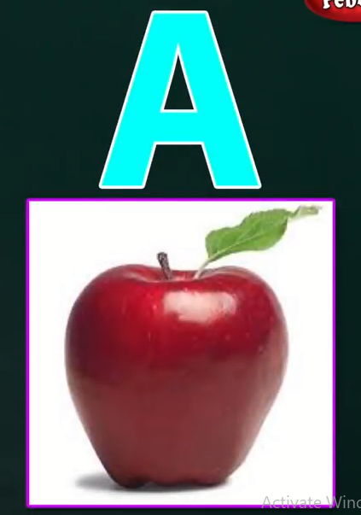
Now I’ll show you some pictures.

Slide 11
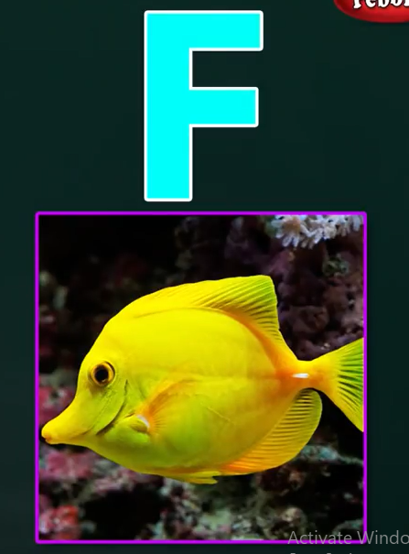
Now I’ll show you some pictures.
F f
for
fish

Slide 12
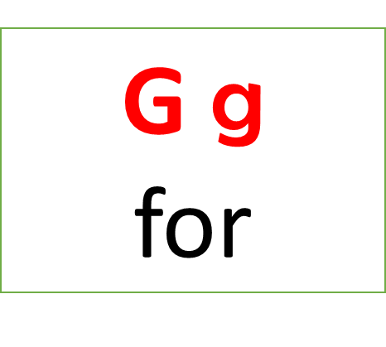
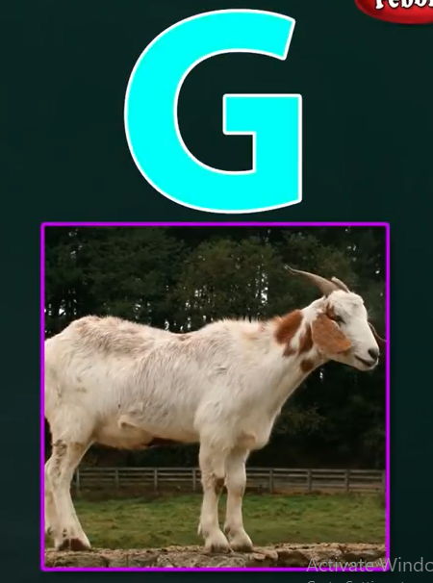
Now I’ll show you some pictures.

Slide 13
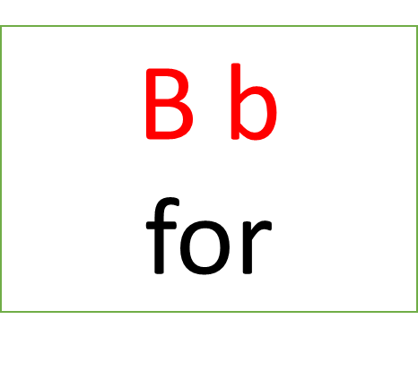
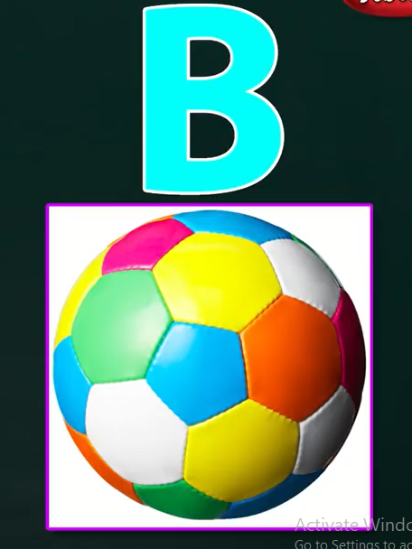
Now I’ll show you some pictures.

Slide 14
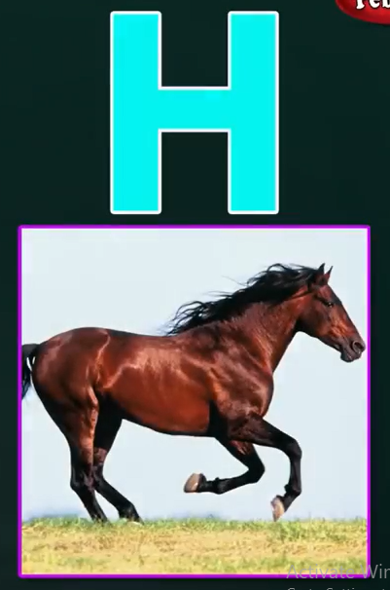
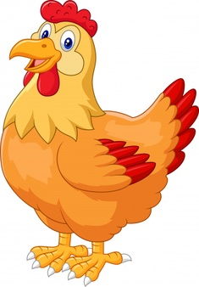
Now I’ll show you some pictures.
H h
for
hen

Slide 15
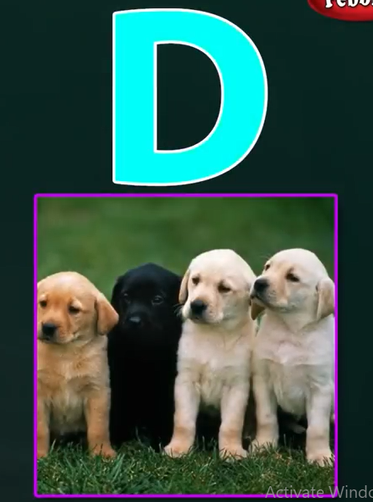
Now I’ll show you some pictures.
D d
for

Slide 17
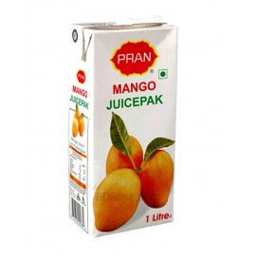
juice

Slide 18
J
j
uice
j

Slide 20
https://www.youtube.com/watch?v=aNyVGvYDW8U

Slide 21
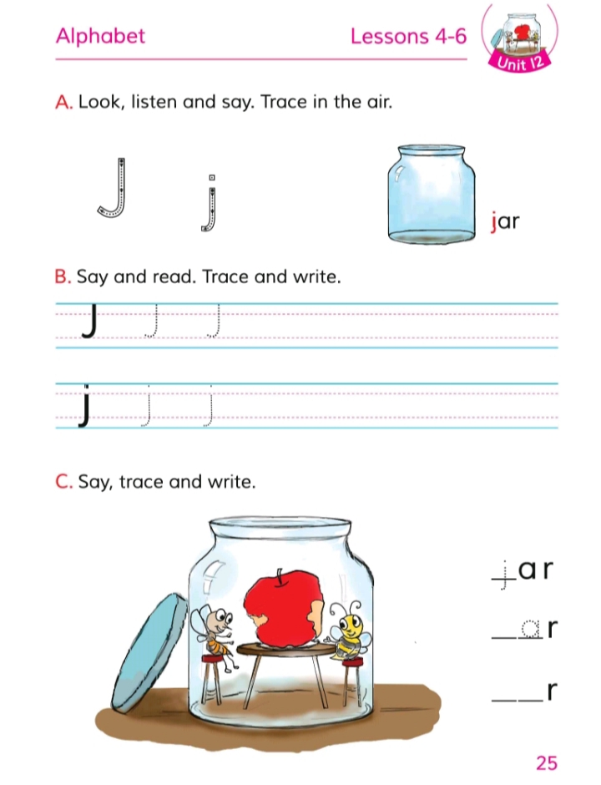

Slide 24
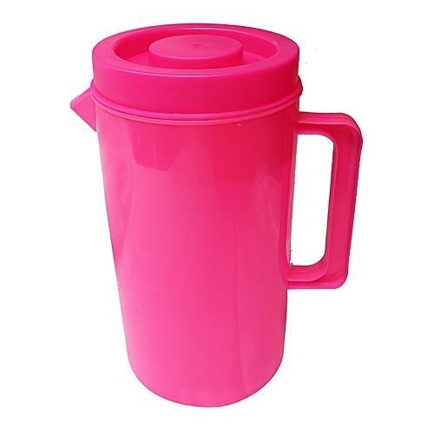
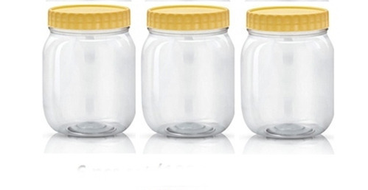

Slide 25
J
j

Slide 26
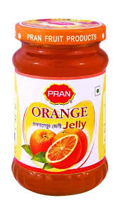
J
j
jelly

Slide 27
Home work

