Slide 2
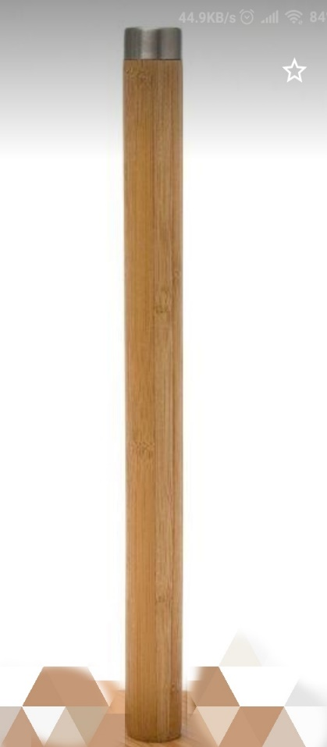
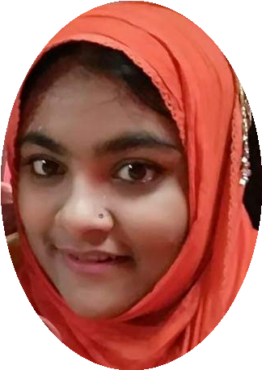
Introduction
Teacher’s identity
Lesson’s introduction
Mahfuza Yesmeen Srabonee
Assistant teacher
Alokdia Govt. Primary School
Narail Sadar, Narail.
Mobile number: 01725875692
Email ID: m.y.srabonee@gmail.com
Class: One
Subject: English For Today
Unit: 12
Lessons: 4-6
Page: 25

Slide 3
Learning outcomes:
At the end of the lesson the students will be able to –
Listening :
1.1.1 become familiar with English sounds by listening to common English words.
Speaking :
1.1.1 repeat after the teacher simple words and phrases.
1.1.2 say simple words and phrases.
Reading :
1.2.1 recognize and read the alphabet both small and capital. (non-cursive)
Writing :
1.1.1 to practice letter shapes/ simple writing patterns, etc.
1.2.1 write non-cursive capital and small letter.

Slide 4
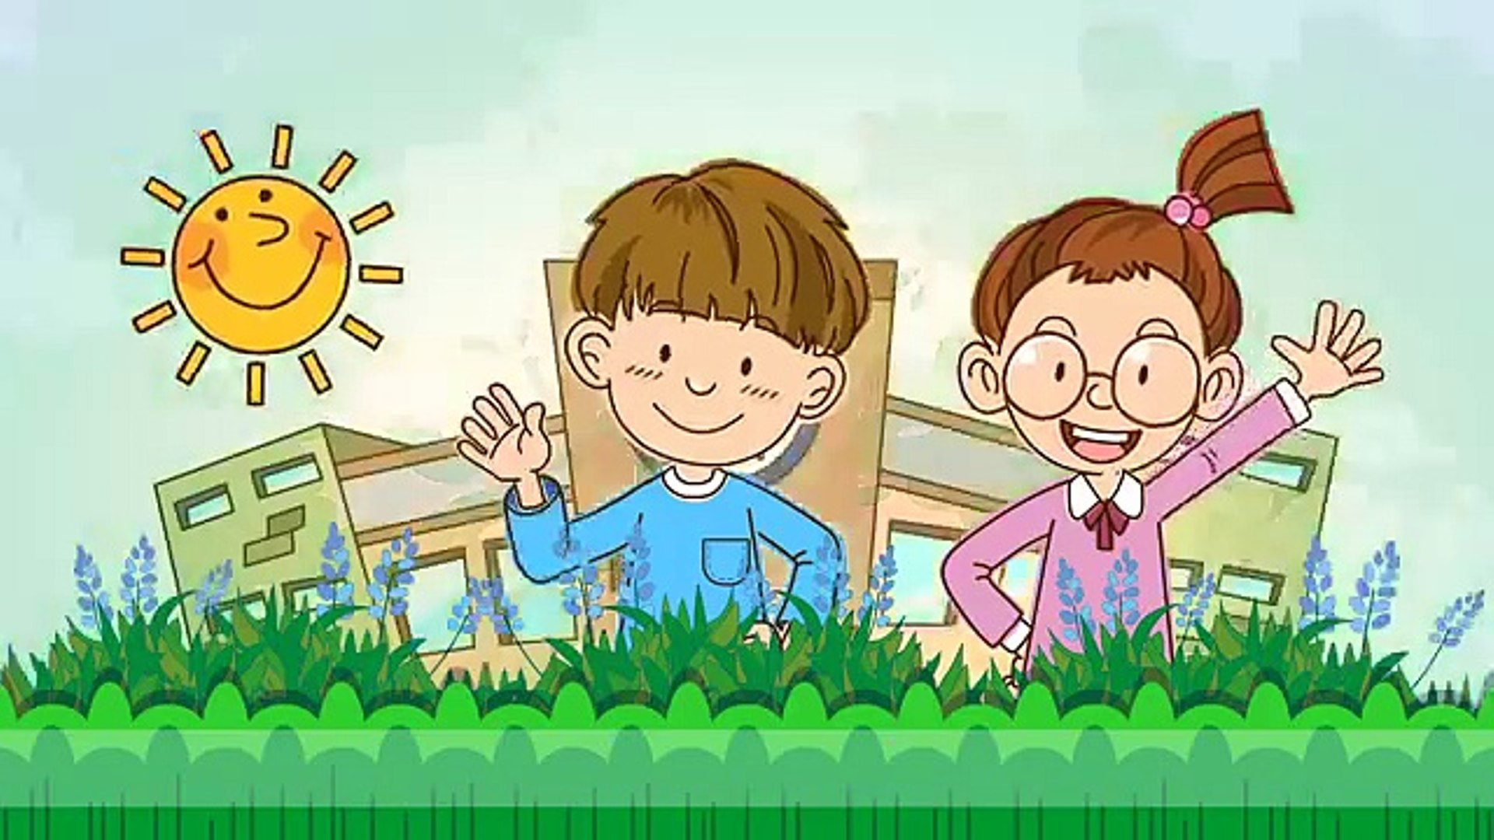
Let’s enjoy ‘Good morning song’

Slide 5
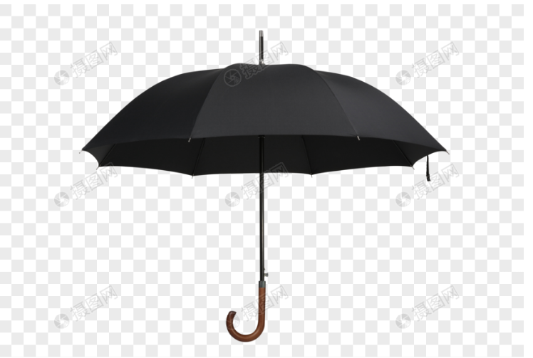
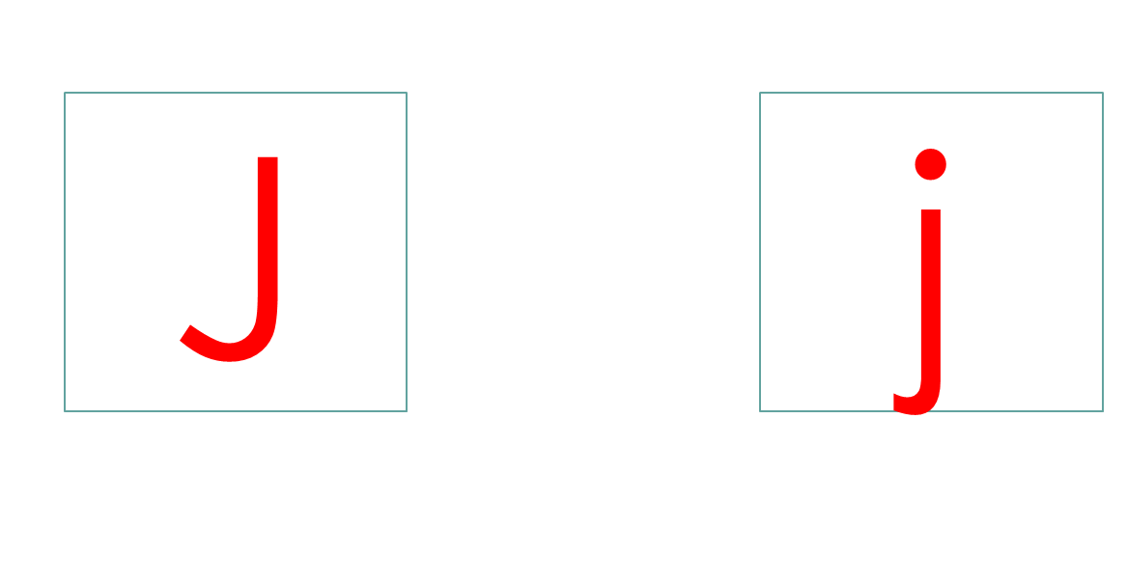
Look at the picture and find out what have we learnt before

Slide 6
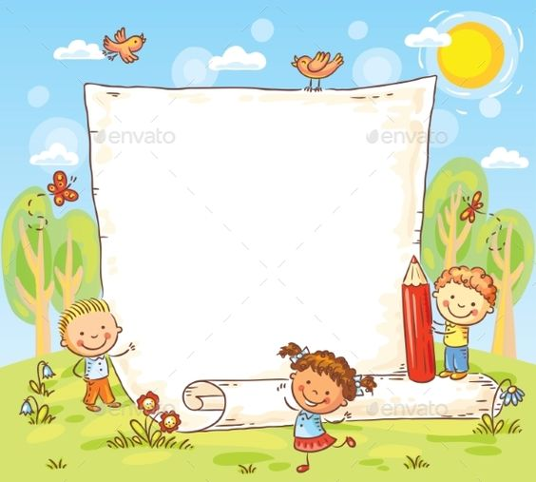

Slide 7
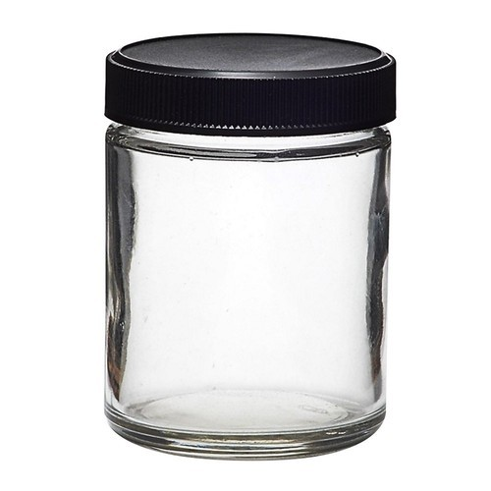
Look at the picture very carefully.
The first letter of ‘jar’ is……
jar
j

Slide 8
Write J, j on your khata.
Trace J, j in the air.
https://www.youtube.com/watch?v=NY2AwWRFxRo

Slide 9
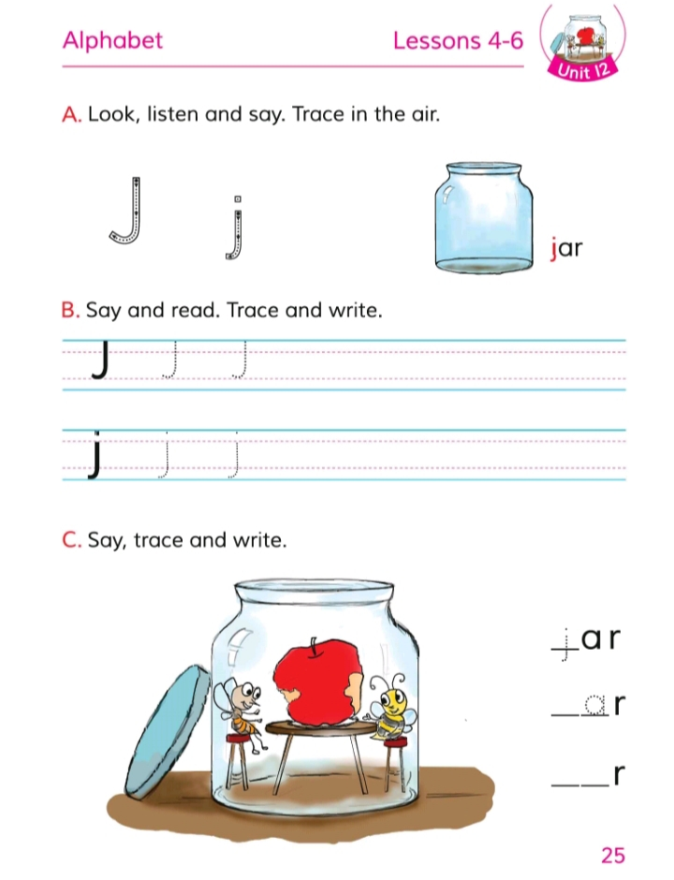
Open your book at page 25.

Slide 10
Look at activity C.

Slide 11
Now watch a beautiful video.
https://www.youtube.com/watch?v=VS3TpkEdqaY

Slide 12
The first letter of Johny…..

Slide 13
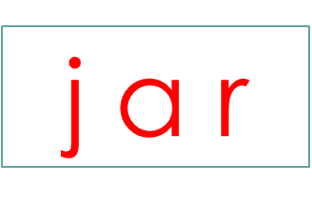
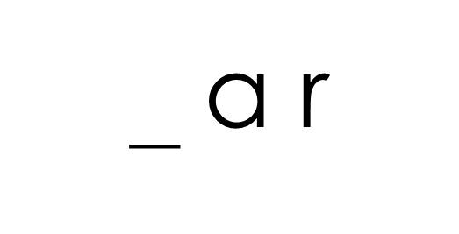
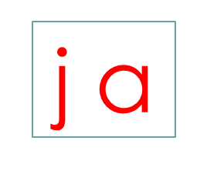
Fill in the gap by using the clue.
_ _ r

Slide 14
Let’s play a game.

Slide 15
Let’s play a game.

Slide 16
Let’s play a game.

Slide 17
One day one word
Word
Meaning
Sentence
jar
বয়াম
This jar is full.

Slide 18
Home work
You have to write the word jar, whole page twice in a line on your khata.

Slide 19
In such a way.

Slide 20
Thanks everybody.

