Slide 1
Khagrachari Online School

Slide 2
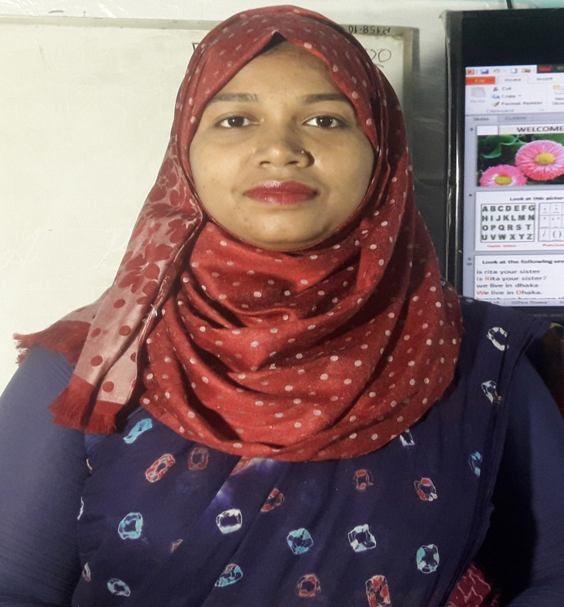
Rupa Mollik Rupu
Assistant Teacher
T and T gate Government Primary School, Khagrachari.

Slide 3
Today’s Lesson is----
Sport
Unit:17
Lesson: 3-4
Page no: 67

Slide 5
Try to answer the following questions from previous class.
1.Which games and sports does Anousha play or do?
Ans: Anousha play badminton.
2. Which games and sports does Baisong play or do?
Ans: Baichong play cricket and weightlifting.

Slide 9
play
play
play
go
go
play
play
do

Slide 10
Discussion about paragraph.

Slide 11
One day one word
Team
দল
Sentence making:
We feel proud for our cricket team.

Slide 12
Home Task
Write ‘Activity F’ in your exercise book..

Slide 13
Good Bye

