Slide 1
Welcome to my class

Slide 2
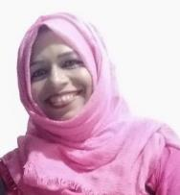
INTRODUCING
MST. LAIJU BEGUM
ASSISTANT TEACHER
RATANPUR GOVT PRIMARY SCHOOL.
BANIACHONG, HABIGANJ.
Unit: 8
Lesson: 1-2
Date: 04/04/2020
Time: 40 Minutes

Slide 3
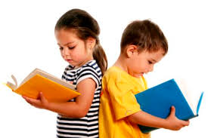
Students will be able to…
Listening:
1.2.1 recognize which syllable in a word is stressed .
1.3.1 recognize which words in a sentence are stressed .
Speaking:
1.1.1 say words,phrases and sentences with proper sounds and stress.
1.1.2 say sentences with proper intonation .
6.1.2 say what others are doing .
6.2.1 talk about people ,objects ,events,etc.
Reading:
1.5.1 read words ,phrases and sentences in the text with proper pronunciation ,stress and intonation .
1.6.1 recognize and read statements ,commands ,greetings,questions answers.
1.7.1 read paragraphs,dialogues stories ,letters and other texts.

Slide 4
Good morning students.
How are you today?
Let’s sing the good morning song.

Slide 5
Dear students, can you remember
what we learnt in our last class?
Yes, we learnt the rhyme…
3, 6, 9
Are you fine?
Let’s hear the previous lesson’s audio.

Slide 6
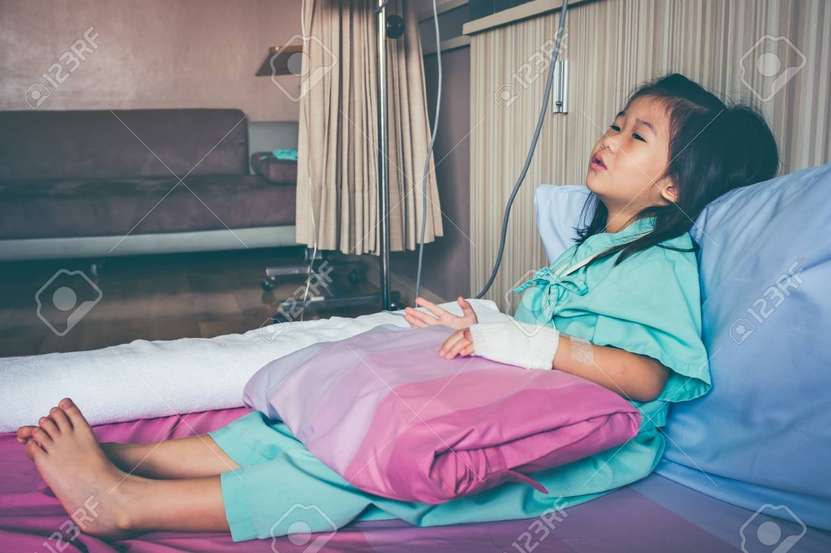
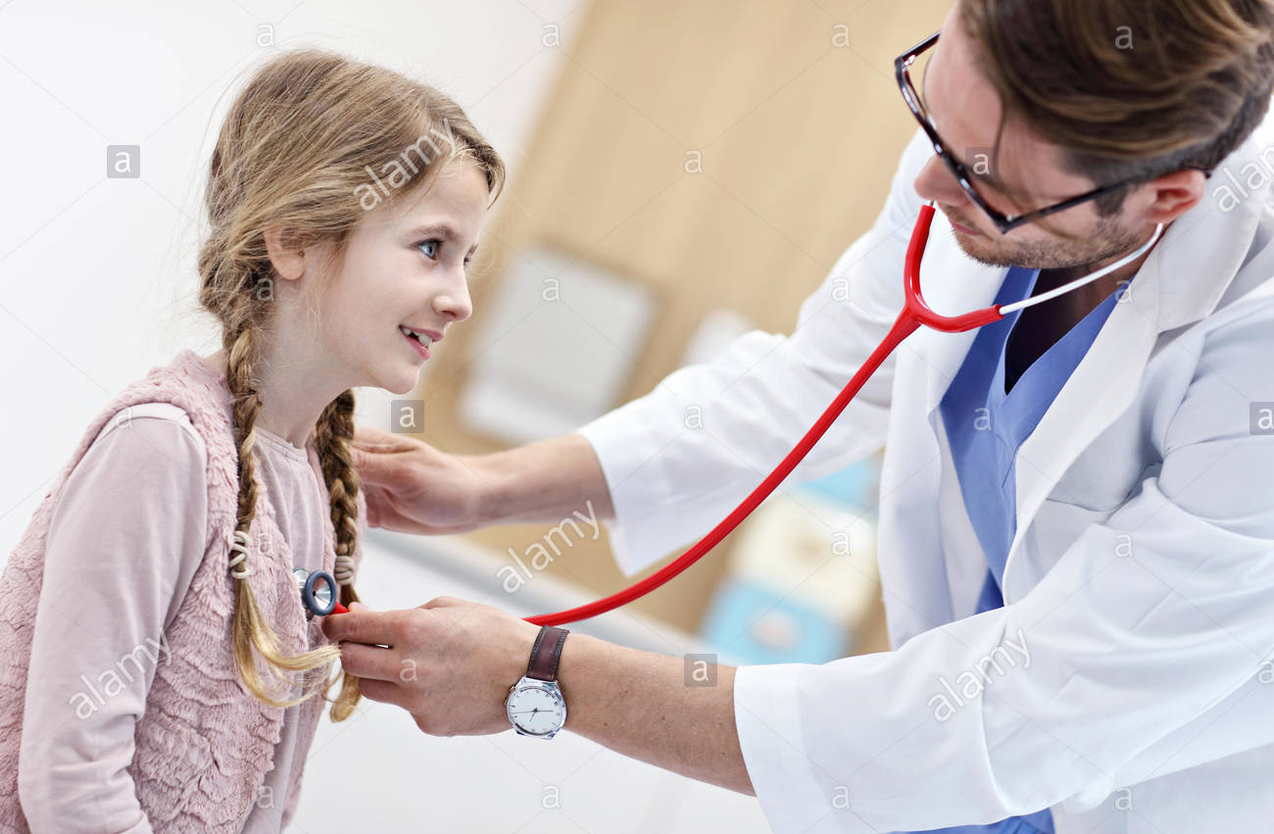
Let’s see some pictures.
A patient.
Doctor is checking up.
Can you guess what’s our today’s lesson?
What can you see in these pictures?

Slide 7
Our today’s lesson is…
Write to me soon !

Slide 8
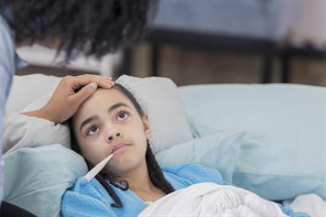
Listen and read.
Sima is at home today. She didn’t
go to school because she is ill.

Slide 9
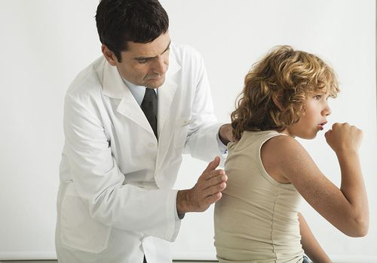
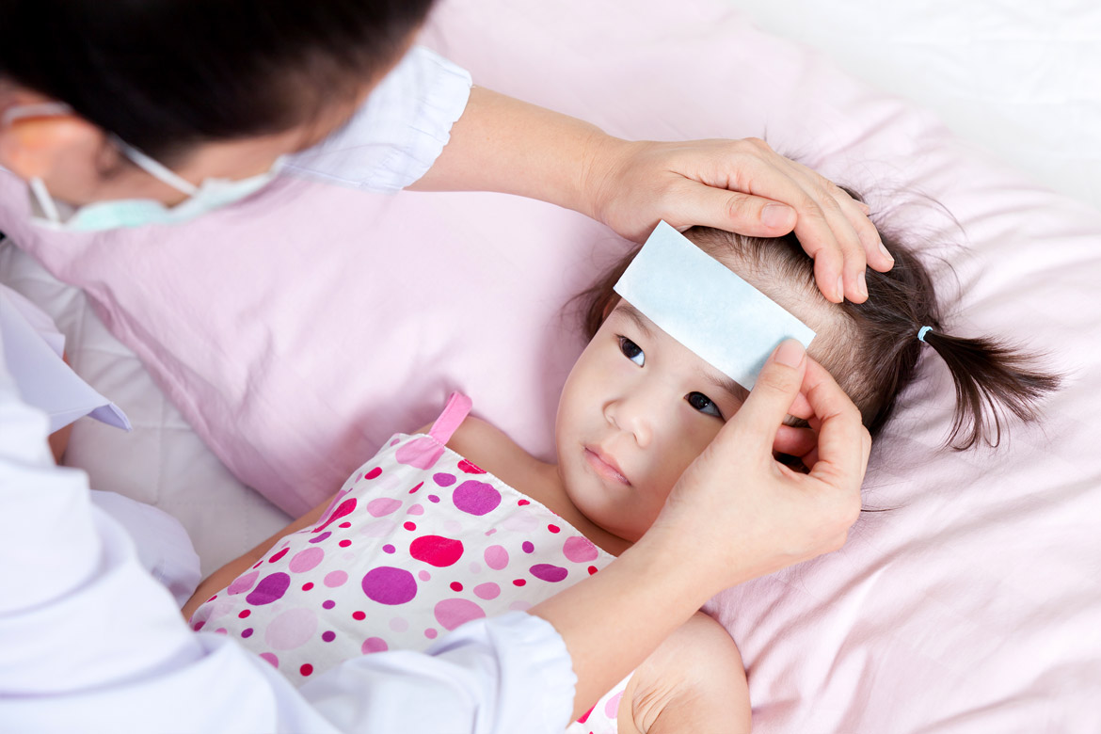
Listen and read.
She has a cough and
a sore throat.
She also feels very warm
because she has a fever.

Slide 10
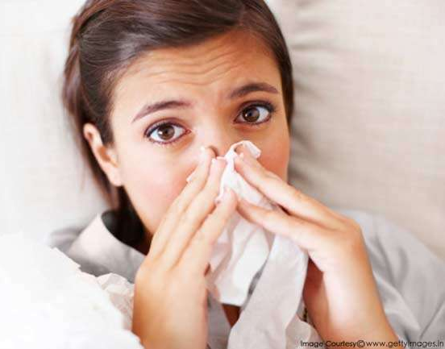
Listen and read.
The doctor visited
Sima last night.
She has the flu.

Slide 11
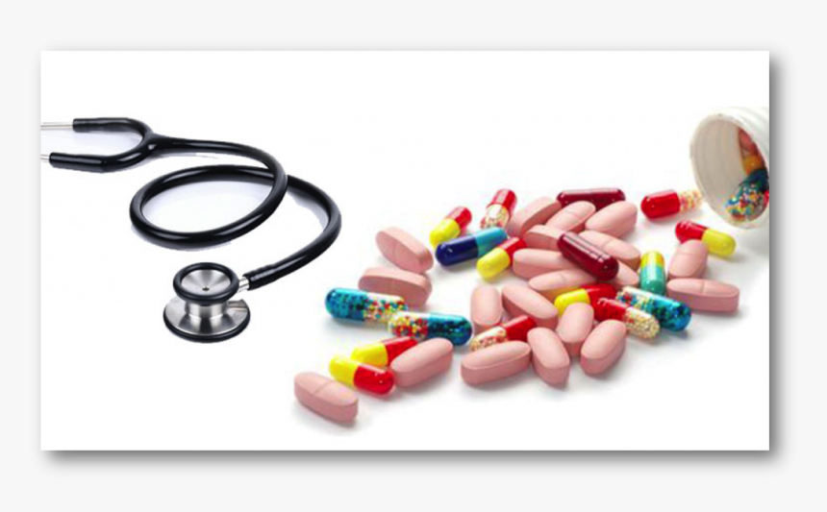
Listen and read.
She needs some medicine. He also told her
what to do in order to get well soon.

Slide 12
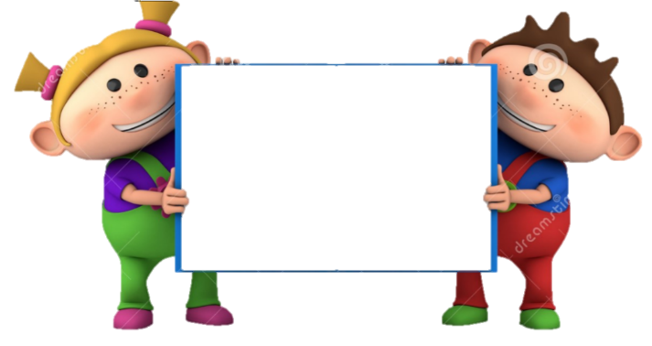
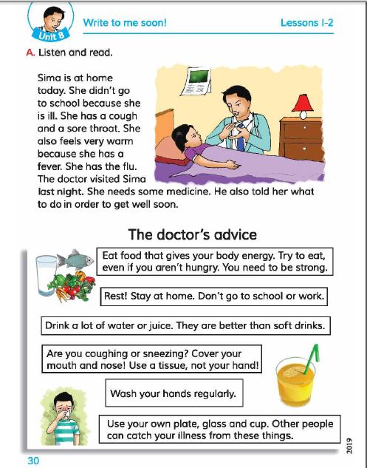
Now, open at page 30 of your textbook.

Slide 13
Now, listen to the audio of the text.
Listen to the audio again and repeat after it.

Slide 14
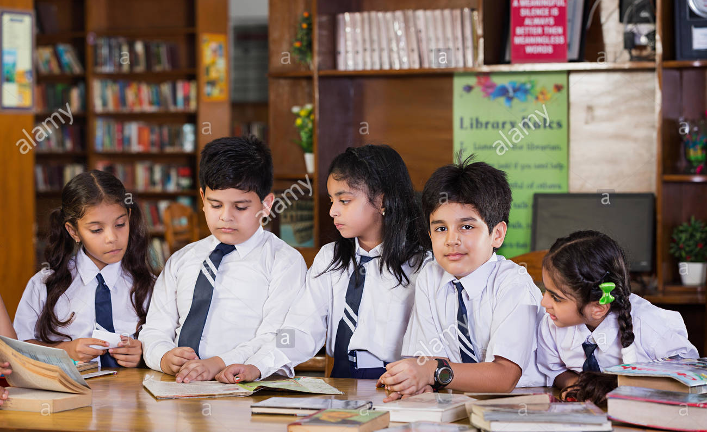
Students’ silent reading.
Students will read the text silently and teacher will monitor.

Slide 15
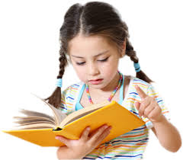
Individual Work
Answer the following questions:
Why did Sima not go to school?
Ans: Sima didn’t go to school because she is ill.
What is Sima suffering from?
Ans: Sima is suffering from flu.
Why is Sima writing a letter to her friend?
Ans: Sima is writing a letter to her friend because she is staying at hoom due to illness.

Slide 16
Teacher’s loud reading.
Now, I’ll read the text and you will repeat after me.

Slide 17
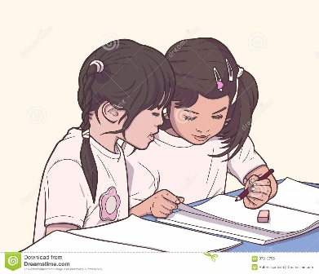
Pair Work
Let’s find out new words from the text.
ill
cough
sore
flu
soon

Slide 18
Similar Words
Match the words with their meaning.
Words | Meaning
ill | hoast
cough | sick
sore | quick
flu | pain
soon | Viral disease

Slide 19
Group Work
Write a short paragraph answering the following questions discussing in groups.
What is Flu?
How does it spread?
“Flu”
Flu is an infectious disease. Influenza is commonly known as flu. It is caused by a virus. It is usually spread by the coughs and sneezes of a person who is infected.

Slide 20
Evaluation
What have you learnt today?
Ans: We have learnt about the disease Flu.

Slide 21
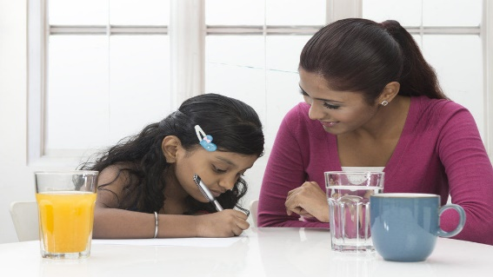
Homework
Re-arrange the following words to make meaningful sentences.
at home/ today/ is/ sima
has/ cough/ she/ a
feels/ also/ very/ warm/ she
the/ she/ flu/ has
last night/ doctor/ the/ visited/ sima

Slide 22
For your active participation-
Thank you

