Slide 1
Welcome

Slide 2
Teacher’s Introduction
Shanjoy Biswas
Assistant Teacher
Harta Government Primary School
Wazirpur,Barishal.
01712-479462
shanjoybiswas@gmail.com

Slide 3
Lesson Introduction
Class : Five.
Subject : English.
Title: My Home District
(Class-5/Unit-10/Lesson-1-2)
Today’s Lesson:
(The name of my home district
……….temple of Chandrabati.)
Time: 45 minutes.
Date: 03-07-2020.

Slide 4
Learning outcomes
Students will be able-
* to ask question and answer with the help of
the text information.
* to read the text with correct pronunciation.

Slide 5
Title Declaration by asking some Questions.
* What is the name of your village?
* What is the name of your Upazila?
* What is the name of your District/Zila?
Home District means in which District you were born or live as a child.

Slide 6
My Home District

Slide 7
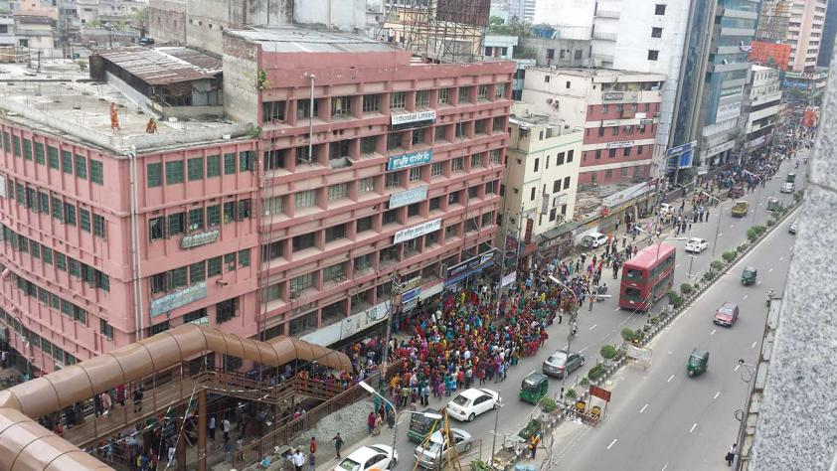
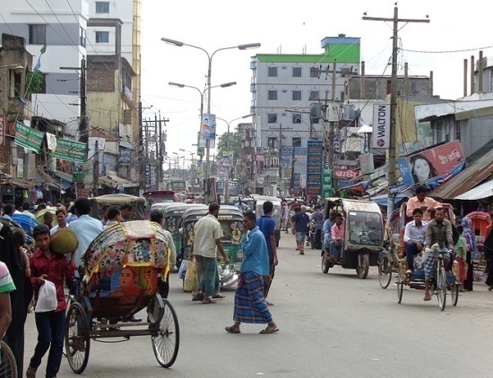
Elicit new words
Urban area of upazila, district or divition level.
Municipalities
M-u-n-i-c-i-p-a-l-i-t-i-e-s
We live in Brahmanbaria municipalities.

Slide 8
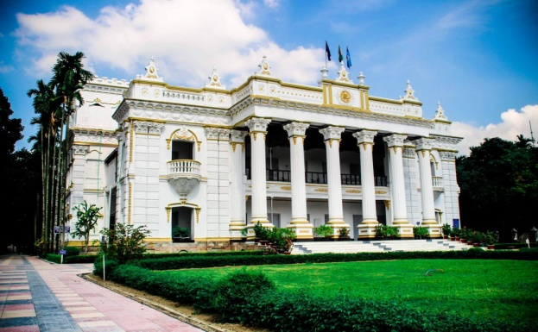
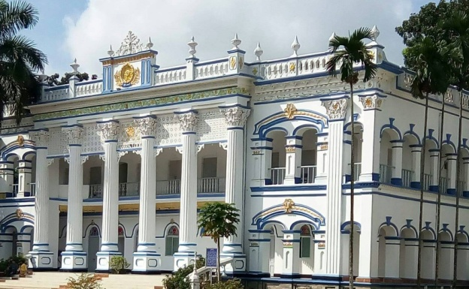
Elicit new words
These were the houses of very rich man .
Who have a lot of land or property they are called landlord
Land lord
L-a-n-d l-o-r-d
My grandfather was a land lord in our area.

Slide 9
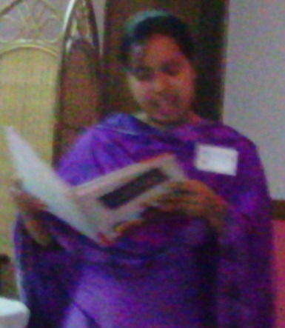
Teacher’s
Reading…
(Standing infront of
students)
Open your book at page no-38. I am reading the text. You all just listen to me. Don’t read with me. Put finger on line.

Slide 10
Student’s
Reading…
You Read the text, others listen to
him/her. Put finger on line.

Slide 11
Pair Work
Fill in blanks
a) There are ------ municipalities in Kishoregang.
b) The river ------ flows through the town.
c) It is about ------- kilometers from Dhaka.

Slide 12
Group work
Answer the following questions (orally)
a) How many Upazilas are there in Kishoregang?
b) How does the name Kishoregang come from?
c) Where is the shiva temple Chandrabati?

Slide 13
Word Bingo (game)
Kishoreganj Upazilla
municipalities Districts
Largest jangalbari
celebrate Mosque

Slide 14
Students silent reading
Read the text silently.

Slide 15
Written test/Evaluation (IW)
Write the answer the following questions.
1. How many villages are there in
Kishoreganj?
2. Where is the fort of Isah Khan?

Slide 16
Thank you

