Slide 1
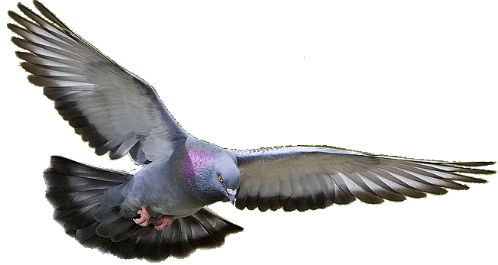
Welcome to HHR PPT Presentation.
Notes:
This is a wonderful picture, related to exclamatory sentence. So I select it as the welcome slide. You may change it.

Slide 2
Identity
Md. Hasan Hafizur Rahman
Lecturer (English)
Cambrian School & College
Baridhara, Dhaka
English 2nd Paper
Grammar
Class VIII--X
Notes:
I select this classical background to draw the attention of the students to the presentation in my identity & class.

Slide 3
The eagle is so amazing.
How amazing the eagle is!
Notes:
I have tried to make the students understand about exclamatory through a surprising video.

Slide 4
Our today’s topic is--
Transformation of sentence
Part-4 (Exclamatory to Assertive)
Notes:
Lesson declaration

Slide 5
Learning outcomes
After completing this lesson, we will be able to-
identify assertive sentence
identify exclamatory sentence and its classifications
change from exclamatory to assertive sentence
Notes:
Basic things with transformation of assertive and exclamatory are focused in this lesson.

Slide 6
The dinosaurs is a very strange animal.
What a strange animal the dinosaurs is!
Notes:
Leading to the main lesson by the video and example.

Slide 7
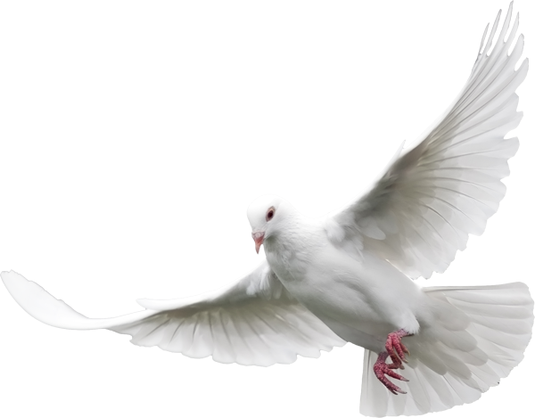
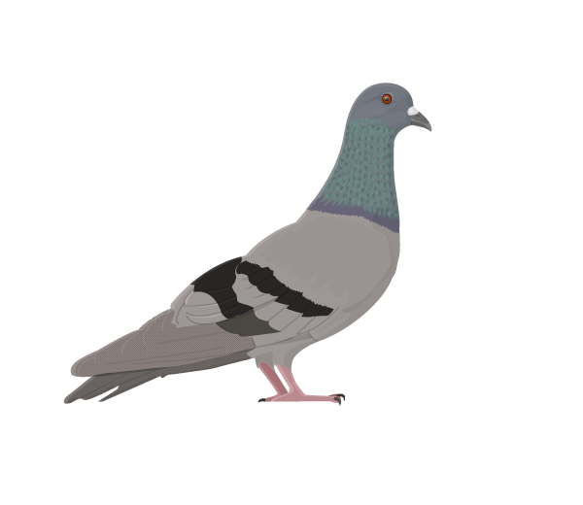
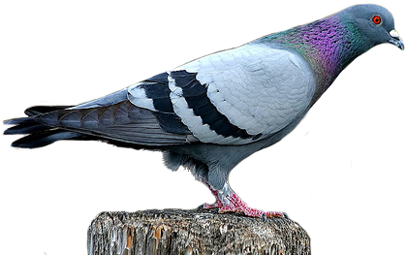
What a beautiful bird the pigeon is!
The pigeon is a very beautiful bird.
Notes:
Exclamatory with ‘what’ shown here.

Slide 8
Structure of Exclamatory Sentence
(a) What + a/an + adjective +subject + verb +!
(b) How+ adjective + Subject + verb +!
What an interesting story it is!
How interesting it is!
Notes:
Formation and examples of exclamatory sentence shown here.

Slide 9
Structure of Assertive Sentence
(a) Subject + verb +a + very/so/great+ adjective +noun
(b) Subject +verb + very/so/great +adjective
.
It is a very interesting story.
It is very interesting. .
Notes:
Very/ equivalent adjective is a must after a/ verb while changing exclamatory into assertive.

Slide 10
Class Activities
Change the sentences into Assertive
What a powerful king of India Akbar was!
How handsome he was!
What an aristocratic throne there was for him!
How gorgeous it looked!
What a successful king he was indeed!
Notes:
As all the grammatical items are contextual now-a-day, I have to set the sentences like above for evaluation.

Slide 11
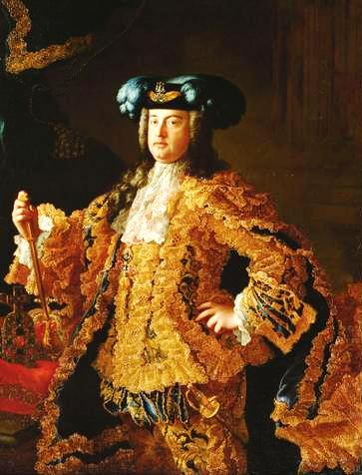
I wish I had the wings of a bird.
Had I the wings of a bird!
If I were a king.
I wish I were a king.
If/Had/Would that <subject + wish
+subject +were + extension +.
Notes:
How to change exclamatory with if/had/would that shown here.

Slide 12
Activities at home
What a big river the Padma is!
How deep it is!
What a vast water the river contains!
How useful the water of the river is for the people!
How beneficial it is for cultivation!
How cheerfully the fishermen enjoy fishing in the river !
How tasty the fish of this river is !
If I had a boat!
If I were a fisher man!
How dearly I like the river !
Notes:
Students will solve it at home and will show teacher in the next class.

Slide 13
Allah Hafez
Notes:
Ending slide.

