Slide 1
Welcome

Slide 2
Introduction
This is Rahim Saikat
Assistant Teacher of
Paraikora Nayantara High School,
Email: rahimsaikat7@gmail.com
Anowara, Chttogram
ENGLISH GRAMMAR.
Class : Nine & Ten
Clause

Slide 3
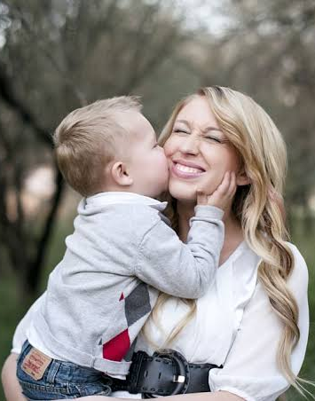
What is it?
We like the baby because it is innocent.
It is a sentence.
But what is this?
We like the baby.
It is a part of the sentence.

Slide 4
Our today’s lesson is-
A part of a sentence that means
Clause.

Slide 5
Learning outcomes
At the end of the lesson, we will be able to—
identify the clauses
identify the kinds of the clauses
identify the structure of the clauses
recognize the clauses

Slide 6
What is clause?
The teacher said that education is the backbone of a nation.
We see the baby who is praying to Allah.
A clause is a part of a sentence. It is formed with a group of words having a subject and a finite verb. It can express a partial or full meaning of the sentence individually.

Slide 7
How many kinds of clauses are there in English Grammar?
Principal clause
Subordinate clause
Coordinate clause
Notes:
Kind of clauses.

Slide 8
Follow
I love my mother
who loves me more than her life.
Independent clause that expresses full meaning individually.
Depended clause that expresses unclear meaning individually.
So, it is a principal clause.
So, it is a subordinate clause.

Slide 9
Explanation of principal clause
I love my mother.
Subject
I
Individually a principal clause and a simple sentence is the same. Whenever a principal clause is added with a bigger sentence is considered as principal clause.
love
Finite verb
my mother
Extension
So, a principal clause is a clause that bears a subject, a finite
verb, an extension and works as a part of a bigger sentence.

Slide 10
Explanation of Subordinate clause
Who loves me more than her life.
Subject
Finite verb
Extension
So, a subordinate clause is a clause that bears a subject, a finite verb, an extension but it cannot work without the help of principal clause.
It always depends on principal clause.
Unless you work hard, you will fail.
Cannot express full meaning
Depended on this principal clause

Slide 11
There are some special words by which subordinate clause is formed.
Subordinating conjunctions
after | although | as | because
before | even if | even though | if
in order that | once | provided that | rather than
since | so that | than | that
though | unless | until | when
whenever | where | whereas | wherever
whether | while | why
Relative Pronouns
that | which | whichever
who | whoever | whom
whose | whosever | whomever

Slide 12
Co-ordinate clause
I invited him and he accepted it.
Independent clause
Independent clause
and
He is poor but honest.
When two independent clauses are added with
a coordinating conjunction is called a co-ordinate clause.

Slide 13
There are some special words by
which co-ordinate clause is formed.
Coordinating conjunctions
and | now | but | Therefore
both-and | well | still | then
also | either—or | yet | so
too | neither—nor | nevertheless | so then
as well as | otherwise | however
no less than | else | while
not only—but also | or | only

Slide 14
Find out and write the names of the clauses
This is a picture which looks attractive.
This is a picture and it looks attractive.
The picture looks good I like most.
The picture is natural but unreal.
Everybody believes that natural pictures are the best.

Slide 15
Home Work
Write some sentences and identify the cluses

Slide 16
Thanks Everyone

