Slide 3
Look at the picture & sentences
She feels very excited.

Slide 4
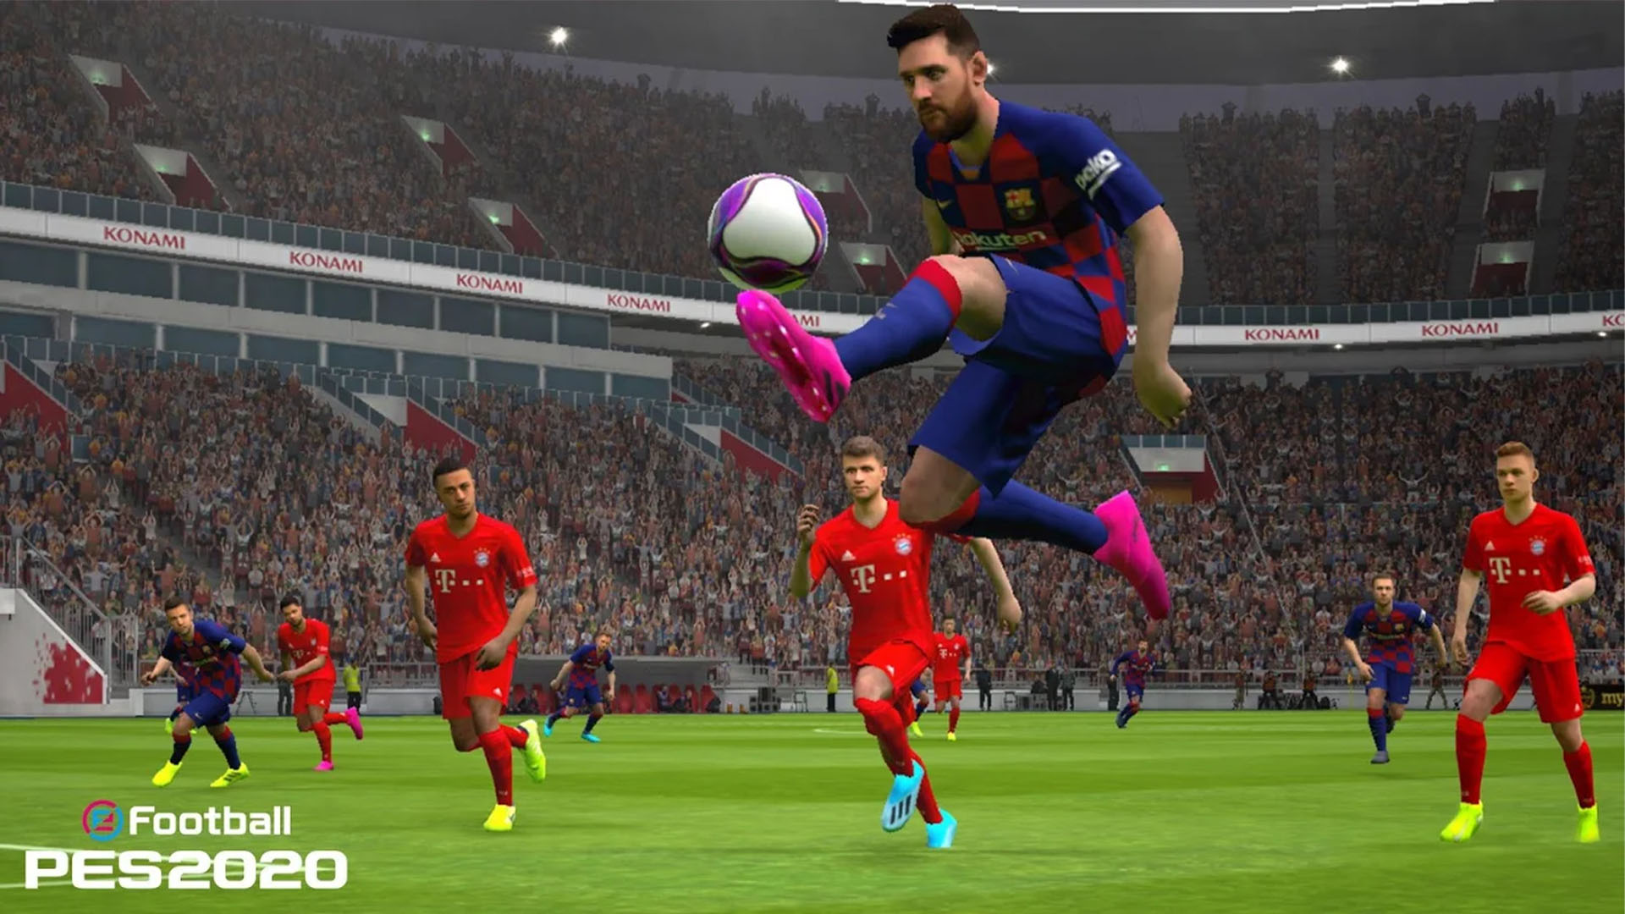
Look at the picture & sentences
They are playing football now.

Slide 5
Today’s our topic is.................
Right form of verbs

Slide 6
Learning outcomes
After completing this lesson, the students will be able to ---
tell the definition of verb
describe the rules of using right form of verbs

Slide 7
Right Forms of Verbs
Subject- Verb Agreement
Rule-1:
Subject singular হলে verb singular. Subject plural হলে verb plural.
Ex- He has done the work
They have done the work.
Rule 2:
And দ্বারা দুটো subject যোগ হলে verb plural হবে।
Ex- He and I were present in the meeting.

Slide 8
Rule 3:
And দ্বারা দুটো পদবী যোগ হলে যদি দুটোর পূর্বেই article থাকে তবে verb plural হবে। কিন্তু যদি একটি পদবীর পূর্বে article থাকে তবে verb singular হবে।
Ex- The headmaster and the secretary were present in the meeting.
The headmaster and secretary was present in the meeting.
Rule 4:
As well as, along with, together with, accompanied by/ with, followed by, and not ইত্যাদি দ্বার যুক্ত দুটো noun/pronoun এর ক্ষেত্রে পূর্বেরটা অনুযায়ী verb হয়।
Ex- He as well as his friends has gone there

Slide 9
Rule 5:
Or, nor, not only--- but also ইত্যাদি দ্বারা যুক্ত দুটো noun/pronoun এর ক্ষেত্রে পরেরটা অনুযায়ী verb হয়।
Ex- He or his friends were going there.
Rule 6:
Subject এর head word অনুযায়ী verb হয়।
Ex- The quality of the mangoes was good.
His choice of words is excellent.

Slide 10
Rule 7:
Each, every, one, more than one, no/ none, Each of, one of, none of, Either of, neither of ইত্যাদির পর noun/ pronoun যাই হোক না কেন Verb singular হবে।
Ex- Everybody is responsible.
One of the students has got injured.
Rule 8:
দূরত্ব, পরিমাণ, সময়, অর্থ, ওজন, বয়স ইত্যাদির verb singular.
Ex- Fifty miles is a long distance.
Two hours is spent.
Twelve years was his age.

Slide 11
Rule 9:
Infinitive , Gerund এগুলো Subject হিসেবে থাকলে verb singular হয়।
Ex- To err is human.
Walking is good for health.
Rule 10:
Collective noun এর পর সাধারণত singular verb বসে। তবে ভিন্নতা বোঝালে verb plural হয়।
Ex- The jury is giving its verdict today.
The jury were divided into groups.

Slide 12
Rule 11:
Uncountable noun এর verb সবসময় singular।
Ex- Knowledge is power.
Rule 12:
Relative pronoun এর পরের verb relative pronoun এর পুর্বের noun/pronoun অনুযায়ী হয়।
Ex- It is I who am doing the work.
He is one of the students who are absent.
Rule 13:
Many a+ singular verb
Ex- Many a student was present.

Slide 13
Rule 14:
A number of + plural verb
The number of + singular verb
Ex- A number of students were present.
Rule 15:
The+ adj+ plural verb
Ex- The poor are happy.
Rule 16:
Information, news, scenery, machinery, advice, mathematics, physics, politics, wages, poetry, statistics ইত্যাদি singular verb হয়।
Ex- Politics is something nasty.

Slide 15
Exercise:
The shop of his brother was/ were closed.
Hasan and kamrul are/is friends.
The chairman along with members have/ has come.
Neither she nor her friends attends/attend the meeting.
Tk 500,000 is/ are spent.
To tell a lie is/ are a great sin.
The committee is/are unanimous.
The wages of sin is/ are death.
It is I who is/am your teacher.
Many a wealthy man live/lives here.

Slide 17
Homework :
The boy (play) in the field now.
He usually (go) to Sylhet by bus.
The child (cry) every night.
Who (wait) for you at present.
It (snow) since last night
I (buy) a car recently.
What you say (be) true.
While (go) to school, I saw a snake.
We just (move) to a new house.
It (rain) for two hours.

