Slide 1
Today’s Class

Slide 2
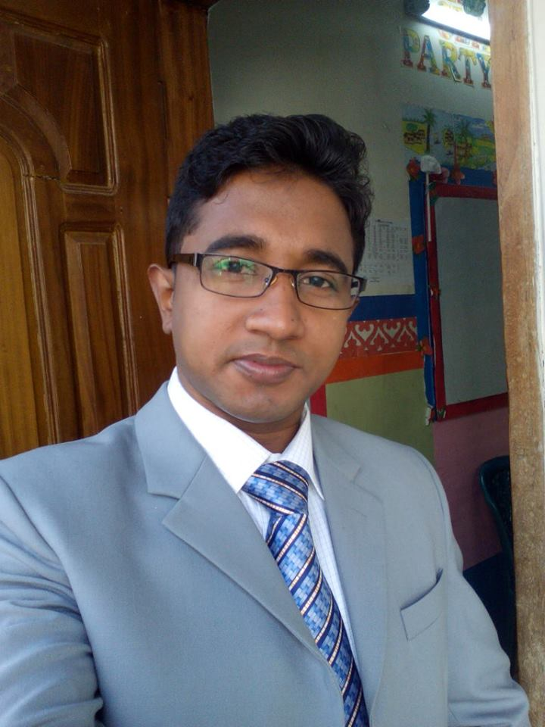
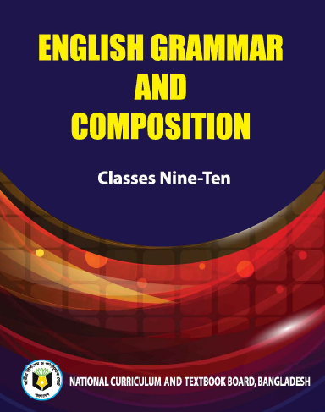
Identity
Teacher
Class
Md. Hamid Ullah
B.A(Hons), M.A (English) 34th BCS (Non Cadre)
Assistant Teacher ( English )
Daulatkhan Govt. High School, Bhola
Class : 9-10
Subject : English 2nd
Topic: Grammar

Slide 3
Look at the picture What can you see?
who
There are two boys --------- are going to school

Slide 4
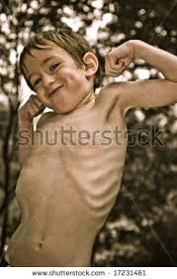
Look at the picture What can you see?
The boy is fat
but
the boy is thin

Slide 5
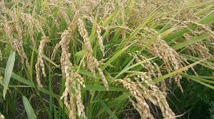
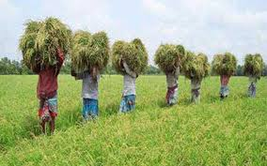
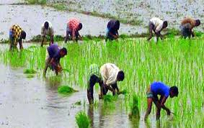
Look at the picture What can you see?
The farmers work hard
so that
they can get good crops

Slide 6
Can you guess what is our today’s topic?

Slide 7
Our Today’s Class is on
CONNECTORS

Slide 8
Learning outcomes
After this class, the students will be able to
Say about connectors
talk about some connectors of words
Write down connectors
Fill in the gaps with connectors

Slide 9
What is Connector?
Connectors are some words that can connect two or more sentences into one. They help us to create longer sentences.
Examples:
We went there and met with my family members.
We study so that we can learn

Slide 10
Seven coordinating conjunctions for using connectors
FANBOYS
F = for (জন্য)
A = and (এবং)
N = nor (এবং না)
B = but (কিন্তু)
O = or (অথবা)
Y = yet (তথাপি)
S = so (তাই)

Slide 11
Some connectors and their meaning.
However(যাহোক)
Further(আরও/অধিকন্তু)
Similarly (একইভাবে)
Too (আরও/ অত্যাধিক)
Moreover(আরও/অধিকন্তু)
Therefore (অতএব/এই কারণে)
As well (যেমন)
On the contrary (অপর পক্ষে/দিকে)
On the other hand(অপর পক্ষে/দিকে)
Either ….or(এটা বা ওটা)
Neither…nor (নাএকটি না আর একটি)
Lest (পাছে ঘটে তাই/পাছে.. সেই ভয়ে)
As (যেমন/যেভাবে/যেহেতু/যেন)
Both…and (উভয় এবং)
Whether……or (হোক বা না হোক)
Not only..but also (শুধু এটা না ওটাও)
As though(যেন)
So that (যাতে)
So… that(এতই যে)
As well as(এবং)
Then (তারপর)
Such as (যেমন/উদাহরণস্বরূপ)
Since (যেহেতু/থেকে/)
When(তখন/ যখন/সেই সময়ে)
While (যখন/সেই সময়ে)
Unless (যদি না/ যদি তা না হয়)

Slide 12
Individual Work

Slide 13
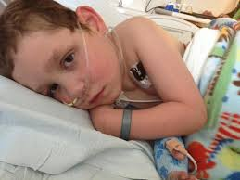
Some connectors come in the middle of the sentence
Rana could not go to school
he was admitted into hospital
because

Slide 14
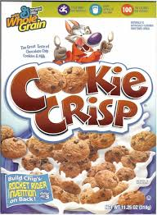
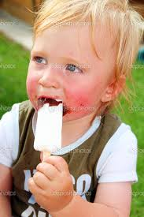
Some connectors come in the middle of the sentence
I do not eat crisp
but
I like ice cream.

Slide 15
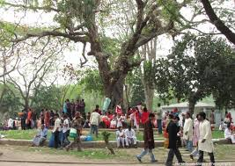
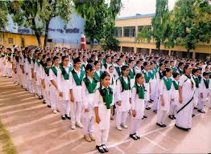
Some connectors come in the middle of the sentence
I went to the park
then
I went to school

Slide 16
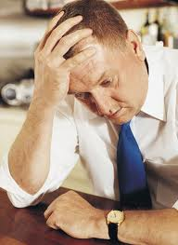
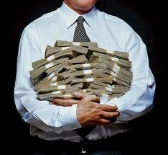
Connectors And or but
He is a rich man
but
he is unhappy

Slide 17
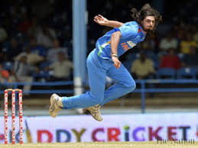
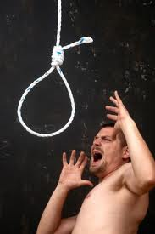
Connectors And or but
Do
Or
Die

Slide 18
Connectors And or but
Boys girls are standing
and

Slide 19
Such as (যেমন)
There are some fruits ------------------
Banana, apple, plum pear , strawberry , lemon
such as

Slide 20
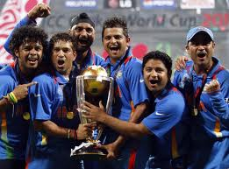
Either – or (হয় এটা নয় ওটা)
-------- Bangladesh ----- India will win the match.
Either
or

Slide 21
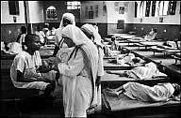
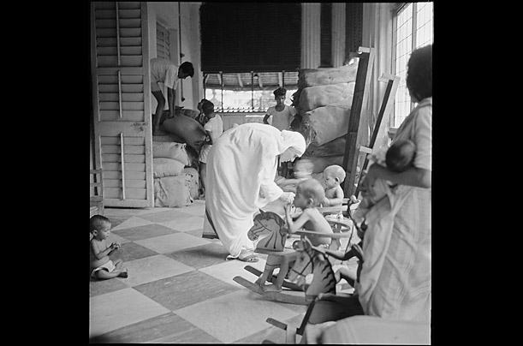
WHO (যে)
There was a woman ------- was very helpful and kind to people
who

Slide 22
WHICH (যা/যার)
There was a fox ------------- had no tail.
which

Slide 23
Pair Work
So that
1.We go to market --------------------- we can buy necessary things.
who
2.There was a king ------------------- was very cruel.
3.It is cow --------------- gives us milk.
which
So that
4. We go to school --------------- we can acquire knowledge.
5.There are many people ---------------- do not work hard.
who
which
6. It is honesty --------------- is the best policy.
7. ------------ you -------- your brother have done the work.
Either
or

Slide 24
Group Work
Complete the passage with suitable connectors.
Teaching is such a profession a)_____________ helps to build a nation. A teacher is b)____________________a guide c)_________________a pioneer. He has to dedicate to this noble profession in order to guide the nation. d)______________he is called an architect of a new society. e)______________ he neglects his duties, social discipline will break down.
that
both/not only
and/but also
So
If

Slide 25
Evaluation
Complete the passage with suitable connectors.
There lived a poor a)_____________honest farmer in a village. He lived a very simple life with his wife b)____________children. c)_____________ he was honest, he worked hard on his farm from dawn to dusk. One day d)____________ he was walking to his field, he suddenly saw a purse of gold on the road. He carried it at home e)____________ he could show it to his wife and children.
but
and
as
while
so that

Slide 26
Home work
Complete the passage with suitable connectors.
Population problem is the burning question of Bangladesh. a)________________it can be termed as number one problem. b)___________________ the population of a country is an asset, it has already become a great problem in our country c)___________________the country cannot afford to give people the basic necessaries of life. d)_________________ food, clothing, education, medicine and shelter are the basic necessaries of life. e)___________________our country cannot provide these equally to all.

Slide 27
Stay Home-Stay Safe
Study
Regularly
Thank You

