Slide 1
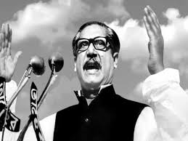
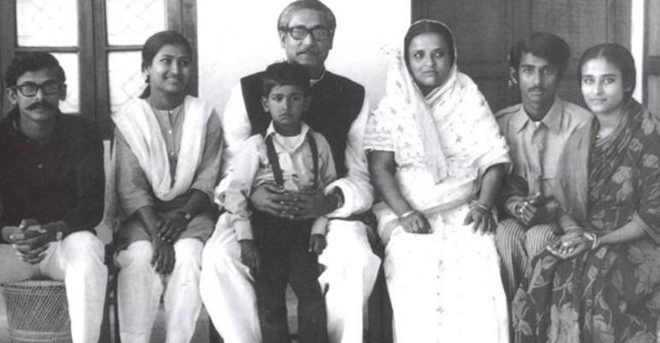

Slide 2
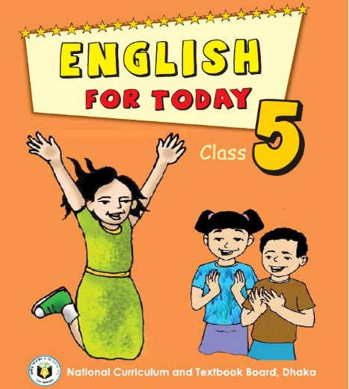
Identity
Biplob kumar das
Ass: Teacher
Lutia GPS
Lohagara,Narail
EFT
Class:5
Unit:19
Activity: A (P:2)

Slide 3
Learning outcomes
At the end of the lesson students will be able to know
4.2.1 understand and enjoy simple stories;
1.1.1 say words, phrases, and sentences with proper sounds and stress;
6.2.1 talk about people, objects, events etc;
1.7.1 read paragraphs, dialogues, stories,
letters and other texts.

Slide 4
Good morning students.
How are you today?
Let’s sing the good morning song.

Slide 5
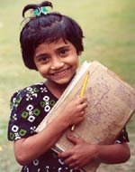
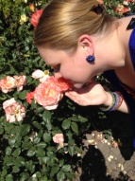
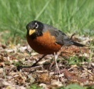
Review
of
Previous
lessons
Group A
Beautiful – It’s a beautiful bird.
Happy - I am very happy.
Group B
Smell - She can smell flowers.
Nice - It is a nice bird.
Group C
Leaves - These are green leaves.
Colours - These colour pencils are good.

Slide 6
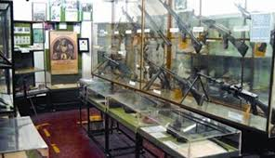
Look at these picture

Slide 7
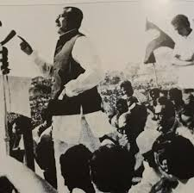
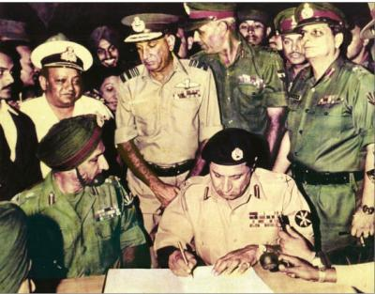

Slide 8
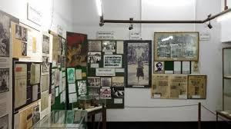
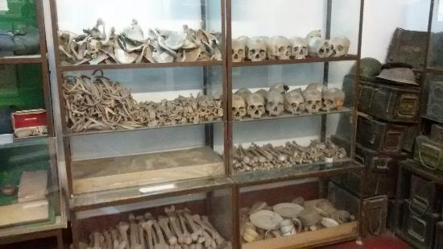
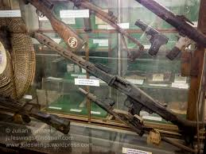
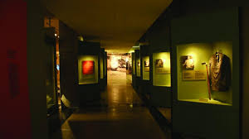

Slide 9
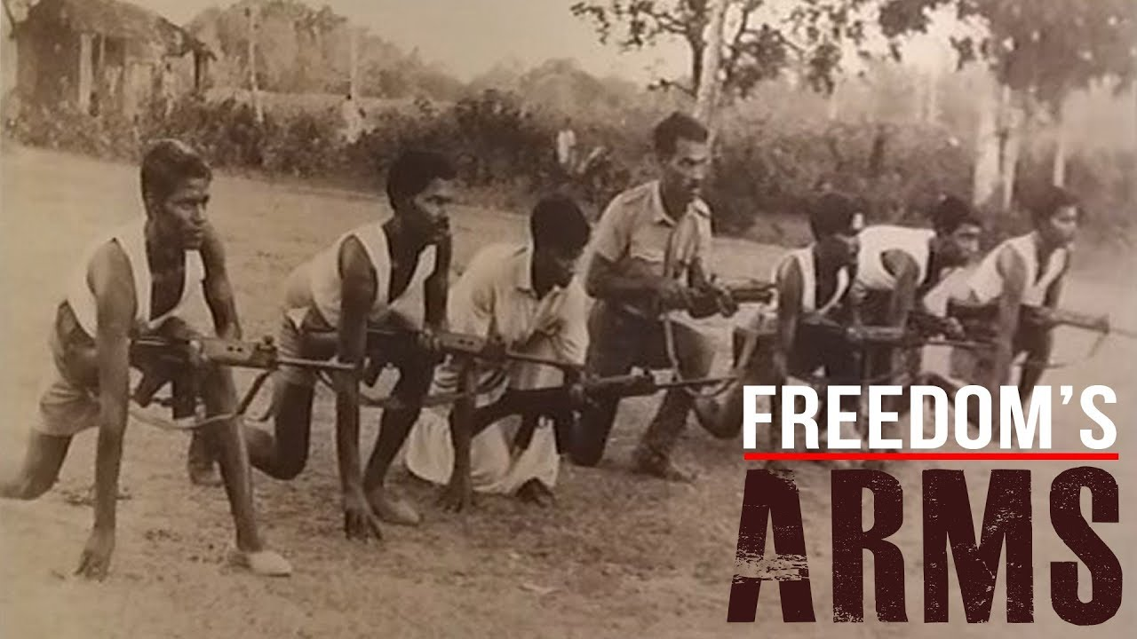
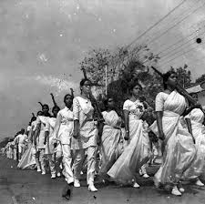

Slide 10
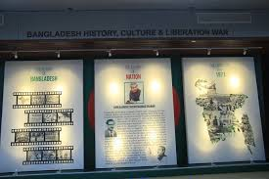
Can you guess what’s
our today’s lesson?
Our Today’s lesson is…
A visit to the Liberation War Museum.

Slide 11
Listen to the audio carefully.
Listen to the audio again.

Slide 12
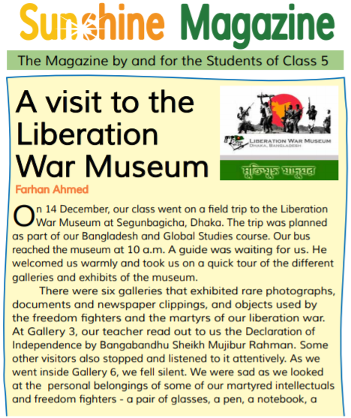
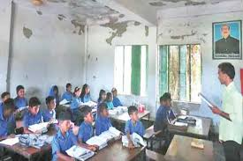
Teacher’s reading
I’ll read the text and you will follow me very carefully.

Slide 13
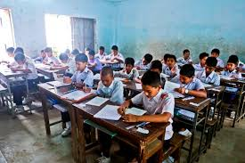
Students’ silent reading.
Read the text silently and answer the following questions.

Slide 14
Answer the following questions in a sentence or sentences:
How many galleries are there in the Museum?
Who read out the Declaration of Independence?
When did they leave the Museum?
What kind of video film they watched there?
How was the experience?

Slide 15
Individual Work
Match the words of column A with their meaning in column B.
Column A | Column B
a) Martyr | 1) Warrior
b) Document | 2) Who died for his country
c) Listen | 3) Announcement
d) Fighter | 4) A piece of written information
e) Declaration | 5) To show something
 | 6) To hear
 | 7) Liberation

Slide 16
Write “True” or “False”
a) The class went on a field trip to Cox’s Bazar.
F
b) A student read out the Declaration of Independence.
F
c) The student fell silent at gallery 2.
F
d) The students reached the Museum at noon.
F
T
e) The video clip was on our Liberation War.
T
f) They left the museum at 12:30.

Slide 17
Fill in the blanks
a) The class went --- a field trip to the Liberation War------------.
b) Our ------- read out----us the Declaration of Independence.
c) The student fell silent at gallery -------------.
d) The students reached the Museum at ------------.
e) The video clip was on our ------------ War.
f) A ---------------- was waiting for us.

Slide 18
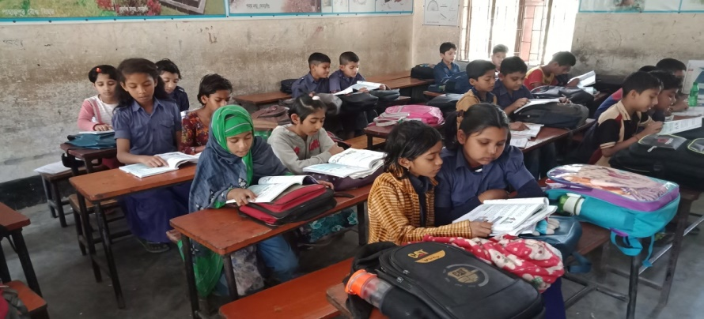
Pair Work….
Answer the following questions.
Where is Liberation War Museum ?
What do you mean Liberation War ?
c. Why do you go to Liberation War Museum ?

Slide 19
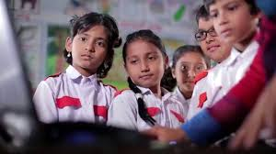
Group Work
Photographs
Documents
Newspaper
Freedom
Declaration
Martyred
Intellectual
Attentively
Dear students see some
new words and
write these
on your khata .

Slide 20
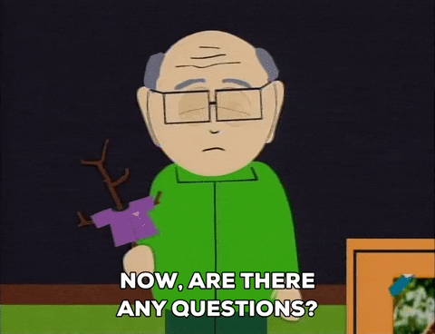

Slide 22
Homework
Write a short composition about
“ The Liberation War Museum”
in 5 sentences.

